Slide 1
LCHS4007 DIGITAL SKILLS AND RESEARCH METHODS
GROUP PRESENTATION
LECTURER BIANCA DODGEN
IRHAM NISSA 2421071
SUMIAH BIBI 2610542
AWA CEESAY 2129819

Slide 2
Staff Communication and daily updates
Microsoft Teams could support communication and daily updates at Ashford community care service. (NHS SCW, 2022).
Using Microsoft Teams at Ashford community care, can provide the Care staff one main place to share daily updates and communicate between various staff.
Staff at Ashford community care can check messages and keep up with important information throughout the working day.
This would help support workers and care coordinates to stay connected while working in service users' homes, supported living settings and the main office at Ashford community care.
Keeping updates in one place could help Ashford reduce missed information and make staff communication more organised for staff and service users.
Irham Nissa 2421071
Sumiah Bibi 2610542
Awa Ceesay 2129819

Slide 3
How Microsoft Teams improves efficiency and communication at Ashford community care service
Keeping staff messages in one place would make information easier to manage instead of having it spread across different platforms at Ashford community care (Department of Health and Social Care, 2026).
Microsoft teams allows staff to communicate through chats and calls and share information across different locations (NHS England, 2025). Research in an NHS community service also found Microsoft Teams supported teamwork and knowledge sharing among staff (Hargreaves et al., 2022).
At Ashford community care staff could check daily updates in one place instead of relying on separate emails, messages and calls. For example, a care coordinator could post a change to the daily visits on Microsoft Teams so support workers can check it before their next appointment. NHS ENGLAND (2025).
This could save staff time reduce duplicated work and important information being missed at Ashford community care.
Irham Nissa 2421071

Slide 4

Advantages and disadvantages of Microsoft Teams in Ashford Community Care
Anon, (n.d.). Available at: https://seeklogo.com/search?q=microsoft%20teams%20logo%20vector.
Irham Nissa 2421071​

Slide 5
Advantages
Microsoft Teams is a platform that allows staff to communicate, share files and work together remotely. NHS England (2025).
This is particularly relevant to Ashford community care service where employees are based in different environments, including individuals' homes, supported accommodation and the central office. Having access to Microsoft Teams could help Ashford maintain communication between these locations.
Microsoft Teams could help Ashford staff stay in touch throughout the day, even when they are based staff in different locations.
Staff could use Microsoft Teams to share information and work together more easily, without needing to be in the same place
Keeping daily updates together could make important information quicker and easier for staff to find at Ashford community care.
Irham Nissa 2421071​

Slide 6
Disadvantages
Some Ashford community care staff may struggle to use Microsoft Teams confidently particularly if they have limited digital experience. Practical training and continued support can help staff develop the skills needed to use Microsoft teams in their daily work effectively.
Ashford community care should set clear rules about what staff can discuss through teams and which details must stay within the services formal care record system
Confidential information should only be accessible to staff who need it for their roles. This would help Ashford meet its responsibilities under the (Data Protection Act, 2018).
Not all Ashford staff may feel confident using digital technology.
Employees may need practical training to use Microsoft Teams properly.
Ashford community care may need to protect service user information when staff communicate through Microsoft teams. (Department of Health and Social Care, 2026)
Staff digital skills were reported as an obstacle to introducing care technology by 39% of adult social care providers (Department of Health and Social Care, 2026).
Irham Nissa 2421071​

Slide 7
Summary
Having looked at both the benefits and challenges, Microsoft Teams appears to be a suitable tool for Ashford community care service. As staff work across different settings, having a shared platform can help exchange daily updates and work together more effectively. (NHS England,2025; Hargreaves et al.,2022.).
However, staff would need suitable training and clear guidance on how to use Microsoft Teams safely and confidently. Ashford would also need procedures for sharing information to ensure confidential details are accessible to authorised staff. Microsoft Teams should support daily communication rather than replace the existing care record for Ashford.
With these measures in place, Microsoft Teams could help Ashford reduce missed updates, improve teamwork and create a reliable way for staff to communicate effectively.
Irham Nissa 2421071

Slide 8
The chosen workplace task and how it links to Ashford
Our workplace task is staff communication and daily updates.
Within Ashford community care service daily updates, unclear rotas, inconsistent records and duplicated work have been an issue at the workforce.
It has been proven that poor communication increases the risk of patient safety within healthcare (Keshtkar et al,2025)
Poor communication has a major contributing factor in adverse events, particularly during patient handovers. ( Müller et al, 2018)
Ashford Community Care Service providers such as support workers, nurses and care coordinators need to share accurate information about service users' care needs. If crucial patient information is not passed on effectively, medication reminders, appointments or changes in a service user's condition could be missed resulting in bad patient care outcome.
Daily, structured staff updates can help prevent important information from being missed when responsibility of patient care is discussed between workers. A structured handover approach has been proven to help reduce problems like inaccurate information and documentation errors (Bukoh and Siah, 2020)
This is why Ashford should introduce a consistent process for staff updates, supported by Microsoft Teams, to improve communication and help protect patient safety.
Sumiah Bibi- 2610542

Slide 9
The chosen Microsoft 365 tool:
Microsoft teams
The chosen Microsoft tool to help support Ashfords lack of communication is Microsoft Teams.
Microsoft teams has been proven to improve communication and teamwork (Lawson et al, 2023)
Microsoft Teams and its file-sharing capacity can improve prioritisation and effective task completion. It can also provide faster delivery of patient care (Lawson et al, 2023)
The functions that Microsoft Teams provides including team communications, meetings/calls, sharing relevant work information's and files and most importantly keeping communication organised can help Ashford have a platform for the staff to communicate and share daily updates. Ashfords problems with communication can be resolved, therefore reducing risk to patient safety.
Sumiah Bibi- 2610542 ​

Slide 10
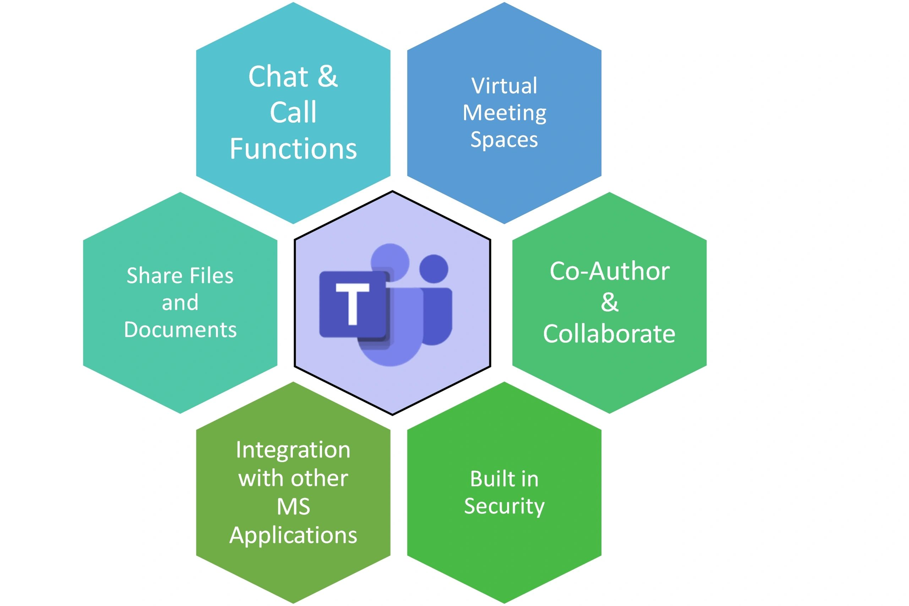
Why is teams suitable.
Microsoft Teams is considered to be a suitable communication tool for Ashford Community Care Service because it can improve information sharing, teamwork and efficiency among support workers, nurses, care coordinators and administrative staff (NHS England, 2025).
Due to Ashford employees working across service users’ homes, supported living settings and the main office, using Microsoft teams can provide instant messaging, video conferencing and shared document facilities that can help staff communicate and collaborate across different locations (NHS England, 2025).
This could help address the case study’s problems with missed updates, duplicated work, unclear rota's and inconsistent records by providing dedicated communication channels and access to approved, up-to-date documents. Effective communication is very important within healthcare, as ( NHS England ,2014) highlights the patient safety risks associated with failures to communicate and act on information during care handovers. Therefore, the implementation of teams within Ashford Community Service can help support better coordination and continuity of care at Ashford. However, staff must follow confidentiality and information governance policies, and urgent clinical concerns must be escalated through the appropriate procedures.
Awa Ceesay 2129819

Slide 11
Recommendatios on how the Ashfords’ can implement
One of the changes can be that Ashford should introduce Microsoft shifts to replace previous poorly designed rota system. Staff should receive training on how to access and manage their schedules while managers should be responsible for keeping the rotor accurate and up-to-date
Ashfords’ should initially trial the system with a small team gather feedback and then implement it across the organisation ( NHS England, 2025)
Awa Ceesay 2129819

Slide 12
References
Anon, (n.d.). Available at: https://seeklogo.com/search?q=microsoft%20teams%20logo%20vector. [Accessed 01 October.2026].
Bukoh, M. X., & Siah, C.-J. R. (2020). A systematic review and meta-analysis on the structured handover interventions in improving patient safety outcomes. Journal of Nursing Management, 28(3), 744–755. https://doi.org/10.1111/jonm.12936
data protection act 2018.[online] Available at: https://www.legislation.gov.uk/ukpga/2018/12/contents/enacted [Accessed 2 Oct. 2026].
Department of Health and Social Care (2026). Using smartphones and devices as an adult social care provider. [online] GOV.UK. Available at: https://www.gov.uk/guidance/using-smartphones-and-devices-as-an-adult-social-care-provider [Accessed 02 October. 2026].
Francis, R. (2013) Report of the Mid Staffordshire NHS Foundation Trust Public Inquiry. London: The Stationery Office. Available at: https://www.gov.uk/government/publications/report-of-the-mid-staffordshire-nhs-foundation-trust-public-inquiry (Accessed: 9 October 2026).
Hargreaves, C., Clarke, A.P. and Lester, K.R. (2022) “Microsoft Teams and team performance in the COVID-19 pandemic within an NHS Trust Community Service in North-West England,” Team performance management, 28(1/2), pp. 79–94. Available at: https://doi.org/10.1108/TPM-11-2021-0082. [Accessed 04 October.2026].
Keshtkar, L., Bennett-Weston, A., Khan, A.S., Mohan, S., Jones, M., Nockels, K., Gunn, S., Armstrong, N., Bostock, J. and Howick, J. (2025). Impacts of communication type and quality on patient safety incidents. Annals of Internal Medicine, 178(5). https://doi:10.7326/annals-24-02904
Irham Nissa 2421071​
Sumiah Bibi 2610542
Awa Ceesay 2129819

Slide 13
Lawson, L., Di, R., Evans, J. and Saleem, W. (2023). Being a ‘teams’ player: A quality improvement project expanding the role of Microsoft teams to improve communication and efficiency of junior doctors in a ward-based hospital setting. PubMed, 10(Suppl 3), pp.89–90. https://doi:10.7861/fhj.10-3-s89
Müller, M., Jürgens, J., Redaèlli, M., Klingberg, K., Hautz, W.E. and Stock, S. (2018). Impact of the communication and patient hand-off tool SBAR on patient safety: A systematic review. BMJ Open, 8(8), pp.1–10. https://doi.org/10.1136/bmjopen-2018-022202
NHS England (2025). NHS England » Microsoft Teams and remote working. [online] www.england.nhs.uk. Available at: https://www.england.nhs.uk/long-read/microsoft-teams-and-remote-working/ [Accessed 05. October. 2026].
NHS SCW (2022). Digital Champions In Adult Social Care - How Can They Help Your Organisation? Available at: https://digital-transformation.hee.nhs.uk/binaries/content/documents/digital-transformation/components/national/download-cards/building-a-digital-workforce/digital-champions-toolkit/digital-champions-toolkit/hee%3AfileLinks%5B2%5D/hee%3Afile [Accessed 03. October. 2026].
NHS England (2014) Patient safety alert: Risks arising from breakdown and failure to act on communication during handover at the time of discharge from secondary care. Available at: https://www.england.nhs.uk/publication/patient-safety-alert-risks-arising-from-breakdown-and-failure-to-act-on-communication-during-handover-at-the-time-of-discharge-from-secondary-care (Accessed: 9 October 2026).
NHS England (2021) Digital clinical safety strategy. Available at: https://www.england.nhs.uk/long-read/digital-clinical-safety-strategy (Accessed: 9 October 2026).

