Slide 1
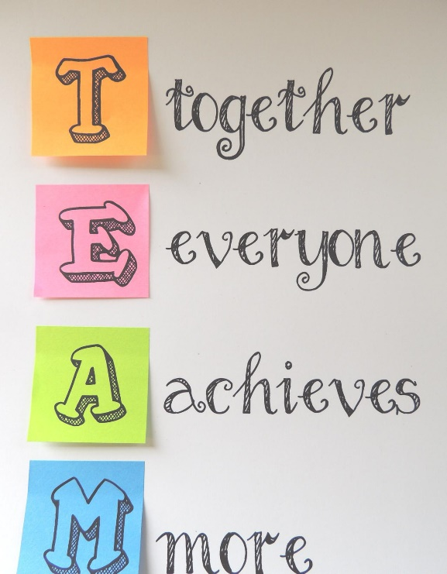

ABC SOLUTIONS
ANA DINCA - 2030033
OANA TUTUI - 2003036
MARIA RAMONA LUPU - 2030040
ELENA-DIANA URSANU - 2028540
VIKTORIYA RACHEVA– 2030292
Module : Effective Teamwork and Communication – BMSW4002

Slide 2
Table of content :
Benefits of team working
Stages of team development
Team roles
Managing conflicts
Successful team development

Slide 3
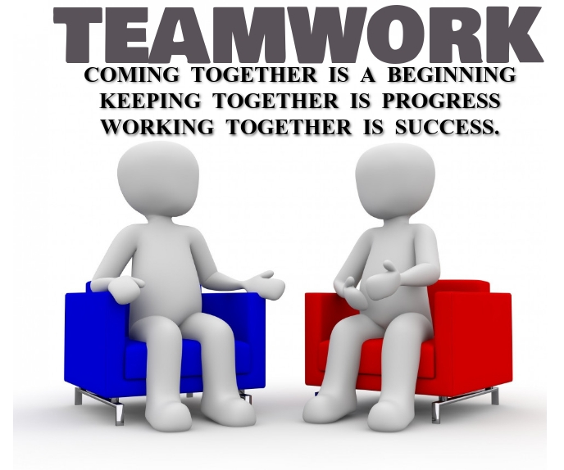







Benefits of team working
1. Team Improves Productivity
2. Problem solving
3. Overcomes Obstacles
4. Improves Service levels
5. Productivity Boost
6. Enhances Flexibility
7. Better idea's
8. Risk taking can be a step

Slide 4
Stages of Team development
Forming
Get to know each other, set up boundaries, find the leader
Storming
Conflict arise, clarity of purpose, power struggle, coaching
Norming
Arrangement between parts, clear roles and responsibility
Performing
Clear vision, purpose, focus on goal , delegation
Adjourning
Task completion, celebrating the team succes , recognition

Slide 5
Team Roles
Belbin’s Team Roles
Shaper – A team should drive and courage for overcoming the obstacles
Implementer – A team should turns the ideas into practical actions
Completer Finisher – A team should deliver any project on time
Co-ordinate – A team should clarify the goals and promotes the decision-making delegates well.
Team Worker – Team workers should be co-operative, perceptive and diplomatic

Slide 6
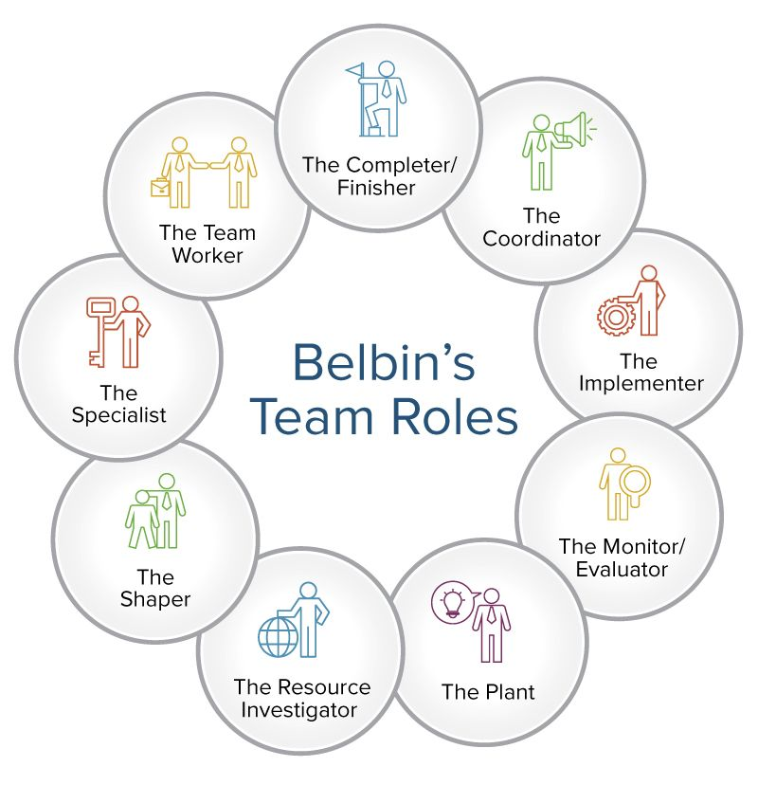
Belbin’s Team Roles
Resource Investigator – A team should be extrovert, enthusiastic, communicative, and explores opportunities.
Plant – A team should have the creativity, imaginative power, and unorthodox for solving difficult problems.
Monitor – A team should also works as a monitor for identifying all the possible options and judging properly.
Specialist – Workers should be self-starting, dedicated, and should have the proper knowledge.
Source : How to Use Team Roles to Boost Performance | Smartsheet

Slide 7
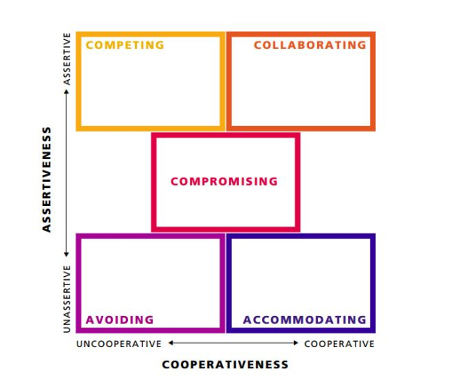
Managing conflict
The Thomas – Kilmann Conflict Mode Instrument
Conflicts can take place between teams that are aiming for a similar goal.
Emotions in special can lead people to serious disagreements.
Unresolved conflict can be the biggest challenges a team can face.
Managing conflict is a critical skill, it must be done by someone capable to be
objective.
A dispute should be managed in an effective manner as prompt as possible.
Source : Conflict Resolution Styles: Which One is Best For Managers? (fellow.app)

Slide 8


Successful team development
To make a plan/ set SMART goals
Define roles
To deal with conflicts/problem solving
Strong leadership
Communicate efficiently
To set expectations for feedback
Reward good work
Source : https://www.spearhead-training.co.uk/blog/5-things-team-leaders-do-to-build-an-effective-team

Slide 9
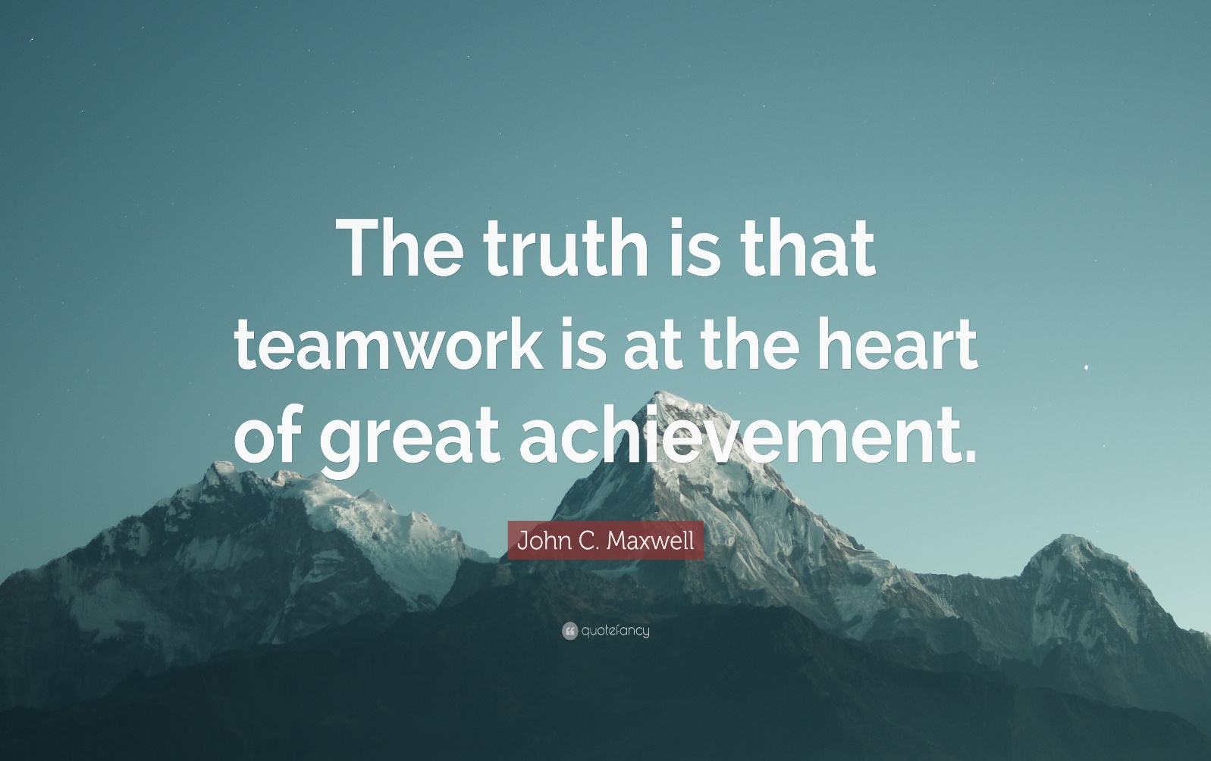
Teamwork in the workplace can help you and others be more productive, happier at work, and increase the quality of work that is being produced.
Source: https://quotefancy.com/quote/841708/John-C-Maxwell-The-truth-is-that-teamwork-is-at-the-heart-of-great-achievement

Slide 10
Reference list:
Glenn Llopis ( Oct 1, 2012,09:03am EDT) 6 Ways Successful Teams Are Built To Last, Available at: https://www.forbes.com/sites/glennllopis/2012/10/01/6-ways-successful-teams-are-built-to-last/?sh=52c3b99b2b55 (Accessed: 03/12/2021).
Indeed Editorial Team (February 9, 2021) 8 Steps To Building a Successful Team, Available athttps://www.indeed.com/career-advice/career-development/steps-to-building-a-successful-team.(Accessed: 03/12/2021).
Adam Bryant (12/01/2020) How to Build a Successful Team, Available at: https://www.nytimes.com/guides/business/manage-a-successful-team (Accessed: 04/12/2021).
Rosalind Cardinal ( Updated June 23, 2015) 5 Steps to Building an Effective Team, Available at: https://www.huffpost.com/entry/5-steps-to-building-an-effective-team_b (Accessed: 04/12/2021).
Moodle at University of Wales Trinity Saint David (n.d) Effective team work and Communication BMSW4002 Available at:https://moodle.uwtsd.ac.uk/mod/
www.nibusinessinfo.co.uk. (n.d.). Advantages of effective teamwork | nibusinessinfo.co.uk. [online] Available at: https://www.nibusinessinfo.co.uk/content/advantages-effective-teamwork.
Thomson, I. (2020). The Benefits of Team Building Activities. [online] www.sodexoengage.com. Available at: https://www.sodexoengage.com/blog/rewards-recognition/the-benefits-of-team-building-activities

Slide 11
Bit Blog. (2020). Top 10 Benefits of Teamwork You Must Know! [online] Available at: https://blog.bit.ai/benefits-of-teamwork [Accessed 26 Nov. 2021]
Kaur, S. (2018). ADVANTAGES OF TEAMWORK. [online] SUKHAMPREET’S BLOG. Available at: https://teamwork681898193.wordpress.com/2018/10/23/advantages/ [Accessed 26 Nov. 2021].
Fisher, S., W.D., K. and Semple, J., 2018. Control and Belbin’s team roles. Personnel Review, 30(5), pp.578-588.
11. Managing Conflict through Communication 5th ed. jodi M Dueck-Read Peace Research 46 (1), 113-115, 2014.
12. ResearchGate. (n.d.). (PDF) Thomas-Kilmann conflict MODE instrument. [online] Available at: https://www.researchgate.net/publication/265565339_Thomas-Kilmann_conflict_MODE_instrument.[ Accessed 10 December 2021].

