Slide 1

JAMES ARTHUR QUARTEY
2234446
Cert HE Construction, Digital, Computing & Engineering
DIGITAL TECHNOLOGIES
PRESENTATION OF POWER POINT

Slide 2

INTRODUCTION
POWER POINT presentation was first introduced to me last semester during the course of my studies at the University of Sanit David Trinity and this has helped in use PowerPoint. It has shown me how to write on videos, edit videos when recording audio as attachments, and send emails as well. Has helped in creating graphs and chats

Slide 3

presentation
Working with Computers and Devices

Slide 4
Structure an argument in a presentation using google slides
I had my presentation on Google Drive which instructed me on how to prepare a professional flyer. A professional flyer is for the promotion of a project. And as in a form of awareness. first accessed Google Drive with my password and ID, then on the menu, I opened the needed new page and then under it, I opened the Google Drive menu which allow me to a new presentation. I opened the unedited title and wrote my title.
I opened a new presentation and under the sub menu choice google slide and started to use the various features like the use of colors, insert pictures from either my laptop computer or from the internet . The use of presentations and words are very useful in persuading someone especailly in idea,product and service fig1 below shows various slides in its presentation

Slide 5
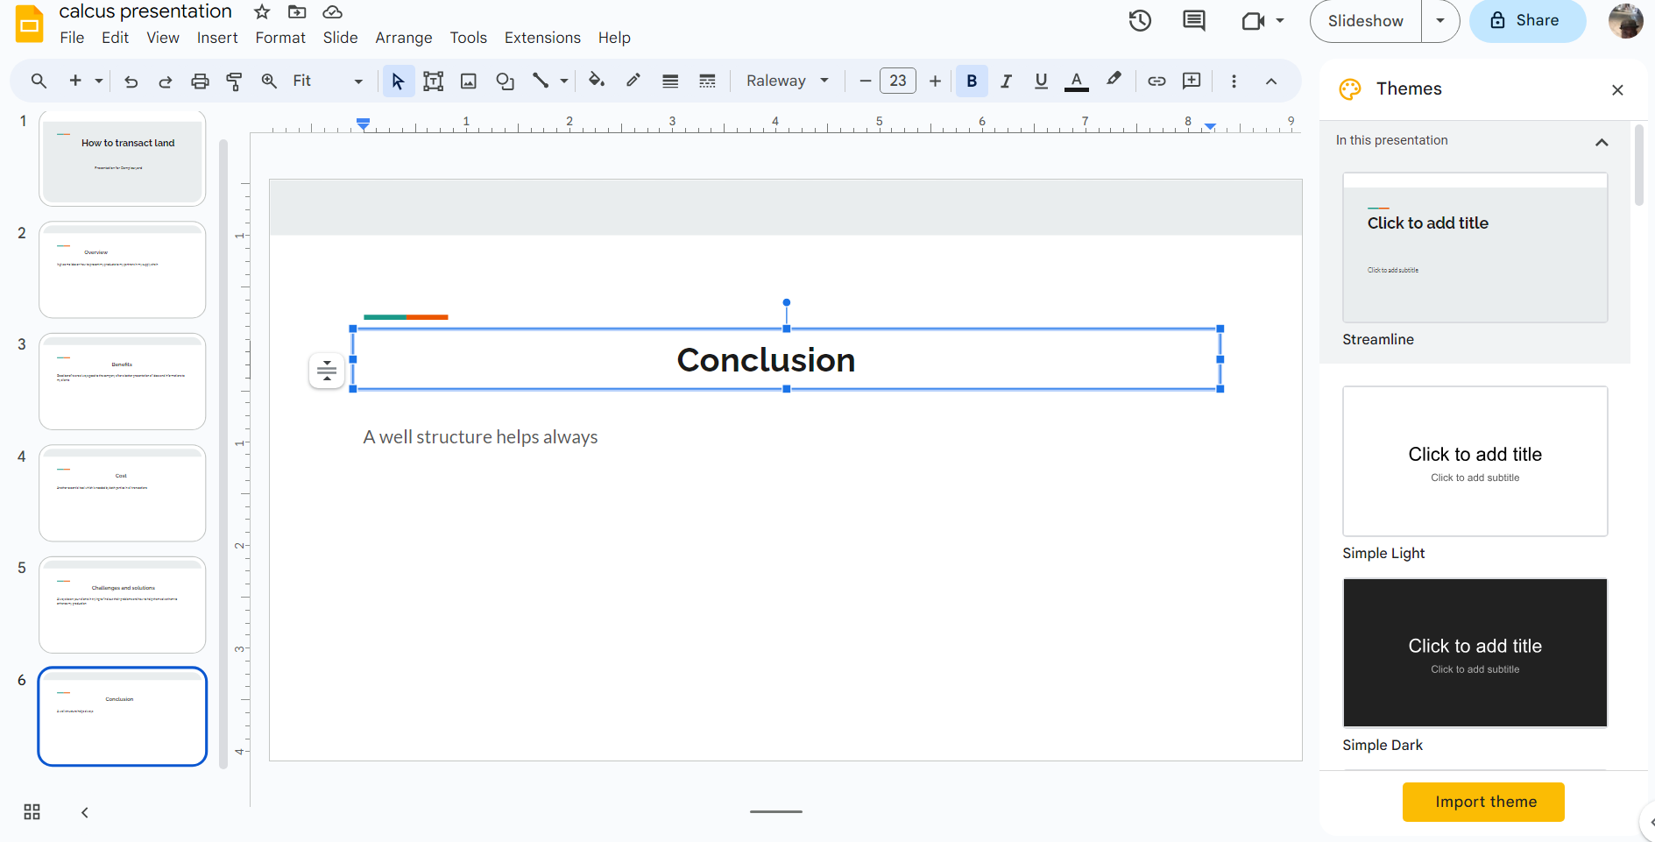
Encouraging potential buyers
Ref: Celine 2022
Natalie 2022

Slide 6
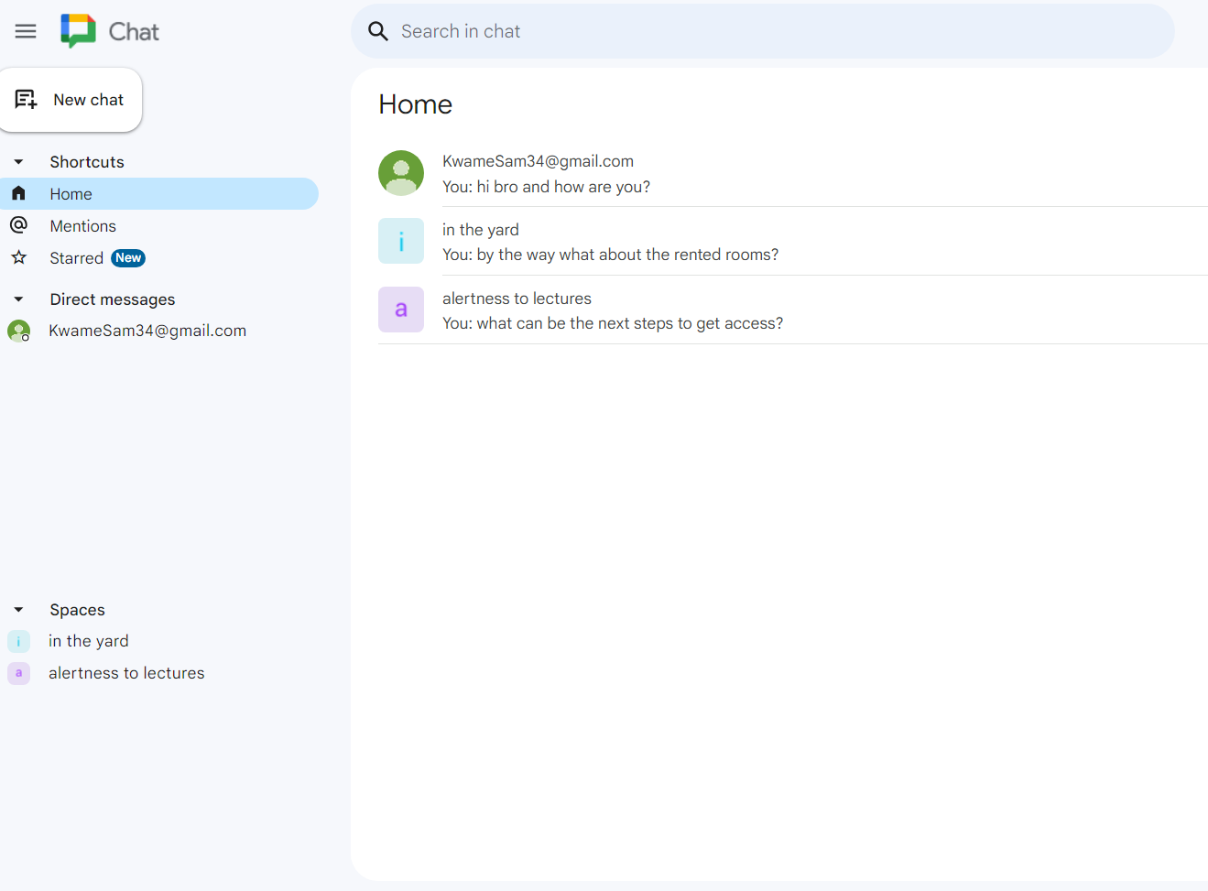
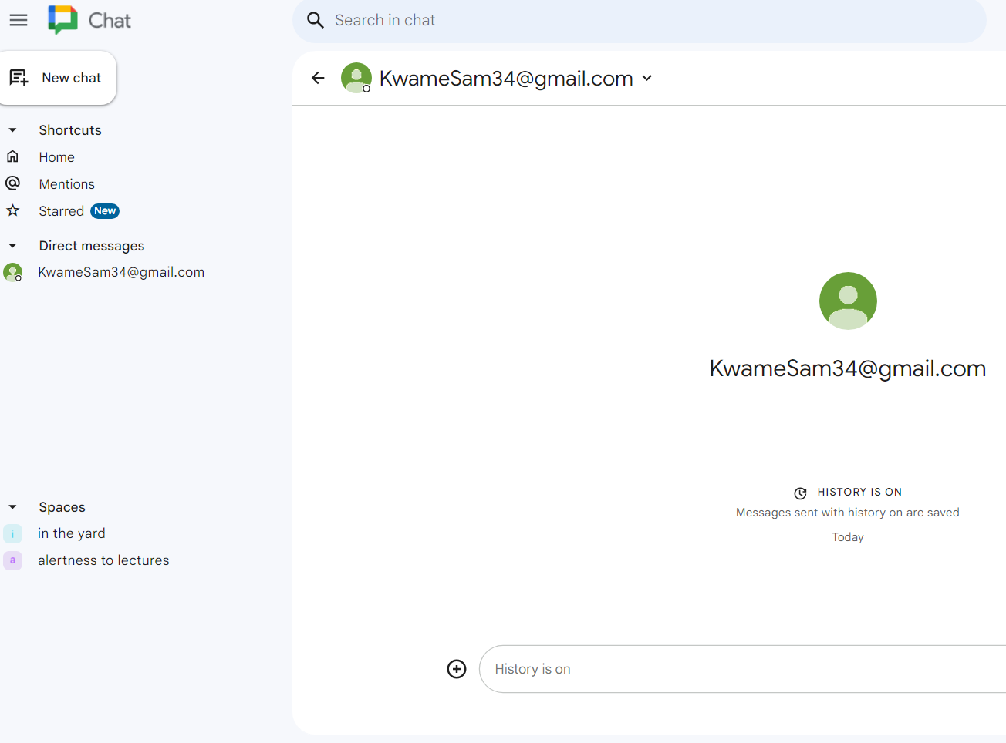
Connect and collaborate anywhere with digital tools
SEND A DIRECT MESSAGE USING GOOGLE CHAT.
This is a fast way of getting a needed answer on comments, notes or question from your mate you share same platform with because they are shorter and quicker as compared to normal email. After accessing my google.com, I entered the subtitle www.chat.google.com and tapped on entered to access the main page. On the menu on the lefthand side I added a friend link by tapping on the plus icon and sent him a message after tapping on enter on the keyboard to the start the chatting. I turned on the notification bottom to help me alert to new messages. The two figures represent adding and inviting my new friend in the chat room with figure 2 being able to send my friend a chat and waits for his respond by turning on the notification bottom. I can also as well create a group chat by inviting another friend to the one already having.
Ref.Smith2022

Slide 7
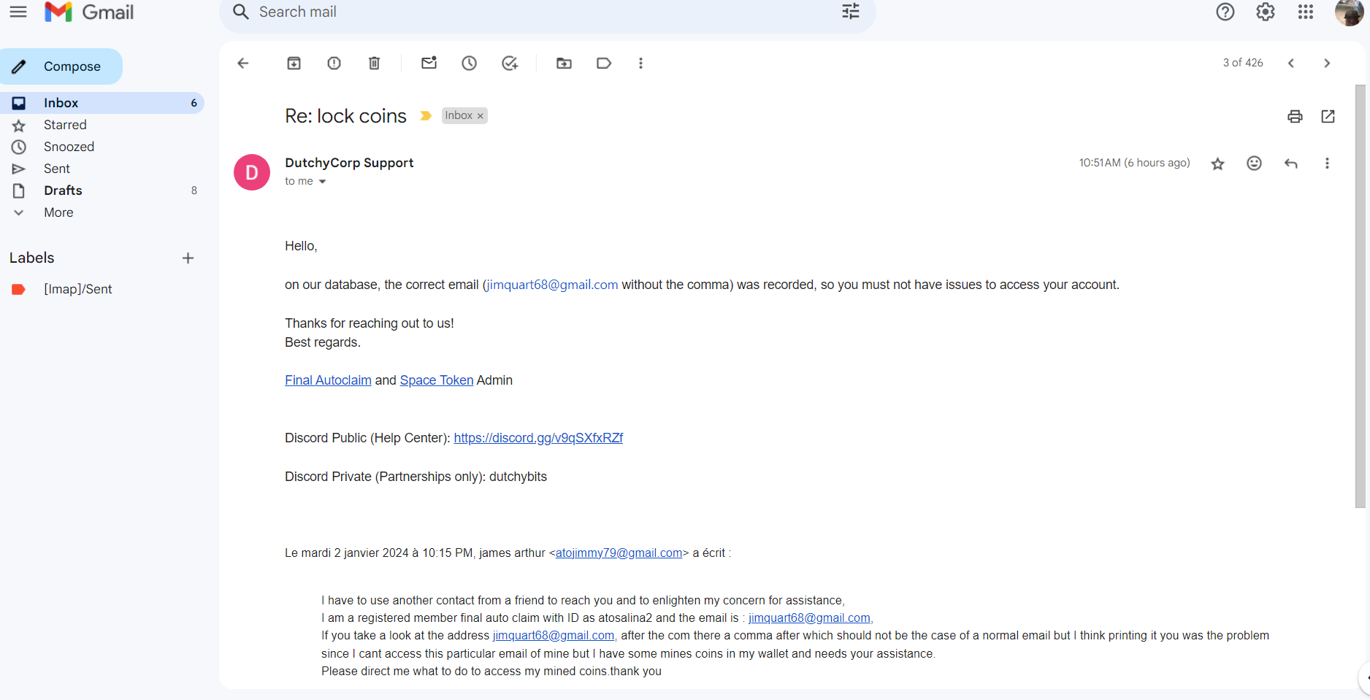
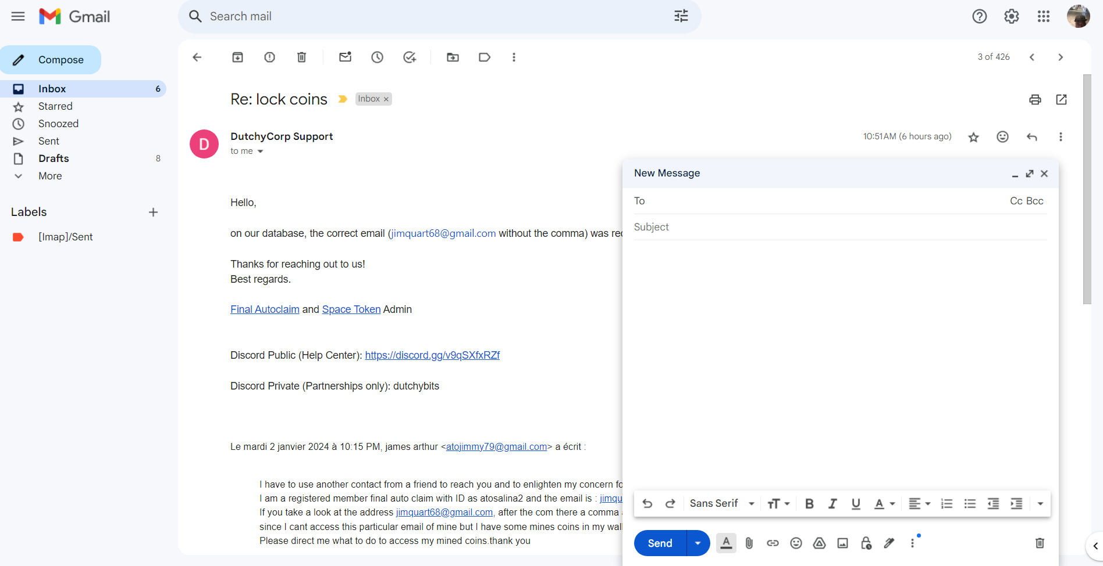
Communicating using email/send emails in the workplace
Emails are one of the effective ways of sending messages to friends or clients in terms of business. Apart from sending messages its equally allows attachments of files , pictures ,audio or video to give better explain to why I am sending those information to him or her. A well organized and give the recipient enough time to understand the sent content. Email brings about profitability in production. My google mail allows me to send messages to friends and clients on my Emails contacts.
Software implementation:
First on the webpage I print www.gmail.com on the main dashboard to access my email. Then on the main menu on the left I accessed sending messages to recipients together with attachment of spreadsheet and video and audio which
Demonstration of work: fig 1 show opening of the email
Fig2, Sending a new mail with attachment.
Ref: Inter observers 2022,Anthony 2022

Slide 8
Avoid online scams
This chapter is how to use the Google Docs to light on the situation on online scams, which have help me to really identify the types of scams I encounter on daily bases and how to avoid it to lose cash and value information to be given out.
Fig one: Display below accessing my google mail accounts and with subtitle on my google drive.

Slide 9

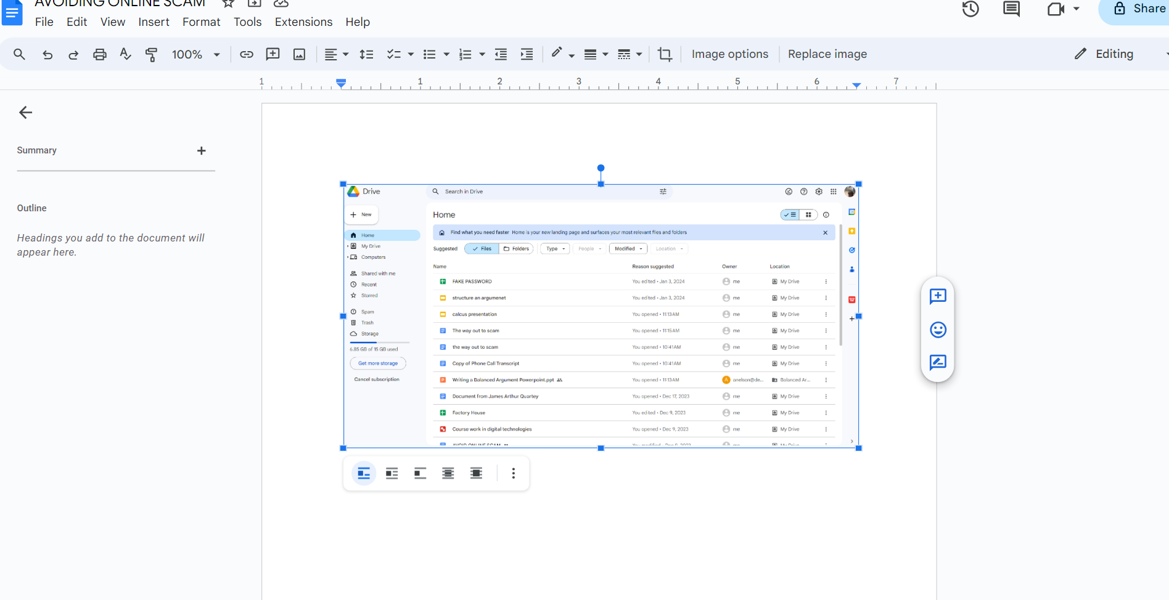
FIG3

Slide 10

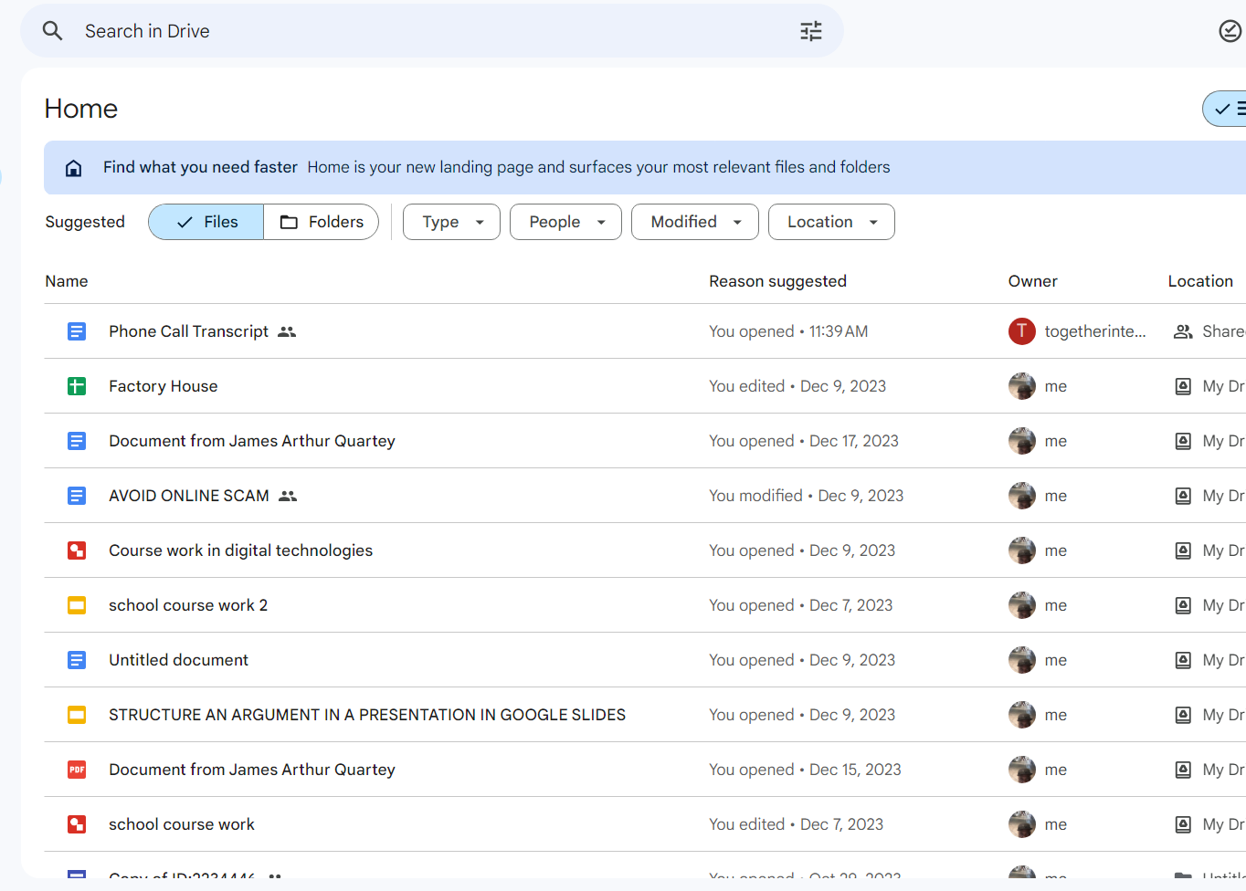

Fig 2 :
Then on the drive submenu I access the google doc from the list and open the blank account to have a fresh page

Slide 11
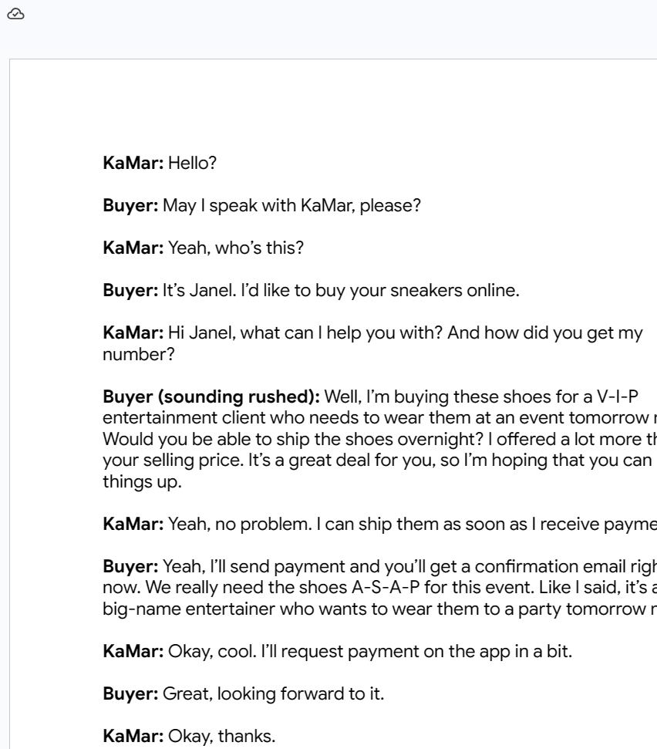
Fig3
Writing of transcript
To edit the phone conversation transcripts I open the menu and copied the file to be edited and realize I can edit the file

Slide 12

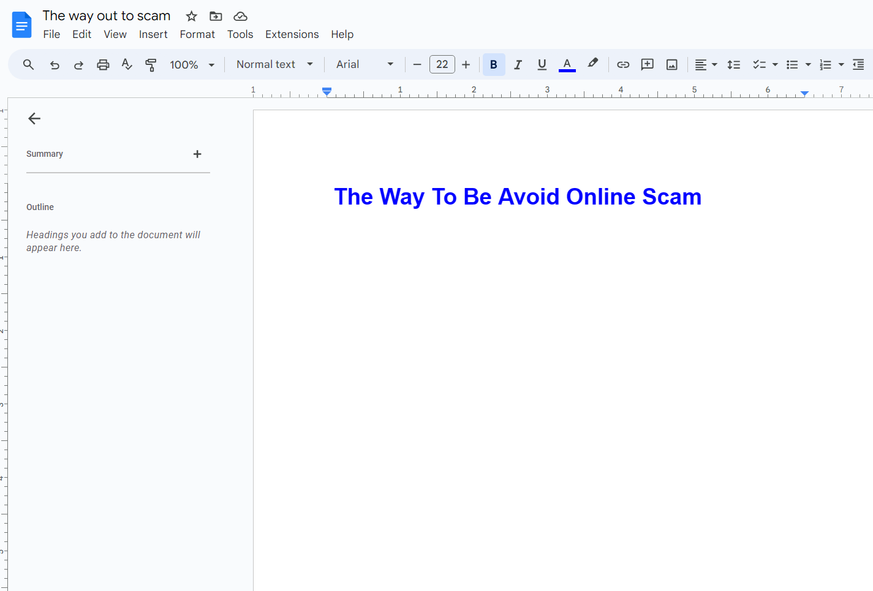
The way out to scam.
F I g 3:
on the fig 3 I s writing heading for open of the file and writing a subtitle as well

Slide 13
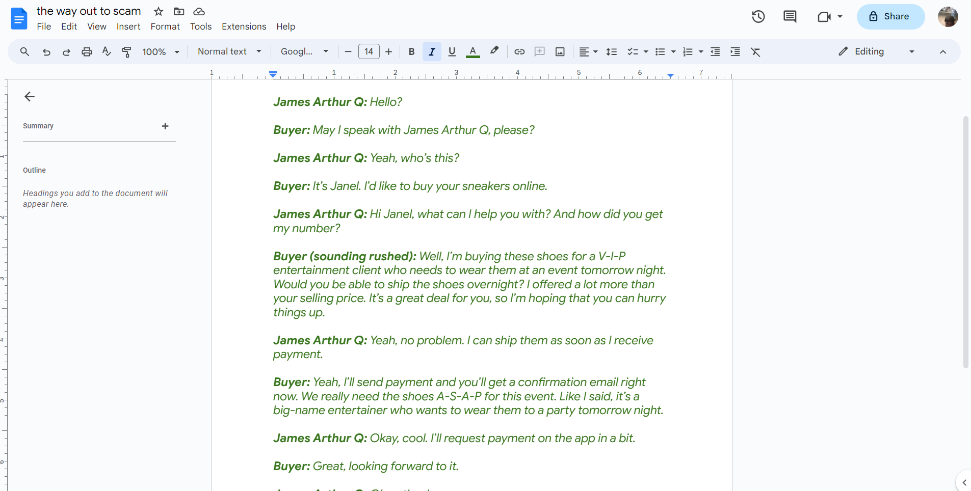
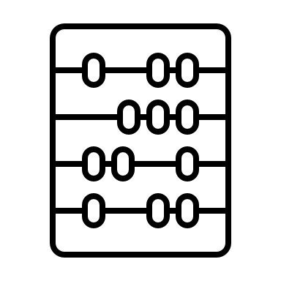

Editing the files fig 4:

Slide 14
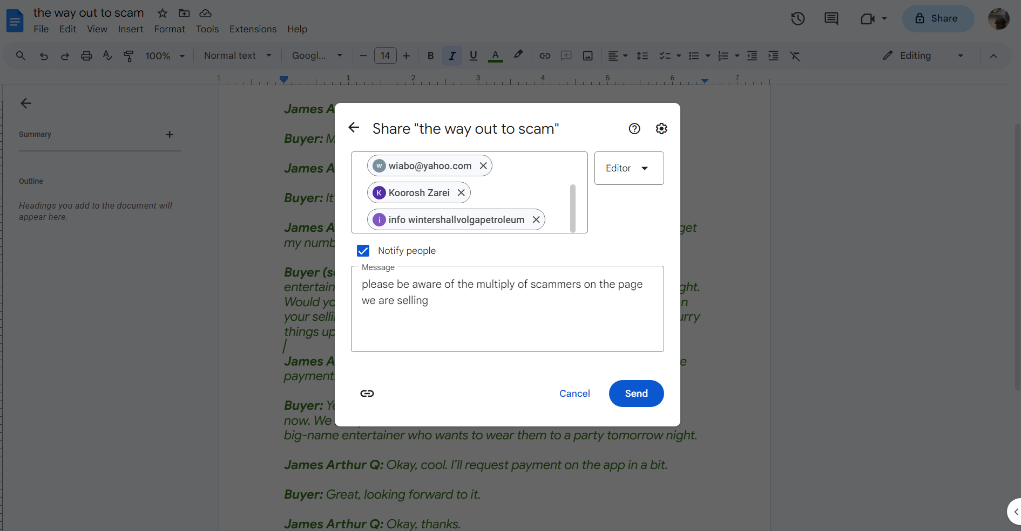
Fig 5

Slide 15
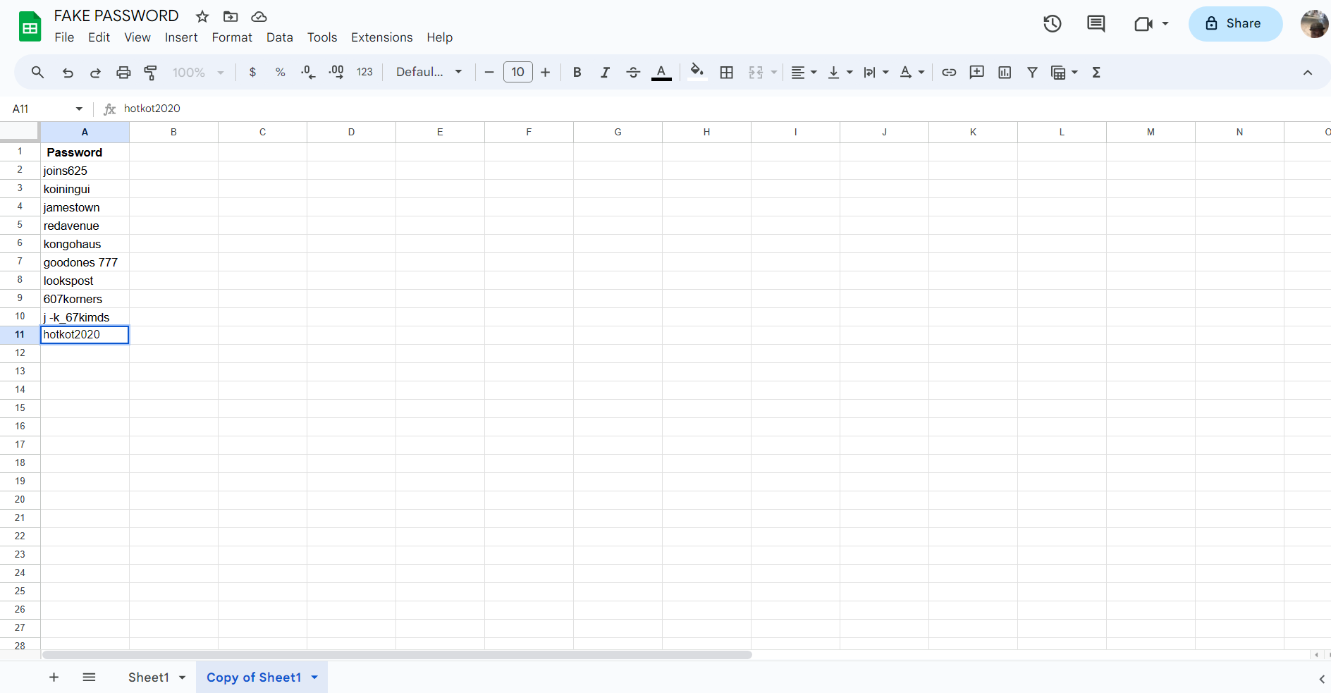
Create and safeguards passwords
Using Spreadsheet to protect passwords :Passwords description comes with a combination or words, letters, symbols and figures and are used to protect one id and information
With my registered google account, I open the google drive and the opened a new spread sheet. I title the page dangerous attack and then duplicated it and rewrote another title fake passwords. With these multiple passwords saved on the Spreadsheet, It is better protected from losing it either by forgetting it or mis writing it
Rig 1 : show a spread sheet with passwords
Ref Hoffmann 2022

