Slide 1
Does soft tissue massage or foam rolling affect 20m sprint performance?
Ellen Delaney
2222185
BMST5005/C
Notes:
Good morning/ afternoon

Slide 2
Introduction and rationale
Warm-ups enhance performance
Foam rolling & massage widely used
Aim to improve muscle function
Effects on sprint performance unclear
(Jeffreys, 2007)
(Konrad et al, 2022)
(Wiewelhove et al, 2019)
(Davis, Alabed and Chico, 2020)

Slide 3
Research question and hypothesis
Research question - Does foam rolling or soft tissue massage influence 20m sprint time?
Hypothesis – Sports massage will improve 20m sprint performance
Notes:
The research question was whether these interventions influence sprint time over 10 metres

Slide 4
Methodology (Overview)
Design: Repeated measures (same participants in all conditions)
3 conditions:
Standardised warm-up → 20m sprint
Warm-up + foam rolling → 20m sprint
Warm-up + soft tissue massage → 10m sprint
10 participants (6 male and 4 female) of mixed sporting background athletes (team players or recreational)
Notes:
A repeated measures design was used, where all participants completed three conditions: a standard warm-up, foam rolling, and soft tissue intervention.

Slide 5
Methodology (Procedure)
Procedure
10-min RAMP warm-up
20m sprint (baseline)
Interventions:
Warm-up + Foam rolling
Warm-up + Soft tissue
Protocol:
Calves (3 min) | Hamstrings (4 min) | Quadriceps (3 min)
Effleurage, Petrissage, Tapotement
Testing:
20m distance measured with timing gates
3G pitch
3 sprints (best time used)
Notes:
Participants first completed a 10-minute RAMP warm-up, followed immediately by a 10-metre sprint to establish a baseline measure.
The sprint distance was measured to 10 metres using a measuring tape, and all testing was conducted on a 3G pitch to ensure consistency.
For the intervention conditions, participants repeated the same warm-up, followed by either foam rolling or soft tissue treatment.
Each intervention lasted 10 minutes, targeting the calves for 3 minutes, hamstrings for 4 minutes, and quadriceps for 3 minutes. The soft tissue condition included effleurage, petrissage, and tapotement techniques.
Following each condition, participants completed three 10-metre sprints, with the fastest time used for data analysis. Sprint times were recorded using timing gates

Slide 6

Ethical Considerations
Informed consent
Ethics forms approved by uwtsd
Right to withdraw
Injury risk minimised
Data kept confidential

Slide 7
Data Analysis
Analysed using SPSS
Fastest sprint used
Mean ± SD calculated
Repeated measures ANOVA
Notes:
Data were analysed using SPSS. The fastest sprint time from each condition was used, and descriptive statistics were calculated. A repeated measures ANOVA was conducted to compare conditions.

Slide 8
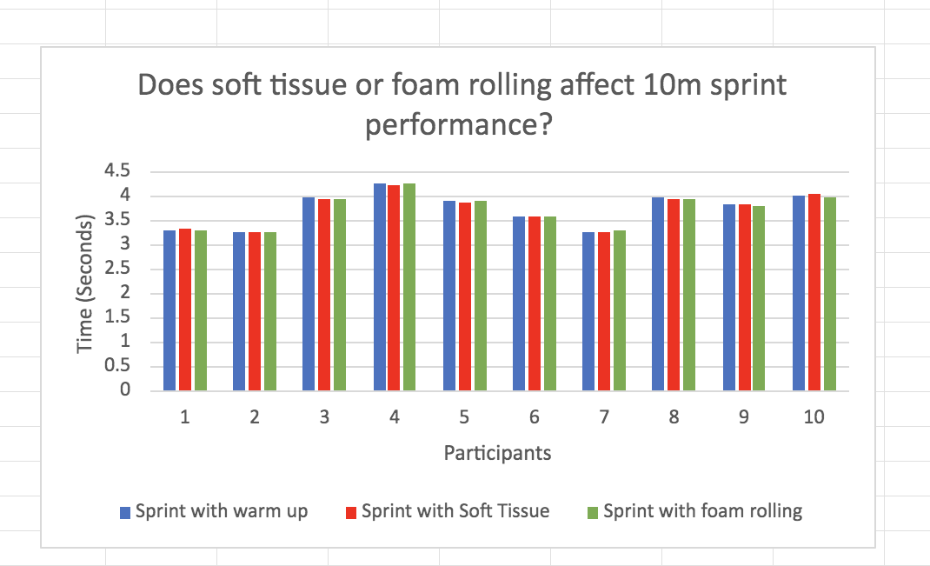
Results

Slide 9
Key Findings
20m Sprint Performance (Mean ± SD)
Warm-up: 3.732 ± 0.36 s
Foam rolling: 3.725 ± 0.35 s
Soft tissue: 3.729 ± 0.35 s
Statistical Analysis
Repeated measures ANOVA
No significant difference (p .600)
Notes:
Key results showed that sprint performance was very similar across all conditions.
The mean sprint times ranged from 3.72 to 3.73 seconds, with minimal variation between the standard warm-up, foam rolling, and soft tissue conditions.
Statistical analysis using a repeated measures ANOVA found no significant differences between conditions, with p-values greater than .05.

Slide 10
Interpretation/discussion
No significant differences between conditions
Warm-up likely sufficient
Foam rolling may improve ROM, not sprint performance
Soft tissue massage has limited effect on sprint performance
Findings support previous research
Limited benefit for 20m sprint performance
(Jeffreys, 2007)
(Konrad et al, 2022)
(Wiewelhove et al, 2019)
(Davis, Alabed and Chico, 2020)

Slide 11
Limitations to experiment
Small sample size
Participant training level
Variation in intervention application
Notes:
Despite the findings, there are several limitations that should be considered.
Firstly, the small sample size may have reduced the statistical power of the study, making it more difficult to detect significant differences between conditions.
Additionally, there may have been some variability in how the foam rolling and soft tissue interventions were applied, particularly in terms of pressure, which could affect consistency.
Individual differences in participant training status may have also influenced how participants responded to the interventions.
Finally, this study only examined the acute effects, so it does not account for any potential longer-term adaptations.
These limitations should be considered when interpreting the results.

Slide 12
Conclusion and implications
Conclusion
No significant effect on sprint performance
Interventions may not benefit short sprints
Notes:
In conclusion, neither foam rolling nor soft tissue massage significantly affected 10-metre sprint performance, suggesting limited benefit for short-distance acceleration
These findings suggest that coaches may prioritise dynamic warm-ups over these interventions for short sprint performance, although further research is needed.”

Slide 13
Reflection
Developed research & data analysis skills
Improved understanding of experimental design
Recognised importance of control & consistency
Would improve sample size & testing order
Notes:
This study helped develop my understanding of research design and data analysis, particularly using SPSS.
It also highlighted the importance of maintaining control and consistency when testing performance variables.
If I were to repeat the study, I would aim to increase the sample size and improve the randomisation of testing order to reduce potential bias.
Overall, this project has helped prepare me for future research, particularly my dissertation. thankyou

Slide 14
References
Davis, H.L., Alabed, S. and Chico, T.J.A. (2020). Effect of sports massage on performance and recovery: a systematic review and meta-analysis. BMJ Open Sport & Exercise Medicine, [online] 6(1), p.e000614. doi:https://doi.org/10.1136/bmjsem-2019-000614.
Jeffreys, I. (2006). Warm up revisited -the ‘ramp’ method of optimising performance preparation. [online] Available at: https://cdn.uksca.org.uk/assets/pdfs/UkscaIqPdfs/warm-up-revisited-the-ramp-method-of-optimising-performance-preparation-636825542084389098.pdf.
Konrad, A., Nakamura, M. and Behm, D.G. (2022). The Effects of Foam Rolling Training on Performance Parameters: A Systematic Review and Meta-Analysis including Controlled and Randomized Controlled Trials. International Journal of Environmental Research and Public Health, [online] 19(18), p.11638. doi:https://doi.org/10.3390/ijerph191811638.
Miller, K.L., Rockey, A. and Doberstein, S. (2017). The Effects of Foam Rolling on Maximum Sprint Performance and Range of Motion - ProQuest. [online] Proquest.com. Available at: https://www.proquest.com/openview/a8351dd1e8091408e71174cfae11273a/1?pq-origsite=gscholar&cbl=18750.
Wiewelhove, T., Döweling, A., Schneider, C., Hottenrott, L., Meyer, T., Kellmann, M., Pfeiffer, M. and Ferrauti, A. (2019). A Meta-Analysis of the Effects of Foam Rolling on Performance and Recovery. Frontiers in Physiology, 10(376). doi:https://doi.org/10.3389/fphys.2019.00376.

