Slide 1

University of Wales Trinity Saint David
Leadership and Management Skills for the Workplace
Developing Relationships and Workplace achievement
Training and Development needs for a HR officer.
PRESENTED BY
OLAMIDE BOBBY ERINOSHO
Student I D -2008390
Lecturer Nishi Ramsurrun
Course Code – BMSW5102
UWSTD
Address: London
Tel:
Email:uwstd@edu.co.uk

Slide 2

INTRODUCTION
Amazon.com Inc (Amazon) is an online retailer and web service, provider.
This company provides services and products such as apparel, auto, and grocery items, beauty and health products electronics, industrials, books, kids, jewelry, games, and baby products, tools, music, sports goods, toys, movies, and other related products.
Which provides some of the related product support services, while Amazon merchandises most of the products through other companies’ own online and physical platforms, Amazon founded in Seattle Washington in the US. Founded 5 July 1994, Bellevnue, Washington United State. CEO Andy Jassy, Founder Jeff Bezos.

Slide 3

Knowledge and Behaviour of HR Officer Role in amazon.
Human resources HR officers in Amazon i will like to improve, also advise with organisation policies, related and reflective upon the staff.
HR in amazon organisation as my role to implement organisation right and balance on employees, in the areas of skill and training opportunity being available for every category of the employees according to their roles and ability.
.

Slide 4

Knowledge of HR Officer in amazon.
HR Organising and encourage policies on any issues with working conditions, also ability on management, as well equal benefit, and procedures on amazon management.
HR to make sure handbooks, also payrol with other related matter, with promotion and opportunity as well regular salary reviews
Computers hardware and software including application and programming.

Slide 5

Behaviour of HR Officer Role in amazon.
As amazon HR it is our responsility to add value to the amazon organisation with all support.
As amazon HR in the organisation is must to make sure every support to work closely with line managers, and in every various areas to increasingly in consultancy role, to understand and implement policies and procedures.
HR to make sure organization capable with understanding that all the employees has adequate and well training for their role.
.

Slide 6

Skills of HR Officer in Amazon
Communication:
As amazon HR Speaking-Talking to others to convey information effectively.
Awareness:
Social perceptiveness - being aware of others reactions and understanding why they react as they do.
Coordination:
adjusting actions in relation to others actions.
Negotiation:
bringing others together and trying to reconcile differences.

Slide 7
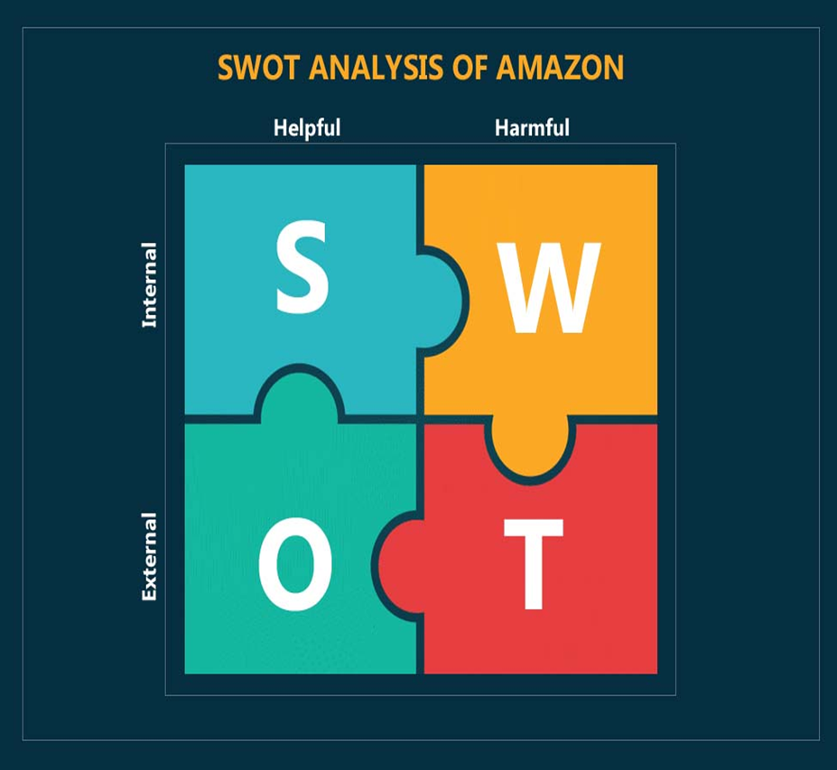
As Amazon HR- Swot Analysis.
Strenght:
As HR I understand all the knowledge of business and management.
* Organisation with a big performance business idea understands the importance of managers that are capable talented to identify any opportunity for both people and organisation they manage.
* Weakness:
As HR i understand the weakness can be vary according to the different types of performance within amazon organization.
* I understand less HR training will not help my ability with amazon.

Slide 8

As Amazon HR- Swot Analysis.
Opportunity:
Ulrich, 1997) As HR in amazon I always perform support to amazon organisation on market activities with customers on standard orientation and opportunity.
* Opportunity:
Greer et al. , 1999) HR implement a positive change towards opportunity within amazon as to perform in a better ways for the progress of the organisation goal.
Threats:
Kanter ( 2003 ) HR suggest towards the future of their tasks that can be practicalise in alternative manner in some other organization.
HR outsourcing of HR tasks while the means of organisation alternatively outsource from outside supplier.

Slide 9

Benefits of training as a HR officer in amazon
HR benefit in the amazon organization.
To make sure business has a enough employee.
The employee carry out the various function as given task.
HR in the Amazon to perform additional task.
Shaping key policies.
Consulting with executive.

Slide 10
Personal Skills Audit

Slide 11
CONCLUSION
This particular HR proposal topic had leds me to a better understanding about learning HR, and the reflection model and is generally the framework that encourages Knowledge Skills and Behaviour , the structured progress that explains the learning (KSB), which also reflected on me, I have mentioned. Executive summary of HR, explaining & Analysis HR Operations, I have discussed my understanding with help of class lesson and materials reflection topics that helped me with effective understanding.

Slide 12
REFERENCES
<https://www.academia.edu/32280546/ARMSTRONGS_HANDBOOK_OF_HUMAN_RESOURCE_MANAGEMENT_PRACTICE_i> [Accessed 25 July 2022].
Globaldata.com. 2022. Amazon.com Inc Company Profile - Amazon.com Inc Overview. [online] Available at: <https://www.globaldata.com/company-profile/amazoncom-inc/> [Accessed 9 July 2022].
LIN GRENSING-POPHAL, 2019. What HR Can Learn from Amazon’s Massive Training Initiative. Brentwood: Newstex.
Eigenhuis, & Dijk, R. van. (2008). HR strategy for the high performing business inspiring success through effective human resource management. Kogan Page.
Anthony W.P., Kacmar, K.M., Perrewé, P.L. (2002) Human resource management: a strategic approach, 4th ed. Fort Worth : Harcourt College Publishers.HF5549 .A866 2002
ALL IMAGE, Sustainability - US. 2022. Employee Engagement. [online] Available at: <https://sustainability.aboutamazon.com/people/employees/engagement> [Accessed 21 July 2022].
*Lepak, D.P. and Snell, S.A. (1998) ‘Virtual HR: Strategic human resource management in the 21st century’, Human resource management review, 8(3), pp. 215–234. doi:10.1016/S1053-4822(98)90003-1.
SILLIKER, A., 2012. Transformative HR moves organizations forward, creates sustainable advantage. Canadian HR Reporter, 25(16), pp. 12-12,14.
DELMOTTE, J. and SELS, L., 2008. HR outsourcing: threat or opportunity? Personnel Review, 37(5), pp. 543-563.

Slide 13


