Slide 1
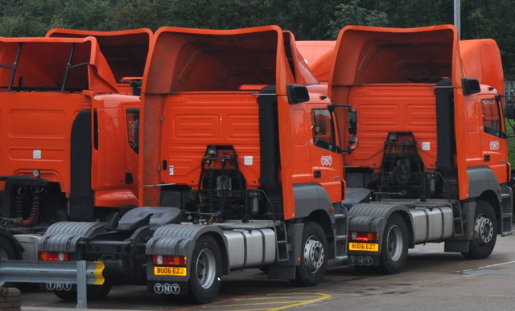
The Global Business Environment
Assignment 2
Student: Ionut Aurelian Stanciu
Student id: 2219322
Module code: LCBB4005
Lecturer: Nadeem Mirza

Slide 2
Introduction
The purpose of this presentation is to outline the key factors of why the logistic company should be globalized to Romania
Kapoor, (2019) agrees that business environment is a comprehensive account for the Fourth Industrial Revolution that apprehends current shifts in the global environment
In our written report we have identified the threats, challenges, opportunities, etc., to asses the best way to merge the company overseas
A SWOT and PESTLE analysis has been used in the paper to analyse the important factors. And why a strategic management plan is important.

Slide 3
Business introduction
Logistic company founded in London in 2017, providing administration services for smaller business.
Due to the outstanding services provided, the company had a huge success.
It started with a man and a van, becoming popular and successful being highly demanded by many other companies.
The business flourished so it’s ‘’van’’ became a lorry and shortly a very successful business with many lorries, employees, shareholders.

Slide 4
Globalization
Worthington and Britton, (2009) states that globalization does not have only one definition. However the term it is used to describe the process of incorporation on a worldwide scale of markets and production.
Globalization is changing according to the authors. Moreover, we can agree to them as the economy has changed after BREXIT, but not only that is a factor these days.
Motohashi, (2015), has presented the two frames, the AAA frame and research and development frame ( R&D), explaining the globalization of a company
The frame is used to help the shareholders to make the best decision regarding the globalization of the company
The AAA and R&D frame

Slide 5
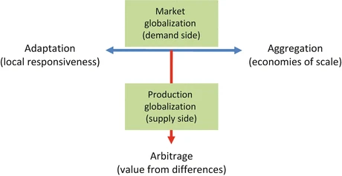
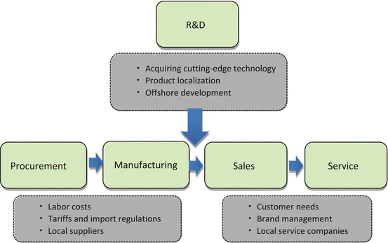
The AAA and R&D frame

Slide 6
Strategy
Motohashi, (2015), agrees that management strategies increase the value of any company.
A good strategic plan, according to the author, it is vital for any company to help it achieve the set objectives.
However, Johnson and Scholes, (2003), an organisation must follow a direction and a scope over long term to achieve advantages through it’s own resources.
For the business to be successful there must be creative thinking and identify the competitors, challenges, market, etc.

Slide 7
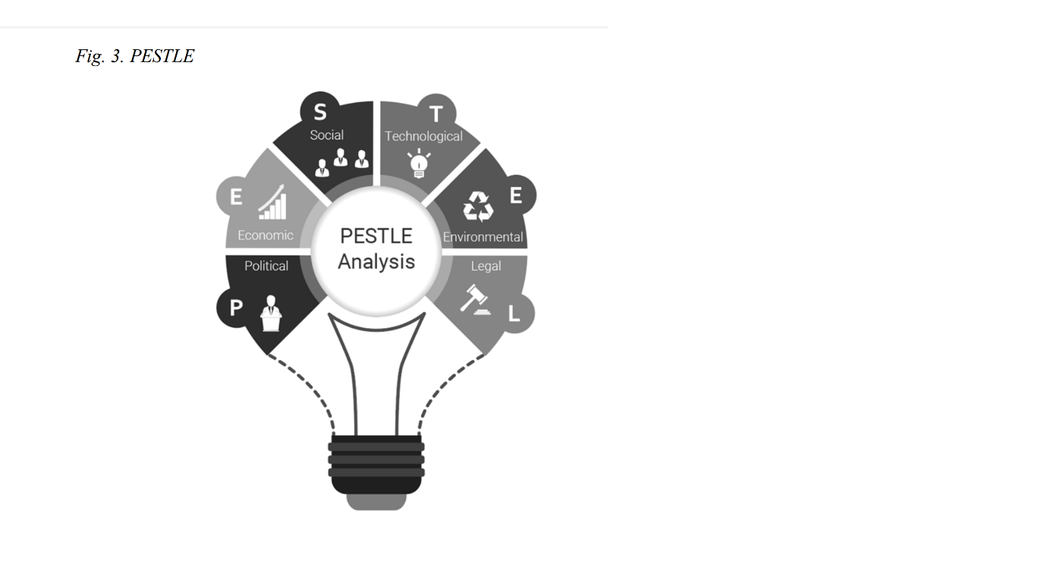
PESTLE Analysis
Political factors- Taxes and regulations, Import and export procedures, Registration of the vehicles at RAR (Romanian Automotive Register)
Economic factors- Labour wage, Inflation and interest rate, Economic growth, Productivity
Social factors- Education, Culture, Religion and ethics
Technological factors- upgrading the system, Research and improvement, Automation
Legal factors- Health and safety, Data protection, Consumer protection
Environmental factors- Recycling, Waste management and pollution, Global climate change

Slide 8
SWOT Analysis
Strengths- Good marketing skills, Exchange rate, £ is higher than Romanian currency LEU, meaning less £ to invest, It already has a large scale of customers that operates worldwide also.
Weaknesses- The company is UK-based, which means there must be someone trustworthy to lead the company overseas, Language barrier, The competitors that are already on the market.
Opportunities- Meeting new people with fresh ideas, Attracting new shareholders
Threats- Competitors, The merge of the company may be a bit difficult due to Brexit and the changing laws.

Slide 9
Conclusion
Worthington and Britton (2009), states that manufacturing business is diversly in many ways, however, they all have in common the transformation of the inputs into outputs.
I believe that by globalizing the company to Romania, it will not only be a success there, but worldwide also, after reviewing the key points of research from our written report.
The company has the knowledge, the cost advantaged, it can offer good quality services at a lower cost.

Slide 10
References
Kapoor, M., (2019), Global Business Environment, Shifting Paradigms in the Fourth Industrial Revolution, 1st Ed., Sage Publication
Worthington, I. and Britton, C., (2009), The Business Environment, 6th Ed., Pearson Education LTD., Edinburgh Gate, Harlow.
Motohashi, K., (2015), Global Business Strategy: Multinational Corporations Venturing into Emerging Markets, 1st Ed., Springer Japan
Johnson, G, and Scholes, K., (2003), Exploring Corporate Strategy, 6th Ed., Pearson's Education LTD.

