Slide 1
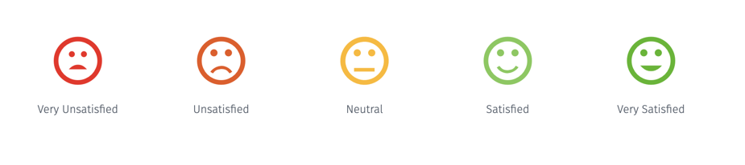

LCDB7011 Quantitative Research Methods
Week 2 – Research Design: Developing Scales and Questionnaires
Dr. Helen LEE

Slide 2
Burgess (2001) identified the basic process of survey research
1. define your research aims
2. identify the population and sample
3. decide how to collect replies
4. design your questionnaire
5. run a pilot survey
6. carry out the main survey
7. analyse the data

Slide 3

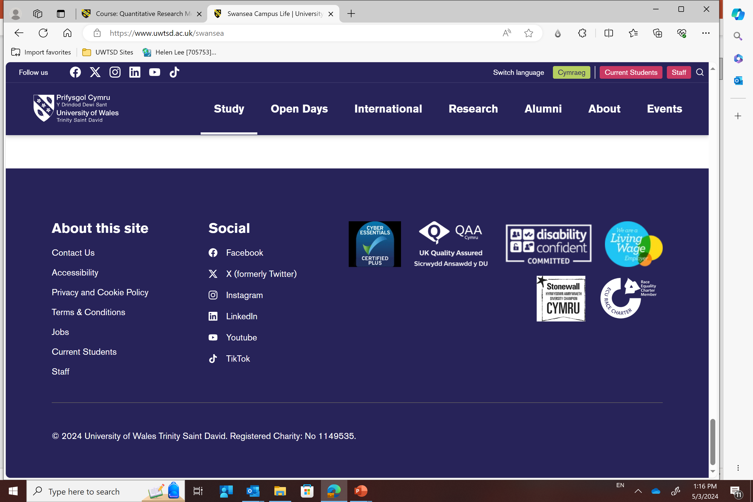
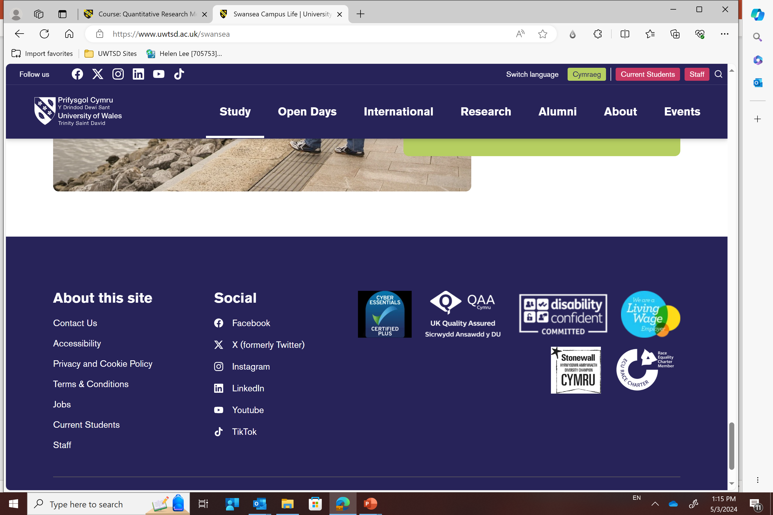

Questionnaire for a Survey Research
The purpose of today's lecture is to enable you understand issues relating to:
Designing and constructing the questionnaire
Identifying and keeping track of respondents (6).
Delivering the questionnaire (6)

Slide 4
Designing and constructing the questionnaire
“A crucial part of good research design concerns making sure that the questionnaire design addresses the needs of the research. To put this another way; somehow we need to ensure that the questions asked are the right ones. To move from the research aims (1) to decide what are the right questions to be put on a questionnaire (4) is a key aspect that needs to be addressed by the researcher.” Burgess (2001, p.1)

Slide 5
Designing and constructing the questionnaire
“Start your survey by setting down the aims for the survey. To define the aims for academic, as opposed to market research, you will need to review the relevant literature and you may need to do some preliminary research amongst your target subjects. Fulfilling these aims should then drive the design of your questionnaire and help select questions that are relevant, concise and efficient.” (Burgess, 2001, p.3).

Slide 6
Identifying the Variables (Measurement items) for your Questionnaire and carrying out your Survey
Creating Your Survey Instrument:
1. What items (questions) to use?
2. Is there enough literature in the area? (see p.168 to 176 of thesis)
3. If not, what to do?
Likert Scale

Slide 7
Designing and constructing the questionnaire
If not enough literature and no validated measurement items, what to do?
Create your own variables
How to do that – Focus Group

Slide 8
Ensuring suitability of your questionnaire to the sample for your study - Run a Pilot Study
“Most researchers make the mistake of asking too many questions. This often arises from an incomplete analysis of how to meet the survey aims. Your greatest enemy in survey research may well be poor response rate. Clear and concise questionnaires can help get the best response.” (Burgess, 2001, p.3).

Slide 9

Ensuring suitability of your questionnaire to the sample for your study - Run a Pilot Test

Slide 10
To determine the feasibility of the study protocol in a study.
To test whether the study instrument(s), is asking the intended questions, whether the format is comprehensible and whether the selected validated tool is appropriate for the target population.
To test the appropriateness of data collection using the selected interview technique (face-to-face or telephone) or self-completed questionnaire (postal or administered at the centre).
To test the data collection process – the time taken to complete questionnaire, and the subjects’ willingness to participate in the study.
To obtain preliminary data for the primary outcome measure, in order to calculate a required sample size (especially in randomized control trials).
Is pilot test important ?

Slide 11

Quantitative Data Collection Methods
Time and effort required to produce useful data before data is collected (changes difficult to make once data collection starts)
  Good knowledge of the area under investigation (qualitative input)
  Knowledge of the subjects to be questioned
  Clear idea of the objectives of the research instrument
http://www.survey-reviews.net/wp-content/uploads/2012/02/survey.jpg

Slide 12
Considerations For Quantitative Research Design
Better response rates from interviewer-led surveys than from self-response surveys.
Self-response surveys are usually cheaper.
Interviewer-led surveys can produce richer information.
Self-response surveys can reach more people.
Online surveys are faster but have lower response rate
The quality of online surveys is more difficult to control
Make sure you choose online survey software carefully
Notes:
Its generally held that the larger your sample size, the more reliable your information. However, you also need to consider your response rates and quality of information that you’ll get.
Interview-led surveys have that element of human interaction which means they usually result in better response rates, however they are more costly because of the training and staff time to administer them.
Richer information: can prompt for more information or can clarify any ambiguities in the questions, and have greater scope for open-ended questions.
Sample size: for clinical audit you’re looking to get at least 40 data sets to get a good sample, for research you’re probably looking for a statistically significant sample.
Additional info
Refer to page 3 of the ‘Guidance for writing effective questionnaires’ for pros and con’s of each method’

Slide 13
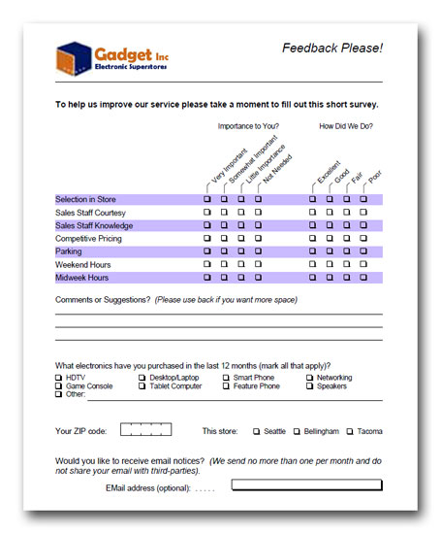
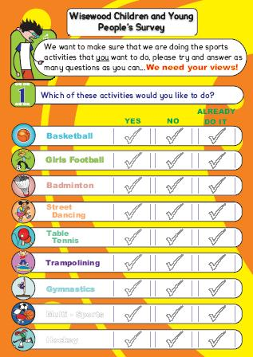
Who Are your respondents?
http://www.sheffkids.co.uk/adultssite/documents/Wisewood%20questionnaire.pdf
http://apian.com/landing/market-research.php
Notes:
Are you pitching it at the right age group? Are you asking too much?
Will it really be the child or the parents answering it?
Not just about children; the average reading age for Leicester is between 7-10 years old. Need to ensure your questions are

Slide 14
More considerations
Will the survey be completed right after the event, or sometime after?
Will it be completed in front of other people or in private?
Many people are poor at estimating numerical info about their lives.
The more common the event the shorter a person’s window of recall is.
People’s behaviour does not necessarily reflect what they say in a questionnaire
Notes:
If asking people to complete a questionnaire when they have ‘gate-fever’ i.e. after a training session, after a clinic, then you need to make sure it is short enough and to the point. Asking someone to complete 6 sides of A4 questions when they are worrying about whether their car-parking money has run out, or whether their clinic is over-running just isn’t going to happen.
Asking a teenager about their sexual health when they are with their friends may give you one set of answers, with their parents a completely different set of answers and in private a third set.
However you also need to consider that the more common an event the less people are likely to be able to remember it accurately, for example: if you were to ask a heavy smoker exactly how many cigarettes they had smoked yesterday it is unlikely they would be able to tell you.
If you are asking an evaluation question then you also need to consider is the timescale you are asking in appropriate. You might ask someone coming out of a clinic – how friendly did you find the clinic staff today? while it is fresh in their minds this is an appropriate timescale to ask within. However if you are also asking them how useful they have found information they have been given in the clinic they may not be able to evaluate this effectively having not had a chance to put it into practice.

Slide 15

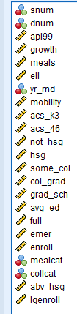
Type of questions
The type of question determines your analysis – you cannot go back!
Categorical questions – the answers are distinct categories that do not overlap (colours, gender, nationality etc)
Ordinal questions – the answers are categories that have an inherent order but uneven intervals (e.g. 1 week, 1 month, 1 year)
Interval questions – the answer categories have an order with a specific interval (e.g. Strongly Agree, Agree, Neutral, Disagree and Strongly Disagree) Sometimes that even interval is assumed!
Ratio questions – the same as Interval questions but with a true (meaningful) zero (e.g. money)
In practice, categorical and ordinal questions are often treated the same; and interval and ratio questions are often treated the same

Slide 16
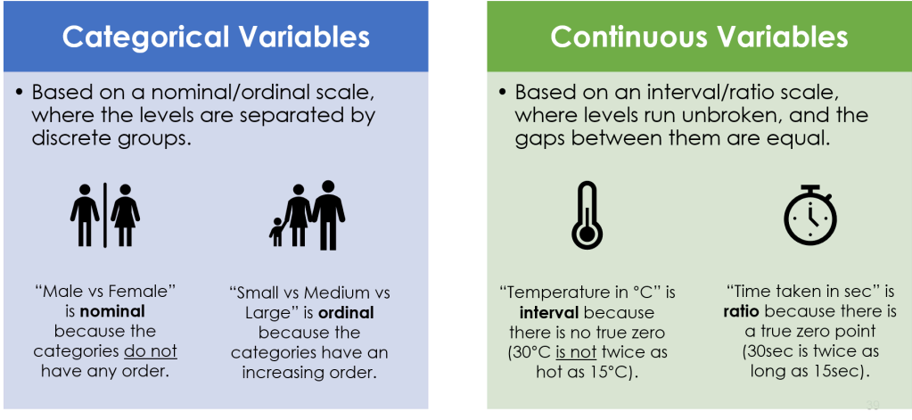
Example

Slide 17
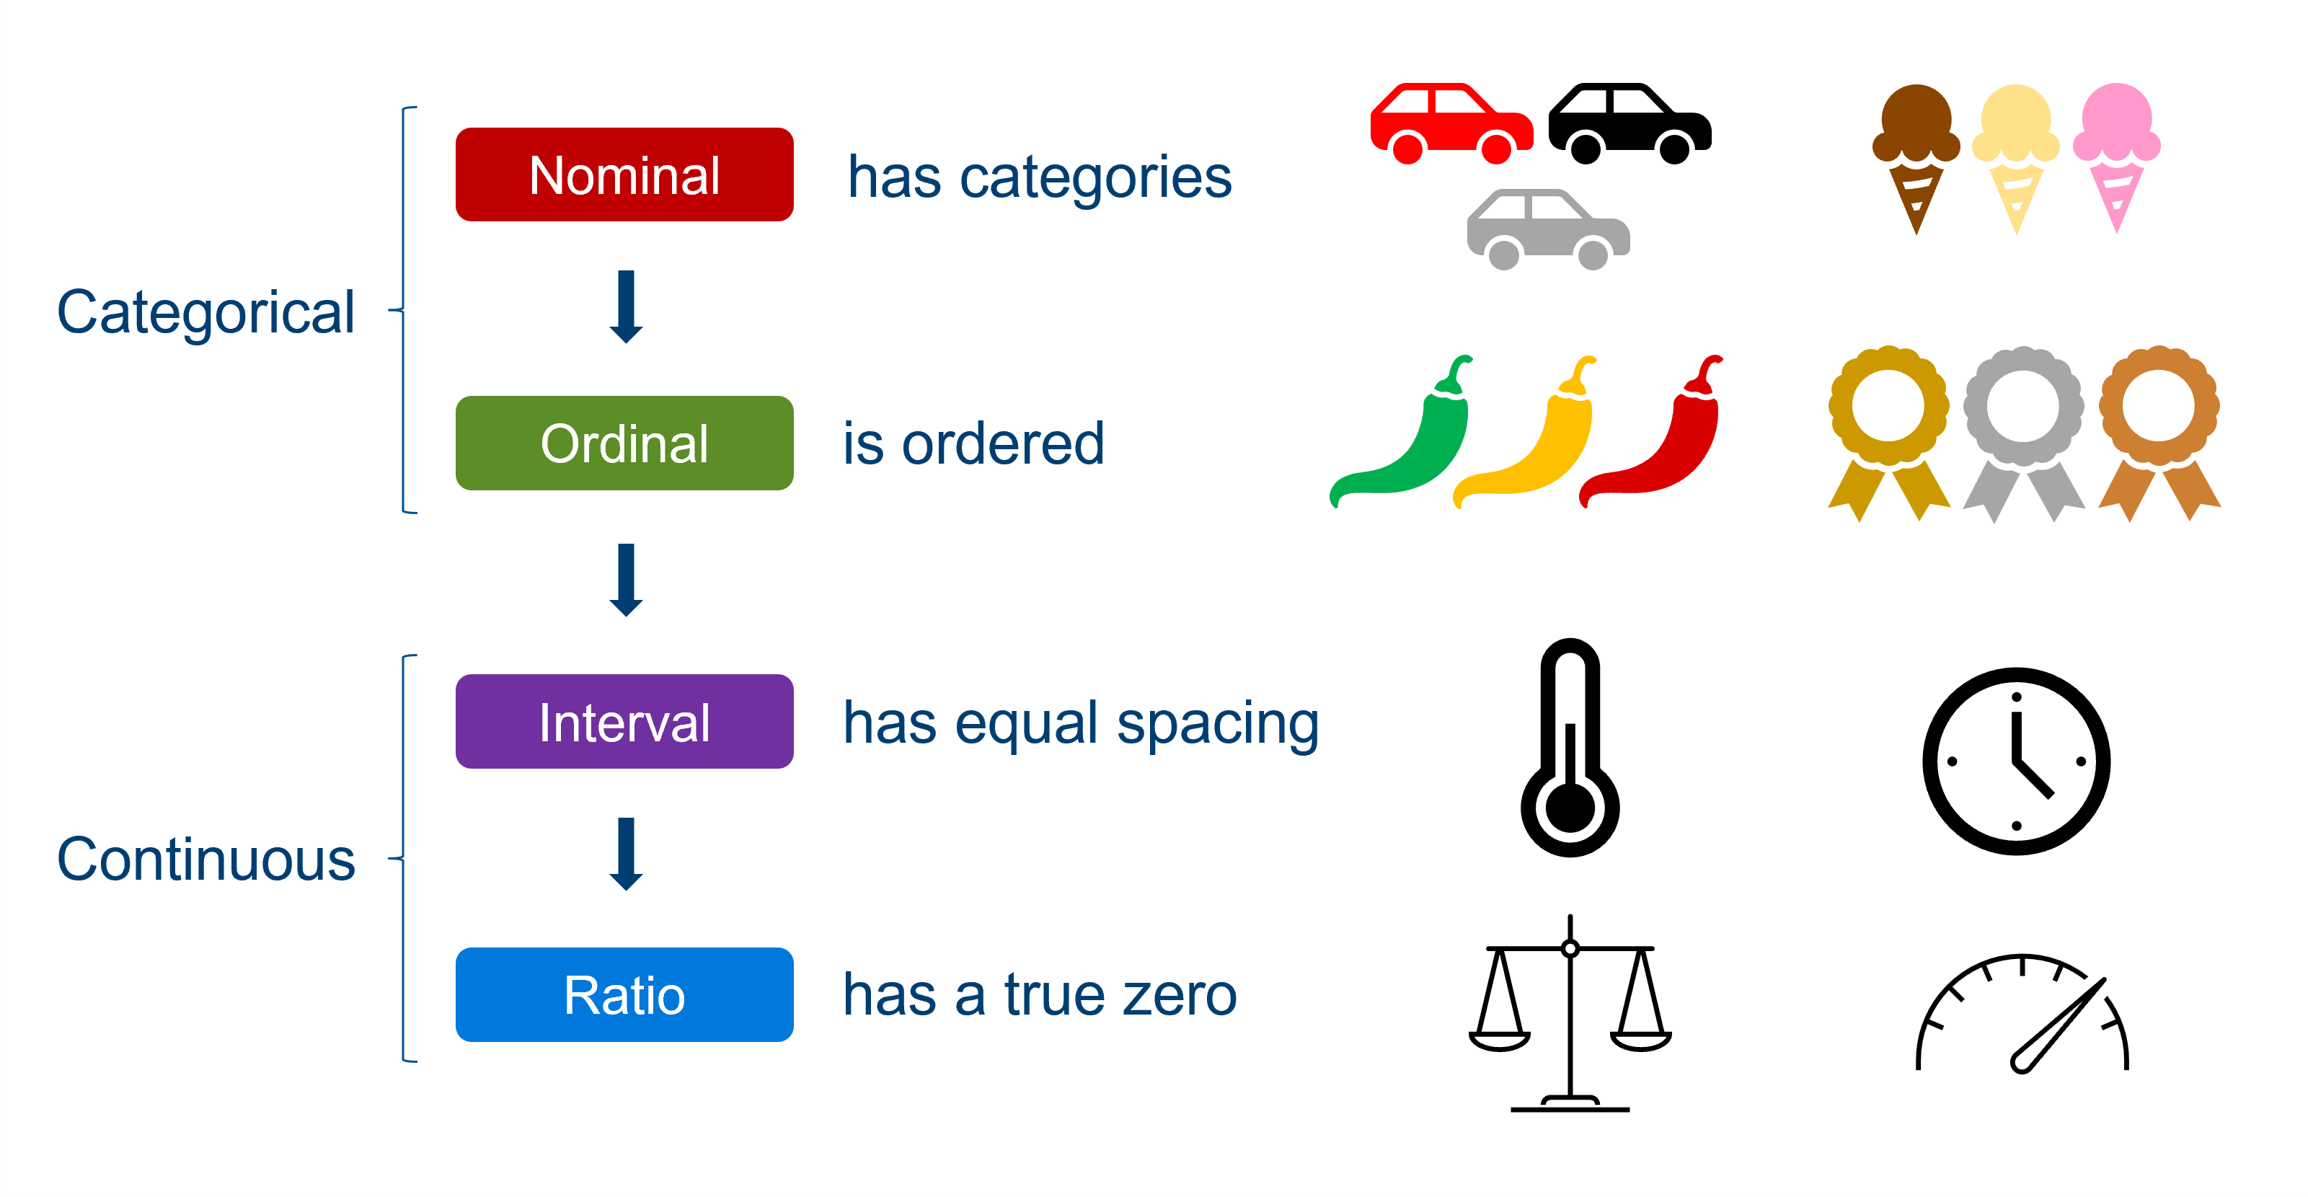
Example

Slide 18
Question wording
Keep questions as short as possible
  Max 16 words.
Consider providing medium length (30 word) introductions to groups of related questions (context is vital!)
Use open-ended questions sparingly
Notes:
Keep questions as short as possible:
The longer a question, the harder it is to understand.
A rough guide is a maximum of 16 words, though you’re looking to keep your questions shorter than this.
If you have several questions on the same topic, then consider grouping them together with a short introduction at the top. This will achieve two things:
First, it clarifies the topic for the respondent (so they’re clear about what you’re after),
Secondly, it likely means you can cut down the length of the questions underneath it (making them easier to understand). Doing this has been shown to improve the data quality.(1)
Open-ended questions are great because they give a lot of quality information, and I would recommend that you have at least one of these in your questionnaire. However, they take time to answer and are seen as a more burdensome than a multiple choice option.
If you’re using a lot of open-ended questions, then perhaps you should consider a more appropriate method of data collection such as interviews or focus groups.

Slide 19

Responses and scales
Are the response options clear and complete?
How many response categories are required?
How do the response options link with the planned analysis? (Will you get what you need?)
Is the question necessary?
Several questions or just one?
Can respondents answer the question?
Will respondents answer the question?
Is the question clear and unbiased?

Slide 20

Scales
How many response options do you give?
Do you use a mid point?
Do you use ranking questions?
What can you do to minimise response style bias?
Do you use end points?
How many response points do you offer?
What is response style bias and how can you avoid it?

Slide 21
Mid-point / neutral opinions
Strongly disagree
    
Strongly agree
Use mid-points in questions on attitude.
Historically controversial as it was thought that respondents chose a neutral option to avoid thinking about a question.
Now shown that including a mid-point increases reliability and validity
But: scales without mid-point can be useful in international research to reduce response bias
Notes:
Some controversy exists as to whether a neutral point should be offered. If this option is removed, this forces the respondent to choose a response, which may lead to respondent irritation and increase non-response bias
Additional info:
This desirability of having a neutral middle point to increase the reliability and validity of response scales has also been confirmed by a meta-analysis of 87 experiments of question design reported by Saris and Gallhofer (2007)

Slide 22
Common Issues
What did you think about the waiting time?
Excellent | Very good | Good | Average | Poor
‘Good’ responses
‘Bad’ response
Notes:
You’re giving many more good options than poor ones – this is unbalanced.
Number of points used:
Recommend to use either five or seven point scales.
Generally, three-point scales are too narrow to be effective, and there is no evidence that nine points gives greater precision than a seven point scale.
Stick to using the same range of options for all questions where possible.
Or at least for each section
If necessary re-phrase your questions so that they work with the ratings.

Slide 23
Common Issues
What is your age group?
0-18 | 18-30 | 30-45 | 45+
Notes:
Sometimes it can be better to appear pedantic than to risk skewing the responses.

Slide 24
Common Issues
What was the first drink you had today?
Tea
Coffee
Water
Juice
Haven’t had a drink today
Notes:
What might be wrong with this closed question?
When writing closed questions ensure you cover all options or it could bias the analysis. – if unsure whether you have covered everything add an Other option to capture that data.
The answers from closed questions are easier to analyse BUT you are not leaving it open to allow respondents to raise unexpected, or missed, issues. OR to explain their answers.
Other tip for closed questions is :
Research has shown that in self completion questionnaires the first options on a list are chosen most often – whereas in interview situations the latter options are chosen most often.
Additional information
* There is evidence that openin

Slide 25

Common Issues
How do you rate the student experience and teaching at your university?
Very poor | Poor | Satisfactory | Good | Very good

Slide 26
Common Issues
Great CRM leads to great WOM. How true is this in your experience?
Very untrue | Untrue | Don’t know | True | Very true

Slide 27

Ordering your questionnaire
Place easy, non-challenging questions first
Key filter questions should go in early.
Use a funnel structure
  Go from basic to more in depth.
  General questions before specific questions.
  Go from the least sensitive to the most sensitive questions.
  But – try and put important questions in before the end.
Notes:
There is good evidence that the order of your questions can influence the responses you receive. So, here is some advice on how you can get the best information from your questionnaire:
Easy, non-challenging questions should come first. It makes your questionnaire appear inviting to your respondents.
Key filter questions should go in early. We’ll look at filters a bit later on.
Use a funnel structure to your questions (basic to in-depth, general to specific). Placing general questions before specific questions topic reduces bias. For example, if you’re interested in levels of happiness, then ask about the respondents general happiness before moving onto specifics such as happiness at work.
Least to most sensitive questions. What are the most commonly asked sensitive questions in NHS questionnaires?
> Demographics, (age, gender, religion, sexuality, disability).
These are very sensitive questions and should be left to the end.
However, remember to put your important questions in before the end. As Annette discussed earlier, if the respondent decides to cut the questionnaire short because of time constraints, then at least you have some useable data.
----------------------------------
General / specific questions
The order in which you place questions has been shown to affect the way people respond to them.
Placing general questions before specific questions on the same topic reduces bias from respondents wanting to be consistent with their previous responses.
E.g. asking about general happiness before moving onto specifics such as happiness at work.
Go from the least sensitive to the most sensitive questions to prevent turning respondents off straight away. If it feels too personal too quickly it can be a bit of a jolt – you need to warm respondents up.
e.g. Demographic questions
such as age, gender, disability and sexual orientation, are often required as part of health services research and evaluations to demonstrate equality of services, or to cross-match against the other questions to see if there is variation in response by groups, such as gender, or age, for example.
However, they do come across as threatening / an invasion of the respondent’s privacy, and if they’re placed first in the survey will affect how the respondent answers the rest of the questions or whether they complete the questionnaire at all.
But – try and put important questions in before the end - as that way if people are turned off you may still have collected a reasonable amount of important data before they abandon it.

Slide 28

Other elements to remember
Make it look professional.
Give an estimated completion time.
Put the deadline for return at the beginning and end of the questionnaire.
Provide a return address – on the questionnaire.
Say ‘Thank you’.

Slide 29

Evaluating & Testing the Questionnaire
Is the questionnaire a ‘good’ questionnaire?
Will it collect the data necessary to address the research objectives?
Is the way in which the data is collected suitable for the planned method(s) of data analysis?
Testing …DOES IT WORK????

Slide 30


Slide 31
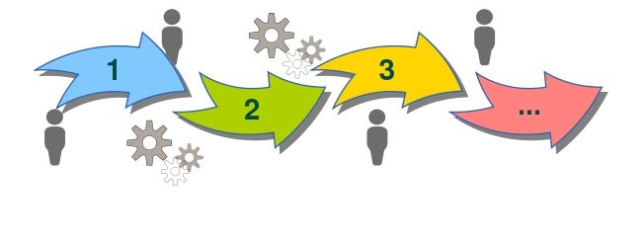
Activity
Think about a topic for your pilot test (30 valid cases)
State the aim, Objectives and questions
Identify your population and sample
Select the sampling method
Think about your conceptual framework
Based upon your conceptual framework, please prepare the questionnaire.

Slide 32
Summary
Quantitative research is based on a number of key stage: Planning, designing, piloting and final questionnaire development.
Key considerations include:
  The wording of questions
  How many questions for each variable?
  The number of response options
  The avoidance of response style bias

Slide 33


