Slide 1
Community Care and Development
(BMHP6022)
Student Name Liliana Turbatu
Student ID 1919066
Lecturer Name Dr Laila Surani
Potential barriers for successful community development
Presented by: Liliana Turbatu
Date: 01 08 2023

Slide 2
Table of contents
Slide no. | Content
3 | Introduction
4 | Tower Hamlets in East London
5 | Barriers/obstacles in community development
7 | Impact of barriers/obstacles on the growth of the community
9 | Recommendations
11 | Conclusion
12 | References

Slide 3

Introduction
Community care and development encompasses diverse initiatives that are designed to enhance the well-being of communities, ensuring that they are equitable and strong (Christenson, 2019).
The following presentation aims to evaluate the barriers to community development and their impact on the growth of the community in the borough of Tower Hamlets in East London and provide suitable recommendations to overcome these barriers.

Slide 4
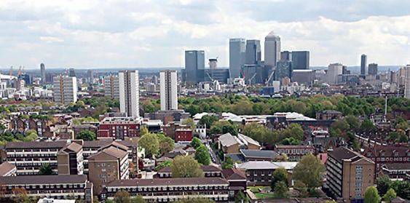
Tower Hamlets in East London.
Tower Hamlets has a population of 324,745, with around 44% of its population aged 25-44 years (Borough profile, 2022).
44% identify as Asian British or Asian, and 32% identify as White British, 7% identify as Black British or Black (Borough profile, 2022).
Has low life expectancy due to health risks such as alcohol consumption, smoking, crime, poor diet and social isolation.

Slide 5
Barriers/obstacles in community development
Language barrier/lack of communication as significant section of the population that does not speak English as their first language creating communication barriers.
Lack of public participation caused by its history of political indifference and disengagement hinders community development. (The Challenge, 2023).
Lack of competency-based leadership makes it difficult for the community to achieve shared goals as leaders lack the necessary knowledge and skills that are required to manage community development .
Lack of infrastructure makes it challenging for people to take part in community development initiatives.
Lack of initial funding hinders projects from getting started.

Slide 6

Cont..
Lack of short-term funding caused by limited number of funding sources hinders development
Lack of ongoing funding acts as a barrier as community development initiatives require to need funding to sustain and maintain their progress (Ledwith, 2020).
Lack of stakeholder participation makes them unwilling to work together with each other and invest in activities and initiatives for community development.

Slide 7
Impact of barriers/obstacles on the growth of the community
Language barriers in the borough hinders individuals from acquiring the information that they require to take part in community development activities.
Lack of understanding of the challenges facing the community due to language barrier (Roitman, 2019).
Development of a sense of disengagement and apathy, which leads to the lack of motivation to work towards achieving community goals.
Lack of purpose as well as direction in the community due to poor leadership.
Lack of access to various essential services such as proper healthcare, education and transportation due to lack of infrastracture.

Slide 8

Cont…
Delayed projects and a lack of sustainability due to a lack of resources to continue with the project when the initial funds run out.
Lack of momentum in the completion of the project, as some projects may need to be stopped due to lack of short-term and ongoing funding.
Lack of stakeholder participation hinders the community from acquiring support as well as input from its key stakeholders.
Lack of ownership of the community development activities

Slide 9

Recommendations
Communication should be accessible and clear by using translation services and multiple languages.
Promoting public participation through public meetings and conducting surveys, as well as creating opportunities for people to provide feedback, opinions and ideas.
Build capacity for the development of leadership by offering support and training for potential leaders as well as creating opportunities for the people of the community to develop their knowledge and skills through proper education (Christenson, 2019).

Slide 10
Cont…
Investing in infrastructure by asking the government to assist by investing in infrastructure projects.
Secure initial funding and acquire sustainable funding sources by creating effective business plans to show the viability of community development initiatives and identify possible sources of funding.
Ensure stakeholder participation and also inform them of the decisions and progress while also addressing the stakeholder concerns and developing effective solutions to ensure effective community and development initiatives (Ledwith, 2020).

Slide 11
Conclusion
Community care and development is a crucial issue that can have significant and positive effects on the wellbeing of communities.
The well-being of the Tower Hamlets community can be enhanced by using the above recommendations and ensuring collaboration, participation and the development of sustainable community development initiatives.

Slide 12
References
Borough profile. (2022). Borough profile. Available at: https://www.towerhamlets.gov.uk/lgnl/community_and_living/borough_statistics/Borough_profile.aspx. (Accessed: 29 July 2023).
The Challenge (2023). Tower Hamlets Together. Available at: https://www.towerhamletstogether.com/the-challenge. (Accessed: 29 July 2023).
Christenson, J. A. (2019). Community development. In Rural Society in the US (pp. 264-272). Routledge.
Ledwith, M. (2020). Community development: A critical approach. Policy Press.
Roitman, S. (2019). Urban poverty alleviation strategies in Yogyakarta, Indonesia: Contrasting opportunities for community development. Asia Pacific Viewpoint, 60(3), 386-401.

