Slide 2
Introduction:
Cybercrime, Digital Forensics,
Cyber Laws
Dr. Nitheesh Murugan Kaliyamurthy
Digital Forensics
(ACCA7031)
Applied Computing - WISA

Slide 3
During this week, we shall get introduced to this module, discuss the plan, coursework and the tools to be used in this module.
We also discuss the overview of Cybercrime, role of technology in Crime, its typology.
In continuation, let us try to understand the principles of Digital Forensics to begin our journey with. Moving forward, we shall look over the Law Enforcement and the key aspects on Security Vs Privacy.
Cybercrime
Principles of Digital Forensics
Law Enforcement
Security vs Privacy
Lab/ Tutorials
Lab Briefing
Coursework Description.

Slide 4
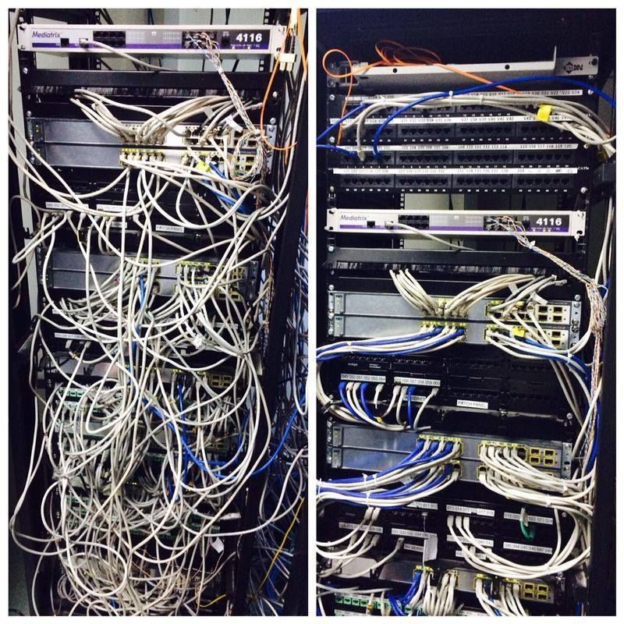
What do you see here?
(Renato Vidaña) https://www.pinterest.co.uk/pin/before-after-cabling--572097958892993219/

Slide 5
Cybercrime
To start from a discussion during our other lecture….
Proliferation of Technology
  (Zickuhr, 2011) – Individuals under the age of 20 regularly send texts and prefer that rather than making calls.
Digital Migrants
Technology in Crime:
  Communication Medium
  Target Sensitive Resources
  Engage in Crime
  Facilitate the offense
  Dark Web – via The Onion Router/ TOR Service
  Use of Digital Currency
  Cyberdeviance
Cybercrime
Cyberterrorism
Cyberdeviance

Slide 6

Cybercrime
You are in a Coffee Shop. You could see a wifi which is password protected.
You used your knowledge and proficiency to guess the password
  You didn’t use any tools to break in / brute force
  You just guessed the password (or) googled for a default password and used that
  You successfully connected to the network
  Is that a CRIME?
Cyber-trespass

Slide 7

Cybercrime
You create an email in the name of your friend/ (or) your Lecturer and send it to just your (close) friends in the class for fun. The email claims that there’s a change in the lecture time for this week.
  Is that a CRIME?
Cyber Deception

Slide 8
Discussion Point:
“The cyber deception in this scenario involves the email sender pretending to be a trustworthy entity to gain your trust and prompt you to take certain actions.” –
“If you follow the instructions in the deceptive email, you may unknowingly provide your sensitive information to cybercriminals, who can then use it for identity theft, financial fraud, or other malicious purposes.”
From the above example,
Will you be providing any sensitive information?
Is there any chance of Fraud (Financial, etc)?
Any Damage?
Is it a Crime?

Slide 9

Cybercrime
You use CMC (Computer Mediated Communication) to form a flash mob without alerting local citizens or law enforcement.
  Is that a CRIME?
Cyber Violence

Slide 10
Question:
“How much overlap do you see between real-world crimes and cybercrimes? Should we have distinct terms to recognize crime or deviance in online environments, or should all offenses just be classified as crimes, regardless of where and how they occur?” – (Bossler, 2018)

Slide 11

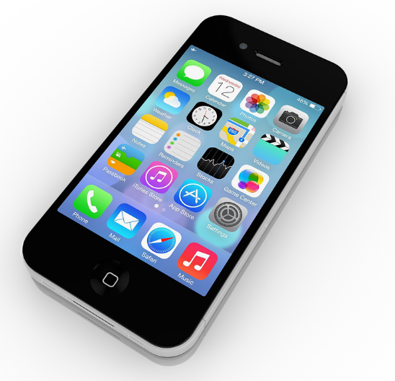
Privacy Vs Security
Privacy is the freedom from being observed or disturbed by other people, or the state of not being observed or disturbed in this way. It is the right to keep one's personal matters and relationships secret
(International Association of Privacy Professionals (IAPP)
Information security is the preservation of confidentiality, integrity, and availability of information. It also involves maintaining authenticity, possession, or control of that information
International Organization for Standardization (ISO)

Slide 12
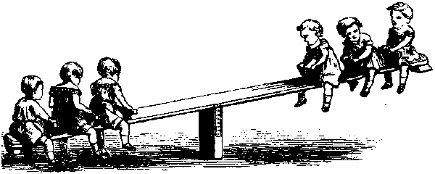
Privacy
Security
This Photo by Unknown Author is licensed under CC BY-SA

Slide 13
Discussion Point:
“KARMA POLICE” program was a surveillance initiative conducted by GCHQ that sparked controversy due to its extensive data collection and privacy implications. It contributed to a broader global debate on the balance between national security and individual privacy in the digital age.
What is the concept of privacy?
Why it is important in the context of digital surveillance programs like the above?
How do you define the boundaries between individual privacy and government surveillance in today’s scenario?
What do you think as an impact of mass surveillance on individual’s freedom of expression?
How can technology be used to enhance the security while minimizing the impact on individual privacy?

Slide 14
Forensic Science!!!
Forensic Science is the application of science to the law, meaning the scientific process of gathering and examining information to be used by the criminal justice system (Saferstein, 2010)
There are different fields in Forensic Science. Forensic Art, Nursing, Accounting, Engineering, Firearm, Serology, Document Examination, Digital Forensics, Psychology etc.
Digital Forensics
The application of computer science and investigative procedures for a legal purpose involving the analysis of digital evidence after proper search authority, chain of custody, validation with mathematics, use of validated tools, repeatability, reporting, and possible expert presentation.
(Casey, 2011)
Definition from ISO/IEC 27037
Digital forensics is defined as "the process of identifying, preserving, analyzing, and presenting digital evidence in a manner that is legally acceptable."

Slide 15
Forensic Science!!!
Computer ? Digital ? Forensic
The National Institute of Standards and Technology (NIST) defines digital forensics as "the application of science to the identification, examination, and analysis of data while preserving the integrity of the information and maintaining a strict chain of custody for the data.“
NIST defines computer forensics as "the discipline that combines elements of law and computer science to collect and analyze data from computer systems, networks, wireless communications, and storage devices in a way that is admissible as evidence in a court of law.“
Are you confused??? Just to back to the past and try to clarify things!!!
Late 1970’s
  1976 – Council of Europe Conference on Criminology Aspects of Economic Crime – Strabourg, France: Identified several categories of Cyber Crime. ^{Schjolberg, S. (2004).}
  1977 – The Federal Computer Systems Protection Act – USA – not passed
  This Act would make “the use, for fraudulent or other illegal purposes, of any computer owned or operated by the United States, certain financial institutions, and entitles affecting interstate commerce” a federal crime.
  1978 – Florida Computer Crimes Act – based on a scandal
  1986 – Computer Fraud and Abuse Act – USA

Slide 16
Forensic Science!!!
Ad Hoc Phase (early 1980s)
Structured Phase (mid 1980s)
Golden Age – Enterprise Phase (early 2000s)
Evolving into Digital Forensics from Computer Forensics.
Courts more familiar with the process of collecting and examining
More sophisticated tools, on-site examination, Open-source tools
Mapping between forensic procedure/ Policy and Computer Crime Legislation
Development of tools to withstand courtroom challenges
Definition of Digital Evidence
Evidence without any sense
Lack of Accuracy
Challenges in documentation of evidence
Lack of Policies and Standards
Advancement Phase (early 2010s)
IoT, Drones, Surveillance, Wireless etc

Slide 17
Forensic Science!!!
Digital Forensics
Digital forensics refers to the analysis of digital evidence, which includes network forensics (Internet traffic), computer forensics, mobile device forensics (e.g., cell phone), and malware forensics (e.g., viruses). Overall, digital forensics included a whole array of digital devices. (Bossler)
Note that, in most cases the development of new technology required new forensic tools. (Bossler)
Pre-Investigation
Identification
Collection
Examination
Interpretation
Documentation
Presentation

Slide 18
Digital Forensics
Digital Evidence
“Any information of probative value that is stored or transmitted in a binary form” – Whitcomb, 2007
Information that is either transferred or stored digitally.
Digital Evidence is only admissible if its authenticity can be verified in a court of law.
Key Challenges: Different stages of data/ information

Slide 19
Discussion Point
Victor Collins Case – Smart Home Devices – Alexa as an evidence
Summary:
Victor Collins was found dead in a hot tub at a friend's residence in Bentonville, Arkansas, in November 2015. The friend, James Bates, was the owner of the residence and was present at the time of the incident. Bates initially reported finding Collins' body the next morning and called 911
Case Overview
Role of Digital Forensics
Privacy and Legal Issues
Reflection

Slide 20
Summary
Cybercrime
Types of Crime
  Economic Crimes – CMC, ID Theft, Email Scams, Stolen Data Market
  Intellectual Property Theft
  Sexual Crimes – Pornography, Child Pornography, Sexual Exploitation and Sex Crimes
  Cyberbullying, Online Harassment, Cyberstalking
  Online Extremism, Cyber Terror, Cyberwarfare
Privacy Vs Security
Digital Forensics
Notes:
Bossler, Adam M._ Holt, Thomas J._ Seigfried-Spellar, Kathryn C - Cybercrime and digital forensics_ an introduction-Routledge (2017_2018)

Slide 21
Any Questions?
Digital Forensics
(ACCA7031)
Applied Computing - WISA

Slide 22
References
Bossler, Adam M._ Holt, Thomas J._ Seigfried-Spellar, Kathryn C –
Cybercrime and digital forensics_ an introduction-Routledge (2017_2018)
Schjolberg, S. (2004). Computer-related offences .
Presentation at the Octopus Interface 2004 Conference on the
Challenge of Cybercrime, September 15–17, Council of Europe,
Strasbourg, France.
Whitcomb, C. (2007). The evolution of digital evidence in
forensic science laboratories. The Police Chief, 74(11).
Digital Forensics
(ACCA7031)
Applied Computing - WISA

