Slide 1

The Function of Human resources
By Isabelle Solomon: 1919798
Word count: 3071

Slide 2
HR Function
The HR function was primarily to deal with personnel issues including the hiring and training of a work force pre 1980’s, research suggests 95% of organisations have undergone some form of HR transformation in the last 20 years (Taylor and Woodhams, 2016). The HR function has developed a wider scope and now plays a vital role in most aspects within a company.
The HR function deliver objectives and business strategy by ensuring the workforce plan is right, along with the skills needed and optimum performance is delivered.
HRM is about managing, attracting, developing and retaining people, also addresses employee well-being, legal compliance and ethical management.
HR plays a vital role in change management.
Notes:
No two HR departments are the same. They differ in structure, size, expertise and service from organisation to organisation, even though they share the same goals. The CIPD, 2006 report concluded the driver for the “structural transformation of HR was the desire for the function to be a more strategic contributor and to maximise HR’s contribution to business performance” (Taylor and Woodhams, 2016).
HR is responsible for developing and organising the human aspects in an organisation. The recruitment, training, management of staff and putting the right people in the right place is seen as necessary to having a successful business. An example of this is Virgin, owned by Richard Branson. They reshaped the role of HR within business to one which puts the employees first. They recognised that happy employees meant happy customers, having a great experience which is reflected in their bottom line. An unhappy employee can ruin the brand image and experience for numerous customers. They have developed a culture of employee engagement and recognition, listening to feedback and giving employees a sense of ownership (Roberts, 2016).

Slide 3
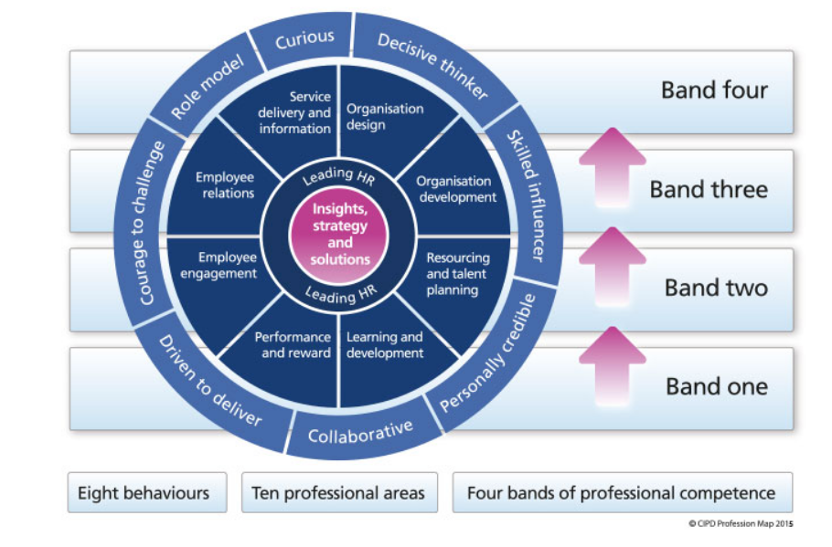
CIPD HR Profession Map 2013
The CIPD developed the profession map in order to help reflect these changing objectives. The profession map underpins good practice and enables the HR professional to build on their abilities and career paths.

Slide 4
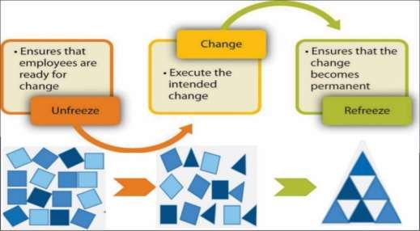
Change Management
Businesses need to be agile and flexible.
Lewin’s Change Management Model looks at change as a process with distinct stages so organisations can prepare, plan and manage the transition. For change to be successful there must first be a clear understanding of why it needs to happen before the stage of unfreezing can begin and process followed (Mind Tools, 2009).
Notes:
Lewin’s Change Management model was developed to make change successful. The model can be implemented in three ways:
Changing the existing organisational structures, systems and processes.
Changing the organisational climate, culture and interpersonal style.
Changing the behaviour, attitudes, skills of the individuals working in the organisation. (Juneja, 2015)

Slide 5
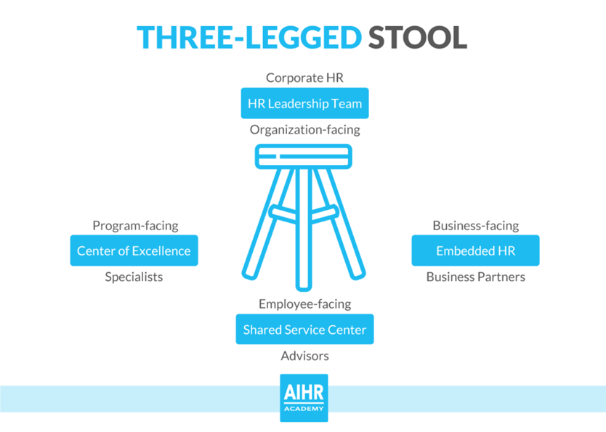
HR Service Delivery
The CIPD 2016, suggests the HR function should resemble the organisations and what its business customers want. There are two dominating structures to HR services currently-
Traditional approach where there is a team of generalists, administration and specialists.
The ‘three-legged stool’ model developed by Ulrich involving business partners, shared services and centres of expertise.
This concept was developed in the late 1990s by Dave Ulrich who suggested that the HRM function in large organisations is more efficient when divided up into areas of activity (Taylor and Woodhams, 2016). Ulrich model published in 1997, suggested there are four major roles HR managers undertake in an organisation.
Change agents
Administrative experts
Employee champions
Strategic partners
This theory has developed over time, with different interpretations emerging. The ‘three-legged stool’ model refers to HR business partners, HR centres of expertise and shared HR services.
Notes:
Traditional – 43% of organisations is reported by the CIPD as using this structure for their HR departments, with 55% of those being small to medium sized organisations with the majority in the private sector (Taylor and Woodhams, 2016). This structure usually consists of a single integrated team that generally looks after employees and line managers across the whole organisation, if a small company, or assigned to a specific department or unit within the company.
These HR teams generally consist of a HR director, a couple of HR managers, HR supervisor, some HR officers and a couple of HR assistants according to Crail (2006) study. The HR department would generally be set within a high standing within the organisation and would influence the day to day running and decision making.
HR business partnering is where HR professionals work along side the organisations leaders to deliver the organisations objectives and tailor the HR approach to support these. Business partners are senior HR professional and work side by side with operational managers to influence and implement the organisational strategy (Taylor and Woodhams, 2016). Benefits of the business partner role is that they are more aligned with management and can escalate people management issues to be a key focus.
Centres of expertise in the model comprises a team of HR experts who offer their services either to HR business partners or directly to line managers. They diagnose needs and offer solutions to problems. They are detached from the day-to-day business operation which can lead to them not having full knowledge of current situations.
Shared services are based on a relatively large unit within an organisation that deals with all the routine transactional services such as routine administration relating to recruitment, contracts of employment and absence monitoring (Taylor and Woodhams, 2016). This structure is low cost and leans towards the development in technology. I previously worked for Marks and Spencers who adopted this approach. Employees could request leave via the online system, they could view their work schedules and payslips. They could access the staff handbook and any other relevant information regarding their role and the company. From a management side, it made things easier as there weren’t bits of paper here there and everywhere and one centralised system everyone had access to. We also had computers available in the staff canteen area which people could use. When carrying out disciplinary meetings, absence review meetings etc, we would adjourn before making a decision and call our HR contact centre within head office, where they would offer advice on the situation we were dealing with.
Within my current organisation, a large part of the HR function is outsourced. There is an in-house HR representative that deals with day-to-day issues, communications etc and we use Redkite solicitors to draw up contracts, contractual changes, redundancy letters, seek advice on when to discipline, what actions to take in regards to certain situations etc. Outsourcing has increased in popularity due to organisations being too small to house an in-house HR team along with being able to access specialist skills when outsourced and make significant savings by not employing a HR team/ representative (Taylor and Woodhams, 2016).

Slide 6
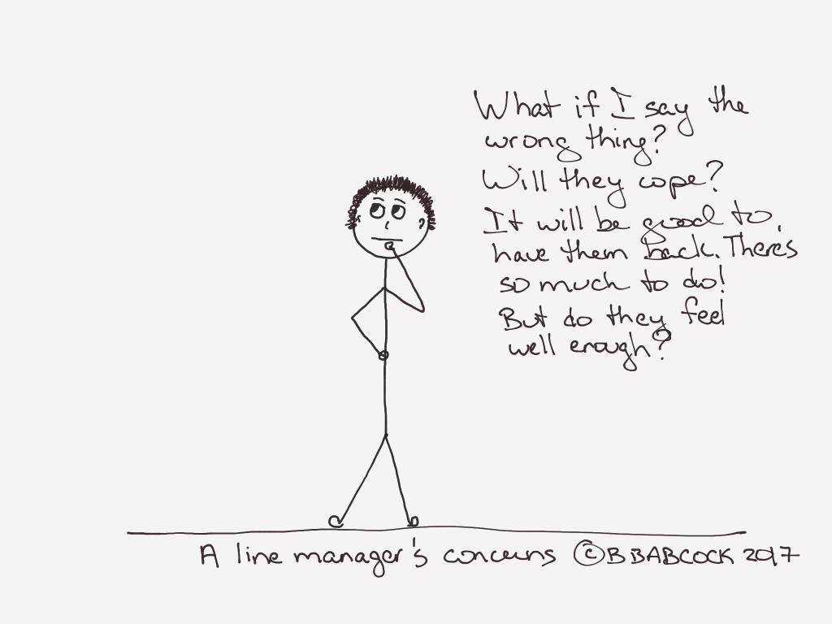
HR and line managers working together to deliver HR services:
Line managers deal with the day-to-day operations so have direct involvement with their employees, in managing them, scheduling their work, reviewing work, absence, customers, technical issues and development. They want their team to be trained, efficient and in good health to ensure the smooth running of their departments/organisations.
The link between HR and line managers has evolved over the years and placed more accountability with the line manager because trends regarding performance related pay along with individualisation of the employment relationship have arisen (CIPD, 2018). Line managers are now more involved with the development of staff, acting as role models, or expected to share their knowledge.
Notes:
Outsourcing of most of the HR function has also increased the burden on line managers to pick up some of the more basic HR roles such as record keeping, staff requests including time off, training needs and payroll information. When a line manager is not properly trained in the processes of HR or delivering this part of their role, then the organisation can face issues. They also need to allow time to complete these HR tasks within their line manager roles. It is said that an employee does not leave an organisation, they leave a manager, and it is this link with their line manager that impacts how they feel about their job, their commitment and loyalty. A study by Bath university found that if an employee felt positively towards their line manager, had a good working relationship with good communication then they in turn provided higher levels of performance and discretionary behaviour
(CIPD, 2018).
The CIPD identified the crucial influence line managers play on employee engagement which then impacts on employee performance and retention and stresses that organisations need to ‘pay close attention to the way they select, develop and manage the performance of line managers’ especially in relation to their people management behaviours and organisational values (Taylor and Woodhams, 2016).

Slide 7
Ethical HR practices:
Ethical practice is the application of ethical values within an organisation and applies to all aspects. HR should always be managed in an ethical manner because HR professionals have unique access to staff, hold great influence within an organisation and the way it manages its workforce (CIPD, 2020). HR professionals should create cultures of trust and transparency by leading by example and acting with integrity.
Risks occur within an organisation when its principles and ethical values are one thing, but they act in another. If the culture of the organisation that was sold to an employee or customer is not the reality then damage to reputation, brand image and employee engagement and retention are affected (CIPD, n.d.).
Developing an ethical culture is about centring the operation around the values. Ethical practices and policies are shaped by outside influences and their environment.

Slide 8
Unethical behaviour:
The CIPD (2019), research shows that organisational culture and leadership influences unethical behaviour but also can enhance ethical behaviour. A frustrated employee is more likely to act unethically in the workplace because they already have a negative view of their employment situation.
Example: The failure of Carillion, 2018.
This construction company held a lot of Government contracts and its collapse resulted in 3,000 jobs lost, 75,000 people affected in its supply chain and 450 public sector projects including hospitals, prisons and schools were all left in crisis (the Guardian, 2020). Unethical practice causes distrust in business, governance and undermine the regulations and systems designed to protect economies and individuals (ROTTEN APPLES, BAD BARRELS AND STICKY SITUATIONS An evidence review of unethical workplace behaviour, 2019). Carillion acted unethically because they were not honest about the Company’s finances and debt levels. They continued to pay dividends to shareholders beyond a sustainable point, indicating a lack of integrity and transparency (Sheila Drew Smith, 2018).

Slide 9
HR’s contribution to an organisation:
Measuring the HR function and its impact within an organisation can be a tricky task.
When looking at the recruitment process, if an organisation can not recruit, train, retain and deploy staff effectively then that is a clear indicator that the HR function is failing. However, we need to measure more than just this function.
A CIPD survey (2015) found that 63% of HR professional’s thought their HR data did influence business decisions, promote change and improvement within their organisation (Taylor and Woodhams, 2016).
Notes:
Methods of evaluating:
Specific quantitative indicators can be used, such as sickness absence, staff turnover figures, grievance and disciplinary case numbers along with appraisal outcomes (Taylor and Woodhams, 2016). Using these indicators to benchmark your organisation against another can be useful in measuring how effective your organisations HR function is, but the organisations need to be comparable in size, structure, environment and culture.
Other general measures include measuring employee engagement through surveys, either internally or externally, customer and stakeholder feedback and studying the response rates of the recruitment process. General tests of the HR function rely on the extent to which HR objectives are intertwined with the operational and strategic plan of the organisation. An example of this is developing the workforce plan at the same time as the business strategy so the two are intertwined so when the organisation as a whole succeeds, the HR function is also seen to be (Taylor and Woodhams, 2016).

Slide 10
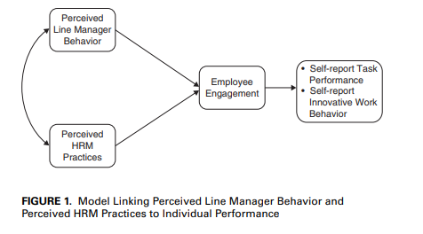
THE RELATIONSHIP BETWEEN LINE MANAGER BEHAVIOR, PERCEIVED HRM PRACTICES, AND INDIVIDUAL PERFORMANCE: EXAMINING THE MEDIATING ROLE OF ENGAGEMENT K E R S T I N A L F E S , C AT H E R I N E T R U S. S , E M M A. C . SOANE, CHRIS REES, AND MARK GATENBY.
The article explores the link between HRM practices and individual performance outcomes and how the line manager role effects this.
Notes:
This study found a direct link to employee engagement and productivity based on employees feeling valued by their line managers and HRM practices that encourage this positive relationship, such as investing in employees development and training. This investment is then reciprocated by the employee by means of discretionary behaviour (HRM, 2013). “HRM practices are viewed by employees as a ‘personalized’ commitment to them by the organization which is then reciprocated back to the organization by employees through positive attitudes and behaviour” (HRM, 2013).

Slide 11
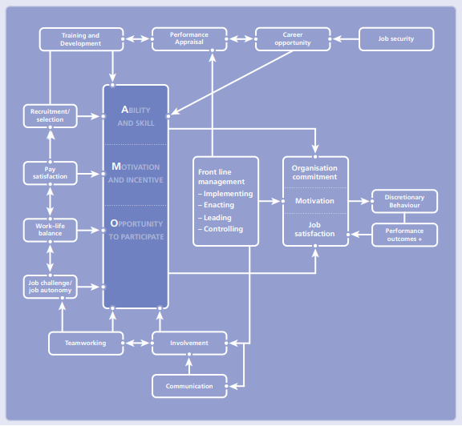
Ability, motivation and opportunity (AMO) model developed by Boxall and Purcell, 2003.
Notes:
AMO means Ability, Motivation and Opportunity. Ability refers to the employees ability to be able to carry out job roles within the organisation and have the necessary training and development to do so successfully. You need to get the recruitment, selection and training process right to enable employees to work without much supervision, thus giving the employee a sense of ownership, responsibility and creating a trusting and encouraging culture. These qualities within a workplace are what motivates people to stay in a position leads to discretionary behaviour where they want the organisation to be success and feel valued and like their role is making a difference- these are the motivations. The opportunity takes form by way of being involved in decision making processes, being engaged, being listened to. According to Wood and Wall (2007), Boxall and Macky (2009) and Appelbaum et al., (2000) , it is the distinguishing feature that differentiates high performance work practices whereby the decision making process should be de-centralized and shared rather than the control of hierarchy (UKEssays.com, n.d.). Discretionary behaviour (going the extra mile) is directly linked to how employees view their employer. If they feel committed to their job and want to stay there long term then they are more likely to engage in discretionary behaviour to ensure the organisations success. They are motivated to perform well and get job satisfaction.
Overall, the study found there is a clear link between managerial and employee discretion and how HR policies are brought to life.

Slide 12
References:
CIPD (2020). Ethical Practice and the Role of HR | Factsheets | CIPD. [online] CIPD. Available at: https://www.cipd.co.uk/knowledge/culture/ethics/role-hr-factsheet.
CIPD (2018). Role of Line Managers in HR and L&D | Factsheets | CIPD. [online] CIPD. Available at: https://www.cipd.co.uk/knowledge/fundamentals/people/hr/line-managers-factsheet.
CIPD. (2019). Understanding and tackling the causes of unethical behaviour in the workplace | Reports | CIPD. [online] Available at: https://www.cipd.co.uk/knowledge/culture/ethics/ethical-behaviour.
Juneja, P. (2015). Kurt Lewin’s Change Management Model: The Planned Approach to Organizational Change. [online] Managementstudyguide.com. Available at: https://www.managementstudyguide.com/kurt-lewins-change-management-model.htm.
Mind Tools (2009). Lewin’s Change Management ModelUnderstanding the Three Stages of Change. [online] Mindtools.com. Available at: https://www.mindtools.com/pages/article/newPPM_94.htm.
Human Resource Management, November–December 2013, Vol. 52, No. 6. Pp. 839–859 © 2013 Wiley Periodicals, Inc. Published online in Wiley Online Library (wileyonlinelibrary.com). DOI:10.1002/hrm.21512
Roberts, R. (2016). Employee Engagement the Virgin way. [online] HRZone. Available at: https://www.hrzone.com/community/blogs/richard-roberts/employee-engagement-the-virgin-way.
ROTTEN APPLES, BAD BARRELS AND STICKY SITUATIONS An evidence review of unethical workplace behaviour. (2019). [online] Available at: https://www.cipd.co.uk/Images/unethical-behaviour-in-the-workplace_report-2_tcm18-57022.pdf.
Sheila Drew Smith (2018). The Collapse of Carillion - a Failure of Ethical Standards? - Committee on Standards in Public Life. [online] Blog.gov.uk. Available at: https://cspl.blog.gov.uk/2018/02/01/the-collapse-of-carillion-a-failure-of-ethical-standards/.
Taylor, S. and Woodhams, C. (2016). Human resource management : people and organisations. 2nd ed. London: Chartered Institute Of Personnel And Development.
The Guardian. (2020). Carillion collapse: two years on, “government has learned nothing.” [online] Available at: https://www.theguardian.com/business/2020/jan/15/carillion-collapse-two-years-on-government-has-learned-nothing.
The RBL Group. (n.d.). RBL’s HR Effectiveness Audit: How effective is your HR Department? [online] Available at: https://www.rbl.net/insights/articles/auditing-the-effectivessness-of-your-hr-department [Accessed 20 Jan. 2021].
UKEssays.com. (n.d.). The Amo Model Theoritical Framework Commerce Essay. [online] Available at: https://www.ukessays.com/essays/commerce/the-amo-model-theoritical-framework-commerce-essay.php#:~:text=%20The%20Amo%20Model%20Theoritical%20Framework%20Commerce%20Essay [Accessed 21 Jan. 2021].

