Slide 1
LCBB5003
Management Economics
Week - 9
Externalities & The Role of the Government in Microeconomics i.e. Government Intervention

Slide 2
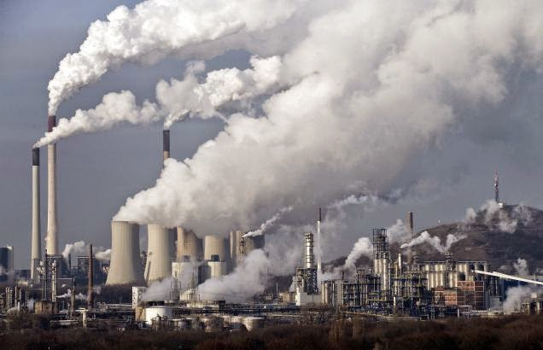
Session Objectives:
Define externalities
Discuss the different types of externalities
Discuss the role of government in microeconomics

Slide 3

Discussion - Watch the video clip on this slide and discuss what externalities are
(10 Minutes)

Slide 4
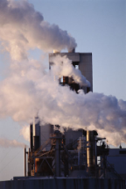
Externality
When one person’s actions imposes a cost or benefit on the well-being of a bystander.
Externalities usually result in market failure.

Slide 5
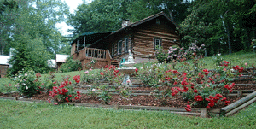

Externalities can be:
1) Positive: an external benefit is imposed on someone. (examples: gardens, restored historic buildings, research)
2) Negative: an external cost is imposed on someone. (examples: exhaust from autos, barking dogs, noise from airplanes)

Slide 6
Discussion (5 Minutes)
Do externalities cause markets to allocate resources inefficiently?
YES!
How?

Slide 7
This happens through:
1) CONSUMPTION: consuming a good results in externality.
2) PRODUCTION: producing a good results in externality.
In general, an external cost means the market over produces the good (i.e. paint). An external benefit means the market under produces the good (i.e. gardens)

Slide 8
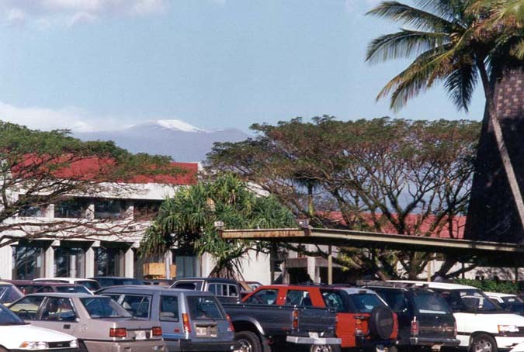
Are there benefits for other people in the parking lot when someone puts their car alarm on?

Slide 9
ANSWER:
Yes, because thieves don’t know which cars have alarms.
What about the club?
Are there benefits for other people in the parking lot when someone puts the club on their car?

Slide 10
ANSWER:
No . . .because the thief can SEE the club.

Slide 11

Your neighbor puts in a nice garden. Are you receiving a benefit?

Slide 12
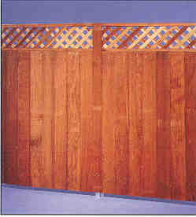
When you admit you are receiving a positive benefit, your neighbor asks you to pay him £100 a month for the benefit.
When you say no, he puts up a fence.

Slide 13
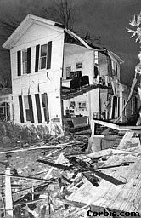
What if you lived next door to this?
Do you receive a benefit?

Slide 14

PROPERTY RIGHTS is the issue?
Who owns the air? The rivers? The parks?

Slide 15

If we can figure out who pollutes the stream, we punish the offender because we are not sure who owns the stream, but we DO know who pollutes it.
We get into trouble when we use this criteria regarding the air.

Slide 16
TRAGEDY OF THE COMMONS
The tendency for a society to overuse and therefore abuse common resources is called ‘Tragedy of the commons’

Slide 17
The government has dealt effectively with most water issues.
BUT. . . . .what about GARDENS???

Slide 18

So . . .
Your neighbor plants a garden and it is beautiful.
But 5 years later, the garden has grown and you can no longer see the lake.
Do you have a right to your view?

Slide 19

Is this pollution?

Slide 20
Externalities
Externalities
Positive (+benefit)
Negative (+cost)
Consumption (education)
Consumption (cigarettes)
Production (honey)
Production (pollution)

Slide 21
NEGATIVE EXTERNALITY IN PRODUCTION:
Example: Pollution
Because of the externality, the cost to society is larger than the cost to producers.
MSC
PRICE
S = MPC to Firm
MC is the private cost to the firm.
Marginal social cost (MSC) is cost to society = MC + externality.
D = MB to Society
The market overproduces and charges a price that is too low.
QUANTITY
Qmarket
Qoptimum

Slide 22
POSITIVE EXTERNALITY IN PRODUCTION:
Example: Honey
MPC to firm
PRICE
S = MSC
MC is the private cost to the firm.
Marginal social cost (MSC) is cost to society = MC + externality.
D = MB to Society
The market under produces and charges a price that is too high.
QUANTITY
Qoptimum
Qmarket

Slide 23
NEGATIVE EXTERNALITY IN CONSUMPTION:
Example: Cigarettes
Overproduction in this case raises MC.
D gives the private benefit in consumption.
Marginal social benefit (MSB) = D + externality.
PRICE
MC
The market overproduces and charges a price that is too high.
D = MB to Buyer
MSB
QUANTITY
_{Qmarket}

Slide 24
POSITIVE EXTERNALITY IN CONSUMPTION
Examples: Education, Charities
The social value of education is greater than the private value.
Underproduction in this case lowers MC.
PRICE
MC
D gives the private benefit in consumption.
Marginal social benefit (MSB) = D + externality.
MSB
D = MB to Buyer
The market under produces and charges a price that is too low.
QUANTITY
Qmarket
Qoptimum

Slide 25
SOLUTIONS:
1) Assign property rights => internalise externality
(Negotiate if mutually beneficial)
2) Government involvement
Tax on negative externality
Subsidy for positive externality
Permits

Slide 26
Now, suppose that two firms are awarded permits and have met the government standard.
Firm 1 then decides it wants to increase its emissions by 100 tons and firm 2 agrees to reduce its emissions by 100 tons if firm 1 pays its £5 million.
Should the government allow the two factories to make this deal?

Slide 27
If the Environmental Protection Agency allows the firms to make this deal, it will have created a new scarce resource: pollution permits.
A market to trade these permits will develop and that market will be governed by the forces of supply and demand.

Slide 28
The production of Good X creates an externality.
Price
Is this a negative or positive externality?
13
12
7
4
0
Marginal Social Cost
Negative
Marginal Private Cost
Why?
Because MSC > MPC
D-MSB
MR
Q1 Q2 Q3
Quantity of Good X

Slide 29
The production of Good X creates an externality.
Price
Identify the socially optimum output.
13
12
7
4
0
Marginal Social Cost
Q2
Marginal Private Cost
Why?
MSC=MSB
D-MSB
MR
Q1 Q2 Q3
Quantity of Good X

Slide 30
Suppose that good X is produced by a profit-maximizing monopoly.
Price
Identify the unregulated firm’s output.
Marginal Social Cost
Q1
13
12
7
4
0
Why?
Marginal Private Cost
At Q1, MPC = MR
D-MSB
MR
Q1 Q2 Q3
Quantity of Good X

Slide 31
Suppose that good X is produced by a profit-maximizing monopoly.
To produce socially optimum output, should the government tax or subsidize the firm?
Price
subsidise
13
12
7
4
0
Marginal Social Cost
How much will it be?
Marginal Private Cost
£3
Why?
D-MSB
Optimum Quantity at Q = MR
MR
Q1 Q2 Q3
Quantity of Good X

Slide 32
Suppose that good X is produced in a perfectly competitive industry.
Identify equilibrium output in the absence of regulation.
Price
Q3
13
12
7
4
0
Marginal Social Cost
Why?
D=MPC or MSB=MPC
Marginal Private Cost
D-MSB
MR
Q1 Q2 Q3
Quantity of Good X

Slide 33
Suppose that good X is produced in a perfectly competitive industry.
To produce at socially optimum output, should the government tax or subsidize?
Price
Tax
13
12
7
4
0
Marginal Social Cost
How much?
Marginal Private Cost
£5
D-MSB
MR
Q1 Q2 Q3
Quantity of Good X

Slide 34

Any Questions?
Thank you!

