Slide 1

Business Sakura Sushi Ltd
Name: Edgar Lopes Vieira
Student ID: 2438630
LCLM4006
Enterprise and Entrepreneurship
Lecturer Name: Charles Obinwa

Slide 2

Table of Contents
Introduction
Overview of the Business Idea
Organization Structure
Pestel Analysis
Marketing Strategies
Swot Analysis
Funding Requirements and Allocation
Financial Plan

Slide 3
My name is Edgar, and I am the Chief Executive Officer (CEO) and founder of Sakura Sushi London.
Legal Format: limited LTD
Sakura Sushi London will operate as a small, modern sushi restaurant offering dine-in, takeaway, and delivery services. The business aims to attract office workers, tourists, and residents.
I bring a strong background in hospitality management and business operations, with hands-on experience in the food and beverage industry. Over the 9 years.
My ability to combine strategic planning with practical execution allows me to drive business growth, maintain operational efficiency, and deliver a consistently high-quality dining experience.
I am deeply passionate about delivering authentic Japanese cuisine and creating meaningful dining experiences that bring people together. What motivates me most is the ability to turn a passion for food and hospitality into a successful business.
My connection to the food and hospitality industry comes from both professional experience and a genuine personal passion for Japanese cuisine.
Introduction

Slide 4
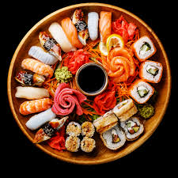
Overview of the Business Idea
Sakura Sushi London is a modern Japanese restaurant focused on delivering high-quality, includes a wide variety of freshly prepared sushi Sashimi, Nigiri and rolls, Bento boxes and vegetarian, Japanese drinks and desserts.
While there are many sushi options available, customers often face challenges such as inconsistent quality, limited menu variety, high prices, or a lack of authenticity.
Excellent customer service and a welcoming dining atmosphere further enhances the overall experience by combining authenticity, affordability, consistency, and convenience. Well-positioned to meet the expectations of modern consumers and stand out in the competitive food market.

Slide 5
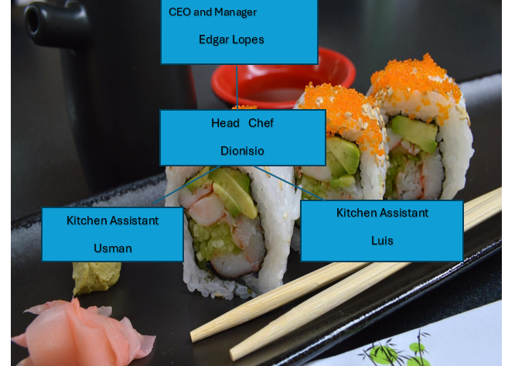
Organization Structure
Notes:
You can use either MS Visio or MS Word to create this.

Slide 6
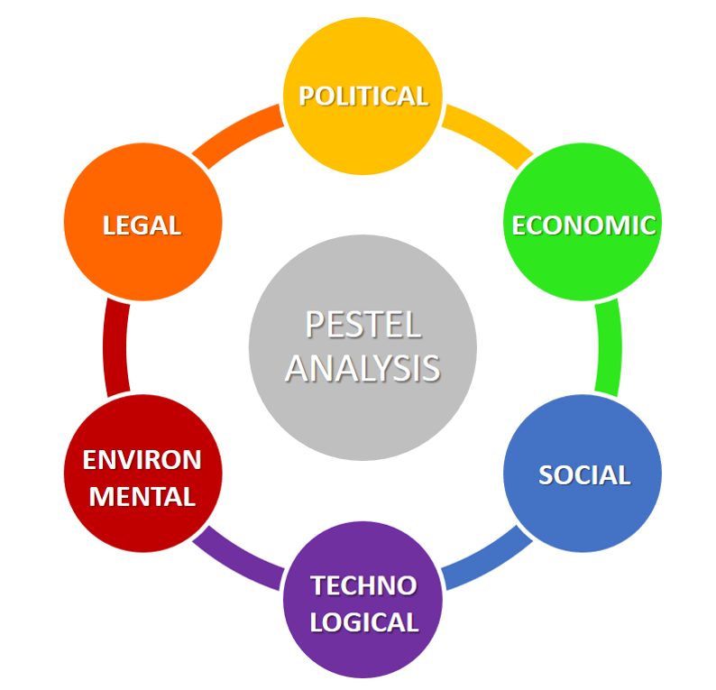
Section 3 – PESTEL Analysis
Social
Economic
Environmental
Legal
Political
Technological
Compliance with food safety regulations and hygiene standards is mandatory
Rising cost of living may influence customers’ spending habits
Increasing consumer preference for healthy and international cuisine
Online ordering and delivery apps are becoming essential for customer convenience
There is growing pressure to use sustainable packaging and reduce waste
The business must adhere to licensing, food hygiene, and employment laws
Notes:
Apply PESTEL analysis taught in week 4:
Analyse the following factors:
Political – Government policies, regulations, tax laws, trade restrictions.
Economic – Inflation, interest rates, economic growth, consumer spending.
Social – Demographics, cultural trends, lifestyle changes, education.
Technological – Innovation, digital transformation, automation.
Environmental – Sustainability, climate change regulations, waste management.
Legal – Employment laws, intellectual property rights, industry-specific regulations.
2. Align PESTEL with Business Strategy
After identifying key external factors, explain how they impact your business and what strategies you will adopt to mitigate risks or leverage opportunities.

Slide 7
Target Market
The primary target market is young professionals aged 18–45.
Key Characteristics:
Busy lifestyle limited time to cook
Disposable income willing to pay for quality food
Value convenience prefer fast service and takeaway options
Students
Lower income highly price-sensitive
Attracted by discounts, deals, and meal offers
Likely to purchase takeaway or budget options
Tourists
Looking for quick, reliable food in a central location
Attracted by good reviews, branding, and visibility
More likely to make one-off purchases, but spend more per visit
Marketing Strategies
Notes:
Refer to week 5: Market Segmentation, Targeting, Positioning and marketing mix
Here are some key aspects of Unique Selling Points:
Differentiation: USPs highlight what makes a product or service unique and differentiates it from similar offerings in the market. It can be a feature, quality, or capability that competitors do not offer or cannot replicate easily.
Customer-Centric: USPs are designed to address the needs, wants, or pain points of the target market. They showcase how the product or service fulfills a specific customer demand or solves a particular problem effectively.
Value and Benefits: USPs emphasize the value customers will gain by choosing the product or service. They demonstrate the benefits and advantages the customers will experience by using the offering.
Memorability: A compelling USP is memorable and easy to communicate. It should be concise, clear, and leave a lasting impression on the audience.
Emotional Appeal: USPs can tap into emotions and aspirations of customers. They can create an emotional connection, making the product or service more appealing and desirable.
Competitive Advantage: USPs help companies gain a competitive edge in the market. They provide a reason for customers to choose their offerings over alternatives from competitors.
Examples of Unique Selling Points:
A smartphone with an exceptionally long-lasting battery life.
A cleaning product that is eco-friendly and non-toxic, appealing to environmentally conscious consumers.
An online platform that offers 24/7 customer support and assistance.
A restaurant that serves unique fusion cuisine not available anywhere else in the area.
An e-commerce website with free and fast shipping, setting it apart from competitors with longer delivery times and shipping fees.
Identifying and effectively promoting USPs is crucial for successful marketing and business growth. It allows businesses to position themselves as the best solution for their target customers and build a loyal customer base.
Regenerate

Slide 8
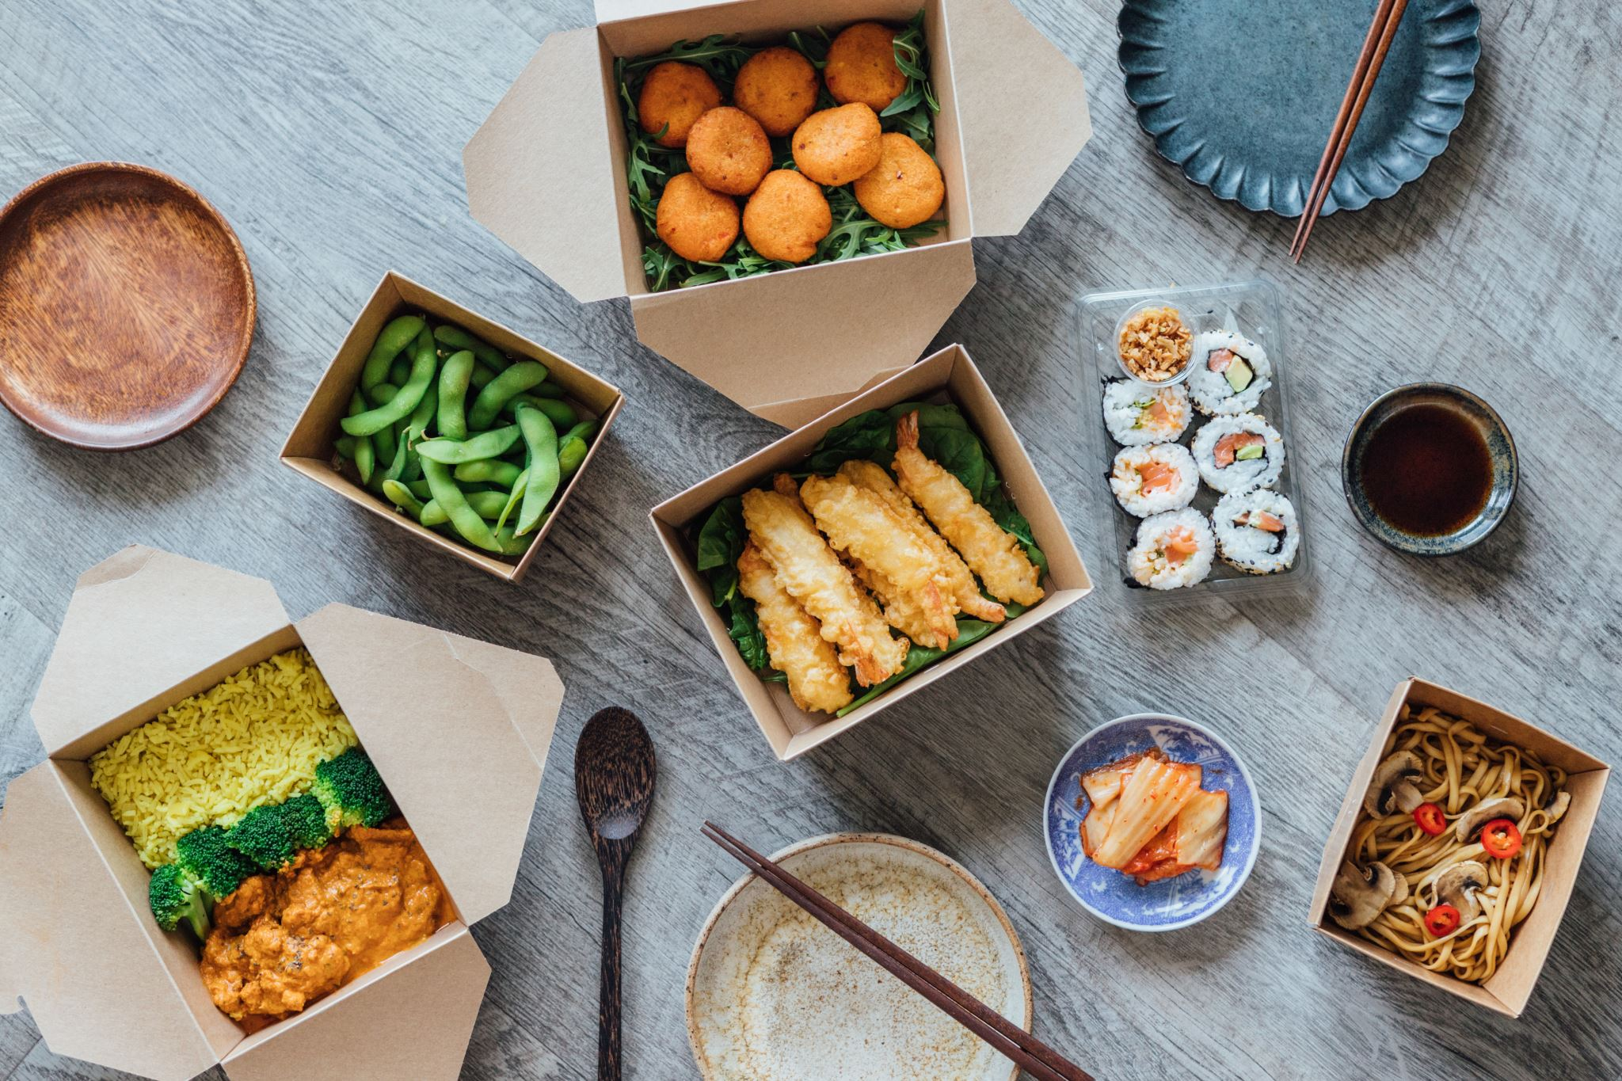
Marketing Mix (4Ps)
Product: Fresh sushi, bento boxes, Japanese drinks and desserts
Price: Competitive pricing between £6–£15 per meal
Place: Central London location with dine-in, takeaway, and delivery options
Promotion: Social media marketing (Instagram, TikTok), student discounts, and loyalty cards to retain repeat customers

Slide 9
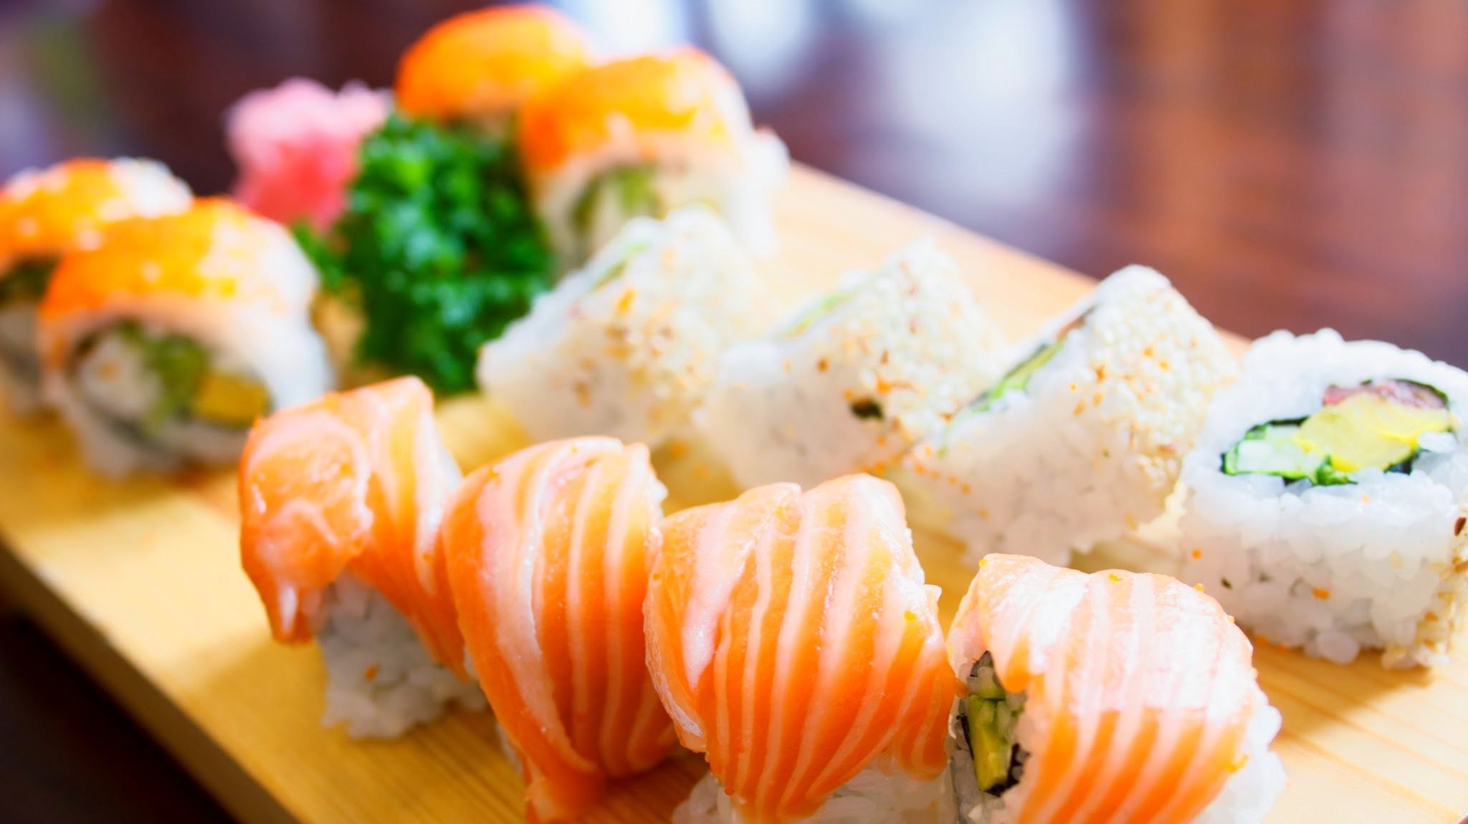
SWOT Analysis
Strengths:
Fresh, high-quality sushi
Prime Central London location
Weaknesses:
High rental and operating costs
Strong local competition
Opportunities:
Growing demand for sushi and healthy dining options
Expansion through online delivery services
Threats:
Competitors reducing prices or launching promotions
Economic downturn reducing discretionary spending

Slide 10
Startup Cost
Furniture | £8,000
Accessories/equipment | 12,400
Toiletries | 3,000
Renovation | 25,000
Total | £48,400
Fixed Costs | per month
Rent | £2,000
Bus. Rate | £500
Gas bill | £500
Two Emp Salary | £1,500
Accountant | £500
Total cost | £5,000

Slide 11
Variable Costs | JAN | FEV | MAR | APR | MAY | JUN | JUL | AUG | SEP | OUT | NOV | DEC
Electricity | 500 | 500 | 600 | 600 | 700 | 700 | 800 | 800 | 900 | 900 | 1,000 | 1,000
Raw materials | 2,000 | 2,200 | 2,400 | 2,600 | 2,800 | 3,000 | 3,200 | 3,400 | 3,600 | 3,800 | 4,000 | 4,200
hourly paid Emp | 1,500 | 1,600 | 1,700 | 1,800 | 1.900 | 2,000 | 2,100 | 2,200 | 2,300 | 2,400 | 2,500 | 2,700
Total Var cost | 4,000 | 4,300 | 4,700 | 5,000 | 5,400 | 5,700 | 6,100 | 6,400 | 6,800 | 7,100 | 7,500 | 7,900

Slide 12
 | Jan | Feb | Mar | Apr | May | Jun | Jul | Aug | Sep | Out | Nov | Dec
Fixed | £5,000 | £5,000 | £5,000 | £5,000 | £5,000 | £5,000 | £5,000 | £5,000 | £5,000 | £5,000 | £5,000 | £5,000
Variable cost | £4,000 | £4,300 | £4,700 | £5,000 | £5,400 | £5,700 | £6,100 | £6,400 | £6,800 | £7,100 | £7,500 | £7,900
Total cost | £9,000 | £9,300 | £9,700 | £10,000 | £10,400 | £10,700 | £11,100 | £11,400 | £11,800 | £12,100 | £12,500 | £12,900
Revenue | £6,000 | £7,000 | £8,000 | £9,000 | £10,000 | £11,000 | £12,000 | £13,000 | £14,000 | £15,000 | £16,000 | £18,000
Profit/loss | -£3,000 | -£2,300 | -£1,700 | -£1000 | -£400 | £300 | £900 | £1,600 | £2,200 | £2,900 | £3,500 | £5,100
Investment capital needed =40,000 + 3,000 + 2,300 + 1,700 + 1,000+400= 48,400

Slide 13

Questions?

