Slide 1
LCBB4004
Marketing Fundamentals
Week 5
Strategy

Slide 2
Corporate Strategy
What business(es) is the company in?
What business(es) should the company be in?
What amount of total resources should the company devote to each business to achieve its overall goals and objectives?

Slide 3
Business-Level Strategy
What distinctive competencies can give the business unit a competitive advantage?
Which of these competencies best matches the needs and wants of the customers in the business target segment(s)?

Slide 4
Marketing Strategy
What target market(s) exist for each product?
How can the marketing mix elements best be tailored to the needs and wants of potential customers in each target market?

Slide 5
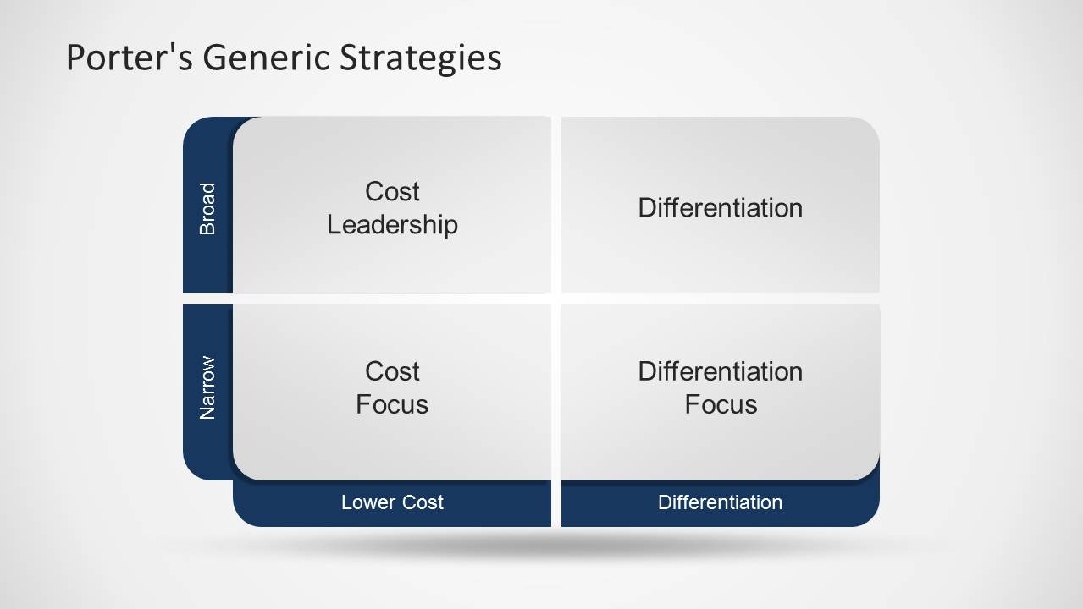
Porters Generic Strategy Model

Slide 6
Cost Leadership
Following this strategy means that the company aims to produce in large quantities, at the lowest cost possible and sell at lower prices.
By doing this they can capitalise on economies of scale and defeat any competitor who has not got equal production capacity, or who can keep prices to a minimum

Slide 7
Differentiation
This strategy involves offering some unique selling (service) proposition (USP) that the competition do not have.

Slide 8
Focus
The company aims at very select market sectors and will be charging higher prices or lower prices.

Slide 9
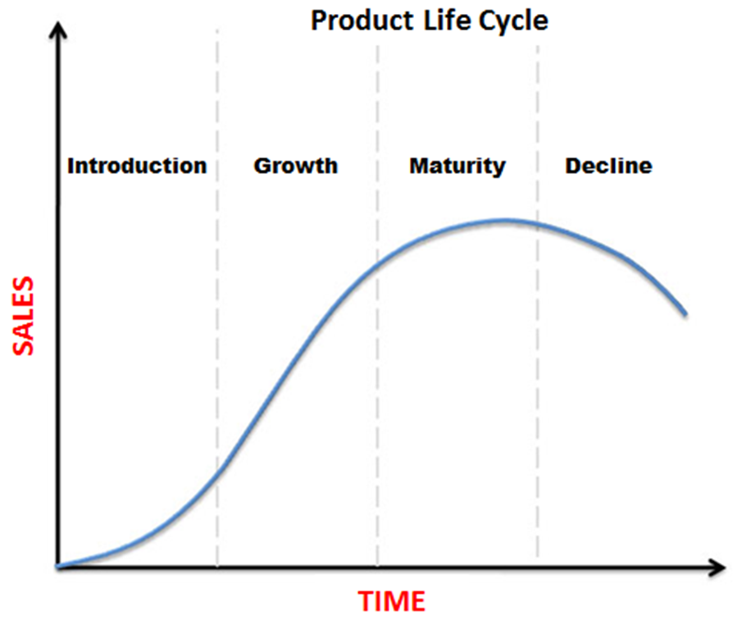
Product Life Cycle Model

Slide 10
Strategies for Pioneers in the Introduction stage of the PLC
Mass market penetration strategy
Niche penetration strategy
Skimming and early withdrawal strategy

Slide 11
Defence strategies for Pioneers in the Growth stage of the PLC
Fortress or position defence strategy
Flanker strategy
Confrontation strategy

Slide 12
Defence strategies for Pioneers in the Growth stage of the PLC
Market Expansion Strategy

Slide 13
Attack strategies for Followers in the Growth stage of the PLC
Frontal Attack Strategy
Leapfrog Strategy
Flank Attack
Encirclement strategy

Slide 14
Strategies in the Maturity stage of the PLC
Increased penetration strategy
Extended Use Strategy
Global market expansion strategy

Slide 15
Strategies in the Decline stage of the PLC
Harvesting Strategy
Niche Strategy

Slide 16
Question
What are the advantages of being a pioneer and follower company.

