Slide 1

Exploring the factors that influence eating behaviour among postgraduate students in a public university
Zeno Leung
Feb 21, 2024

Slide 2
Contents
Introduction
Rationale
Research Objectives
Research Design
Data Analysis
Ethical Considerations
Implications
Schedule of Work
References

Slide 3

Introduction
Healthy eating behaviours are crucial for the overall well-being and academic success of postgraduate students.
However, there is a lack of comprehensive understanding regarding the factors that influence eating behaviour among this specific demographic within public university settings.
This proposal outlines a quantitative research study aimed at exploring the factors that shape eating behaviour among postgraduate students.

Slide 4
Rationale
Understanding the factors that influence eating behaviour among students is essential for addressing the unique challenges they face in maintaining their health.
Postgraduate students often experience high levels of stress, time constraints, and demanding academic schedules, which may impact their food choices and eating patterns.
Additionally, the availability of healthy food options on campus and socio-demographic factors such as age, gender, and cultural background may further influence their dietary habits.
By exploring these factors, this study seeks to provide evidence-based insights that can inform the development of targeted interventions and campus policies aimed at promoting healthier eating behaviours among postgraduate students.

Slide 5

Research Objectives
To identify dietary patterns and food choices among postgraduate students.
To investigate the influence of socio-demographic factors on eating behaviour.

Slide 6
Research Questions
Or
What are the common dietary patterns and food choices among postgraduate students?
What are the socio-demographic factors influencing on eating behaviour of postgraduate students?

Slide 7
Research Design
Methodology
Sampling, Participants & Recruitment
Cross-sectional quantitative approach
Self-administered online survey
The Diet and Behaviour Scale (DABS) (Richards et al., 2015) will be adopted to measure participants’ eating habits, while
other data including socio-demographic information, perceived stress levels, time constraints, and availability of healthy food options will also be collected
Convenience sampling
Inclusion – UWTSD postgraduate students
Exclusion – non-postgraduate students
Expected no. of responses: 150
Mass emails to be sent to all UWTSD students, screening questions will be used to locate the target group
Voluntary participation

Slide 8
Data Analysis
Descriptive statistics for understanding overall patterns of eating behaviour among students - frequencies and percentages, mean, SD, range, etc.
Inferential statistical tests for understanding factors influencing student choices – T-test, chi-square test, ANOVA, regression analysis etc.

Slide 9
Ethical considerations

Slide 10
Implications and Contributions
The findings will provide valuable insights into the factors influencing eating behaviour among postgraduate students in UWTSD;
contributing to the development of targeted interventions and policies aimed at promoting healthy eating habits and overall well-being among the target population.

Slide 11
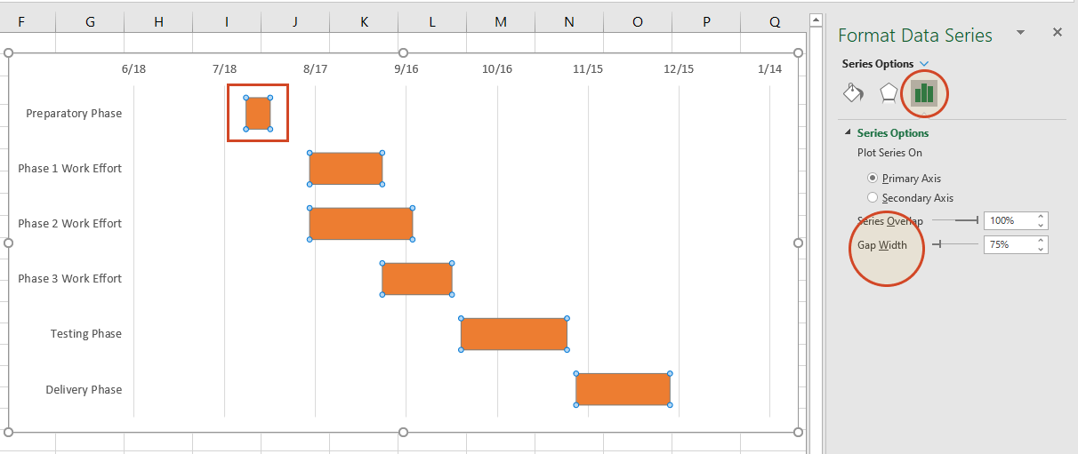
Schedule of Work

Slide 12
References

Slide 13
Please note that I have not inserted any in-text citation in my slides (except DABS in slide 7), because this proposal is just for demo purpose.
You are expected to have relevant references in sections such as Introduction, Rationale, Research Objectives, Research Design and Ethical Considerations

