Slide 1




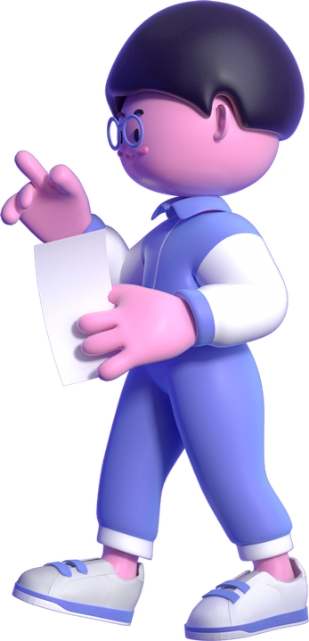


Title: Application for HR Manager Position: My Leadership Style & Development Needs
Subtitle: A Critical Analysis of Leadership Style and Development Perferences
Name: Yuze Tang
Module: Leading and Developing People
Student ID: 25000218
Date: 28st April 2026

Slide 2



2026
Presentation Structure
01 My leadership style: questionnaire results & feedback
02 Critical analysis: strengths & limitations
03 Internal & external challenges facing Havencares
04 Why my style is best suited
05 My development needs as a first-time senior appointee
06 Support I request from the organisation
07 Conclusion

Slide 3

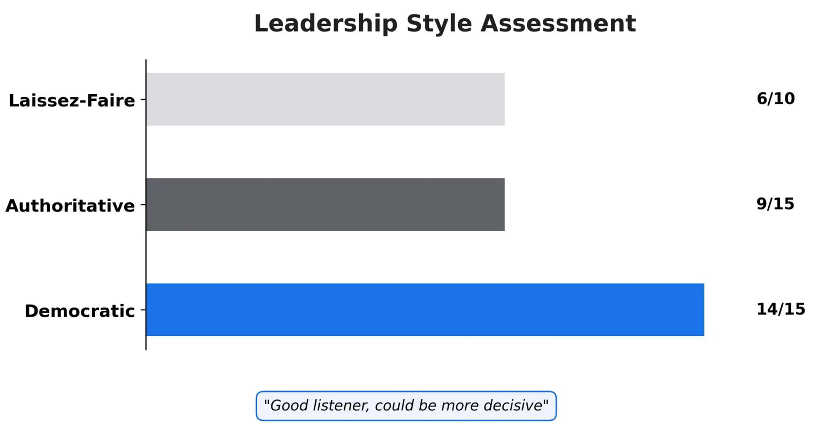
01 My Leadership Style- Questionnaire & Feedback
My Current Leadership Style Profile
Questionnaire results
Feedback from others

Slide 4

02
Critical Analysis of My Leadership Style
Strengths and Limitations of a Participative/Democratic Style
Strengths | Limitations
Increases employee engagement and commitment (Bass & Riggio, 2006) | Slower decision- making in crises (YukI, 2013)
Fosters knowledge sharing and innovation (Uhl-Bien et al., 2007) | Requires high follower maturity (Hersey & Blanchard, 1969)
Reduces turnover- especially in call centres (Gkorezis et al., 2016) | May be less efficient in highly structured environments
1. My style matches Havencares’ current need for retention and cultural change.
2. However, I need to develop situational leadership skills – shifting to a more directive style during high-pressure periods (Goleman, 2000).
My reflection:

Slide 5

03 Challenges Facing Havencares
Internal and External Challenges (Insuance Call Centre Context)
Internal Challenges
1. High employee turnover – industry average 30–45% per year (Contact BPO, 2024)
2. Low employee engagement – repetitive work leads to burnout
3. Middle leadership gap – team leaders promoted internally but lack formal training
External Challenges
1. Regulatory pressure – new FCA consumer duty standards (FCA, 2025)
2. Technological disruption – AI and automation changing claims processing (Deloitte, 2024)
3. Talent market competition – multiple call centres in South Wales competing for experienced staff

Slide 6

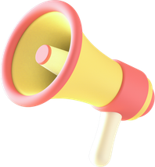


04 Why My Style is Best Stuited
How Participative Leadership Addresses Each Challenge
Challenge | How my style responds | Theoretical support
High turnover | Increases psychological ownership and retention through participative decision- making | Gkorezis et al. (2016)
Low engagement | Regular team meetings to gather input, enhancing job meaning | Bass & Riggio (2006)

Slide 7




How Participative Leadership Addresses Each Challenge
Challenge | How my style responds | Theoretical support
FCA compliance pressure | Involve frontline staff in process design- compliance with practicality | Uhl-Bien et al. (2007)
Al disruption | Democratic discussion on technology imolementation reduces resistance | Brougham & Haar (2018)
Conclusion: My style balances team stability and incremental change - ideal dor our current phase.

Slide 8



05 My Development Needs (First Senior Appointment)
From HR Officer to HR Manager - Key Growth Areas
Development atea | Specific need | Theoretical basis
Strategic thinking | Shift from operational to strategic planning | Mumford et al. (2007)
Conflict management & decisive action | Faster decision- making when needed | YukI (2013)
Financial acumen | Understand HR metrics in relation to P&L | Ulrich et al. (2017)
Change management | Lead larger- scale change projects | Kotter (2012)

Slide 9



06 How the Organisation Should Support Me
Specific Support for a First- Time Senior Appointee
Recommendation 1:
Structured mentorship
Recommendation 2:
External leadership programme
Recommendation 3:
Internal job shadowing/rotation
  Senior leader (e.g.,HR Director) as mentor- monthly 1-to-1 meetings
  Focus: Strategic decisions,
political savvy, cross-functional
influence
  e.g., CIPD Advances Leadership course
  Estimated budget 2500 pound-ROl via improved retention
  2 days per quarter in Claims, Customer Service, Sales
  Builds business credibility and frontiline understanding (Ulrich et al., 2017)
Recommendation 4:
Psychological safety and permission to make mistakes
  Clear boundaries foe failure as a new leader (Edmondson, 1999)
  Quarterly leadership reflection reviews-not linked to performance appraisal

Slide 10
07 Coclusion
Summary and Commitment
Summary
  My leadership style is participative/democratic- validated by questionnaire and feedback
  This style best addresses high turnover, low engagement, regulatory change and Al disruption
  I am aware of my development neesd and request structured support
My commitment
  Complete leadership development plan within 3 months
  Improve team ebgagement scores by 15% within 6 months (baseline: current staff survey)
  Build a sustainable talent pipeline within 12 months

Slide 11

08 References
1. Bass, B.M. and Riggio, R.E. (2006) Transformational Leadership. 2nd edn. Mahwah, NJ: Lawrence Erlbaum.
2. Brougham, D. and Haar, J. (2018) ‘Smart technology, artificial intelligence, robotics, and algorithms (STARA): Employees’ perceptions of our future workplace’, Journal of Management & Organization, 24(2), pp. 239-257.
3. CIPD (2024) Leadership Development: A Guide for HR Professionals. London: Chartered Institute of Personnel and Development.
4. Contact BPO (2024) UK Contact Centre Turnover Report 2024. Cardiff: Contact BPO Research.
5. Deloitte (2024) Insurance Industry Outlook 2025. London: Deloitte Insights.
6. Edmondson, A. (1999) ‘Psychological safety and learning behavior in work teams’, Administrative Science Quarterly, 44(2), pp. 350-383.
7. FCA (2025) Consumer Duty – Final Rules for Insurance Firms. London: Financial Conduct Authority.
8. Gkorezis, P., Petridou, E. and Kroustali, P. (2016) ‘The effect of participative leadership on employee turnover intentions’, Leadership & Organization Development Journal, 37(8), pp. 1107-1124.
9. Goleman, D. (2000) ‘Leadership that gets results’, Harvard Business Review, 78(2), pp. 78-90.

Slide 12
References
10. Hersey, P. and Blanchard, K.H. (1969) ‘Life cycle theory of leadership’, Training & Development Journal, 23(5), pp. 26-34.
11. Kotter, J.P. (2012) Leading Change. Boston, MA: Harvard Business Review Press.
12. Mumford, M.D. et al. (2007) ‘Leadership skills for a changing world’, The Leadership Quarterly, 18(1), pp. 19-35.
13. Northouse, P.G. (2021) Leadership: Theory and Practice. 9th edn. London: Sage.
14. Uhl-Bien, M., Marion, R. and McKelvey, B. (2007) ‘Complexity leadership theory’, The Leadership Quarterly, 18(4), pp. 298-318.
15. Ulrich, D., Kryscynski, D. and Brockbank, W. (2017) Competencies for HR Professionals. Ann Arbor, MI: Ross School of Business.
16. Yukl, G. (2013) Leadership in Organizations. 8th edn. Boston, MA: Pearson.

Slide 13
Thanks For Your Watching ！
Reporter: Yuze Tang

