Slide 1
Electrical Engineering
(ACDA5001)
Lecture - 5

Slide 2
Content
Pure Resistive circuit
Pure Inductive Circuit
Pure Capacitive Circuit
RL Series Circuit
RC series Circuit
RLC series Circuit

Slide 3
Learning Outcome
The student upon completion of the lecture will be able to:
Demonstrate the ability to design circuits using Resistor, capacitor and inductor

Slide 4
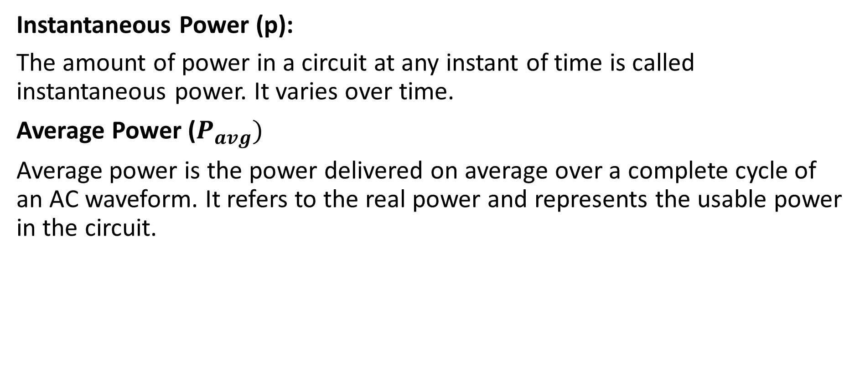
Single Phase AC Circuits
Instantaneous Power (p):
The amount of power in a circuit at any instant of time is called instantaneous power. It varies over time.
Average Power ($P_{avg})$
Average power is the power delivered on average over a complete cycle of an AC waveform. It refers to the real power and represents the usable power in the circuit.

Slide 5
Single Phase AC Circuits
Impedance (Z)
Impedance is the total opposition that a circuit offers to the flow of alternating current (AC). It includes both resistance (R) and reactance (X)
Reactance (X)
Reactance is the opposition of change of flow of current within a circuit
Reactance accounts for the opposition to AC due to inductance and capacitance.

Slide 6
Single Phase AC Circuits
Three Parameters in AC circuits are
Resistance
Inductance
Capacitance

Slide 7
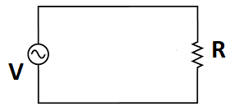
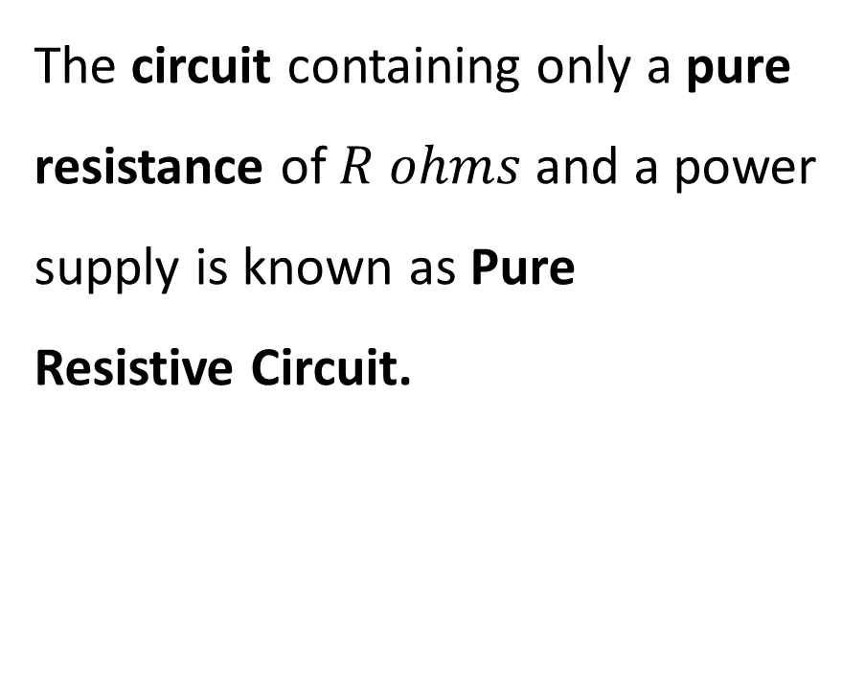
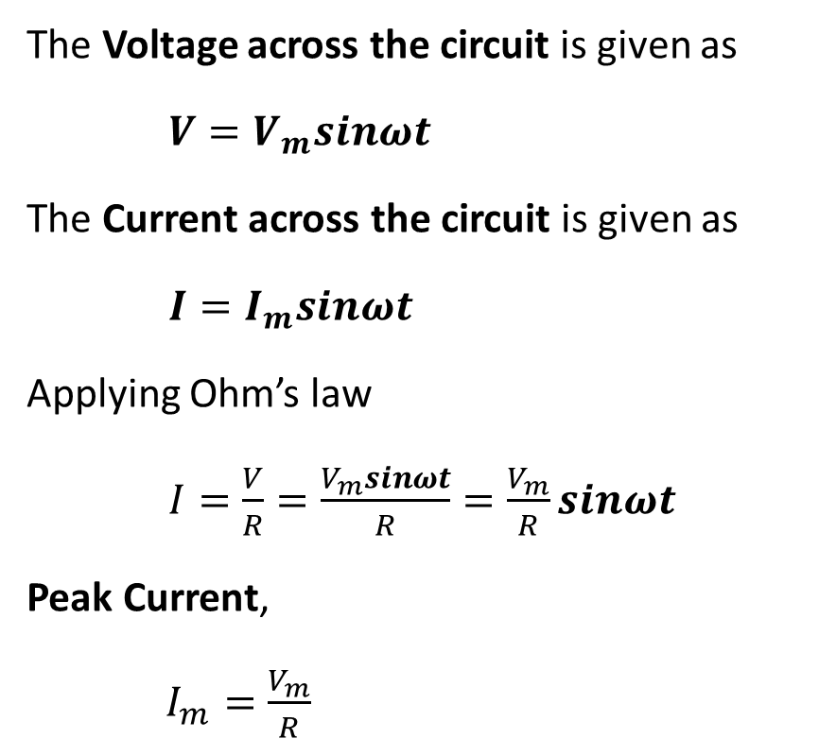
Pure Resistive circuit
The Voltage across the circuit is given as
$V=V_{m}sinωt$
The Current across the circuit is given as
$I=I_{m}sinωt$
Applying Ohm’s law
$I=\frac{V}{R}=\frac{V_{m}sinωt}{R}=\frac{V_{m}}{R}sinωt$
Peak Current,
$I_{m}=\frac{V_{m}}{R}$
The circuit containing only a pure resistance of $R ohms$and a power supply is known as Pure Resistive Circuit.

Slide 8
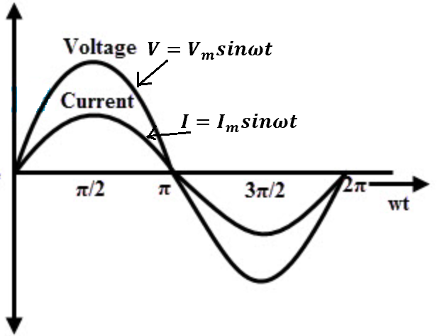
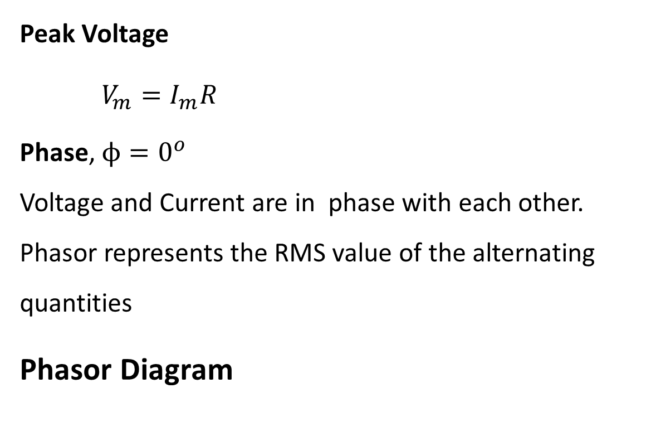
Pure Resistive circuit
Peak Voltage
$V_{m}=I_{m}R$
Phase, $ϕ=0^{o}$
Voltage and Current are in phase with each other. Phasor represents the RMS value of the alternating quantities
Phasor Diagram
Waveform
I
V

Slide 9
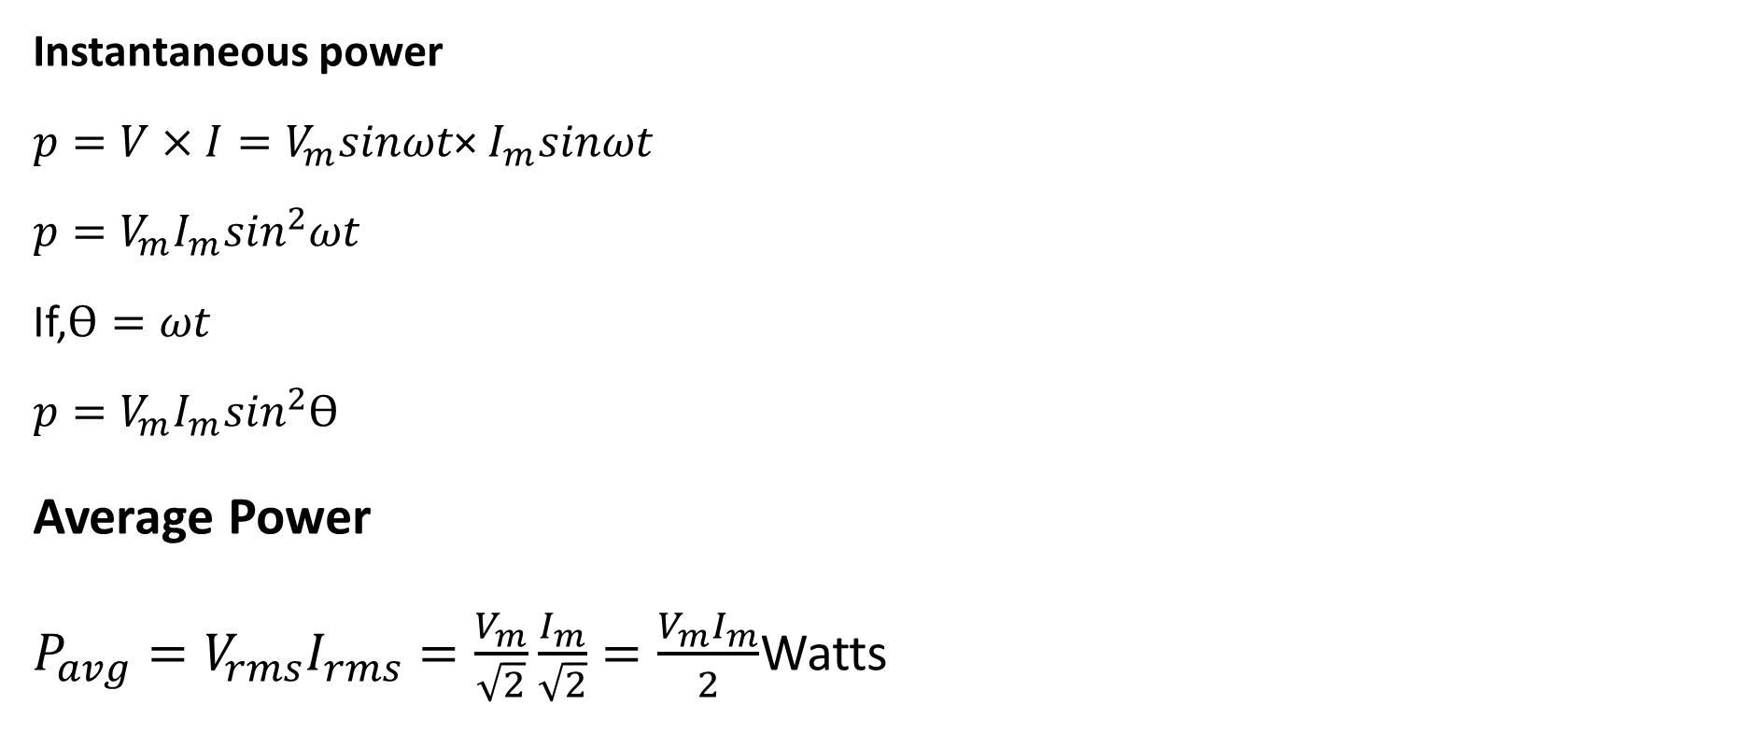
Pure Resistive circuit
Instantaneous power
${p=V×I=V}_{m}sinωt$× $I_{m}sinωt$
${p=V}_{m}I_{m}\sin^{2}ωt$
If,$\text{ϴ}=ωt$
${p=V}_{m}I_{m}\sin^{2}\text{ϴ}$
Average Power
$P_{avg}=V_{rms}I_{rms}=\frac{V_{m}}{\sqrt{2}}\frac{I_{m}}{\sqrt{2}}=\frac{V_{m}I_{m}}{2}$Watts

Slide 10
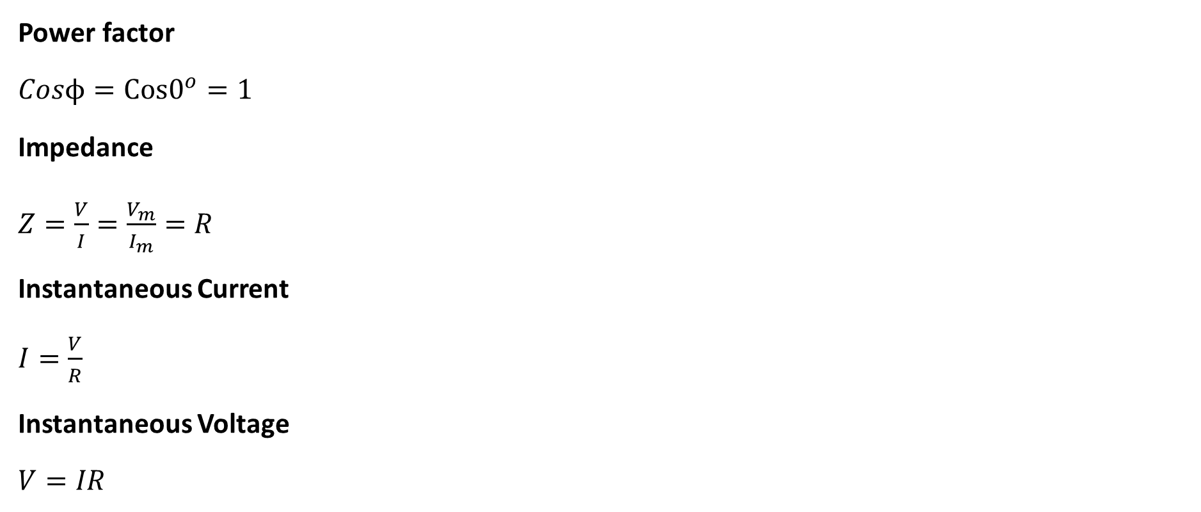
Pure Resistive circuit
Power factor
$Cosϕ=Cos0^{o}=1$
Impedance
$Z=\frac{V}{I}=\frac{V_{m}}{I_{m}}=R$
Instantaneous Current
$I=\frac{V}{R}$
Instantaneous Voltage
$V=IR$

Slide 11
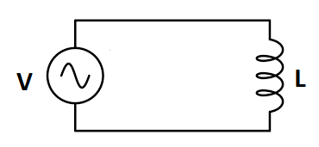
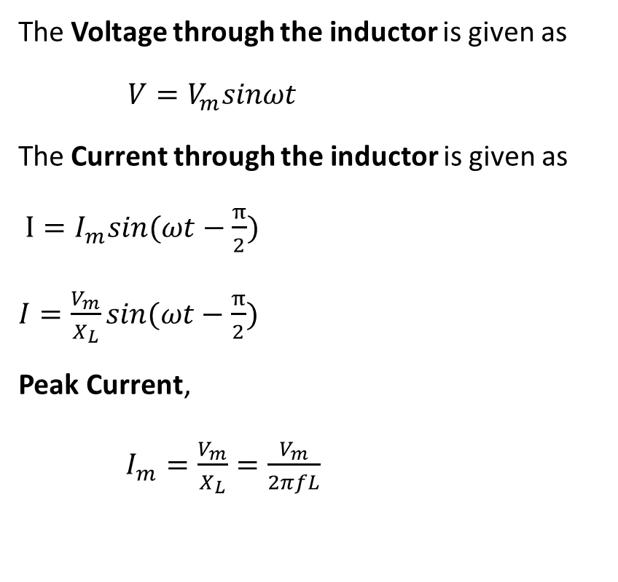
Pure Inductance circuit
The circuit containing only a pure Inductance of L Henry and a power supply is known as Pure Inductive Circuit.
The Voltage through the inductor is given as
$V=V_{m}sinωt$
The Current through the inductor is given as
$I=I_{m}sin(ωt−\frac{π}{2})$
$I=\frac{V_{m}}{X_{L}}sin(ωt−\frac{π}{2})$
Peak Current,
$I_{m}=\frac{V_{m}}{X_{L}}=\frac{V_{m}}{2πfL}$

Slide 12
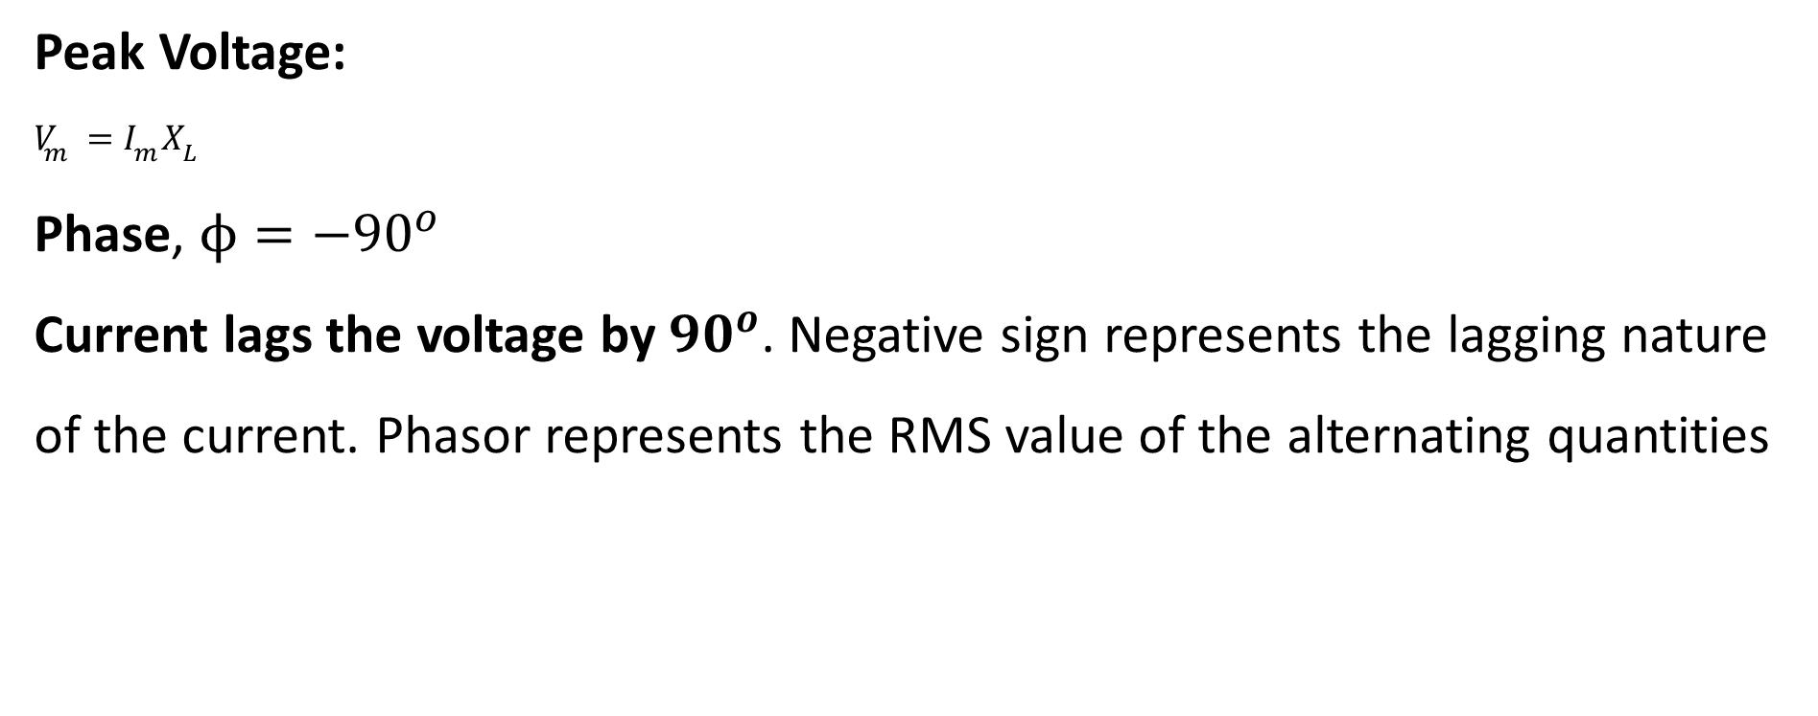
Pure Inductance circuit
Peak Voltage:
$V_{m}=I_{m}X_{L}$
Phase, $ϕ={−90}^{o}$
Current lags the voltage by ${90}^{o}$. Negative sign represents the lagging nature of the current. Phasor represents the RMS value of the alternating quantities

Slide 13
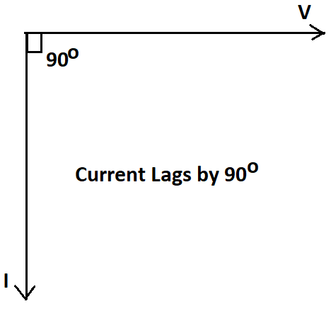
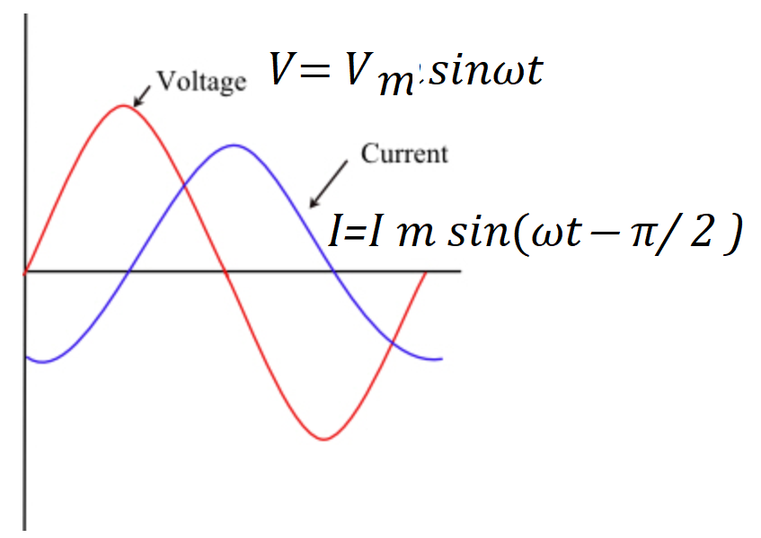
Pure Inductance circuit
Phasor Diagram
Waveform

Slide 14
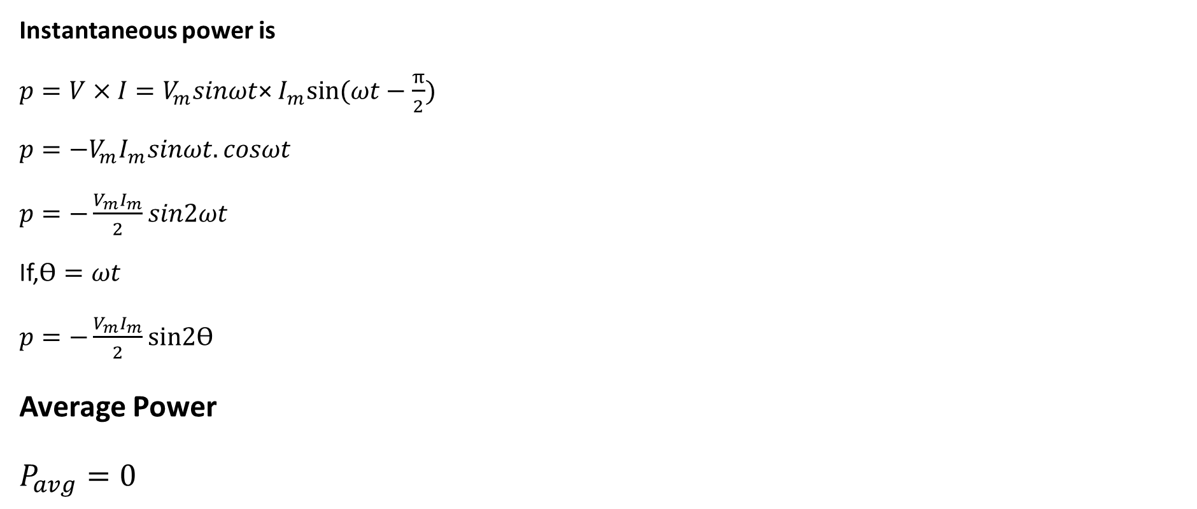
Pure Inductance circuit
Instantaneous power is
${p=V×I=V}_{m}sinωt$× $I_{m}sin⁡(ωt−\frac{π}{2})$
${p=−V}_{m}I_{m}sinωt.cosωt$
$p=−\frac{V_{m}I_{m}}{2}sin2ωt$
If,$\text{ϴ}=ωt$
$p=−\frac{V_{m}I_{m}}{2}\text{sin}\text{2}\text{ϴ}$
Average Power
$P_{avg}=0$

Slide 15
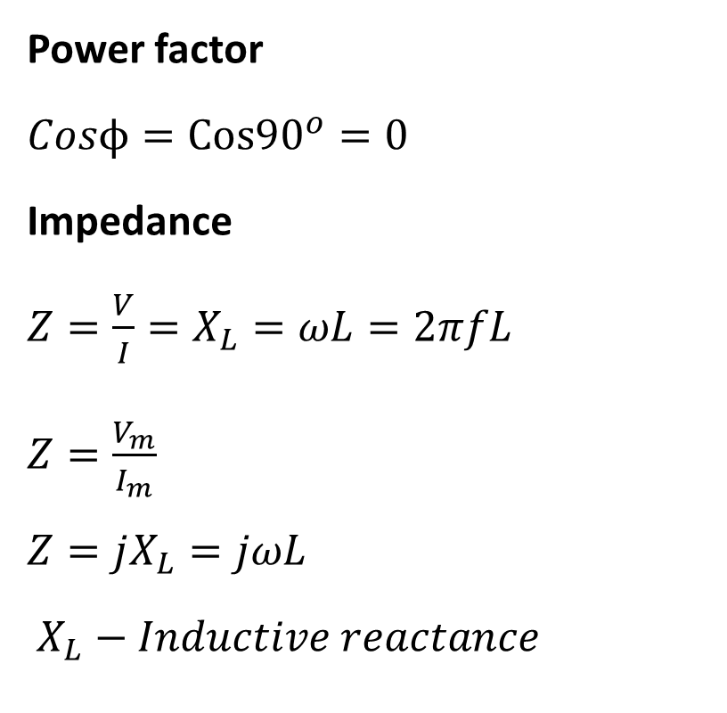
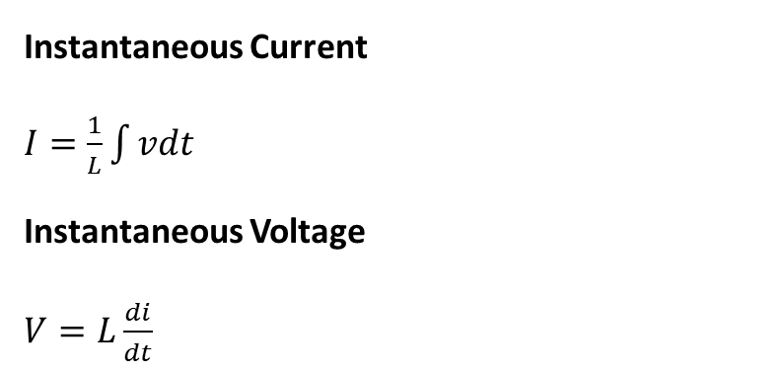
Pure Inductance circuit
Power factor
$Cosϕ=Cos{90}^{o}=0$
Impedance
$Z=\frac{V}{I}=X_{L}=ωL=2πfL$
$Z=\frac{V_{m}}{I_{m}}$
$Z=jX_{L}=jωL$
$X_{L}−Inductive reactance$
Instantaneous Current
$I=\frac{1}{L}\int{vdt}$
Instantaneous Voltage
$V=L\frac{di}{dt}$

Slide 16
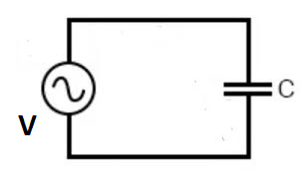
Pure Capacitance circuit
The circuit containing only a pure Capacitance of C Farad and a power supply is known as Pure Capacitive Circuit.

Slide 17
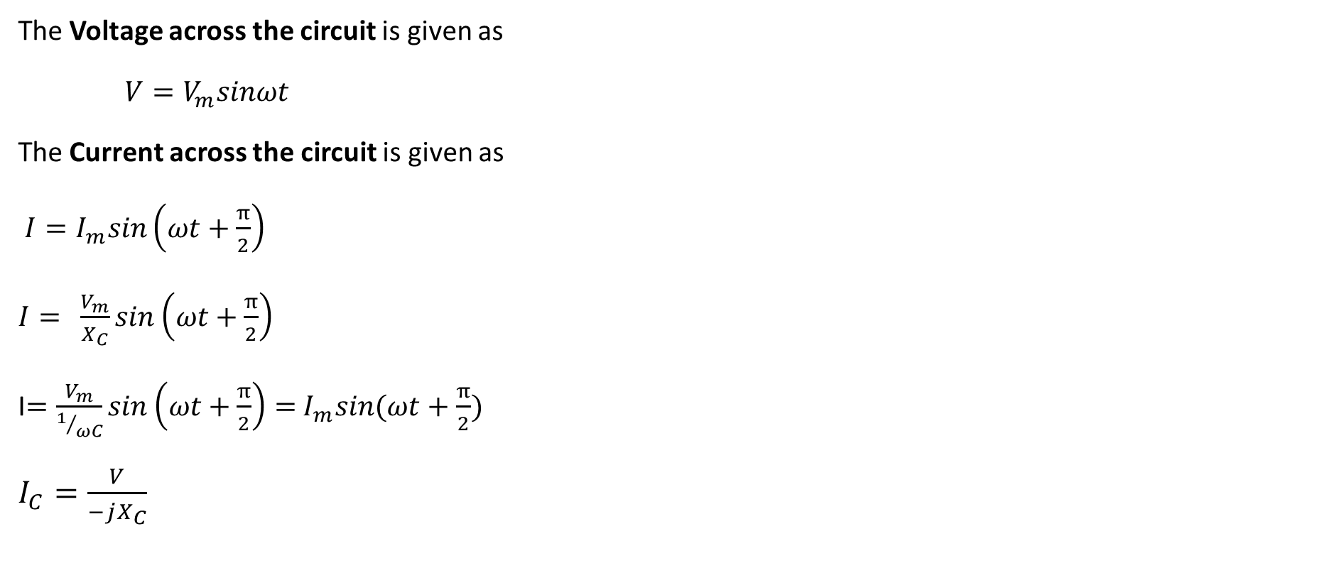
Pure Capacitance circuit
The Voltage across the circuit is given as
$V=V_{m}sinωt$
The Current across the circuit is given as
$I=I_{m}sin\left(ωt+\frac{π}{2}\right)$
$I= \frac{V_{m}}{X_{C}}sin\left(ωt+\frac{π}{2}\right)$
I$=\frac{V_{m}}{1/{ωC}}sin\left(ωt+\frac{π}{2}\right)=$ $I_{m}sin(ωt+\frac{π}{2})$
$I_{C}=\frac{V}{−jX_{C}}$

Slide 18
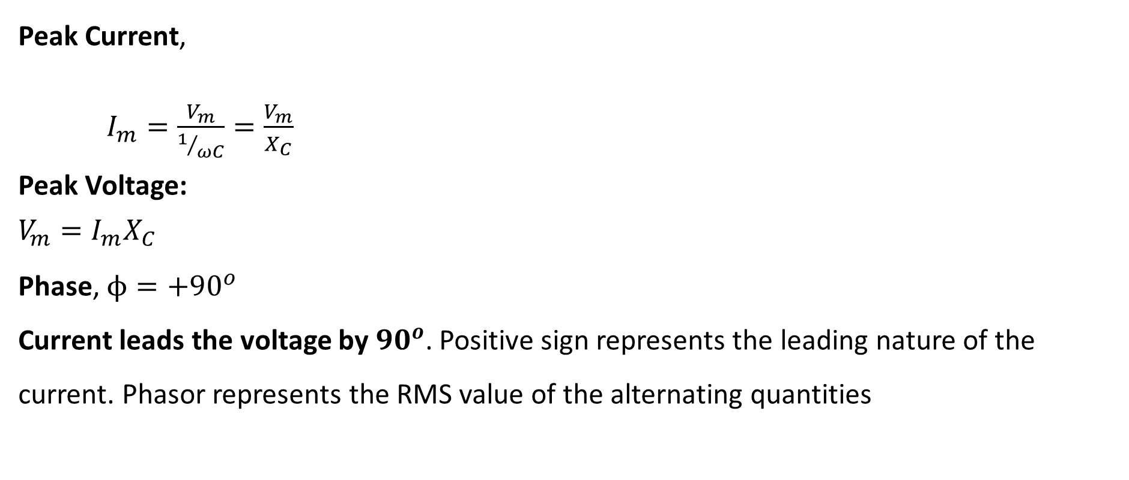
Pure Capacitance circuit
Peak Current,
$I_{m}=\frac{V_{m}}{1/{ωC}}=\frac{V_{m}}{X_{C}}$
Peak Voltage:
$V_{m}=I_{m}X_{C}$
Phase, $ϕ={+90}^{o}$
Current leads the voltage by ${90}^{o}$. Positive sign represents the leading nature of the current. Phasor represents the RMS value of the alternating quantities

Slide 19
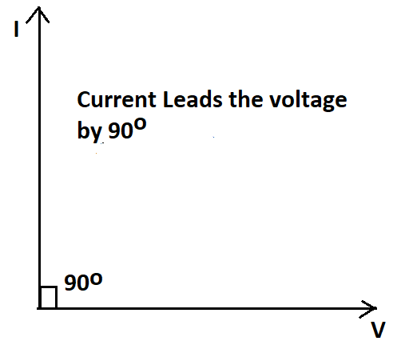
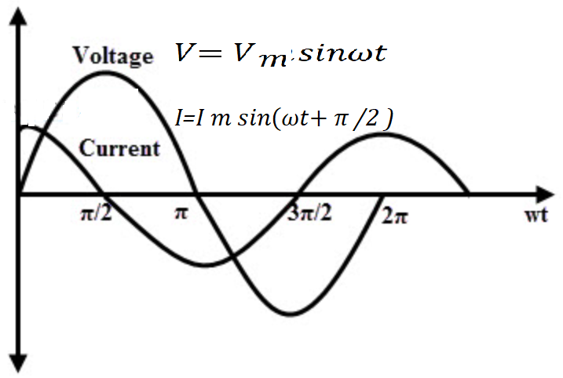
Pure Capacitance circuit
Phasor Diagram
Wave Form

Slide 20
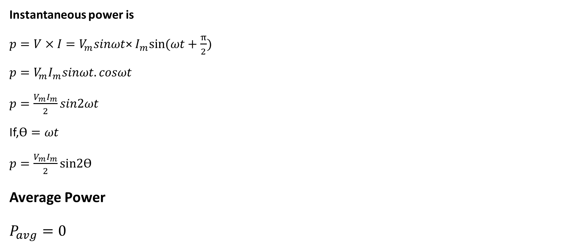
Pure Capacitance circuit
Instantaneous power is
${p=V×I=V}_{m}sinωt$× $I_{m}sin⁡(ωt+\frac{π}{2})$
${p=V}_{m}I_{m}sinωt.cosωt$
$p=\frac{V_{m}I_{m}}{2}sin2ωt$
If,$\text{ϴ}=ωt$
$p=\frac{V_{m}I_{m}}{2}\text{sin}\text{2}\text{ϴ}$
Average Power
$P_{avg}=0$

Slide 21
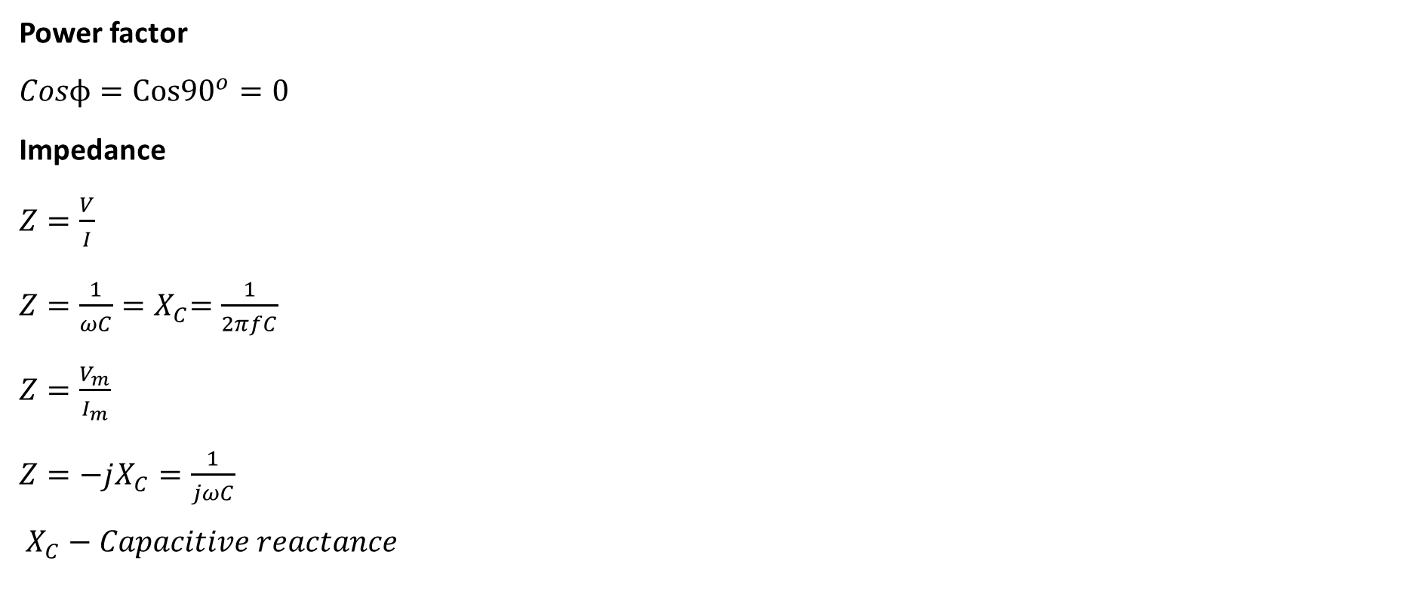
Pure Capacitance circuit
Power factor
$Cosϕ=Cos{90}^{o}=0$
Impedance
$Z=\frac{V}{I}$
$Z=\frac{1}{ωC}{=X}_{C}=\frac{1}{2πfC}$
$Z=\frac{V_{m}}{I_{m}}$
$Z=−jX_{C}=\frac{1}{jωC}$
$X_{C}−Capacitive reactance$

Slide 22
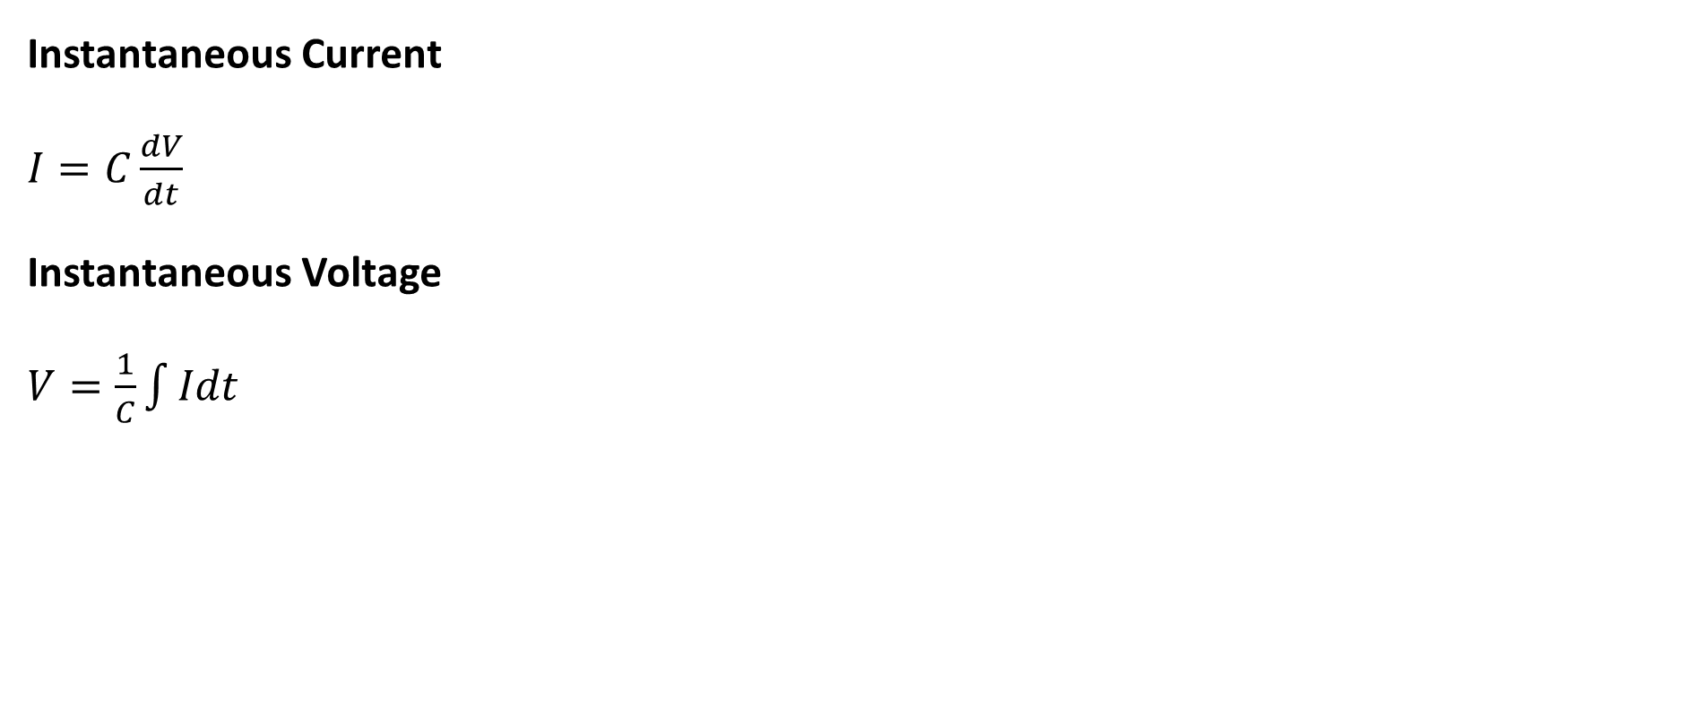
Pure Capacitance circuit
Instantaneous Current
$I=C\frac{dV}{dt}$
Instantaneous Voltage
$V=\frac{1}{C}\int{Idt}$

Slide 23
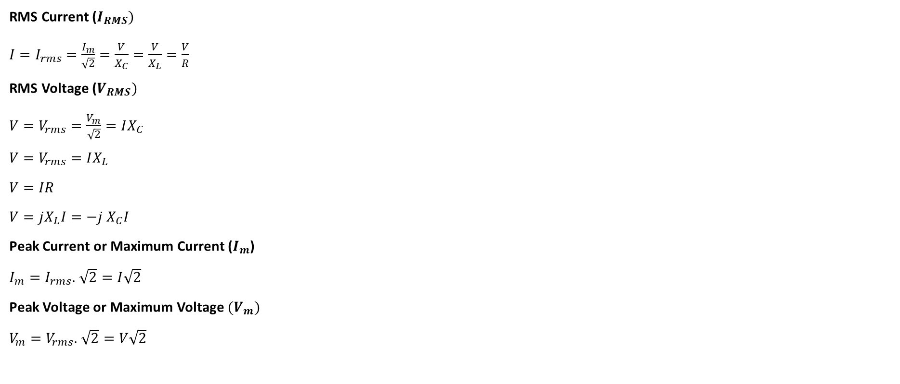
AC circuits
RMS Current ($I_{RMS})$
$I=I_{rms}=\frac{I_{m}}{\sqrt{2}}=\frac{V}{X_{C}}=\frac{V}{X_{L}}=\frac{V}{R}$
RMS Voltage ($V_{RMS})$
$V=V_{rms}=\frac{V_{m}}{\sqrt{2}}=IX_{C}$
$V=V_{rms}=IX_{L}$
$V=IR$
$V=jX_{L}I=−j$ $X_{C}I$
Peak Current or Maximum Current ($I_{m}$)
$I_{m}=I_{rms}$. $\sqrt{2}=I\sqrt{2}$
Peak Voltage or Maximum Voltage ${(V}_{m})$
$V_{m}=V_{rms}$. $\sqrt{2}=V\sqrt{2}$

Slide 24
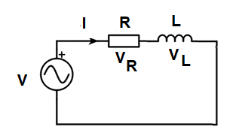
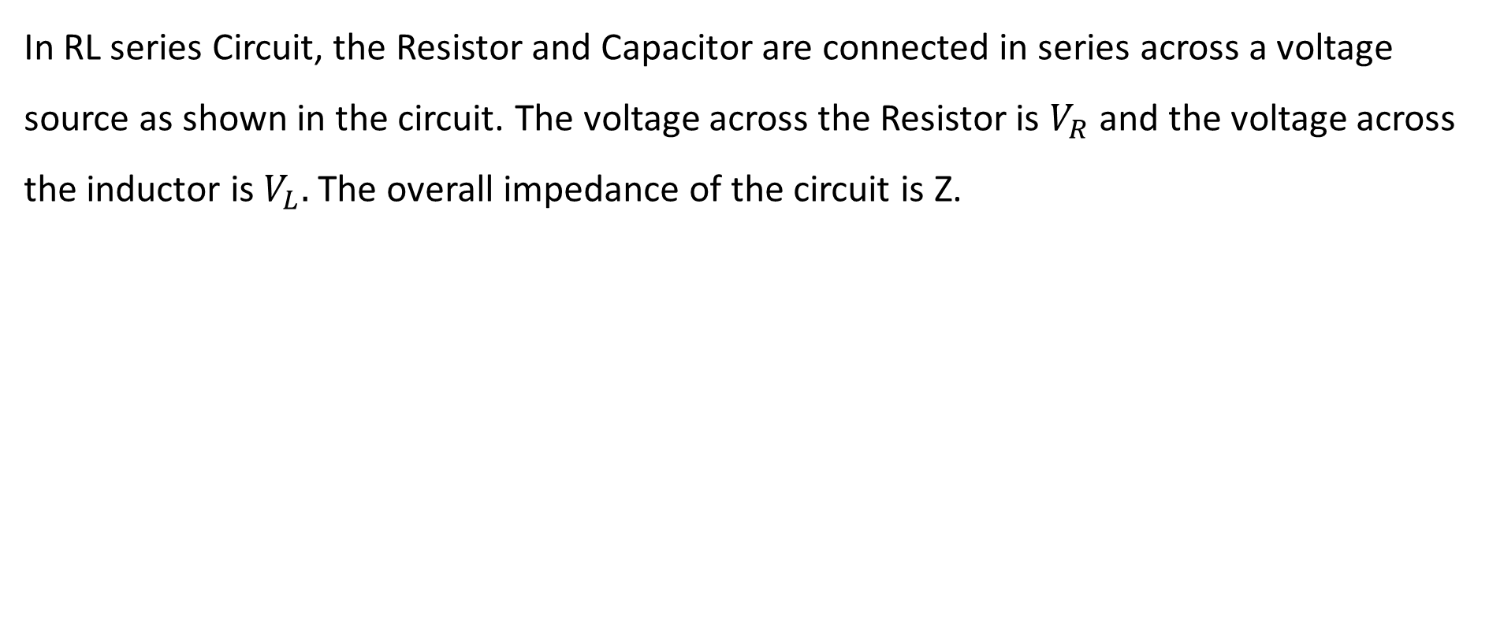
RL series circuits
In RL series Circuit, the Resistor and Capacitor are connected in series across a voltage source as shown in the circuit. The voltage across the Resistor is $V_{R}$ and the voltage across the inductor is $V_{L}.$ The overall impedance of the circuit is Z.

Slide 25
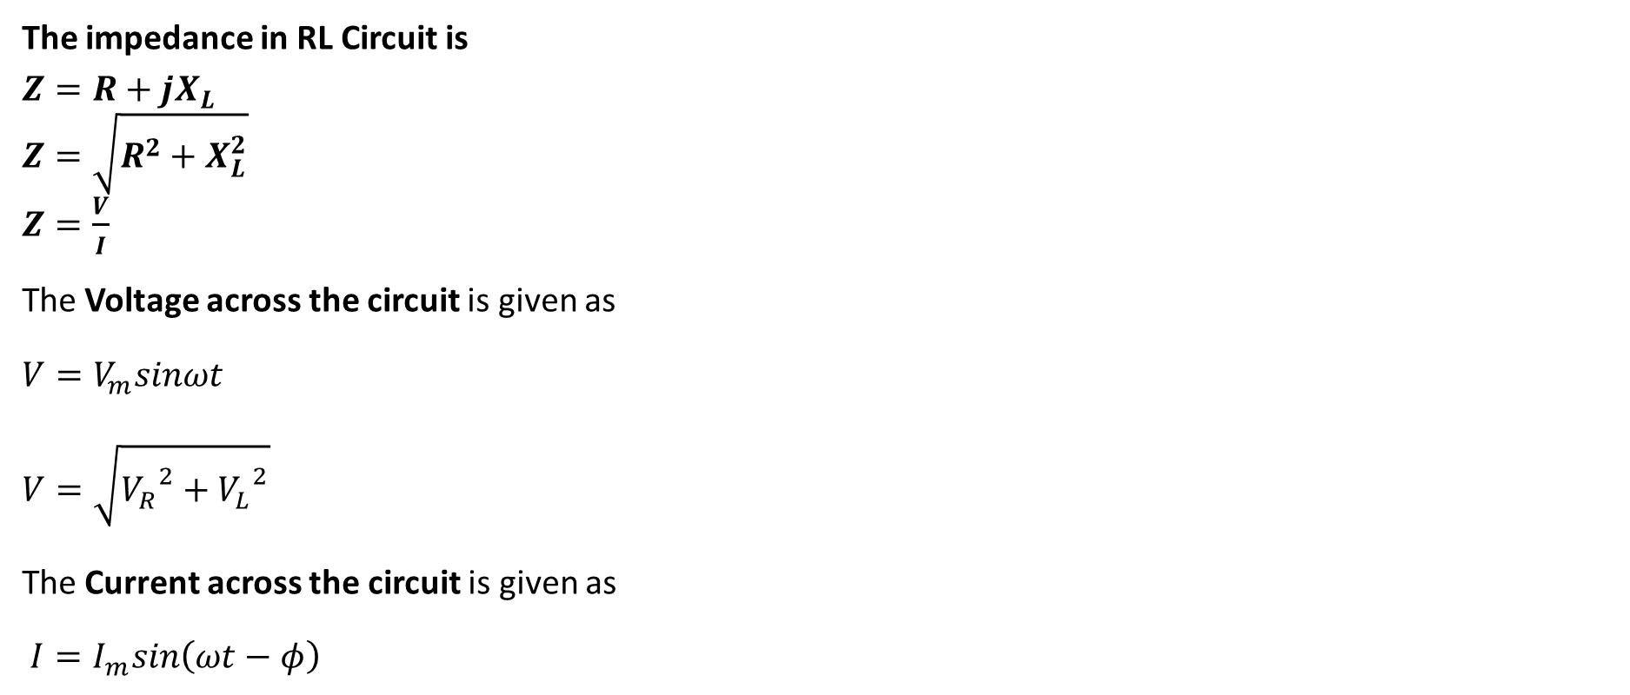
RL series circuits
The impedance in RL Circuit is
$Z=R+jX_{L}$
$Z=\sqrt{R^{2}+X_{L}^{2}}$
$Z=\frac{V}{I}$
The Voltage across the circuit is given as
$V=V_{m}sinωt$
$V=\sqrt{{V_{R}}^{2}+{V_{L}}^{2}}$
The Current across the circuit is given as
$I=I_{m}sin\left(ωt−φ\right)$

Slide 26
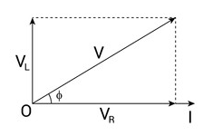
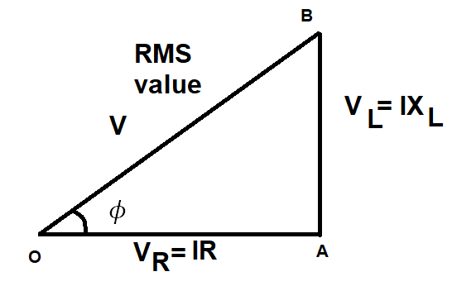
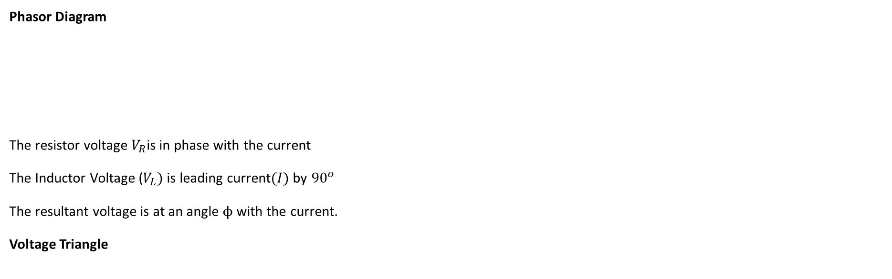
RL series circuits
Phasor Diagram
The resistor voltage $V_{R}$is in phase with the current
The Inductor Voltage ($V_{L})$is leading current$(I)$by ${90}^{o}$
The resultant voltage is at an angle $ϕ$ with the current.
Voltage Triangle

Slide 27
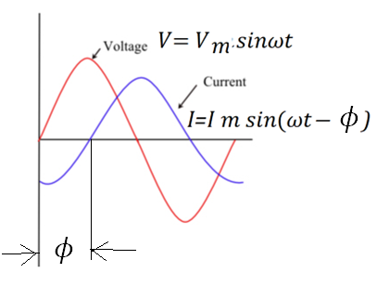
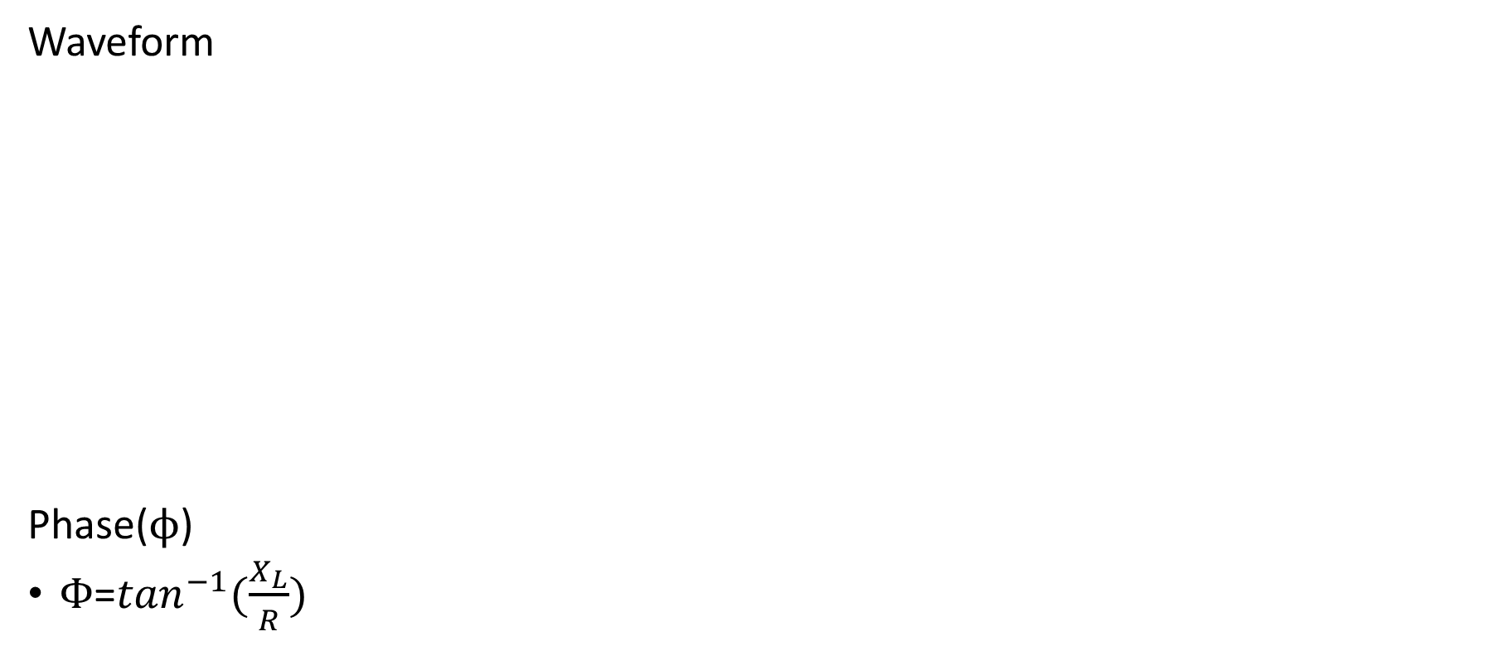
RL series circuits
Waveform
Phase($ϕ$)
$Φ$=$\tan^{−1}(\frac{X_{L}}{R})$

Slide 28
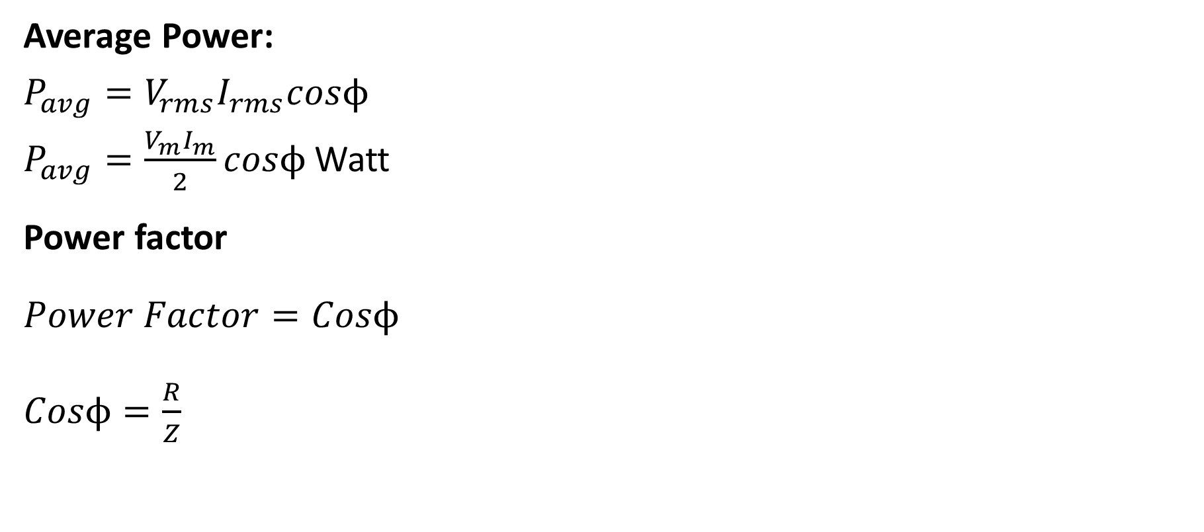
RL series circuits
Average Power:
$P_{avg}=V_{rms}I_{rms}cosϕ$
$P_{avg}=\frac{V_{m}I_{m}}{2}cosϕ$ Watt
Power factor
$Power Factor=Cosϕ$
$Cosϕ=\frac{R}{Z}$

Slide 29
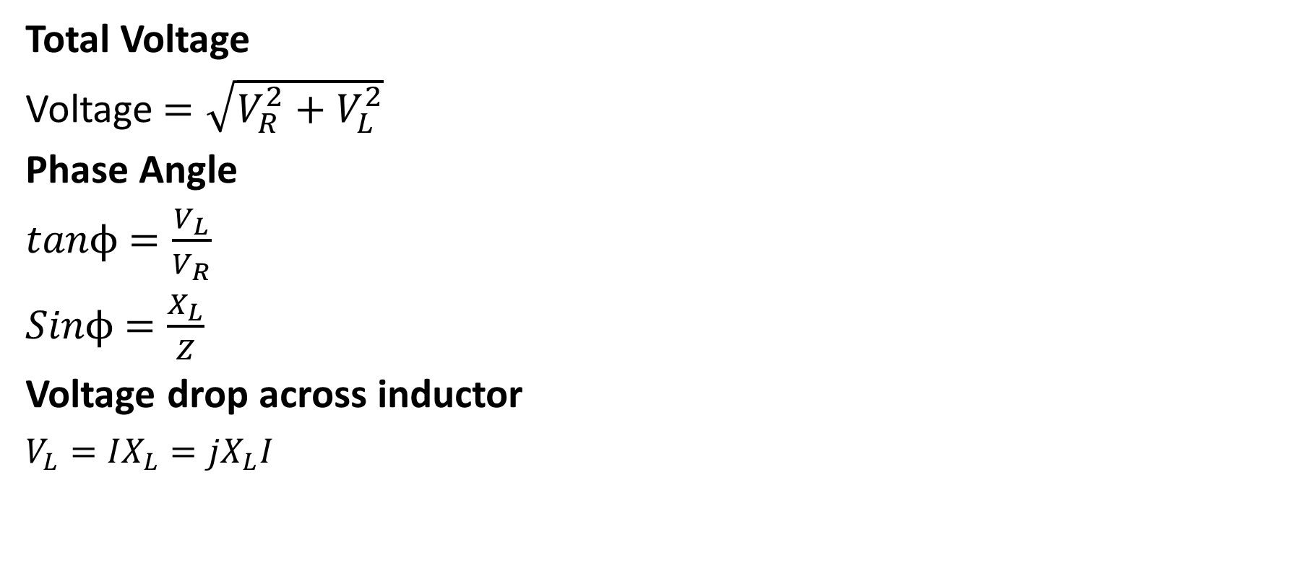
RL series circuits
Total Voltage
Voltage $=\sqrt{V_{R}^{2}+V_{L}^{2}}$
Phase Angle
$tanϕ$ $=\frac{V_{L}}{V_{R}}$
$Sinϕ$ $=\frac{X_{L}}{Z}$
Voltage drop across inductor
$V_{L}=IX_{L}=jX_{L}I$

Slide 30
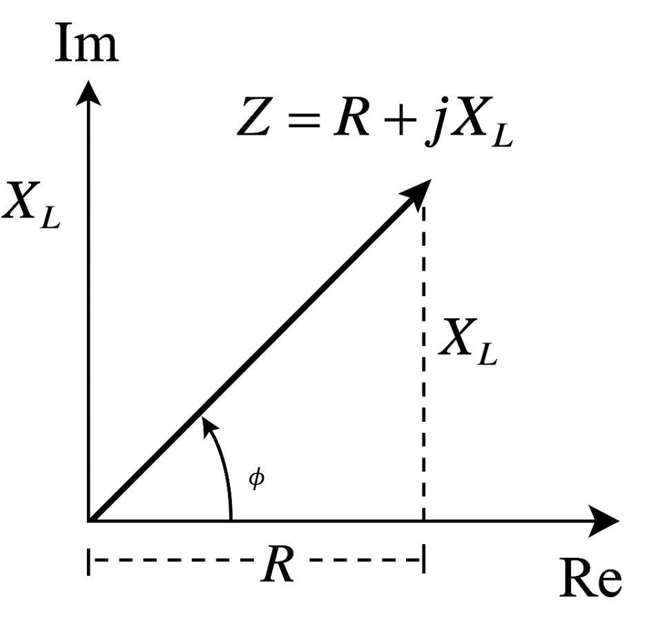
RL series circuits
Impedance plot
Real part along X axis,
Imaginary plot along Y axis
$Z=R+jX_{L}$

Slide 31
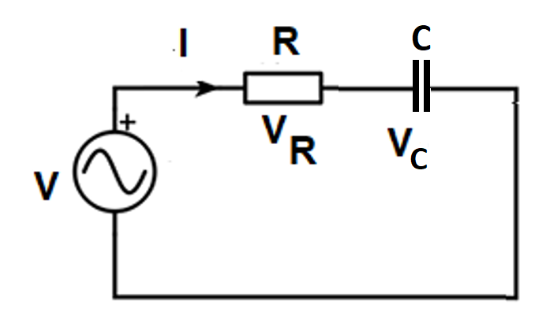
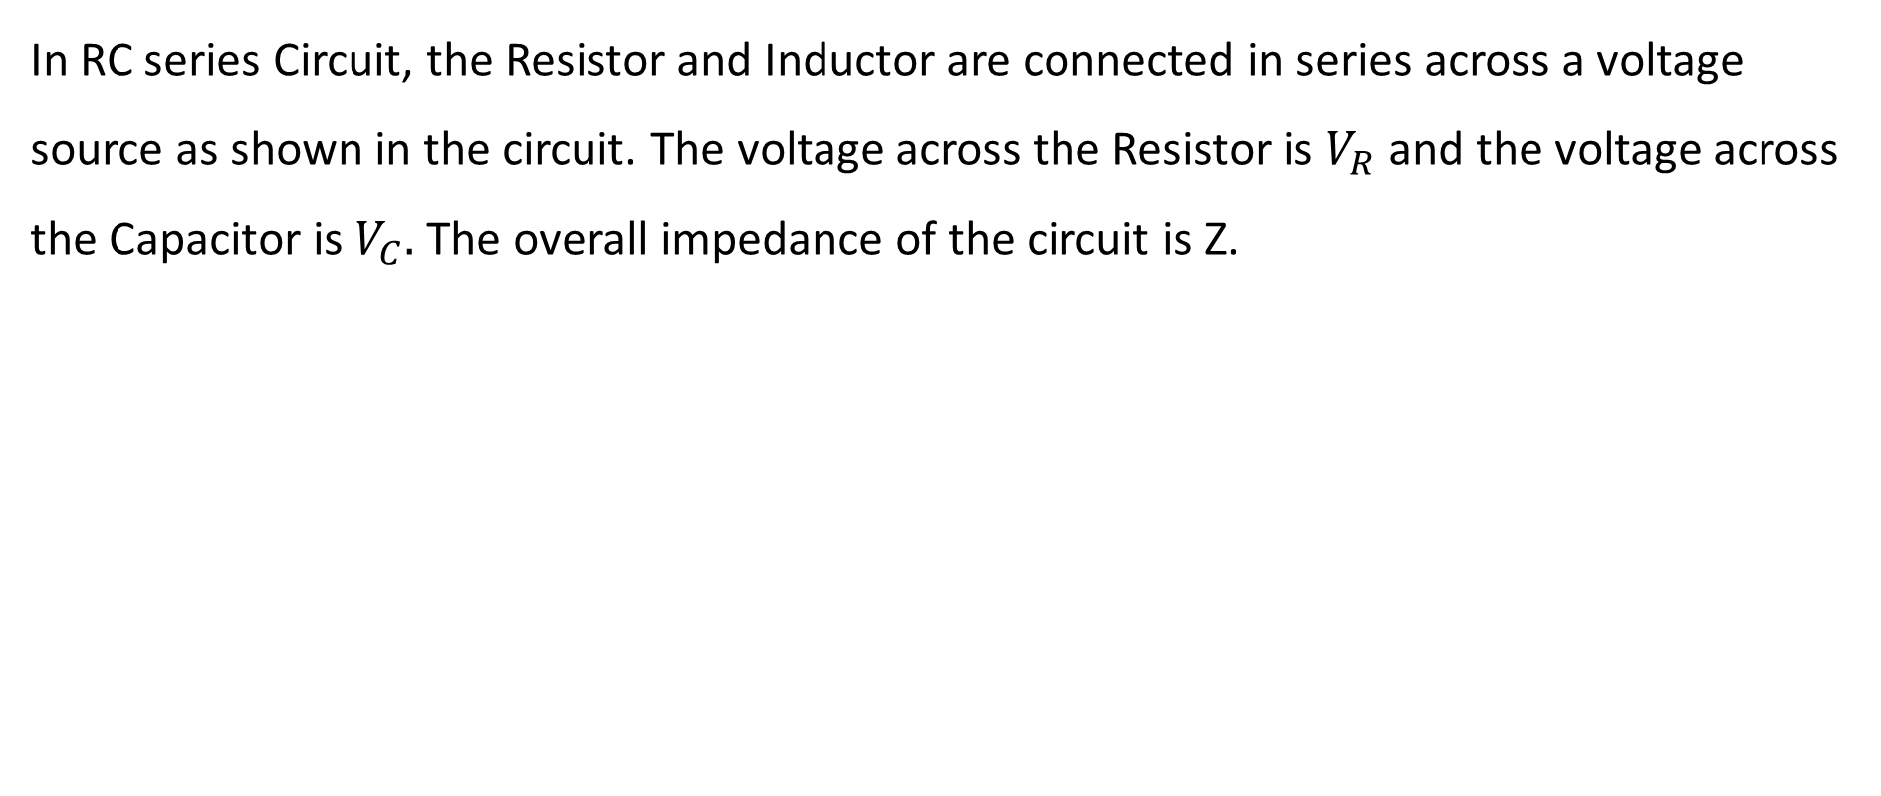
RC series circuits
In RC series Circuit, the Resistor and Inductor are connected in series across a voltage source as shown in the circuit. The voltage across the Resistor is $V_{R}$ and the voltage across the Capacitor is $V_{C}.$ The overall impedance of the circuit is Z.

Slide 32
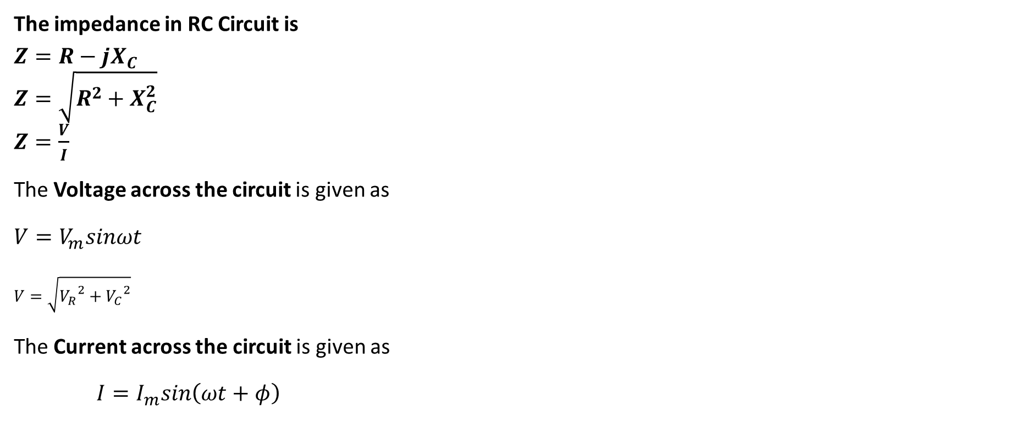
RC series circuits
The impedance in RC Circuit is
$Z=R−jX_{C}$
$Z=\sqrt{R^{2}+X_{C}^{2}}$
$Z=\frac{V}{I}$
The Voltage across the circuit is given as
$V=V_{m}sinωt$
$V=\sqrt{{V_{R}}^{2}+{V_{C}}^{2}}$
The Current across the circuit is given as
$I=I_{m}sin\left(ωt+φ\right)$

Slide 33
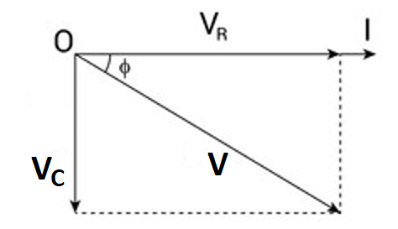
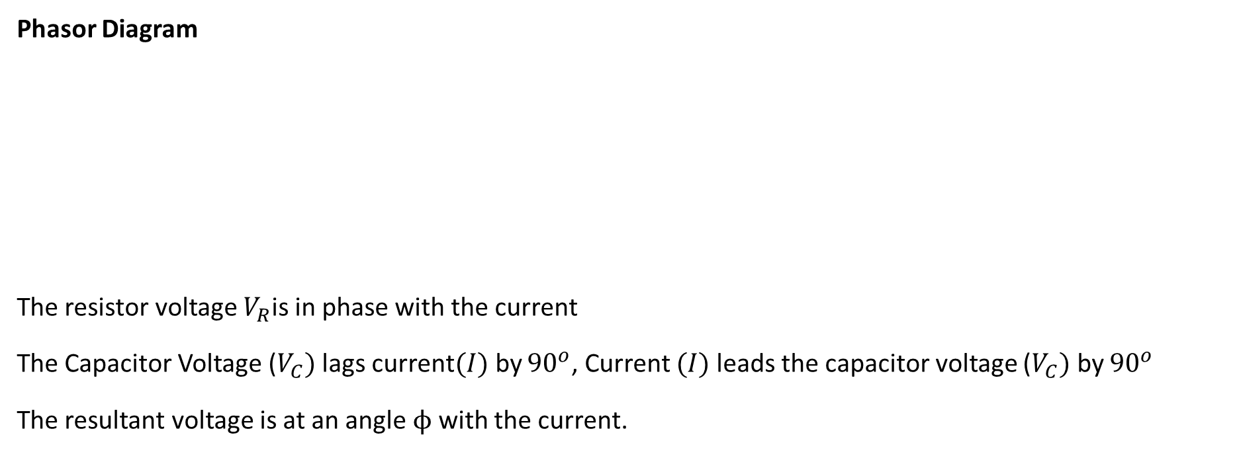
RC series circuits
Phasor Diagram
The resistor voltage $V_{R}$is in phase with the current
The Capacitor Voltage ($V_{C})$lags current$(I)$by ${90}^{o}$, Current $(I)$leads the capacitor voltage ($V_{C})$ by ${90}^{o}$
The resultant voltage is at an angle $ϕ$ with the current.

Slide 34
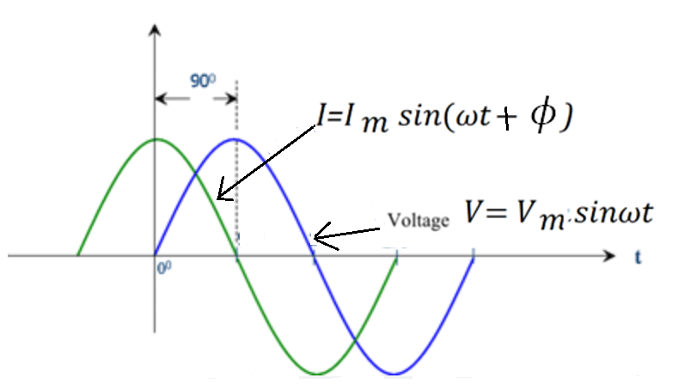
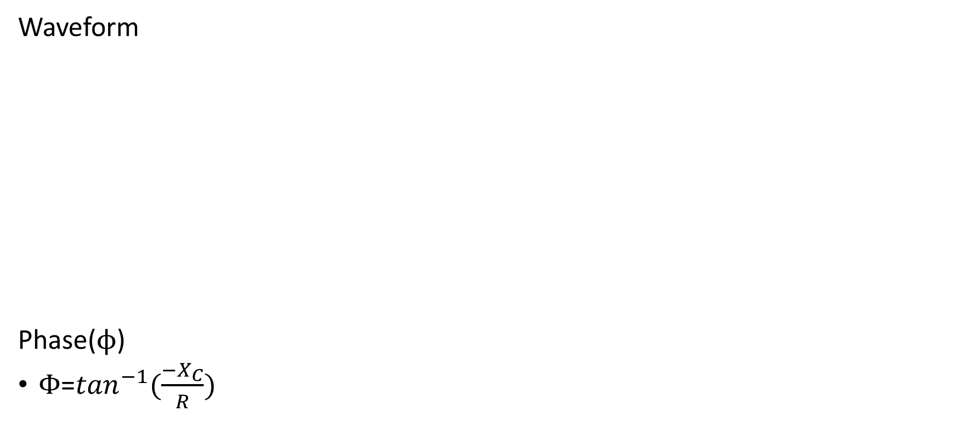
RC series circuits
Waveform
Phase($ϕ$)
$Φ$=$\tan^{−1}(\frac{{−X}_{C}}{R})$

Slide 35
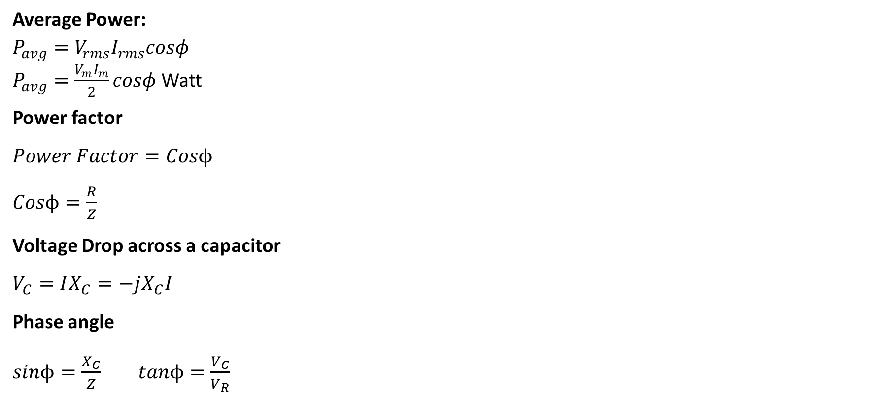
RC series circuits
Average Power:
$P_{avg}=V_{rms}I_{rms}cosφ$
$P_{avg}=\frac{V_{m}I_{m}}{2}cosφ$ Watt
Power factor
$Power Factor=Cosϕ$
$Cosϕ=\frac{R}{Z}$
Voltage Drop across a capacitor
$V_{C}=IX_{C}=−jX_{C}I$
Phase angle
$sinϕ=\frac{X_{C}}{Z}$ $tanϕ=\frac{V_{C}}{V_{R}}$

Slide 36
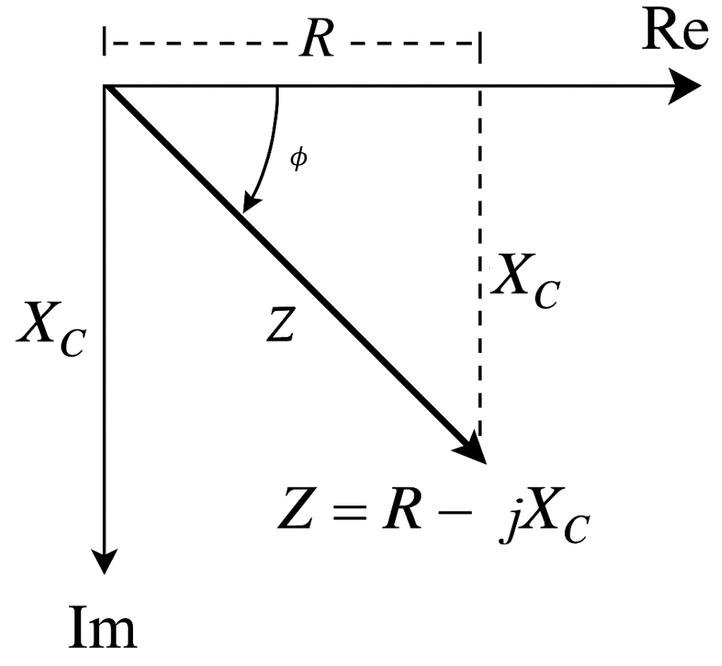
RC series circuits
Impedance plot
Real part along X axis,
Imaginary plot along Y axis
$Z=R−jX_{C}$

Slide 37
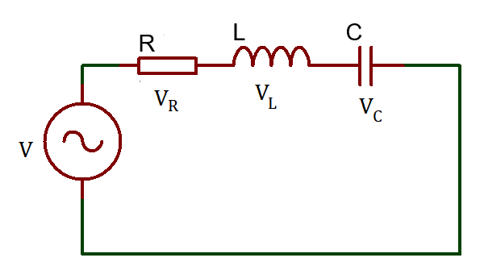
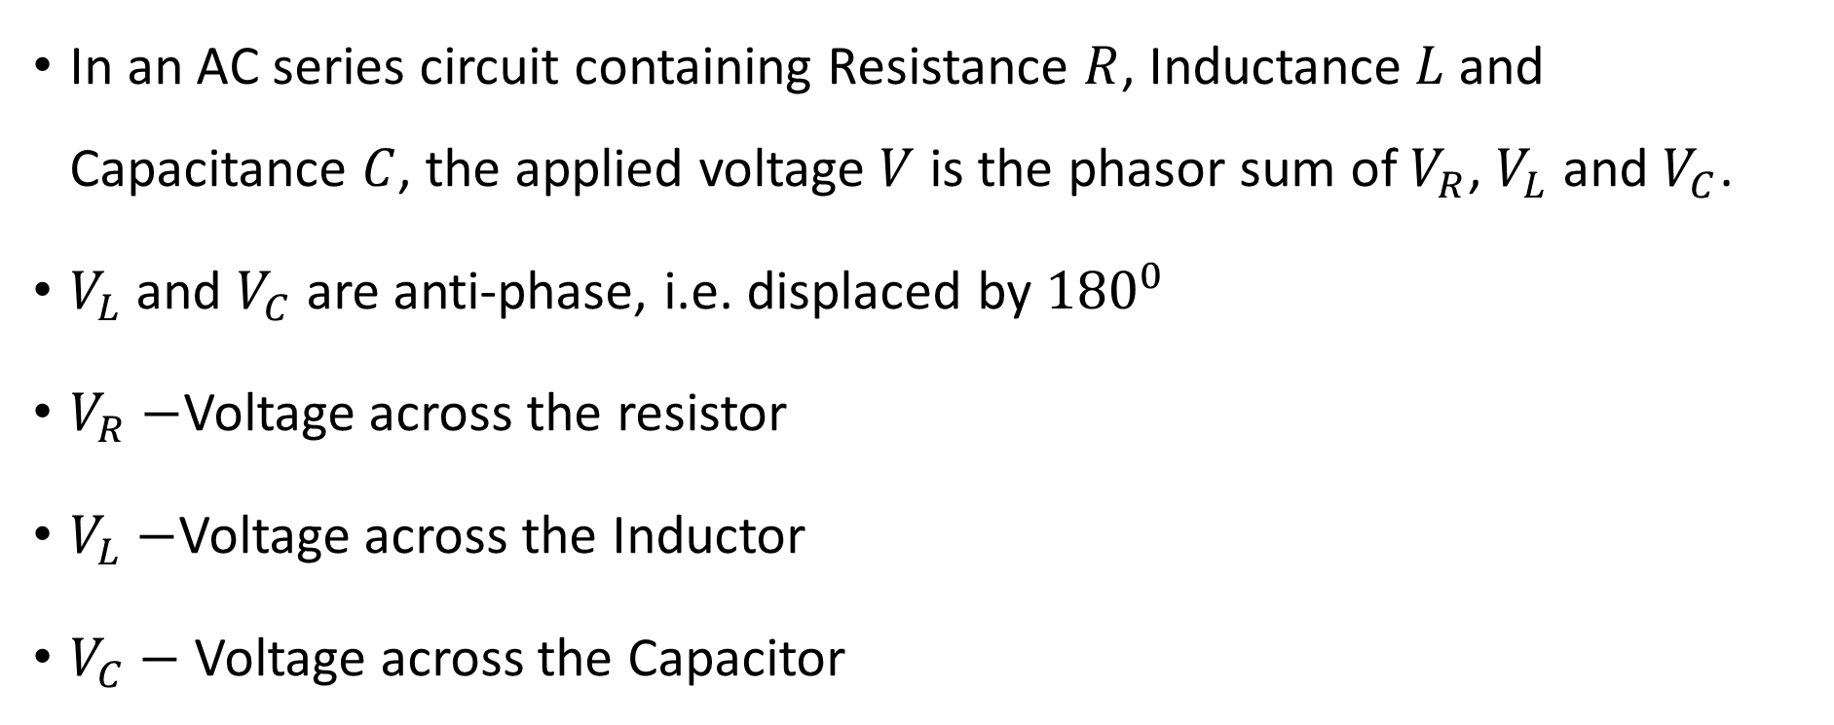
RLC Series circuit
In an AC series circuit containing Resistance $R$, Inductance$L$and Capacitance $C$, the applied voltage $V$ is the phasor sum of $V_{R}$, $V_{L}$ and $V_{C}$.
$V_{L}$ and $V_{C}$are anti-phase, i.e. displaced by ${180}^{0}$
$V_{R}−$Voltage across the resistor
$V_{L}−$Voltage across the Inductor
$V_{C}−$ Voltage across the Capacitor

Slide 38
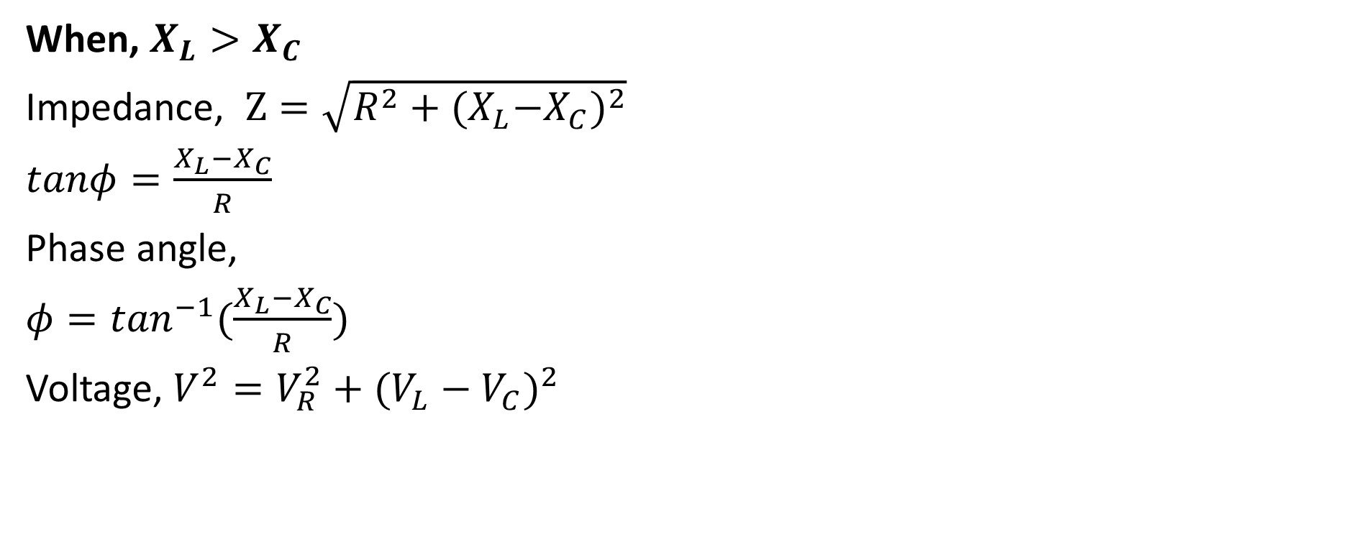
RLC Series circuit
When, $X_{L}>X_{C}$
Impedance, $Z=\sqrt{R^{2}+{{(X}_{L}−X_{C})}^{2}}$
$tanφ=\frac{X_{L}−X_{C}}{R}$
Phase angle,
$φ=\tan^{−1}(\frac{X_{L}−X_{C}}{R})$
Voltage, $V^{2}=V_{R}^{2}+{(V_{L}−V_{C})}^{2}$

Slide 39
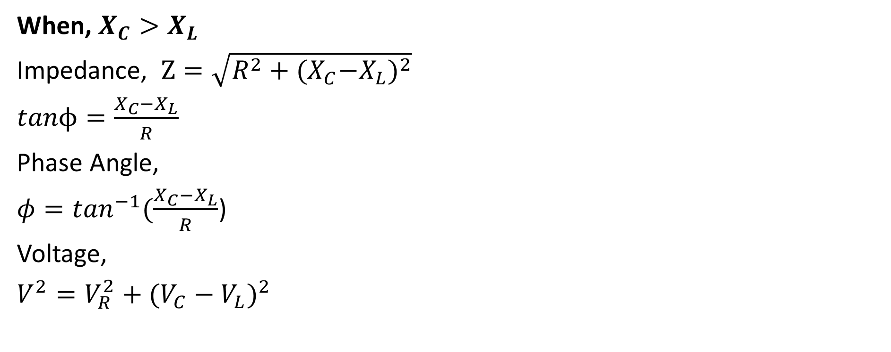
RLC Series circuit
When, $X_{C}>X_{L}$
Impedance, $Z=\sqrt{R^{2}+{{(X}_{C}−X_{L})}^{2}}$
$tanϕ=\frac{X_{C}−X_{L}}{R}$
Phase Angle,
$φ=\tan^{−1}(\frac{X_{C}−X_{L}}{R}$)
Voltage,
$V^{2}=V_{R}^{2}+{(V_{C}−V_{L})}^{2}$

Slide 40
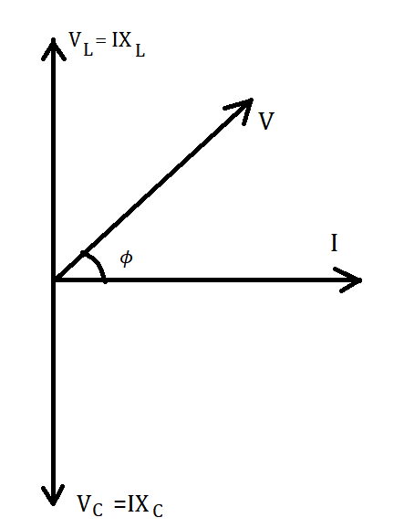

RLC Series circuit
Phasor Diagram
When, $X_{L}>X_{C}$

Slide 41


RLC Series circuit
Phasor Diagram
When, $X_{C}>X_{L}$

Slide 42


RLC Series circuit
Phasor Diagram
When, $X_{L}=X_{C}$

Slide 43

RLC Series circuit
Average Power:
$P_{avg}=V_{rms}I_{rms}cosφ$
$P_{avg}=\frac{V_{m}I_{m}}{2}cosφ$ Watt
Power factor
$Power Factor=Cosϕ$
$Cosϕ=\frac{R}{Z}$

Slide 44

RLC series circuit
When, $X_{L}=X_{C}$, the applied voltage $V$ and the current $I$ are in phase. This effect is called series resonance.
At series Resonance,
$\left|V_{L}\right|=\left|V_{C}\right|$
$V=V_{R}$
$Z=R$ (the minimum circuit impedance possible in an L–C–R circuit)
$I = V/R$(i.e. the maximum current possible in an L–C–R circuit)
$X_{L}=X_{C}$,

Slide 45


RLC series circuits
$X_{L}>$ $X_{C}$ $X_{L}<$ $X_{C}$
Impedance plot
Real part along X axis,
Imaginary plot along Y axis
$Z=R+j{(X}_{L}− X_{C})$

Slide 46
References:
[1] J. W. Nilsson and S. A. Riedel, Electric Circuits, 12th ed. Upper Saddle River, NJ: Pearson, 2019.
[2] J. Bird, Electrical Circuit Theory and Technology, 7th ed. London: Routledge, 2021.

Slide 47

Thank You

