Slide 1

Digital Skills and Research Methods
LCHS4007
Assessment 1: Group Presentation
Programme: Certificate of Higher Education in Health and Social Care
Lecturer name: Muhammad Khan
Group Member:
Muhammad Zubair Hamayo : 2514993
Katherine Montero Coello : 2512506
Nelva Rosa Garrido Soleto : 2515874
Kemisola Shadelco : 2508022
Kiran Saba : 2511429

Slide 2

Introduction
Muhammad Zubair Hamayo - 2514993
Sunrise Residential Care Home is a facility where older adults with complex problems are accommodated.
Recently, Sunrise Home Care has started to adopt digital tools and the MS 365 platform to enhance the level of efficiency, accuracy, communication and quality of care.
MS 365 is cloud based platform designed by Microsoft that offers a suite of productivity tools, including popular applications such as Word, Excel, and PowerPoint, allowing users to work and share information from anywhere, on any device
( Microsoft, 2024).
The documentation, care planning, and teamwork have been enhanced with the help of MS 365 tools. These tools increase efficiency, coordination, and workflow organisation (Cheresharov et al., 2024).

Slide 3

Microsoft Excel
Muhammad Zubair Hamayo 2514993
Microsoft Excel is a spreadsheet application introduced by Microsoft Corporation in 1985. MS Excel helps users record, organise, and calculate data by using rows and columns to arrange information. Excel includes tools such as formulas, charts, graphs, and tables to help with data analysis and decision-making.

Slide 4
Uses of MS Excel in Sunrise Residential Care Home
At Sunrise Residential Care home, MS Excel plays a valuable and practical role in elderly health and care. It helps care professionals and managers maintain and update records for every resident, including medication details, allergies, and mobility support needs. This allows staff to access accurate data quickly.
Excel also helps with staff scheduling, creating rotas that ensure enough staff members are on each shift. On top of that, it is handy for monitoring medication schedules and keeping track of stock, so nothing runs out.
From an administrative point of view, Excel is used for budgeting and tracking expenses, whether that’s food supplies, maintenance or medical equipment. Finally, the stored data can be analysed to identify patterns, such as the number of falls per month or the distribution of staff hours. This helps management make informed decisions to improve care efficiency.
Muhammad Zubair Hamayo 2514993

Slide 5
Benefits of MS Excel in Sunrise Residential Care Home
One of the most significant advantages of Excel is how much time it saves. Instead of doing everything manually, staff can use formulas and templates that automatically calculate totals or generate patient reports.
It also helps with organisation, all the vital information about residents, finances and staff can be kept in one secure spreadsheet.
Another benefit is how visual Excel can be. Charts and graphs make it easy to spot trends, such as whether incidents are increasing or whether staff hours need adjustment.
You can also build spreadsheets that perfectly match the care homes’ routines and requirements rather than trying to adapt to a one-size-fits-all system.
MS Excel reduces errors in records and reports in care homes.
Muhammad Zubair Hamayo 2514993

Slide 6
Limitations of MS Excel in Sunrise Residential Care
Excel does have some limitations; a lot of the data entry is manual, so there is always a risk of human error, for example, entering the wrong date or dosage.
It's also not ideal for collaboration; if several people are trying to edit the same spreadsheet, it can cause version conflicts or even data loss.
Another issue is data security; if spreadsheets are not properly password-protected or stored securely, there’s potential privacy risk.
Sometimes Excel large files may slow down or become difficult to keep organised.
Excel does not automatically link to other systems like electronic health record software, meaning data might need to be entered twice, which again increases the chance of errors.
MS Excel cannot complete analyses with blank cells; they must be selected manually for analysis. In addition, it required multiple steps of data transformation and formulas for survival analysis. (Clinical Spine Surgery 29(5):p 203-204, June 2016).
Muhammad Zubair Hamayo 2514993

Slide 7

Microsoft Word
The software was invented on 25 October 1983, but it was not available to the public until 1989.
The purpose of this software was to create, edit, add photos, tables, and charts, share documents, and provide facilities for spell and grammar checking. It has improved significantly over the years.
In 2014, introduced the option to collaborate and edit documents in real time.
In 2017, the read-aloud feature was introduced, allowing you to listen to your documents read aloud on your device.
In 2022, it improved its security and privacy by adding multifactor authentication to prevent any cyberattack. (Microsoft 365, 2024)
Katherine Montero Coello 2512506

Slide 8
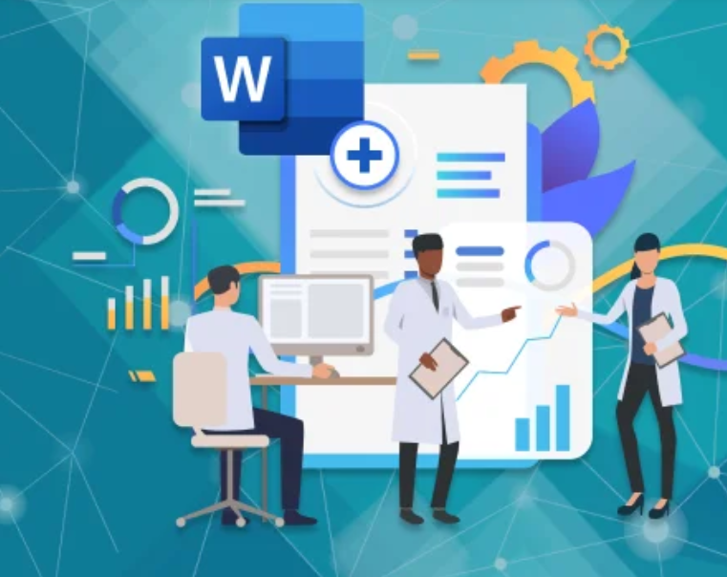
Uses of Microsoft Word in
Sunrise Residential Care Home
It will be used to generate and save documents that can be encrypted in the cloud. Sunrise residential care home will be able to share these documents with other entities and create permissions for downloading or accessing certain documents. (Team, 2018)
Clinical reports will be simplified, and the template tool will be used to optimise the reports.
Patient records will be kept organised and will be easily accessible to any professional who needs them. (iFour team, 2024)
The demand for knowledge of Microsoft Word has increased from 12% to 20%. This knowledge will help workers develop their skills by enabling them to collaborate and contribute ideas in real time on projects. (Kumar, 2022)
Katherine Montero Coello 2512506

Slide 9

Benefits | Limitations
Helps improve employees' grammatical writing and Vocabulary. | Spelling corrections are sometimes not clear regarding the original meaning. (Yulanda, 2023)
Documents can be modified, deleted, retrieved, or printed to facilitate efficient communication between employees or departments. (Han et al., 2015). | Insufficient access control; although Word offers password and encryption options, documents can still be printed or copied without leaving any trace of this. (Bromwich and Bromwich, 2016)
Helps reduce costs and paper use when communicating test results, patients' medical appointments, and health records. (Yulanda, 2023) | Microsoft Word was not created for medical purposes; therefore, it is not compatible with medical writers. The complexity of some documents and scientific data causes Microsoft Word to fail, so writers ultimately have to use other tools, such as EndNote. (Tilly, 2024) Katherine Montero Coello 2512506

Slide 10

Microsoft Teams
Microsoft Teams definition
Microsoft Teams in NHS, communication, secure NHS network
Collaboration, providing the technology, and working together. Information easily
Virtual hub for teamwork
With MS Teams you can:
Invite NHS mail
NHS mail users to meetings
Organise meetings with up to 250 attendees
Collaborate with multi- disciplinary teams
Used for training sessions, recording live events, and virtual conferences
Nelva Rosa Garrido Soleto 2515874

Slide 11
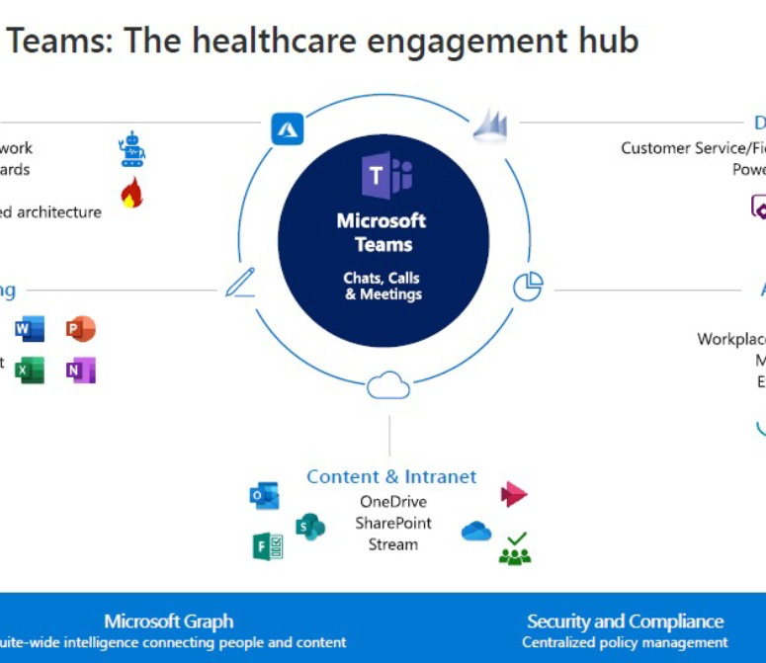
SUNRISE RESIDENTIAL CARE HOME
MS Teams Offers
Microsoft Teams’ ability to host chats, calls, and meetings, the digital healthcare
Efficient, collaborative, streamlined working
The diagram provides the ability to share Information seamlessly but securely
Increase virtual appointment
And the hub can be customised to work with third-party apps, processes and devices
Offer our clients;
flexibility
Security and peace of mind
Highest possible standards.
Nelva Rosa Garrido Soleto 2515874

Slide 12
Remote Working
NHS work from home or from remote location
The introduction of PCN role
Digital technology
Home working
Employers meet with staff for they are supported
Increase the pool of Specialist or clinical capacity
EQUIPMENT AND SERVICE REQUIRED TO SUPPORT REMOTE WORKING
GP practice
Equipment options are;
Provided laptop, software
Smartcard reader
Virtual desktop
Security and confidentiality
Information safe
Internet access is secure
Nelva Rosa Garrido Soleto 2515874

Slide 13
BENEFITS OF MS TEAMS
Less time travelling to attend a meeting
Online meeting
Free and efficient tool for NHS support
Support virtual meetings
High-quality audio and video
Chat rooms
Nelva Rosa Garrido Soleto 2515874
Good uses of MS TEAMS | MISUSE OF MS TEAMS
Ms Teams telephony | Intruders in the meeting
Ms Teams user guides and information | System crashes
Ms Teams support, fluid communication, channels. | Low signal internet

Slide 14

Impact of limited digital skills
Digital limited skills may have a negative impact on the following.
Delivery of care, communication, and teamwork.
How does it impact care delivery:
Limited digital skills can lower the accuracy and safety of care provided to the resident in Sunrise Residential Care Home.
Errors in record keeping: most care homes are now using electronic care plans and medication charts. So, staff who are not capable or confident in using the digital system might make mistakes when recording the medication given to their patients.
On communication: poor communication within health care, like pharmacists and other professionals sharing information through technology, staff with limited skills will not be able to access the information.
Teamwork: Less cooperation and less use of tools.
Training burden: Needs resources and time to develop skills. Investing in employee training is necessary to get the most out of Microsoft 365 features.
(telblog.hee.nhs.2025)
KEMISOLA SHADEKO 2508022

Slide 15

Checklist for Digital Safety Practices
Use strong, unique passwords for all accounts so no one can access the accounts and make sure the passwords are stored somewhere secure so passwords are not forgotten, and you can access anything at any time without problems
Log out after using computers that are shared or are public and not your own private device
Back up documents that are important regularly
Report suspicious emails, activity or logins immediately
Enable multi-factor authentication where possible
Lock devices that are not being used
Keep software updated
Maintain confidentiality in all digital communications
(Ico.org.uk,2025)
Kiran Saba 2511429

Slide 16
Recommendations for Improving Efficiency
Provide regular digital skills training sessions to all staff who are using Microsoft 365. This will help all staff members feel more confident in using it, all it will reduce mistakes
Create clear rules for documents, so use simpler rules for naming and saving documents for everyone to find
Choose a digital helper this means that one person can be chosen to help other staff members with technology problems, which saves money and time for training sessions all the time
Encourage feedback from staff members so they can look for ways to improve and make staff members feel more comfortable about sharing their experiences with it
(Jones, J. ,2025)
Kiran Saba 2511429

Slide 17

In Conclusion, digital tools such as Microsoft Word and Microsoft Teams play a key role in improving efficiency and communication within Sunrise Residential Care Home.
By using these applications effectively, staff can save time, enhance teamwork, and improve the overall quality of care.
Ongoing training and strong digital safety practices will ensure that technology continues to support the residential homes’ mission to provide high-quality care.
Kiran Saba 2511429

Slide 18
Reference:
Muhammad Zubair Hamayo 2514993
Cheresharov, S., Dragomirov, G., Gustinov, G., Hadzhikoleva, S. and Yotov, K., 2024. Transforming Nursing Home Care: An Integrated Approach Using Sensors, AI, and Monitoring Technologies. Computer Science and Interdisciplinary Research Journal, 1(1). https://csirjournal.com/index.php/csir/article/download/5/2
(Clinical Spine Surgery 29(5):p 203-204, June 2016).
Katherine Montero 2512506
Bromwich, M. and Bromwich, R. (2016). Privacy risks when using mobile devices in health care. Canadian Medical Association Journal, [online] 188(12), pp.855–856. doi:https://doi.org/10.1503/cmaj.160026.
Kumar, S. (2022). Why Microsoft Office Skills Are Important in the Workplace. [online] Edoxi Training. Available at: https://www.edoxi.com/studyhub-detail/why-improving-your-microsoft-office-skills-are-important-in-the-workplace

Slide 19
Microsoft 365 (2024). The history and timeline of Microsoft Word. [online] Microsoft 365. Available at: https://www.microsoft.com/en-us/microsoft-365-life-hacks/writing/history-of-microsoft-word [Accessed 27 Oct. 2025].
Team, iFour (2024). Office Add-ins Development - iFour. [online] Office Add-Ins Blogs. Available at: https://www.officeaddinsdevelopment.com/blog/top-8-word-add-ins-for-the-healthcare-sector-a-complete-guide [Accessed 27 Oct. 2025].
Team, T.S. (2018). Why the healthcare industry needs Microsoft 365 | Sherweb. [online] Sherweb. Available at: https://www.sherweb.com/blog/microsoft-ecosystem/office-365/hipaa-microsoft-365-healthcare-industry/ [Accessed 18 Oct. 2025].
Tilly, S. (2024). The challenges medical writers have with MS Word: Why are we still Stuck? - Azur Health Science. [online] Azur Health Science. Available at: https://azurhealthscience.com/the-challenges-medical-writers-have-with-ms-word-why-are-we-still-stuck/ [Accessed 27 Oct. 2025].
Yulanda, E.P. (2023). A Literature Review: Microsoft Word in Improving Writing Skill during Hybrid Learning. Jurnal Penelitian Mahasiswa Indonesia, [online] 3(2), pp.350–356. Available at: https://jurnal.stkipahsingaraja.ac.id/index.php/jpmi/article/view/525.
Nelva Rosa Garrido Soleto 2515874
Central Technology Ltd (2025). Applications to Help Enhance Hospice Care: Maximising Microsoft 365 for Hospices E1. [online] YouTube. Available at: https://www.youtube.com/watch?v=VXEK6dG0_Yo.

Slide 20
eGPlearning (2020). How to use MS Teams for General Practice. [online] YouTube. Available at: https://www.youtube.com/watch?v=ZhWoaZqyySU [Accessed 23 Oct. 2025].
NHS England (2023). NHS England» Microsoft Teams and remote working. [online] www.england.nhs.uk. Available at: https://www.england.nhs.uk/long-read/microsoft-teams-and-remote-working/.
KEMISOLA SHADEKO 2508022
Digital literacy: existing educational resource mapping and analysis A report produced by The Research Base. (n.d.). Available at: https://telblog.hee.nhs.uk/wp-content/uploads/2019/10/6.-Digital-Literacy-Existing-Educational-Resources.pdf. [Accessed 30 Oct. 2025].
Kiran Saba 2511429
Ico.org.uk. (2025). Practical ways to keep your IT systems safe and secure. [online] Available at: https://ico.org.uk/for-organisations/advice-for-small-organisations/information-security/data-security-advice/practical-ways-to-keep-your-it-systems-safe-and-secure/. [Accessed 31 Oct. 2025].
Ico.org.uk. (2025). Practical ways to keep your IT systems safe and secure. [online] Available at: https://ico.org.uk/for-organisations/advice-for-small-organisations/information-security/data-security-advice/practical-ways-to-keep-your-it-systems-safe-and-secure/. [Accessed 31 Oct. 2025].

