Slide 1
CLAH4007: Defenders, Conquerors, Vanquished
Persian Wars

Slide 2
Herodotus

Slide 3
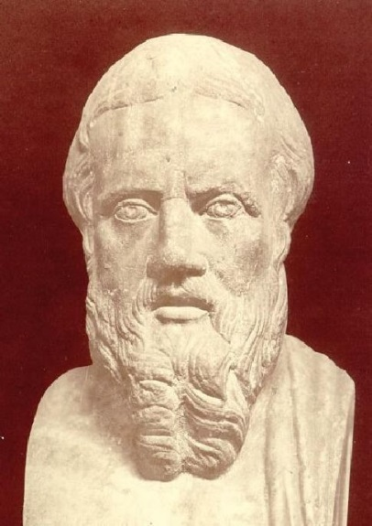
Herodotus
This is the display of the inquiry of Herodotus of Halicarnassus, so that things done by man not be forgotten in time, and that great and marvelous deeds, some displayed by the Hellenes, some by the barbarians, not lose their glory, including among others what was the cause of their waging war on each other. Herodotos 1.1
C485-424 BCE.
Wrote after the Persian Wars.
1st historian = Father of History.
Born in Halikarnassos.

Slide 4
Long view of history
Herodotos spends most of the books of the Histories covering not the Persian Wars per se but the events preceding them.
The Ionian Revolt is not reached until Book 5 (of 9).
In this way, the Persians say (and not as the Greeks), was how Io came to Egypt, and this, according to them, was the first wrong that was done. Next, according to their story, some Greeks (they cannot say who) landed at Tyre in Phoenicia and carried off the king's daughter Europa. These Greeks must, I suppose, have been Cretans. So far, then, the account between them was balanced. But after this (they say), it was the Greeks who were guilty of the second wrong. Herodotos 1.2

Slide 5
Sources and Witnesses
As for myself, although it is my business to set down that which is told me, to believe it is none at all of my business. This I ask the reader to hold true for the whole of my history, for there is another tale current, according to which it would seem that it was the Argives who invited the Persian into Hellas, because the war with the Lacedaemonians was going badly, and they would prefer anything to their present distresses. Herodotos 7.152
Herodotos believes in presenting all views, rather than only his own.
It is up to the reader to decide the truth, rather than up to the historian.

Slide 6
Gods, heroes and credibility
Now when the barbarians drew near and could see the temple, the prophet, whose name was Aceratus, saw certain sacred arms, which no man might touch without sacrilege, brought out of the chamber within and laid before the shrine. [2] So he went to tell the Delphians of this miracle, but when the barbarians came with all speed near to the temple of Athena Pronaea, they were visited by miracles yet greater than the aforesaid. Marvellous indeed it is, that weapons of war should of their own motion appear lying outside in front of the shrine, but the visitation which followed was more wondrous than anything else ever seen. [3] When the barbarians were near to the temple of Athena Pronaea, they were struck by thunderbolts from the sky, and two peaks broken off from Parnassus came rushing among them with a mighty noise and overwhelmed many of them. In addition to this a shout and a cry of triumph were heard from the temple of Athena. Herodotos 8.37
Often Herodotos will include in his Histories tales that we would consider fantastic or supernatural.

Slide 7
Oracles and War

Slide 8
Oracles in the Greek world
Oracles were extremely important as they were part of the way humans communicated with the divine.
Oracles were consulted for all important events (and indeed some not important) both by states and by individuals.
A great fear was of course that someone would manage to corrupt the oracle.
Oracles of note: Delphi, Dodona, Ammon

Slide 9
Medising Apollo
The Athenians had sent messages to Delphi asking that an oracle be given them, and when they had performed all due rites at the temple and sat down in the inner hall, the priestess, whose name was Aristonice, gave them this answer:
[2] Wretches, why do you linger here? Rather flee from your houses and city,
Flee to the ends of the earth from the circle embattled of Athens!
The head will not remain in its place, nor in the body,
Nor the feet beneath, nor the hands, nor the parts between;
But all is ruined, for fire and the headlong god of war speeding in a Syrian chariot will bring you low.
[3] Many a fortress too, not yours alone, will he shatter;
Many a shrine of the gods will he give to the flame for devouring;
Sweating for fear they stand, and quaking for dread of the enemy,
Running with gore are their roofs, foreseeing the stress of their sorrow;
Therefore I bid you depart from the sanctuary.
Have courage to lighten your evil. Herodotos 7.140

Slide 10
The second answer
When the Athenian messengers heard that, they were very greatly dismayed, and gave themselves up for lost by reason of the evil foretold. Then Timon son of Androbulus, as notable a man as any Delphian, advised them to take boughs of supplication and in the guise of suppliants, approach the oracle a second time. [2] The Athenians did exactly this; “Lord,” they said, “regard mercifully these suppliant boughs which we bring to you, and give us some better answer concerning our country. Otherwise we will not depart from your temple, but remain here until we die.” Thereupon the priestess gave them this second oracle: [3] “Vainly does Pallas strive to appease great Zeus of Olympus;
Words of entreaty are vain, and so too cunning counsels of wisdom.
Nevertheless I will speak to you again of strength adamantine.
All will be taken and lost that the sacred border of Cecrops
Holds in keeping today, and the dales divine of Cithaeron;
Yet a wood-built wall will by Zeus all-seeing be granted
To the Trito-born, a stronghold for you and your children.
” [4] “Await not the host of horse and foot coming from Asia,
Nor be still, but turn your back and withdraw from the foe.
Truly a day will come when you will meet him face to face.
Divine Salamis, you will bring death to women's sons
When the corn is scattered, or the harvest gathered in. Herodotos 7.141

Slide 11
Oracles and politics
Now there was a certain Athenian, by name and title Themistocles son of Neocles, who had lately risen to be among their chief men. He claimed that the readers of oracles had incorrectly interpreted the whole of the oracle and reasoned that if the verse really pertained to the Athenians, it would have been formulated in less mild language, calling Salamis “cruel” rather than “divine ” seeing that its inhabitants were to perish. [2] Correctly understood, the gods' oracle was spoken not of the Athenians but of their enemies, and his advice was that they should believe their ships to be the wooden wall and so make ready to fight by sea. [3] When Themistocles put forward this interpretation, the Athenians judged him to be a better counsellor than the readers of oracles, who would have had them prepare for no sea fight, and, in short, offer no resistance at all, but leave Attica and settle in some other country. Herodotos 7.143

Slide 12
Teisamenus the Seer & the Spartans
Read the handout on Teisamenus.
  What do you think?
  How powerful were oracles?
  What does this tell us about Greek religion and warfare?

Slide 13
Darius’ invasion of scythia and the ionian revolt

Slide 14
The Role of the Ionian Greeks
Then the Ionians held a council. Miltiades the Athenian, general and sovereign of the Chersonesites of the Hellespont, advised that they do as the Scythians said and set Ionia free. [2] But Histiaeus of Miletus advised the opposite. He said, “It is owing to Darius that each of us is sovereign of his city; if Darius' power is overthrown, we shall no longer be able to rule, I in Miletus or any of you elsewhere; for all the cities will choose democracy rather than despotism.” [3] When Histiaeus explained this, all of them at once inclined to his view, although they had first sided with Miltiades. Hdt. 4.137

Slide 15
Expansionism vs. Revenge
The kings of the aforesaid nations having gathered, then, the Scythian messengers came and laid everything before them, explaining how the Persian, now that the whole of the other continent was subject to him, had crossed over to their continent by a bridge thrown across the neck of the Bosporus, and how having crossed it and subjugated the Thracians he was now bridging the Ister, so as to make that whole region subject to him like the others. [2] “By no means stand aside and let us be destroyed,” they said; “rather, let us unite and oppose this invader. If you will not, then we shall either be driven out of our country or stay and make terms. [3] For what is to become of us if you will not help us? And afterward it will not be easy for you, either; for the Persian has come to attack you no less than us, and when he has subjugated us he will not be content to leave you alone. [4] We will give you a convincing proof of what we say: if indeed the Persian were marching against us alone, wanting vengeance for our former enslavement of his country, he ought to leave others alone and make straight for us, and would show everyone that Scythia and no other country was his goal. [5] But as it is, from the day he crossed over to this continent, he has been taming all that come in his way, and he holds in subjection not only the rest of Thrace, but also our neighbors the Getae.” Hdt. 4.118

Slide 16
Expansionism vs. Revenge II
When a great multitude of ships and a great army were assembled, the Persians crossed the Hellespont on shipboard and marched through Europe, with Eretria and Athens as their goal. This was the stated end of their expedition, but they intended to subdue as many of the Greek cities as they could. Hdt 6.43

Slide 17
Why eretreia?
Why did Eretreia support the Ionian Revolt?

Slide 18
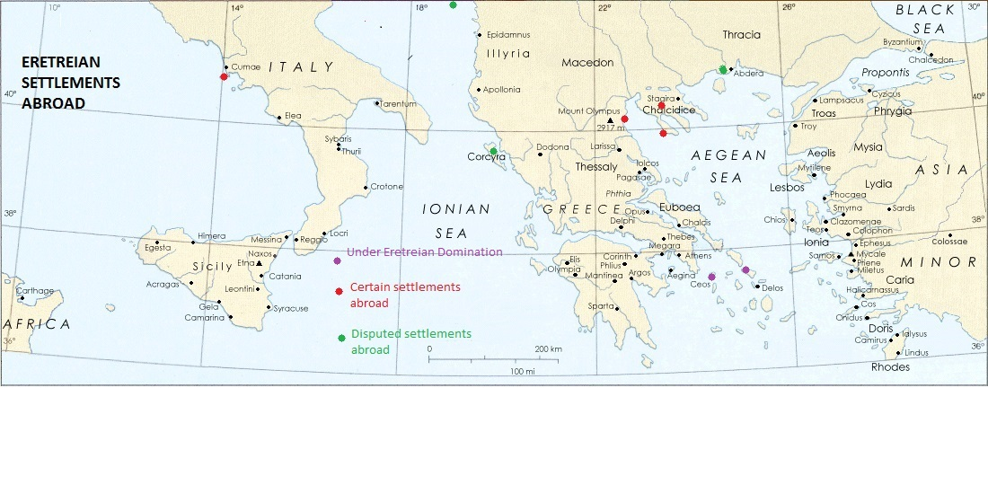
Eretreian Settlements Abroad

Slide 19
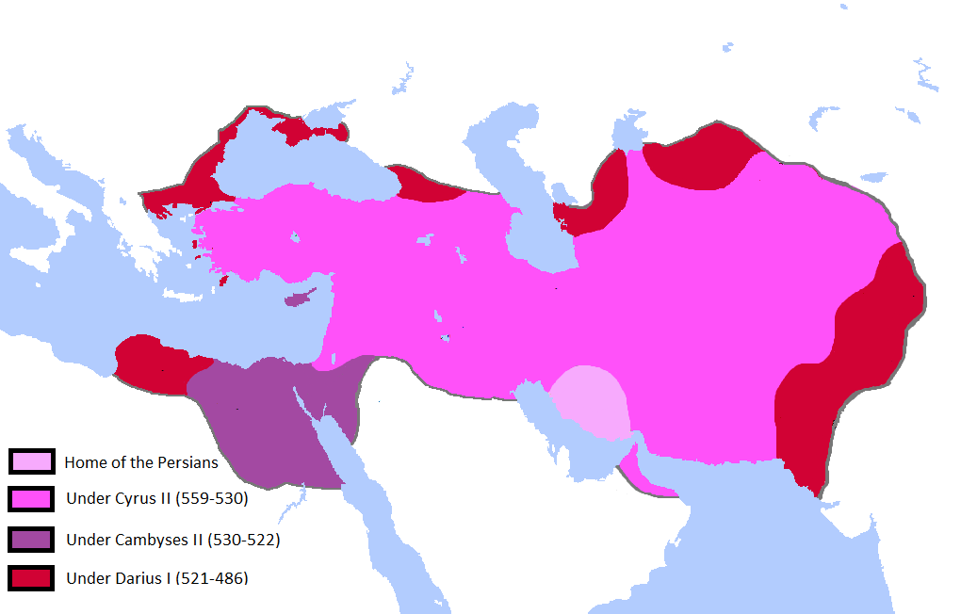
Darius’ Scythian Expedition

Slide 20
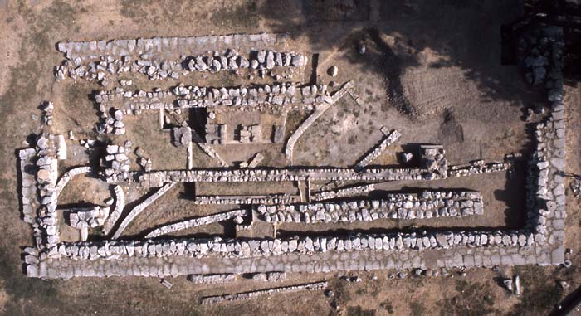
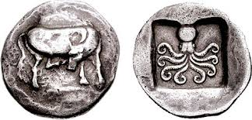
Eretreian Wealth in the archaic period
Eretreian Silver coinage
Bull and octopus
Temple of Apollo Daphnephoros.
First built 8th Century BCE
Ionic Peripteral Temple early 6th
New Peripteral Temple late 6th

Slide 21
The Lelantine War (supposedly 8th century)
The nearest approach to a coalition took place in the old war between Chalcis and Eretria; this was a quarrel in which the rest of the Hellenic name did to some extent take sides. Thuc. 1.15
The Athenians came with their twenty ships as well as five triremes of the Eretrians who came to the war to please not the Athenians but the Milesians themselves, thereby repaying their debt (for the Milesians had once been the allies of the Eretrians in the war against Chalcis, when the Samians came to aid the Chalcidians against the Eretrians and Milesians).

Slide 22
Athenian elites, democracy and marathon

Slide 23
Basics of Athenian History to 490
Aristocratic Government in the early archaic
7th century: Civil discord → Laws of Draco (aristocratic)
Early 6th century: More civil discord → Laws of Solon (oligarchic, with some democratic elements)
Most of the 6th century: Peisistratid Tyranny (several times)
511: Hippias (the last Peisistratid) expelled – Finds refuge in the Persian Court!
508: Another civil discord → Cleisthenes reforms (more democratic)

Slide 24
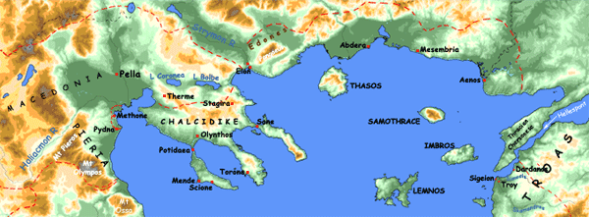
Miltiades at the Chersonnese
The sons of Pisistratus sent Miltiades, son of Cimon and brother of the dead Stesagoras, in a trireme to the Chersonese to take control of the country; they had already treated him well at Athens, feigning that they had not been accessory to the death of Cimon his father, which I will relate in another place. [2] Reaching the Chersonese, Miltiades kept himself within his house, professing thus to honor the memory of his brother Stesagoras. When the people of the Chersonese learned this, their ruling men gathered together from all the cities on every side, and came together in a group to show fellow-feeling with his mourning; but he put them in bonds. So Miltiades made himself master of the Chersonese; there he maintained a guard of five hundred men, and married Hegesipyle the daughter of Olorus, king of Thrace. Hdt. 6.39

Slide 25
Miltiades and the Persians
Then the Ionians held a council. Miltiades the Athenian, general and sovereign of the Chersonesites of the Hellespont, advised that they do as the Scythians said and set Ionia free. [2] But Histiaeus of Miletus advised the opposite. He said, “It is owing to Darius that each of us is sovereign of his city; if Darius' power is overthrown, we shall no longer be able to rule, I in Miletus or any of you elsewhere; for all the cities will choose democracy rather than despotism.” [3] When Histiaeus explained this, all of them at once inclined to his view, although they had first sided with Miltiades. Hdt. 4.137

Slide 26
Miltiades and Marathon
It was this Miltiades who was now the Athenian general, after coming from the Chersonese and escaping a two-fold death. The Phoenicians pursued him as far asImbros, considering it of great importance to catch him and bring him to the king. [2] He escaped from them, but when he reached his own country and thought he was safe, then his enemies met him. They brought him to court and prosecuted him for tyranny in the Chersonese, but he was acquitted and appointed Athenian general, chosen by the people. Hdt. 6.104

Slide 27
Hippias and the Persians
After subduing Eretria, the Persians waited a few days and then sailed away to the land of Attica, pressing ahead in expectation of doing to the Athenians exactly what they had done to the Eretrians. Marathon was the place in Attica most suitable for riding horses and closest to Eretria, so Hippias son of Pisistratus led them there. Hdt. 6.102

Slide 28
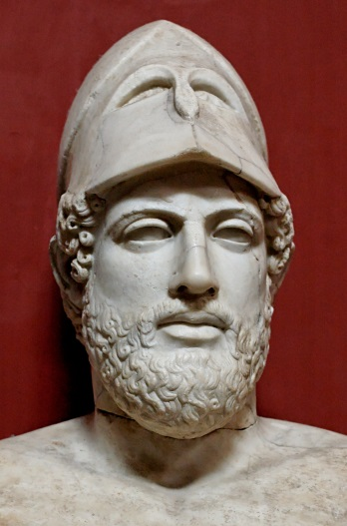
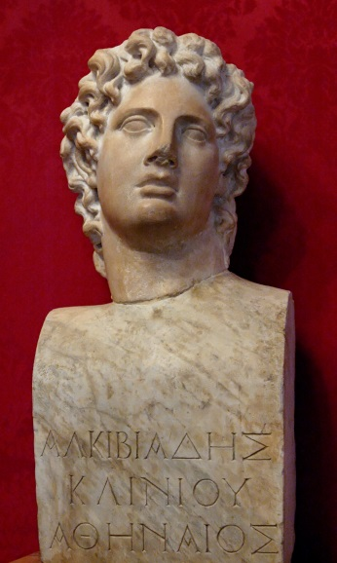
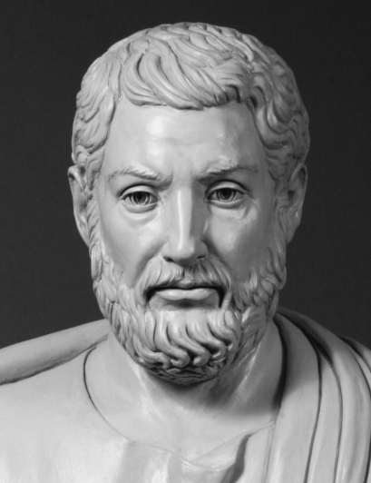
The Alkmaionids
It is a wonder to me, and I do not believe the story, that the Alcmeonidae would ever have agreed to hold up a shield as a sign for the Persians out of a desire to make Athens subject to foreigners and to Hippias; for it is plain to see that they were tyrant-haters as much as Callias (son of Phaenippus and father of Hipponicus), or even more so. Hdt. 6.121
Alcibiades
Pericles
Cleisthenes

Slide 29
Imagining thermopylae

Slide 30
Thoughts and discussion
Take a copy of ONE of the pages.
Consider the following:
  How is it representing the Persian Wars and/or Thermopylae?
  What is the context of the author/artist?
  What is the meaning of the Persian Wars in this instance?

Slide 31
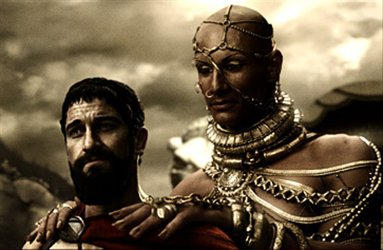
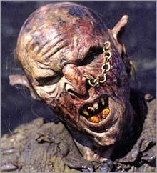
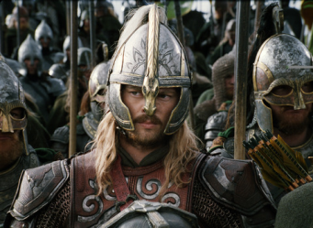

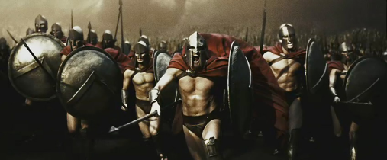

Slide 32
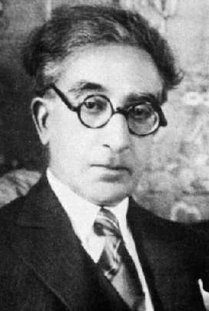
Using antiquity
Honor to those who in their lives
have defined and guard their Thermopylae.
Never stirring from duty;
just and upright in all their deeds,
yet with pity and compassion too;
generous when they are rich, and when
they are poor, again a little generous,
again helping as much as they can;
always speaking the truth,
yet without hatred for those who lie.
And more honor is due to them
when they foresee (and many do foresee)
that Ephialtes will finally appear,
and that the Medes in the end will go through.
K. Kavafis Thermopylae

Slide 33
Reception, Schooling and culture
"What! do you think Sir John Crake, the master of the harriers, knows Latin?" said Tom, who had often thought he should like to resemble Sir John Crake.
"He learned it when he was a boy, of course," said Philip. "But I dare say he's forgotten it."
"Oh, well, I can do that, then," said Tom, not with any epigrammatic intention, but with serious satisfaction at the idea that, as far as Latin was concerned, there was no hindrance to his resembling Sir John Crake. "Only you're obliged to remember it while you're at school, else you've got to learn ever so many lines of 'Speaker.' Mr. Stelling's very particular - did you know? He'll have you up ten times if you say 'nam' for 'jam,' - he won't let you go a letter wrong, I can tell you."
"Oh, I don't mind," said Philip, unable to choke a laugh; "I can remember things easily. And there are some lessons I'm very fond of. I'm very fond of Greek history, and everything about the Greeks. I should like to have been a Greek and fought the Persians, and then have come home and have written tragedies, or else have been listened to by everybody for my wisdom, like Socrates, and have died a grand death." (Philip, you perceive, was not without a wish to impress the well-made barbarian with a sense of his mental superiority.)
"Why, were the Greeks great fighters?" said Tom, who saw a vista in this direction. "Is there anything like David and Goliath and Samson in the Greek history? Those are the only bits I like in the history of the Jews." George Elliot The Mill on the Floss (1860) Excerpts from Chapter 3.

Slide 34

Manfredi The Spartan 2002
In this epic story filled with passion, courage, and adventure, the author of the internationally bestselling Alexander trilogy tells the tale of two warriors united by blood and torn apart by law.
This is the saga of a Spartan family, unraveled by a harsh custom of their people that causes them to abandon one of their own. The elder son, Brithos, strong and healthy, will live comfortably; but Talos, weak and feeble, must be sacrificed to the wolves of Mount Taygetus. Unbeknownst to his grieving parents, however, the child is miraculously found and saved by a Helot -- the once-proud people who now live in servitude to Sparta.
While his brother is raised in the mighty warrior caste, Talos, who is now a slave, is schooled in the history of the Helot people by his adoptive father. It is then that he learns of the legend of Aristodemus, the last King of the Helots, whose armor, it is prophesied, will be worn again by the liberator of his vanquished race. When the brothers meet for the first time since their separation, it is over crossed swords as Talos defends the woman he loves from the brutality of Brithos. But fate has a greater destiny in store for them -- and as war looms on the horizon, their lives become entwined in ways neither could have imagined. They live out their story in a world dominated by the clash between the Persian empire and the city-states of Greece until the voice of their blood and of human solidarity unites them in a thrilling, singular enterprise.
Official synopsis: http://www.fantasticfiction.co.uk/m/valerio-massimo-manfredi/spartan.htm

Slide 35

300
Published 1998-1999
By Frank Miller
Won 3 Eisner Awards in 1999

Slide 36
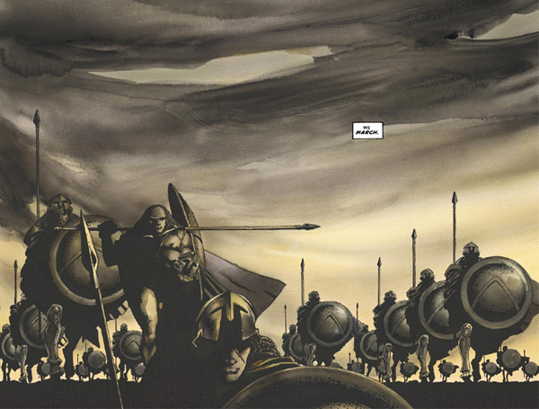
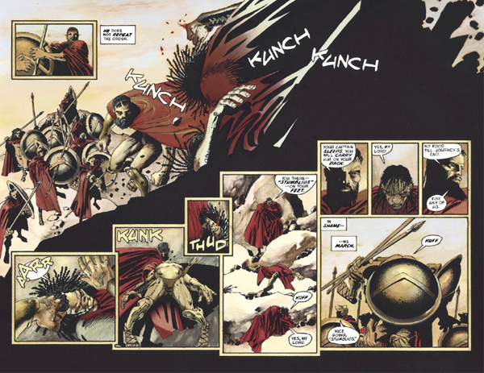
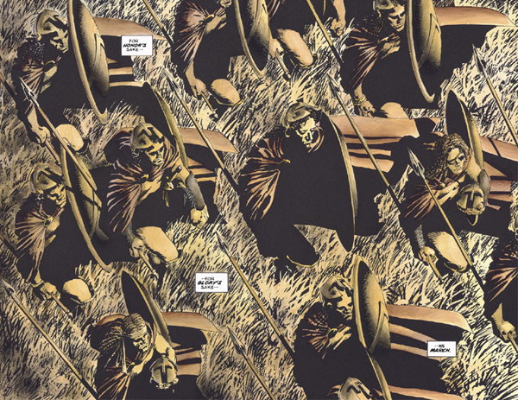
300

Slide 37
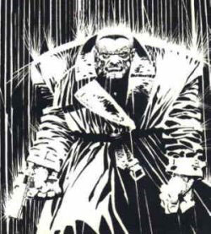

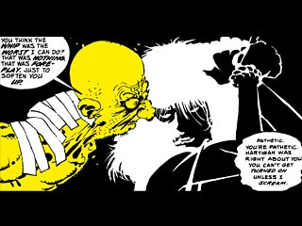
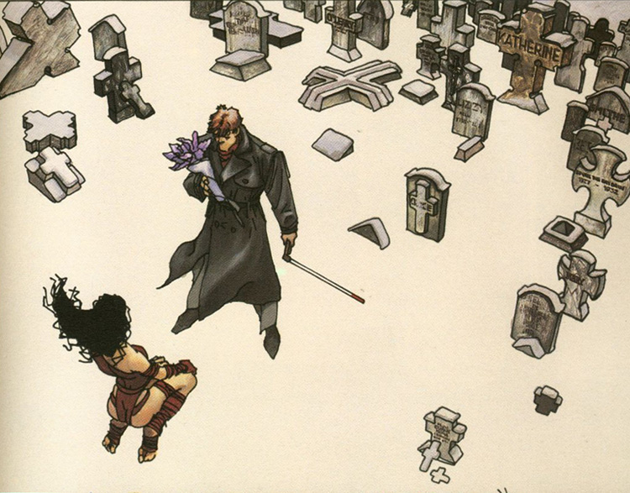
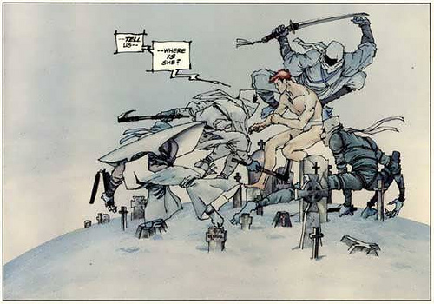
others of Miller’s works

Slide 38
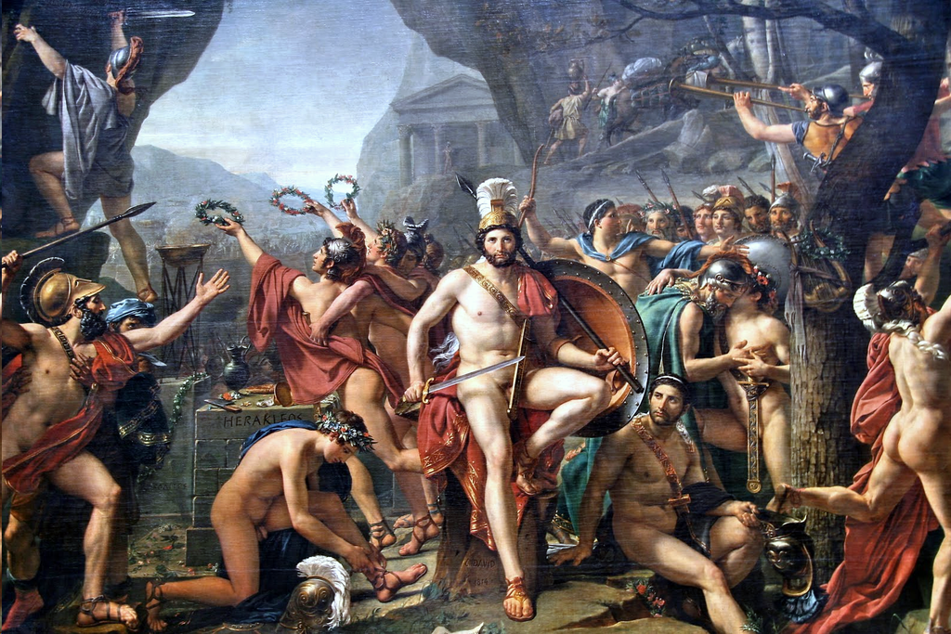
J.L. David, Leonidas at Thermopylae, 1814

Slide 39
Issues of leadership and unity

Slide 40
The combined Greek fleet at Artemision
The Greeks appointed to serve in the fleet were these: the Athenians furnished a hundred and twenty-seven ships; the Plataeans manned these ships with the Athenians, not that they had any knowledge of seamanship, but because of mere valor and zeal. The Corinthians furnished forty ships and the Megarians twenty; [2] the Chalcidians manned twenty, the Athenians furnishing the ships; the Aeginetans eighteen, the Sicyonians twelve, the Lacedaemonians ten, the Epidaurians eight, the Eretrians seven, the Troezenians five, the Styrians two, and the Ceans two, and two fifty-oared barks; the Opuntian Locrians brought seven fifty-oared barks to their aid. Hdt. 8.1

Slide 41
Athenian ambition
In the first days, before the sending to Sicily for alliance, there had been talk of entrusting the command at sea to the Athenians. However, when the allies resisted, the Athenians waived their claim, considering the safety of Hellas of prime importance and seeing that if they quarrelled over the leadership, Hellas must perish. In this they judged rightly, for civil strife is as much worse than united war as war is worse than peace. [2] Knowing that, they gave ground and waived their claim, but only so long as they had great need of the others. This is clear, for when they had driven the Persian back and the battle was no longer for their territory but for his, they made a pretext of Pausanias' highhandedness and took the command away from the Lacedaemonians. All that, however, took place later. Hdt. 8.3

Slide 42
Each on his own?
When Themistocles returned to his ship, Mnesiphilus, an Athenian, asked him what had been decided. Learning from him that they had resolved to sail to the Isthmus and fight for the Peloponnese, he said, [2] “If they depart from Salamis, you will no longer be fighting for one country. Each will make his way to his own city, and neither Eurybiades nor any other man will be able to keep them from disbanding the army. Hellas will be destroyed by bad planning. If there is any way at all that you could persuade Eurybiades to change his decision and remain here, go try to undo this resolution.” Hdt. 8.57

Slide 43
Same as before?
The Spartans sent the men with Leonidas on ahead so that the rest of the allies would see them and march, instead of medizing like the others if they learned that the Spartans were delaying. At present the Carneia was in their way, but once they had completed the festival, they intended to leave a garrison at Sparta and march out in full force with all speed. [2] The rest of the allies planned to do likewise, for the Olympiad coincided with these events. They accordingly sent their advance guard, not expecting the war at Thermopylae to be decided so quickly. Hdt. 7.206

Slide 44
A man with no polis?
As Themistocles said this, Adeimantus the Corinthian attacked him again, advising that a man without a city should keep quiet and that Eurybiades should not ask the vote of a man without a city. He advised Themistocles to contribute his opinion when he provided a city—attacking him in this way because Athens was captured and occupied. [2] This time Themistocles said many things against him and the Corinthians, declaring that so long as they had two hundred manned ships, the Athenians had both a city and a land greater than theirs, and that none of the Hellenes could repel them if they attacked. Hdt. 8.61

Slide 45
Threats and power
Next he turned his argument to Eurybiades, saying more vehemently than before, “If you remain here, you will be an noble man. If not, you will ruin Hellas. All our strength for war is in our ships, so listen to me. [2] If you do not do this, we will immediately gather up our households and travel to Siris in Italy, which has been ours since ancient times, and the prophecies say we must found a colony there. You will remember these words when you are without such allies.” 63.
When Themistocles said this, Eurybiades changed his mind. I think he did so chiefly out of fear that the Athenians might desert them if they set sail for the Isthmus. If the Athenians left, the rest would be no match for the enemy, so he made the choice to remain there and fight. Hdt 8.62-3

Slide 46
Help from the West?
Read the text on the handout
  Who is Gelon and why is he important?
  Why do the Spartans and Athenians not want to give him leadership?
  What does this mean for our understanding of the Hellenic League?

