Slide 1
Children, Young People and Families
Presentation Case Study e
Students Name: Vimi Naiko ( 2120212 ) & Waris Qadri ( 1921231 )
Module: BMHP5004_BIRM
Lecturer: Rachael Rivers

Slide 2
Content
Introduction
Risk factors
Mother
Child
Theory
Child example
Current relevant policy
Invention and prevention
Conclusion
Reference

Slide 3
INTRODUCTION
The term "anti-social behaviour" (ASB) is used to describe a broad variety of selfish and unacceptable behaviours that can reduce the quality of community life (Fyson & Yates, 2011).
The purpose of this study
To quickly and effectively address reports of anti-social behavior
to reduce the number of children who use the criminal justice system,
to increase the attendance of the groups
Key points:
practitioners need to promptly and effectively deal with ASB(Heap, V., Black, A. and Devany, C., 2022).
More attention must be paid to the effects of ASB on victims
To manage those high-risk cases(Wiley, Jacob & Burd, 2020)
Notes:
Definition
Purpose:
to quickly and effectively address reports of anti-social behavior through collaboration with other organizations, thereby enhancing the quality of life for locals.
to increase the attendance of the groups that have been identified at school, and to lessen the conditions that could encourage someone to engage in offensive behaviour (Great Britain: National Audit Office 2006).
Key points:
The available technologies do not give practitioners the flexibility they need to rapidly and effectively handle ASB.
The effects of ASB on victims, particularly recurrent or vulnerable victims, require additional attention
.The best way to support victims is by prompt and efficient responses(Heap, V., Black, A. and Devany, C., 2022)
To manage those high-risk cases, a multi-agency strategy is driven by the MARAC concept. (Wiley, Jacob & Burd, 2020)

Slide 4
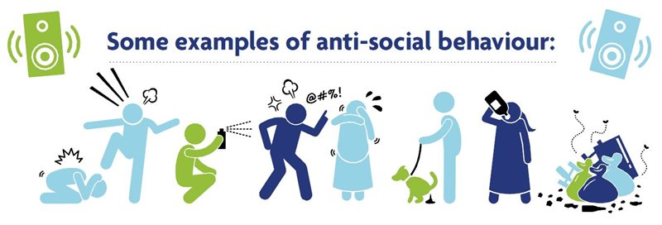
RISK FACTORS
Parenting
School
Community
Individual factors
Notes:
Signs and symptoms of antisocial personality disorder can include
ignore what is good and wrong
ongoing dishonesty or lying to manipulate others
being arrogant, harsh, and disrespectful to other people
using wit or charm to influence people for one's own advantage or enjoyment
arrogance, superiority complex, and having strong opinions
persistent legal issues, including criminal activity
repeatedly violating another person's rights through coercion and deceit
Impulsivity or a lack of preparation
hostile, notably irritable, agitated, aggressive, or violent
Lack of compassion towards others and sorrow for hurting them
reckless or risky activity without consideration for the safety of oneself or others
harsh or poor relationships
a failure to take into account or learn from the negative effects of behaviour
being reckless on a regular basis and continually neglecting to complete tasks

Slide 5
Risk factors
 | Parenting | School | Community | Individualism
 | Poor parenting abilities, a strained parent-child bond, and a history of problematic behavior in the family | School absences, expulsion, and bad behavior that goes ignored. | Living in depressed neighborhoods with chaos and neglect, a lack of sense of community, and neighborhoods with a high level of anti-social behavior. | Abuse of drugs and alcohol, feeling isolated, and engagement in antisocial behavior early in life.

Slide 6
Analysis of mother
Issues:
Mother and kid perceptions of the world are impacted by mother depression on both an internal and outward level.
Mother and kid worldviews are both internally and externally impacted by mother depression (Grunberg, Geller, Durham, Bonacquisti & Barkin,2022).
Implication:
Depression can be successfully treated with cognitive-behavioral therapy (CBT), which is very effective.(David, Cristea &Hofmann, 2018)
"CBT is one of the most effective forms of psychotherapy because it focuses on building skills around managing thoughts and behaviors, (David, Cristea &Hofmann, 2018)"
Additional treatment options for parents
Team:
Social housing, private sector and the police
Notes:
According to Smith, parental depression affects both a parent's and a child's experience of the world on an internal and exterior level. It has been observed that depressed parents engage with their kids differently, which has an impact on the development of the kids. Smith cites research that shows depressed moms speak to their children less expressively and with less emotion, for instance. They also avoid making eye contact.
Numerous issues, some of which are lasting, are linked in studies to parental depression, including prenatal depression. Depression not only hinders parental nurture and connection, but it also makes parents less inclined to take the essential precautions to keep their kids safe and healthy (such as using a car seat or getting immunizations). School-age children with depressive parents may struggle academically, are more likely to experience behavioural issues, and have worse overall health, according to several studies. (Grunberg, Geller, Durham, Bonacquisti & Barkin,2022)
Feeling overburdened or stressed out, getting angry or irritated with your kids, having difficulties focusing or sleeping are some parenting-specific symptoms of depression.
Children of depressed parents are less likely to react when their parents cry or make eye contact. Due to the parents' inability to leave on time, the child may be late for school as a result.
According to study, cognitive-behavioral therapy (CBT) is a very effective treatment for depression. CBT encourages patients to reframe their negative and counterproductive thought patterns, which can serve to exacerbate depression. CBT is one of the most successful types of psychotherapy because it emphasises developing coping mechanisms for controlling thoughts and behaviours.Sessions with their child and/or partner, therapy, and substance abuse treatment are additional treatment alternatives for parents who require them. For some parents, home visits and medicines may also be beneficial.
Team:
Social housingIn order to report the problems, speak with your landlord if you are a tenant or leaseholder of a social housing landlord.private industryIf you own a property or are a private renter, you can get in touch with your local government, which has specialised staff members who deal with anti-social behaviour.by the policeNo matter your position, you can also call the police.

Slide 7
Analysis of child
Issues:
harming others verbally or physically,
disobeying social norms,
acting in a delinquent manner and having troubled interpersonal relationships.
Implication:
most commonly ADHD, ODD, depression, and anxiety(Mitchison & Njardvik, 2019)
significant impacts on the overall health of adults, such as low educational achievement and unemployment. (Clark & Lepinteur,2019)
Survival strategy (Li,Zhang, Ye,Li& Wang, 2022)
Notes:
Symptoms of antisocial behaviour in children and adolescents include verbal and physical abuse of others, breaking social norms, engaging in antisocial behaviours like delinquency, vandalism, theft, and truancy, or having troubled interpersonal relationships. Antisocial behaviour in young people is extremely diverse.
The most frequent co-occurring mental problems with antisocial behaviour and its associated conduct disorder include attention-deficit/hyperactivity disorder (ADHD), oppositional defiant disorder (ODD), depression, and anxiety disorder. The health and wellbeing of the person are significantly impacted by these problems as they get older. The subjective general health of the person is significantly impacted by adolescent behaviour disorder.
Harsh punishment and emotional distance, such as timeouts or grounding, are effective ways to modify behaviour among children who have not experienced trauma. This is because the parents are leveraging the children's long history of attachment to them and their parents to motivate them.
For children who have experienced chronic neglect and trauma, traditional ideas about loss, punishment, and emotional distance may be ineffective. These children have missed important developmental milestones that would have given them the social, emotional, and cognitive abilities to learn from consequences, punishments, or emotional distance. The key to a loving familial relationship for these children is trust and truth-telling. For children who have never experienced safety, permanence, and nurturance, lying and manipulating may be the only way to survive. (Li,Zhang, Ye,Li& Wang, 2022)

Slide 8
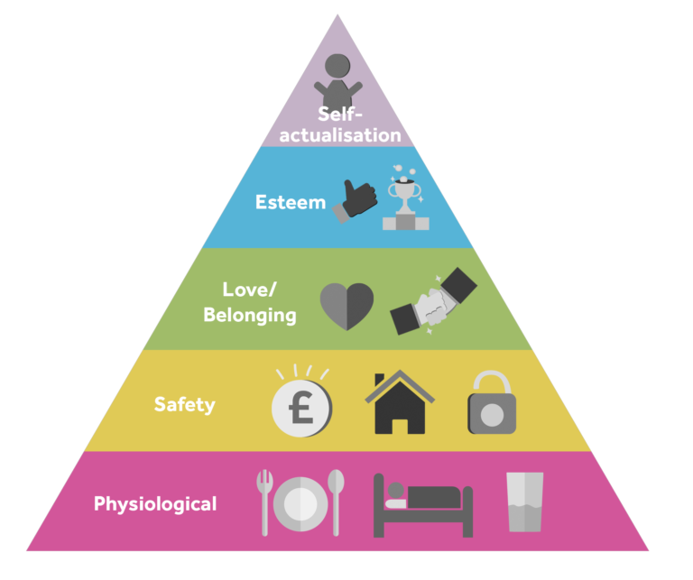
Maslow's Theory of Motivation
Notes:
Maslow's hierarchy of needs is a psychological theory which identifies five needs that must be met in order to feel fulfilled. These are: physiological needs, safety needs, social needs, esteem needs, and self-actualization needs(Tri.vedi & Mehta,2019)
The five needs mentioned are physiological (the need to survive), safety (the need to feel protected), love and belonging (the need to feel accepted and connected), esteem (the need to feel important), and self-actualization (the need to be fulfilled). (Hale, Ricotta, Freed, Smith & Huang,2019)

Slide 9
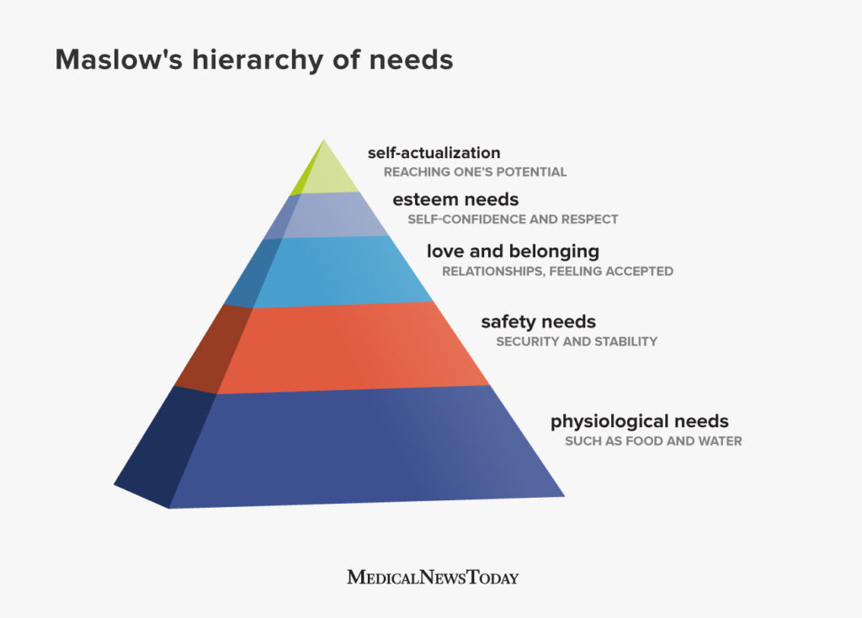
Example of child
Notes:
Maslow's hierarchy of needs theory is a widely accepted theory that suggests that people need certain things in order to be successful(Acquah, Nsiah, Antie & Otoo,2021). Critics of the theory argue that it is based on philosophical rather than empirical evidence, but the theory still serves as a helpful guide for understanding how people are motivated. For example, breakfast may be provided for children who come to school hungry because their basic needs have not been met(Trivedi & Mehta,2019).
If you have a specific need that you cannot meet with the existing system, you may be able to find a solution by looking into the details of the system.
The needs listed above can be grouped into physiological needs (e.g. having the right nutrition and water), safety needs (e.g. feeling safe and secure), and social needs (e.g. feeling part of a community and being loved). Finally, self-actualization needs (e.g. achieving one's full potential) are included.
Maslow's theory encompasses all the needs that children have as they grow and develop(Trivedi & Mehta,2019).

Slide 10
Policies
The Crime and Disorder Act of 1998 created anti-social behaviour orders(Samuels, A., 2005).
Responsible authorities (Menichelli,2020)
Landlord (Gaherity & Birch,2022)
An environmental protection champion
Notes:
a Responsible Authority under the Crime and Disorder Act of 1998 for the Oxford Safer Communities Partnership (OSCP) (Menichelli,2020). The Act mandates cooperation between the Council, the police, and other organisations in order to lessen crime and unrest in Oxford. The Council conducts both investigations and prevention efforts as part of its substantial contribution to combating anti-social behaviour of all kinds.
a landlord as it is the Council's responsibility to address ASB that affects the properties we a
dminister. Our responsibilities as landlords and the authority we have to deal with anti-social behaviour by non-council renters are complementary(Gaherity & Birch,2022).
The Council, an advocate for environmental conservation, has a variety of legal tools at its disposal to address environmental anti-social behaviour like noise, graffiti, litter, fly-tipping, and abandoned automobiles. These obligations are established by a number of laws and local ordinances, but particularly by the Environmental Protection Act of 1990, the Clean Neighbors and Environment Act of 2005, and the Anti-social Behavior, Crime and Policing Act of 2014.

Slide 11
Invention and prevention
Adolescent antisocial conduct is slightly but protectively influenced by parental love and communication. This is in line with earlier studies that discovered that parental love and communication have a direct impact on antisocial conduct, but that the majority of the effect is indirect due to the protective influence on antisocial friendships and the impulsivity and lack empathy of the teenager. (Boele et al., 2019).
Education of children can be significantly impacted by parents' actions. Some parents place a higher priority on education, and they could set an example for their kids in this regard. Additionally, impulsive parenting may result in an inadequate educational pattern for their kids, which can cause anxiety and impulsivity. This may result in unpleasant family circumstances and even the acceptance of certain inappropriate behaviour(Meldrum et al., 2015).
Parents who use behavioral control to prevent their children from engaging in antisocial behavior tend to have positive results, while parents who are hostile and intrusive in their control of their children are more likely to have negative consequences(Li et al., 2018).
Parents generally have a protective effect on teenage antisocial behavior, but this protection is small. However, controlling teenagers' behavior can increase their impulsiveness, which in turn may lead to problems.

Slide 12
Conclusion
According to Pea and Graa (2006), antisocial behaviour is typically defined as behaviour that transgresses social standards and endangers the rights of others(Manne, 2011).
This type of behavior is displayed by a lot of people at some point in their lives. The majority of the time, this is uncommon and only occurs in specific situations. Child is particularly susceptible to it since it is a period of exploration and experimentation that is crucial for the development of a person's identity and during which peer acceptability is crucial. Adolescents occasionally engage in antisocial behaviour to fit in or to elevate their status. Despite this, there are a few instances when antisocial behaviour can be a stable trait that lasts into maturity (Moffitt, 1993).

Slide 13
References
Craske, M.G., 2010. Cognitive–behavioral therapy. American Psychological Association.
Kurtines, W.M., Gewirtz, J. and Lamb, J.L., 2013. Handbook of moral behavior and development: Volume 3: Application. Psychology Press.
Hale, A.J., Ricotta, D.N., Freed, J., Smith, C.C. and Huang, G.C., 2019. Adapting Maslow's hierarchy of needs as a framework for resident wellness. Teaching and learning in medicine, 31(1), pp.109-118.
Moffitt, T.E., 2018. Male antisocial behaviour in adolescence and beyond. Nature human behaviour, 2(3), pp.177-186.
Burney, E., 2013. Making people behave: Anti-social behaviour, politics and policy. Willan.
Rodger, J., 2012. Criminalising social policy: Anti-social behaviour and welfare in a de-civilised society. Willan.
Piotrowska, P.J., Stride, C.B., Croft, S.E. and Rowe, R., 2015. Socioeconomic status and antisocial behaviour among children and adolescents: A systematic review and meta-analysis. Clinical psychology review, 35, pp.47-55.
Sellers, R., Harold, G.T., Elam, K., Rhoades, K.A., Potter, R., Mars, B., Craddock, N., Thapar, A. and Collishaw, S., 2014. Maternal depression and co‐occurring antisocial behaviour: Testing maternal hostility and warmth as mediators of risk for offspring psychopathology. Journal of Child Psychology and Psychiatry, 55(2), pp.112-120.
Morvan, C. and O’Connor, A.J., 2017. An analysis of Leon Festinger’s A theory of cognitive dissonance. Macat Library.
Harmon-Jones, E. and Mills, J., 2019. An introduction to cognitive dissonance theory and an overview of current perspectives on the theory.
Marcum, J.A., 2012. An integrated model of clinical reasoning: dual‐process theory of cognition and metacognition. Journal of evaluation in clinical practice, 18(5), pp.954-961.
Anderson, J.R., 2013. The architecture of cognition. Psychology Press.
Lester, D., 2013. Measuring Maslow's hierarchy of needs. Psychological reports, 113(1), pp.15-17.
Soni, B. and Soni, R., 2016, July. Enhancing Maslow's hierarchy of needs for effective leadership. In Competition Forum (Vol. 14, No. 2, p. 259). American Society for Competitiveness.
Fallatah, R.H.M., Syed, J., Fallatah, R.H.M. and Syed, J., 2018. A critical review of Maslow’s hierarchy of needs. Employee Motivation in Saudi Arabia: An Investigation into the Higher Education Sector, pp.19-59.
(Clark & Lepinteur,2019)
Heap, V., Black, A. and Devany, C., 2022. Understanding how Community Protection Notices are used to manage anti-social behaviour attributed to people experiencing street homelessness. People, Place and Policy (PPP).
Wiley, Z., Jacob, J.T. and Burd, E.M., 2020. Targeting asymptomatic bacteriuria in antimicrobial stewardship: the role of the microbiology laboratory. Journal of clinical microbiology, 58(5), pp.e00518-18.
Grunberg, V. A., Geller, P. A., Durham, K., Bonacquisti, A., & Barkin, J. L. (2022). Motherhood and Me (Mom-Me): The Development of an Acceptance-Based Group for Women with Postpartum Mood and Anxiety Symptoms. Journal of clinical medicine, 11(9), 2345.
Li, C., Zhang, X., Ye, T., Li, X., & Wang, G. (2022). Protection and Damage Repair Mechanisms Contributed To the Survival of Chroococcidiopsis sp. Exposed To a Mars-Like Near Space Environment. Microbiology Spectrum, 10(6), e03440-22.
Trivedi, A.J. and Mehta, A., 2019. Maslow’s Hierarchy of Needs-Theory of Human Motivation. International Journal of Research in all Subjects in Multi Languages, 7(6), pp.38-41.
Menichelli, F., 2020. Transforming the English model of community safety: From crime and disorder to the safeguarding of vulnerable people. Criminology & criminal justice, 20(1), pp.39-56.
Gaherity, C. and Birch, P., 2022. A criminologically informed examination of looting behaviour during natural disaster incidents. Safer Communities, 21(1), pp.19-30.
Acquah, A., Nsiah, T.K., Antie, E.N.A. and Otoo, B., 2021. Literature review on theories of motivation. EPRA International Journal of Economic and Business Review, 9(5), pp.25-29.
Clark, A.E. and Lepinteur, A., 2019. The causes and consequences of early-adult unemployment: Evidence from cohort data. Journal of Economic Behavior & Organization, 166, pp.107-124.

