Slide 1
Coaching Attributes – Skills, Attitudes, Values, Beliefs and Behaviours

Slide 2

1. Skills of the Coach/Mentor
Listening
Questioning
Pausing
Communication/rapport
Using Intuition
Assertiveness
Time management
Organisational
Business acumen
Ethical awareness
Compliant with regulations
Notes:
Listening questionnaire
Questioning tasks – funnel.
Communication – building rapport, using emotional intelligence to stay calm and focussed.
Assertiveness
Time Management exercises
Note taking, diary management, prep
Business acumen – to ask the right questions
Ethical – confidentiality, impartiality,
Data Protection Act

Slide 3
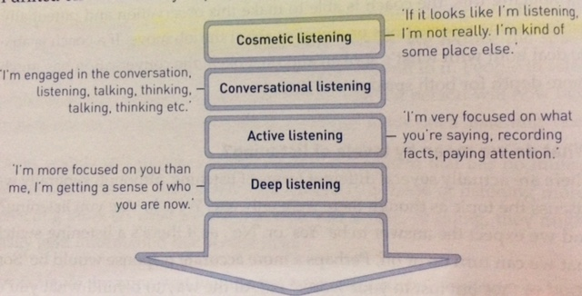
1.1 Listening (Starr, 2011)
Notes:
Julie Starr – The Coaching Manual
The book explains the principles and approaches of personal coaching and shows how to apply them in any coaching situation – from business coaching for performance, to life coaching.

Slide 4
1.1 Different Levels of Listening
Active listening skills
- Reflective/Mirroring
Paraphrasing
Summarizing
Clarifying
Encouraging self-expression
Suspending judgement, criticism, and attachment
Listening for potential
Listening with heart (empathy)
Notes:
Stephen Covey’s Empathic Listening – Habit 5 – Seek first to understand.
https://www.youtube.com/watch?v=i98FAsHydlE

Slide 5
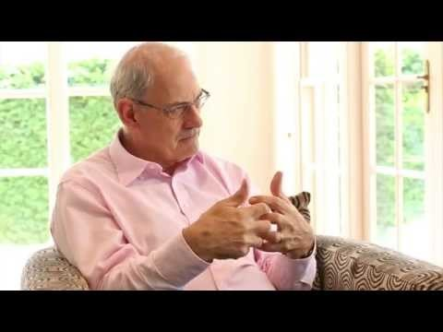
1.2 Questioning Skills
Questioning
David Clutterbuck
Notes:
P
R
A
I
R
I
E

Slide 6
1.2 Questioning Skills
Non – Directive
Helping someone solve their own problem
Reflecting
Asking questions to raise awareness
Giving feedback
Making suggestions
Offering advice
Giving advice
Instructing
Directive
Solve someone’s problem for them
Telling
Notes:
The sliding scale of the coaching spectrum. We start at telling individuals – and work to being non directive and helping them solve their own issues through raising awareness and allowing them to reflect.

Slide 7

1.2 Pausing
This Photo by Unknown Author is licensed under CC BY-SA
Notes:
1 minute exercise
This is a great exercise, get them all to stand up, tell them to close their eyes, ask them to sit down when a minute has passed, time one minute, then note the time the earliest and latest person sits down - it demonstrates how we perceive time differently and that a minute can seem ages, but often when coaching you have to give that person the minute and not jump in with your views etc.

Slide 8
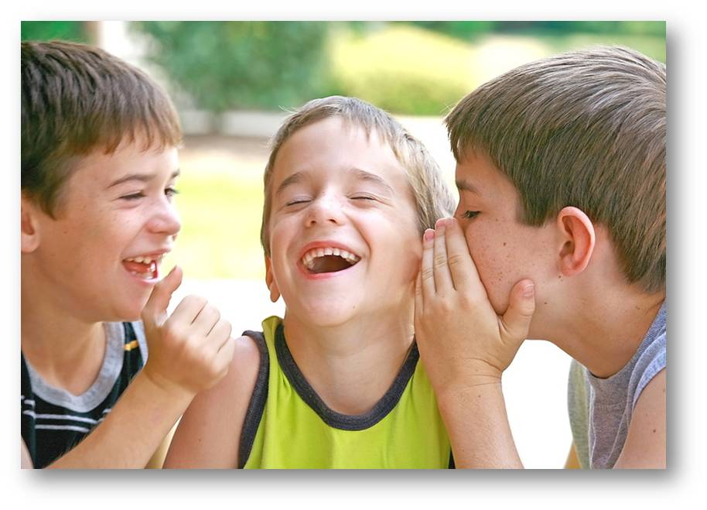
1.3 Building a state of rapport
Notes:
In pairs discuss something you are really passionate about, a hobby for example. Be emphatic in trying to share with your partner why it is something you love so much.
Notice the energy levels, NVC’s

Slide 9

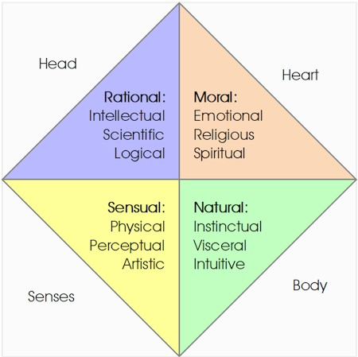
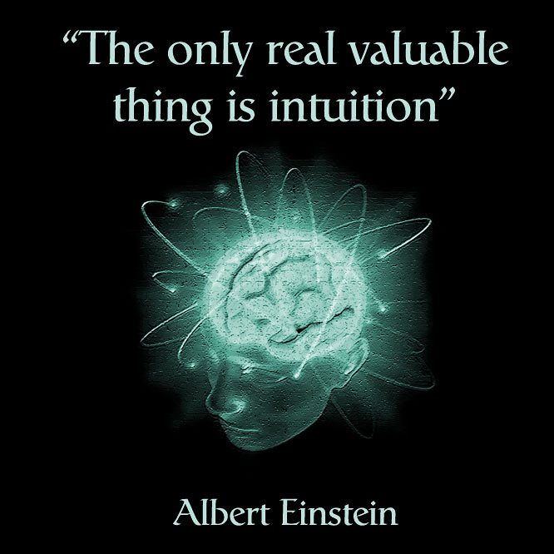

1.4 Using Intuition
This Photo by Unknown Author is licensed under CC BY-ND
Notes:
Intuition can be a powerful tool in coaching—and a perilous one. The trap is that many coaches aren’t clear about how and when it’s appropriate to use it.
Intuition is a facet of our humanity that is, as yet, largely unexplained by science, yet experienced by most.
In coaching, we have an agenda to serve our client’s agenda. Our work is to guide a pathway, with our client’s agreement, toward greater clarity and understanding, and therefore more resourceful actions.
Intuition is not a magical quality that can only be summoned by a few special people. Rather, it is a result of years of learning and deliberate practice. The link between expert performance and intuition cannot be ignored. As performers gain knowledge and experience in a particular field or profession, they become more intuitive and learn to trust the decisions they make. The process of developing and trusting intuition takes years of dedicated practice that results in keen perceptual abilities and a vast knowledge base. Every coach has the potential to become intuitive; it just takes a large investment of time and energy.

Slide 10
1. 5 Assertiveness, Time Management, Organisational Skills, Business Acumen
Why might these skills come in to play for a coach/mentor?
In groups discuss how these skills fit in with the coaching/mentoring professions and feedback
This Photo by Unknown Author is licensed under CC BY-ND

Slide 11
1. 6 Ethical Awareness
Confidentiality
Remaining detached
Not breaching the implied duty of trust and confidence if internal coaching/mentoring
Not abusing the psychological contract
Not leading/directing
No hidden agendas
No Ego
Notes:
Be mindful not to become a counsellor/therapist

Slide 12
1. 7 Regulatory Compliance
GDPR 2018
Not breaching express or implied terms of the employment contract if internal coaching/mentoring
Adhering to the terms of reference of the coaching/mentoring agreement
Notes:
It for skills.

Slide 13
3. Attitudes in the Workplace
Open mindset / closed mindset
Tolerance of mistakes
‘Give and take’ approach or ‘school of hard knocks’
Meritocracy
Reward effort/creativity/entrepreneurialism or just reward results?
Fight for your team/colleagues
Occasionally put the job before yourself
Notes:
‘Top-down’ approach to communication and information sharing
If employee works over one day, can they go early on another? If an employee puts their hand up to work on a really mundane piece of work, do they get a say in a more exciting project at a later date?
Rewarding for achievement
How do these behaviours in the workplace affect a coaching/mentoring relationship?
Emotionally detached – locked in the past, or anticipating something negative about the future. As the coach/mentor you need your client to be present, you must also be present.

Slide 14
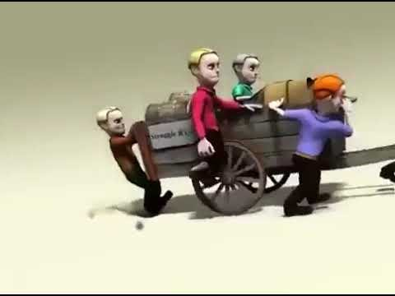
3. Attitudes in the Workplace

Slide 15
4. Beliefs (or Principles) (Starr, 2011)
I will maintain my commitment to support the individual
My coaching relationships are built upon truth, openness and trust
The coachee is responsible for the results they are creating
The coachee is capable of much better results than they are currently generating
I will maintain focus on what the coachee thinks and experiences
I know that coachees can generate perfect solutions
My coaching conversations are based on equality
Notes:
There are certain principles of perspective and belief that support collaborative coaching.
A room may be full of fabulous coaches who all look different, sound different and appear different. However, when they coach, they are operating from a set of common beliefs.
For example, they all believe in the power of coaching and they all believe that they can coach. These assumptions and beliefs are what help define effective coaching.

Slide 16
Johari’s window
 | Known by Self | Unknown by Self
Known by others | Open Area | Blind Area
Unknown by others | Hidden Area | Unknown Area
Notes:
Designed by Joseph Luft and Harry Ingham., Johari’s window is about building more self-awareness.
It’s no secret that emotional intelligence and self-awareness are two of the most important leadership characteristics. The ability to read verbal & non-verbal cues, control emotions, and compassionately empathize with others are necessities for building & sustaining any healthy relationship.
One of the most effective tools for developing self-awareness and opening up lines of communication with others is the Johari Window.
Self-awareness is important for coaching as it impacts the openness of the coach/coachee.
The size on the boxes are flexible. Through coaching and giving feedback the objective is to extend the “open” window. This then decreases the other areas.
A team works well together when they strive to increase their open areas, and minimise the other areas. The open area increases when trust is developed. Also it becomes the norm to give feedback and for it to be discussed.
Hidden area – likes asking questions but does not like to reveal personal information or receive feedback. They like group activities but does not like the emphasis being on them. It is hard to know where they stand on issues and they will not commit themselves, this can lead to distrust and irritate others.
Blind area – Approach issues like a “bull in a china shop.” They tend not to be good listeners, so insensitive to the impact of their behaviour on others. They could react to feedback with tears, anger and that will lead to reluctance to give it. They could be perceived as opinionated, insensitive and critical. Because they are unaware of their behaviour they cannot change it.
Unknown – They will not participate in a group or give feedback. They will say that they learn more from listening, although this is not true.
The goal of coaching is to move information from the blind and hidden areas into the open area. By doing this process, information from the unknown may become unknown through self discovery – an insight or inspiration! A light bulb moment. It should mean that individuals become more accepting of themselves.

Slide 17
Personal Iceberg
Seen
Behaviour
Limiting or Empowering
Appearance
Language
Physical Environment
Beliefs
Values
Justification
Unseen
Limiting or Empowering
Thoughts
Circumstances
Emotions
Habit
Needs
Notes:
Coaching is to raise the awareness and responsibility of people. It is to make people aware and understand the underlying issues and barriers to a problem. It is about realising what drives behaviour and how they can change that behaviour to change and develop themselves.
The iceberg is an example of traits that can be seen, and how they can limit or empower us.
What is not seen are values etc. It is only through questioning and probing that these will become apparent to the coach and sometimes the coachee who is not aware of their habits and thoughts etc. Again it is about self awareness.
Discuss how they could do this. Ie, language and accents – preconceived ideas and stereotyping.

Slide 18

Effective communication
In any communication, the listener’s impression is based on…
Body language (55%)
Tone (38%)
Words (7%)
Notes:
This demonstrates the importance of outside factors rather than what we say. Our tone of voice, energy, attitude, emotions, dress, body language, eye contact, facial expressions, movements and gestures have a stronger impact than words alone. As a coach we need to become self aware of our own behaviour and the impact and impression it can leave on others.

Slide 19
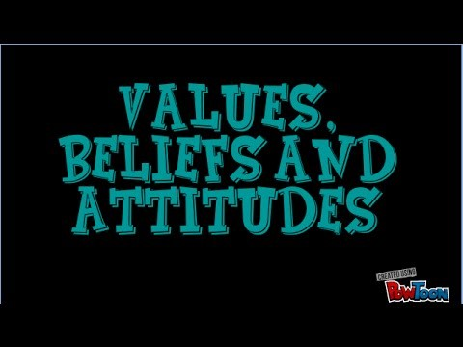
Values, Beliefs & Attitudes
Youtube Clip
Notes:
Person drowning example
1st ask them, if they passed a lake and a man and a dog were drowning, who would they save? Then ask them, the man is a known pedophile, now think about who you would save (you don't have to voice your answer) - this is to get them to think about the values and judgements.

Slide 20
Summary:
The skills, attitudes, values, beliefs, behaviours of an effective coach/mentor

