Slide 1
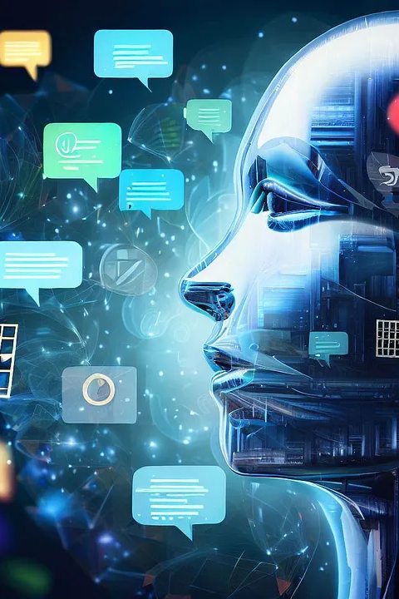

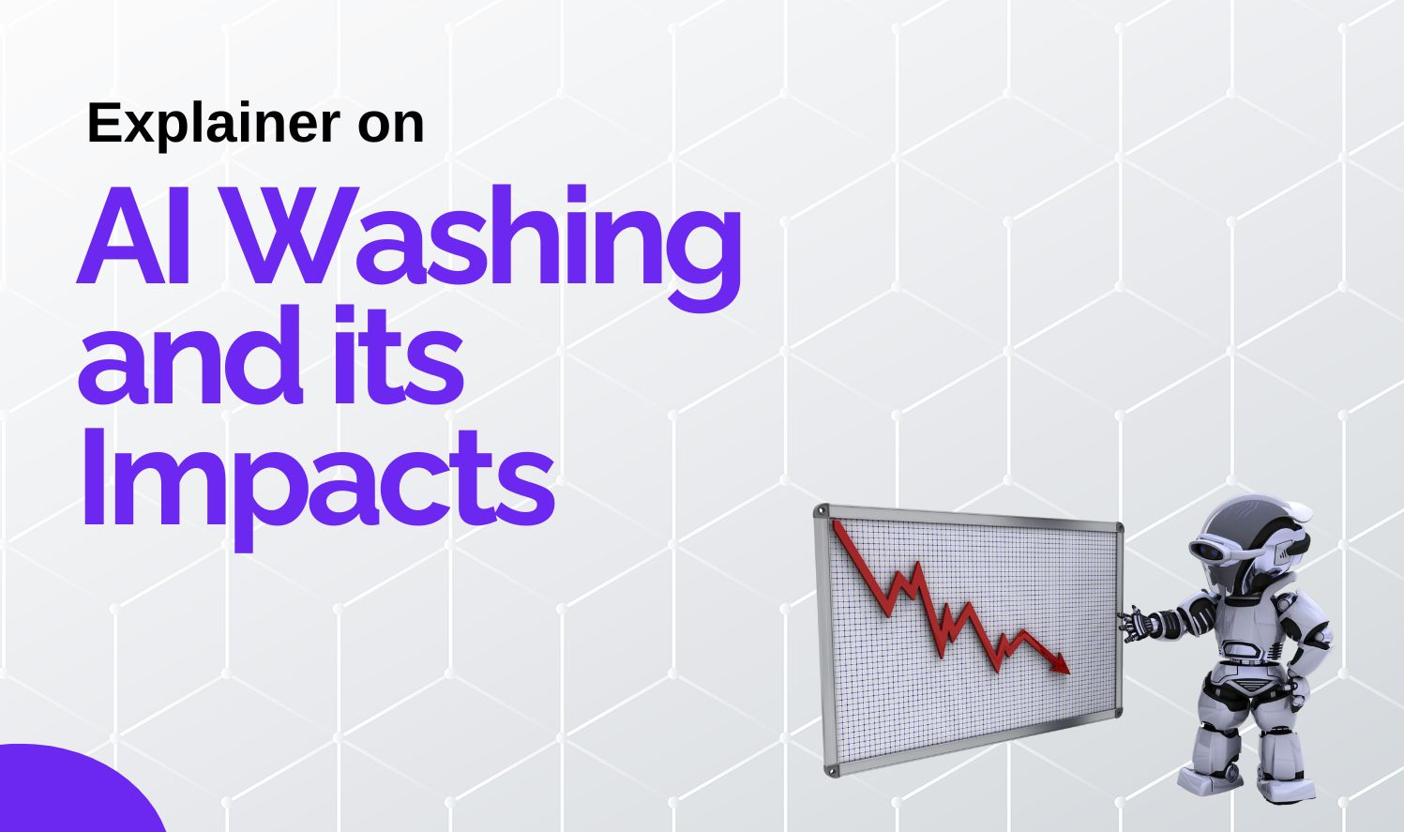
The Impact of AI washing in Big Tech
Module name- Problem Solving and Innovation (BMSW4014)
Module Leader- Chris Wilkin
Focus: What is AI washing and the impacts

Slide 2

AI washing?
AI washing is defined as the exaggeration or misrepresentation of AI capabilities for marketing or competitive advantage.
Common examples are;
Labelling simple automation or statistical tools as “AI”
Overstating the autonomy or intelligence of systems
Marketing hype that obscures the actual technical functionality
(Elhajjar and Itani, 2025)

Slide 3

Impacts of AI washing.
AI washing impacts can be on the organization, Industry wide and Investors which can be both negative or positive.
Positive Impacts:
Organization: Increase of company value, Attract Investment, Acquiring large market share & Profit
Industry: Becoming more attractive, Future ready
Investor: Return on investment, More dividends & Profit
(Li, 2025).

Slide 4
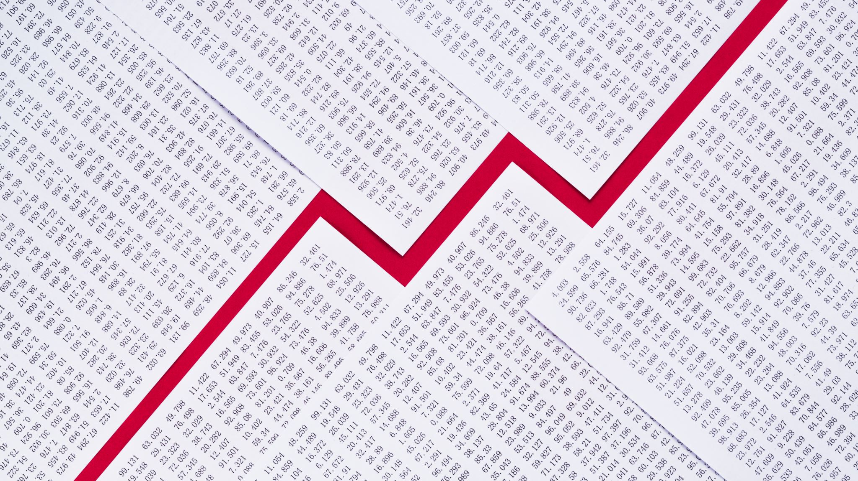
Negative Impact.
Organization: Reputational damage, Legal battle, Lost of consumer confidence.
To Investors: Lost of funds, Confidence, Bankruptcy
To the Industry: Becoming a high-risk sector, Attract hash penalty, Un reliable sector.
(Elsayed, 2026; Ozturkcan and Bozdağ, 2025).

Slide 5
References:
Brynjolfsson, E. and McAfee, A. (2014) The Second Machine Age: Work, Progress, and Prosperity in a Time of Brilliant Technologies. New York: W.W. Norton & Company.
Davenport, T.H. and Kirby, J. (2016) Only Humans Need Apply: Winners and Losers in the Age of Smart Machines. New York: Harper Business.
Floridi, L. (2019) Establishing the Rules for Building Trustworthy AI. Cham: Springer.
Kaplan, J. (2016) Artificial Intelligence: What Everyone Needs to Know. Oxford: Oxford University Press.
Lee, K.-F. (2018) AI Superpowers: China, Silicon Valley, and the New World Order. Boston: Houghton Mifflin Harcourt.

