Slide 1
ECEY4008
Group work

Slide 2
Contents
Working as a group
Interpersonal skills
Ground rules
Strengths
Clear agenda
Lack of progress
Task allocation
Responsibilities
Resources
PP Presentation
References
‘Personality’ activities

Slide 3
Skills
Employability/
Transferable Skills:
Working with others
Communication skills
Problem solving

Slide 4

Working as a group
Working with others,
why is this important?

Slide 5
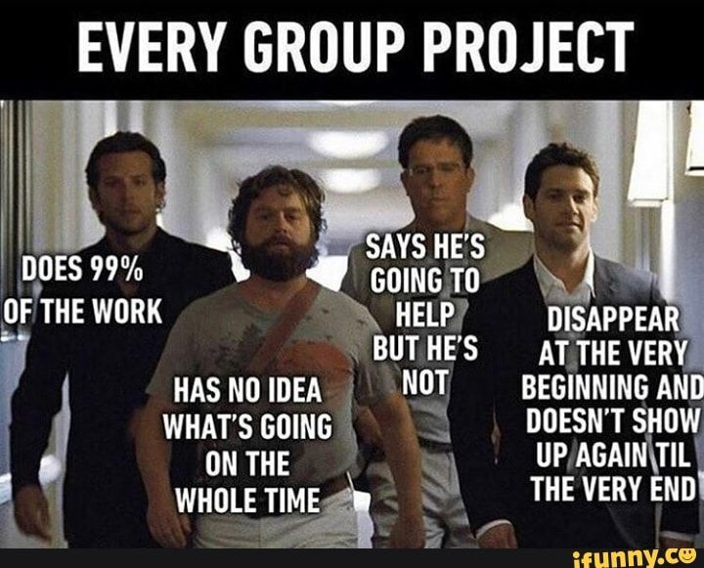
Working as a group…
Students learn from each other through group work and discussion.
Demonstrating effective interpersonal skills.
Developing negotiation, communication, listening, empathy..……

Slide 6
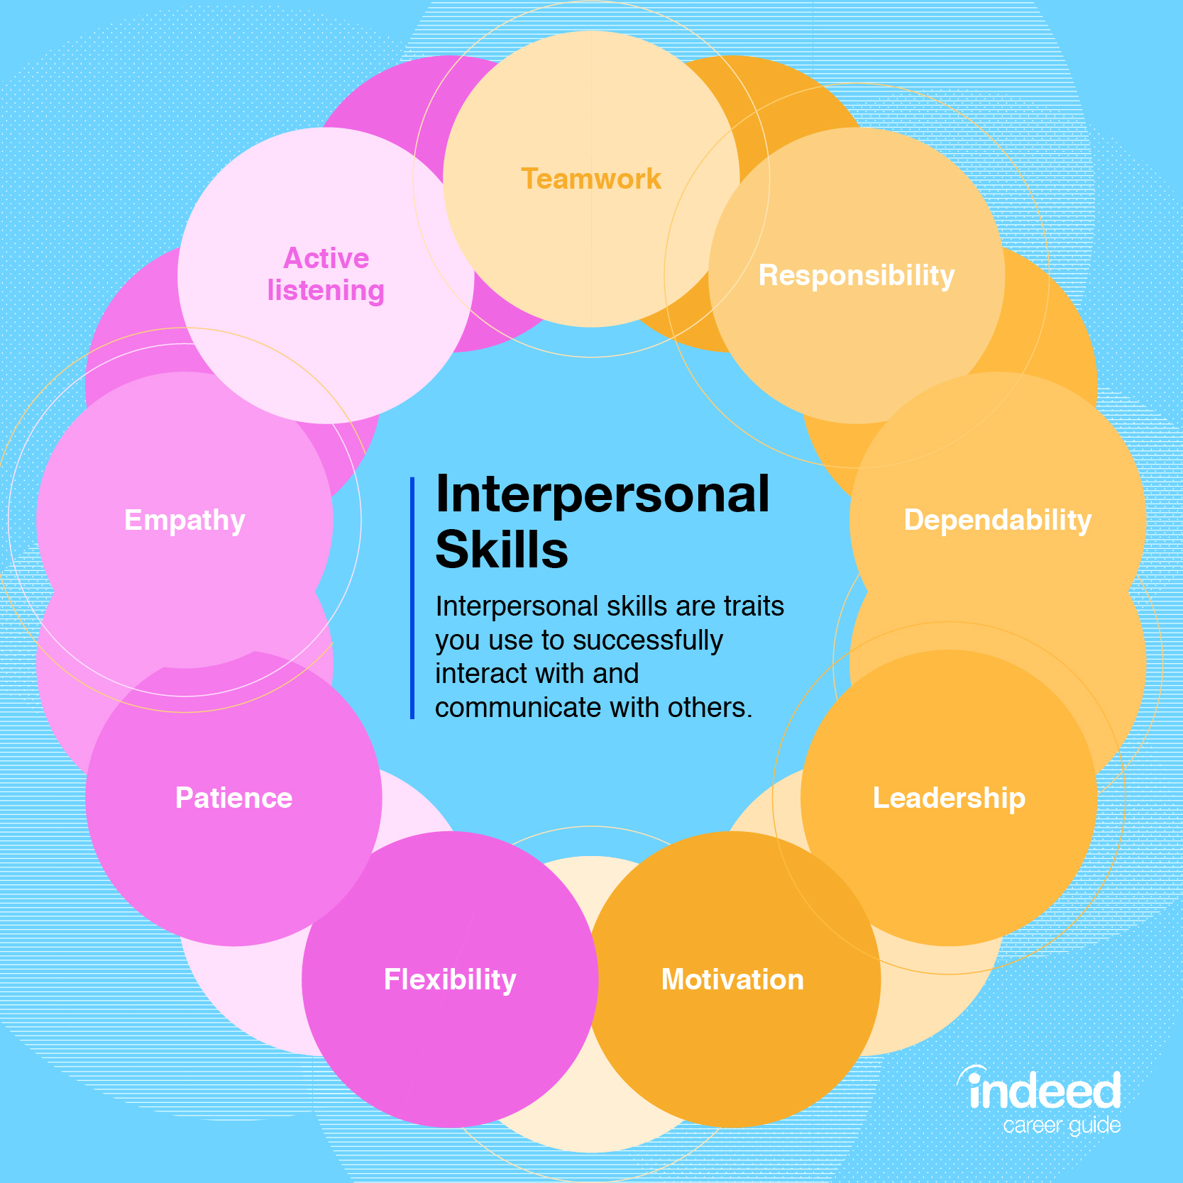
Interpersonal skills
Therefore there is a strong focus on improving people skills during this degree.
How well do you know yourself?
How good are your people skills…
Communication/listening/
leadership/compromise/
delegation?

Slide 7
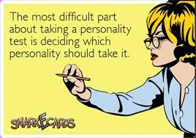
Personality – we all have one
Link to online personality test
Link to online personality test
Link to online personality test

Slide 8

Things to remember
People have feelings
Ground rules
Work to your strengths
Clear agenda
Lack of progress… reflect
Task allocation

Slide 9

Make ground rules for the group
The time you will meet
What to do if someone is dominating?
What to do if someone is not pulling their weight?
What kind of behaviour is acceptable/unacceptable?
What kind of comments are acceptable / unacceptable?

Slide 10

Work to your strengths
Who likes to run meetings?
Who likes to make notes?
Share tasks out
Include all members

Slide 11

Clear agenda
What are you going to discuss in each meeting?-all group members can bring their ideas which will save time – be organised ahead of the meeting
Arrange meeting times and venues well in advance so that everyone can attend.

Slide 12
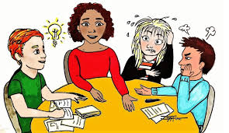
Lack of progress?
Each group member to suggest ways to improve progress which could include what you personally could do differently.
Are tasks shared fairly?
Is somebody dominating the group?
Are you considerate enough about each other’s feelings and ideas?
Experiences I have seen… here and elsewhere

Slide 13


Task allocation
Be clear about who is doing what
Ensure that tasks are allocated fairly
Set clear deadlines for completion

Slide 14

Responsibilities
Where does the group meet?
Can everyone get there?
Have you each other’s contact details?
How can you communicate if you cannot all meet face to face?

Slide 15
References
Cottrell , S. (2010) Skills for success: personal development and employability. 2nd edn. Basingstoke: Palgrave Macmillan.

