Slide 1
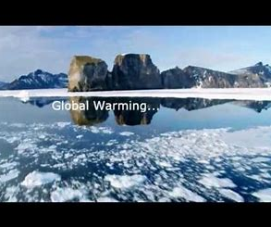

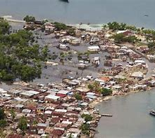
HPAN5003/6003 Contemporary Issues in Comparative Politics
Lecture 7: Development, Growth and Resources
Drawing the module to a close, we'll attempt a balance sheet of the big contemporary issues in comparative politics internationally, and how these relate to the challenges posed by:
Population growth
Global warming
Depletion of resources
Demands for global equity in the sharing of resources, within countries and between countries
An agenda for change?

Slide 2
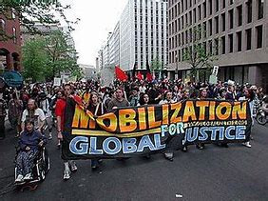
An agenda for change – do we have a choice?
Population growth
Global warming
Depletion of resources
Demands for global equity in the sharing of resources: within countries and between countries

Slide 3
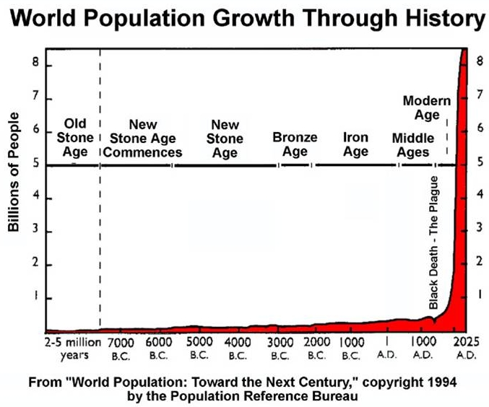
Population Growth

Slide 4
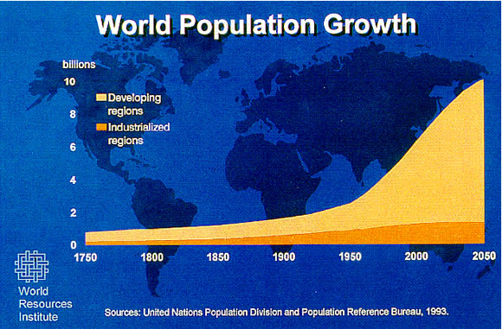
Population Growth
End of the Black Death in 1350: 370 million
First billion: 1800
Second billion: 1930s
Third billion: 1960
Fourth billion: 1977
Fifth billion: 1987
Sixth billion: 1999
Seven billion: 2012
April 2019: 7.7 billion
Projections: 9.8 billion by 2050

Slide 5
Human population
(over the last 12,000 years)
Source: Sachs, J.D., 2015. The Age of Sustainable Development. New York: Columbia UP

Slide 6
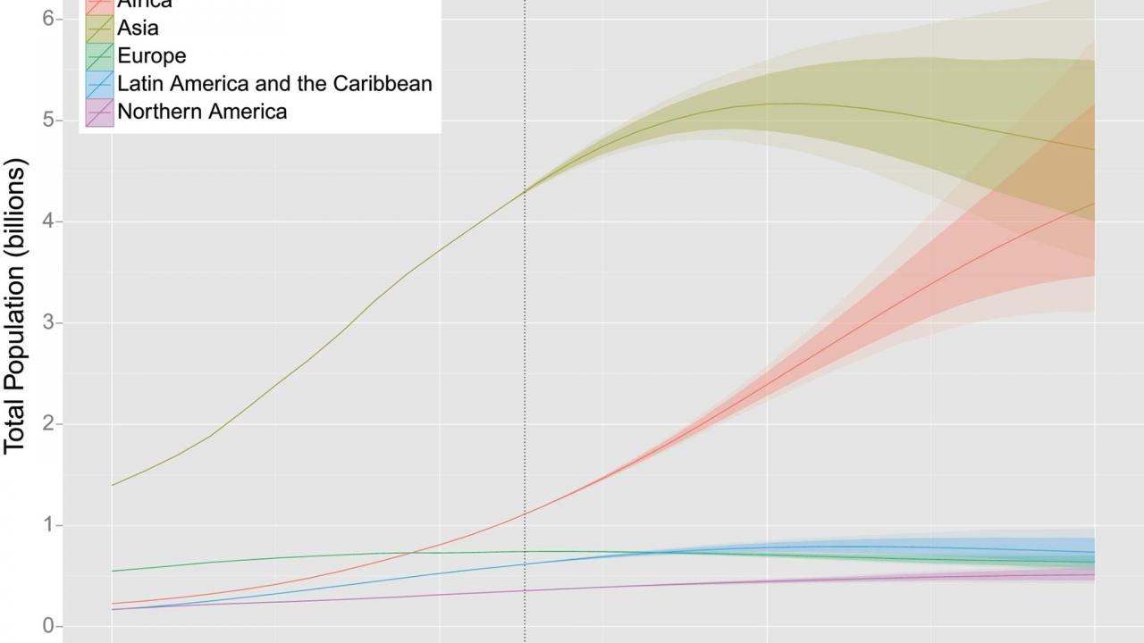
Human population growth into the future
Is it levelling off?
If so, why?
Setting the scene: Human Population through time. American Museum of Natural History. 2016. 6:24
https://www.bing.com/videos/search?q=limits+to+population+increase+&&view=detail&mid=BA30861CC1FE077E4810BA30861CC1FE077E4810&&FORM=VDRVRV

Slide 7
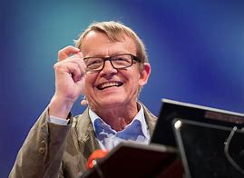
Relax, Hans says, it's all going to be okay. by Ben Winsor (SBS Australia), 13 July 2016
Hans Rosling (1948-2017) was a Swedish doctor, academic, statistician and public speaker, Professor of International Health at Karolinska Institute co-founder and chairman of the Gapminder Foundation.

Slide 8
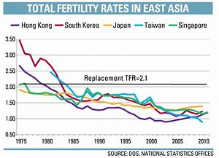
Four main reasons for this predicted levelling off
1) As lifespan gets longer, fertility rates fall
2) Women’s education means fewer children
3) We're getting used to low child mortality
4) We’ve reached peak child

Slide 9
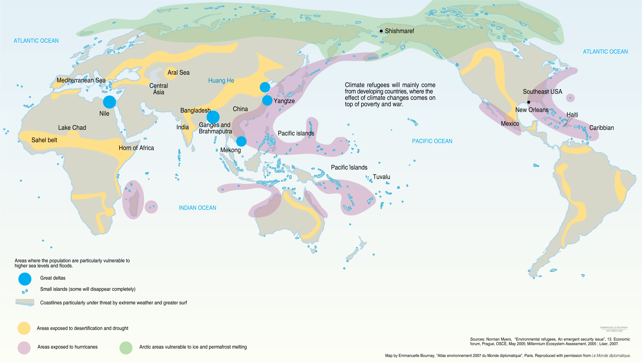
Global warming

Slide 10
Carbon dioxide emissions
Source: Sachs, J.D., 2015. The Age of Sustainable Development. New York: Columbia UP

Slide 11

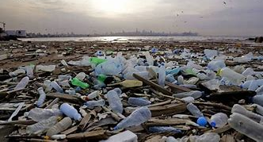
Depletion of resources
Human interaction with the environment
From incidental impact on the planet to
Fundamental impact on the planet to
Overwhelming impact: the Anthropocene era

Slide 12
Gross world output (over the last 2000 years)
Source: Sachs, J.D., 2015. The Age of Sustainable Development. New York: Columbia UP

Slide 13
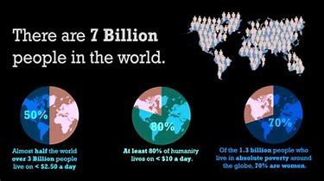
Inequality/Poverty

Slide 14
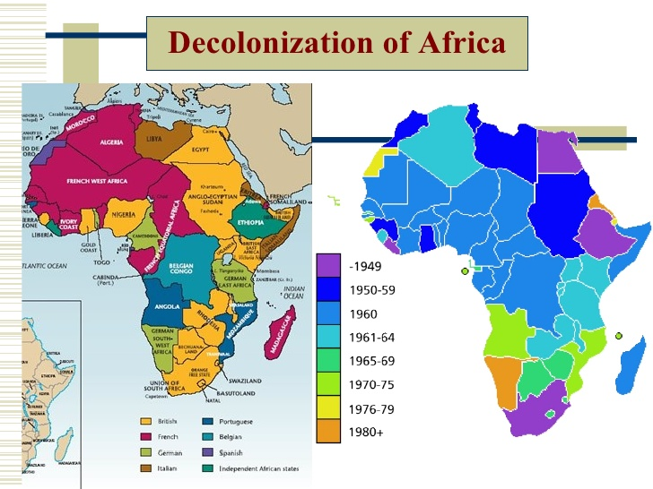
Development and
Post-Development Theory
1945, the Wind of Change and the Post-Colonial Epoch

Slide 15
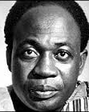



The idea of Neo-Colonialism
“The neo-colonialism of today represents imperialism in its final and perhaps most dangerous stage…In place of colonialism as the main instrument of imperialism we have today neo-colonialism.
The essence of neo-colonialism is that the State which is subject to it is, in theory, independent and has all the outward trappings of international sovereignty. In reality its economic system and thus its political policy is directed from outside.”
Introduction p.ix in Nkrumah, K., 1965. Neo-Colonialism: The Last Stage of Imperialism. London: Heinemann

Slide 16
Theories of “Development” in the post-colonial epoch
Modernisation Theory: popular in the 1950s-
mid-1960s
Structuralism and Dependency Theory: mid-1960s-1970s
Basic Needs Theory: 1970s
Neo-Classical Counter-Revolution/Neo-Liberalism/The Washington Consensus: 1980s-1990s
Human Development Theory: 1990s
Post-Development Theory: 2000s
Sustainable Development: the latest thing?

Slide 17
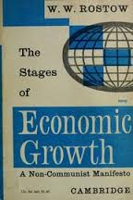
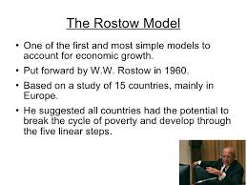
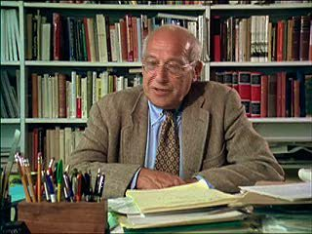
Modernisation Theory
1950s – mid-1960s
Walt Whitman Rostow (1916-2003)

Slide 18
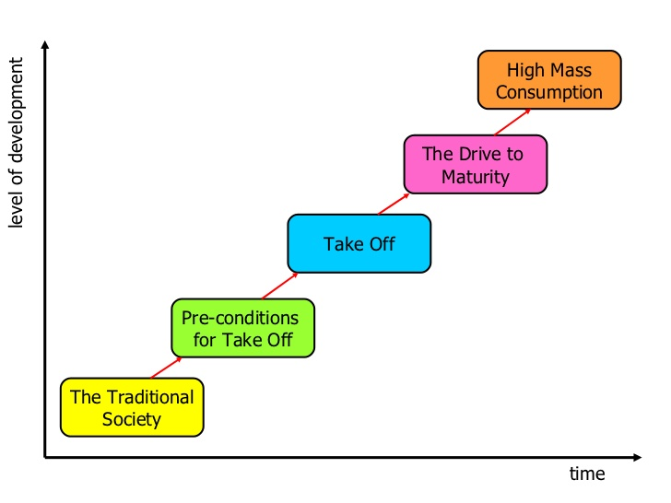
Rostow’s 5-stage model of economic growth

Slide 19
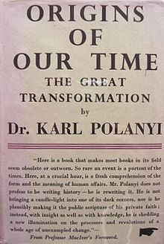
Critique of Rostow’s Theory
An attempt to explain development in an over-arching way (in the footsteps of G F Hegel and Karl Marx - and Karl Polanyi: The Great Transformation, 1944)
“A non-Communist manifesto” – the
subtitle of Rostow’s famous book
Mimicry and repetition, in parallel
with the West: naïve?
Don’t worry: there is a way forward
and it doesn’t involve a revolution!

Slide 20
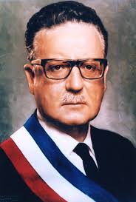
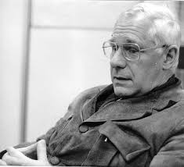
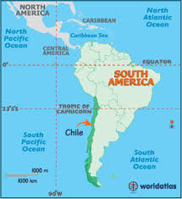

Structuralism and Dependency Theory
Mid-1960s – 1970s
André Gunder Frank (1929-2005)
German-American Economist
Went to Chile in 1962
The Development of Underdevelopment (1966)
Capitalism and Underdevelopment in Latin America (1967)
CD Government of Eduardo Frei 1964-1970
Popular Unity Government, Salvador Allende 1970-73

Slide 21
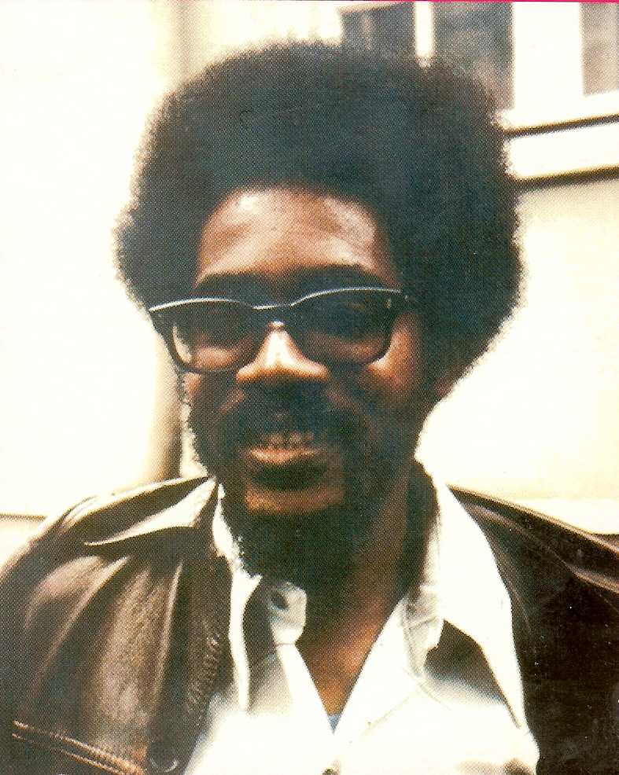
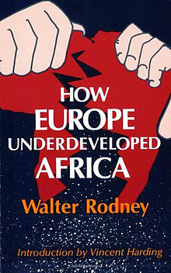
Applying the idea of “Underdevelopment”:
Walter Rodney (1942-1980)
How Europe Underdeveloped Africa (1972)

Slide 22
Structuralism
Dependency Theory: Core and Periphery
Latin American roots
Development and underdevelopment seen as two sides of the same coin
Post-colonial dependence is ensured by the reproduction of socio-economic and political structures at the periphery in accordance with the interest of the centre of power
Main interest of Western monopoly capitalism is to prevent, slow down or control the economic development of underdeveloped countries
So, what structural changes are needed?
Breaking the constraints imposed by the world trade system: tariffs to protect indigenous “infant industry” and promote ISI (Import Substitution Industries*)
More national control over and speed of the transition from rural to urban life
National control and ownership of extractive industry and of foreign trade

Slide 23
Neo-Classical Counter-Revolution/
Neo-Liberalism/The Washington Consensus
1980s - 1990s
A powerful combination
1979: Thatcher’s election victory brings in policies based on monetarism and ideas of the Chicago School: privatisation, rolling back the state
1980: Reagan’s election: Reaganomics
The Washington Consensus and a new tack for the World Bank and IMF

Slide 24
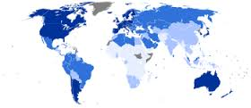
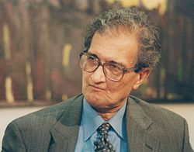


Human Development Theory : 1990s
Amartya Kumar Sen (b. 1933)

Slide 25
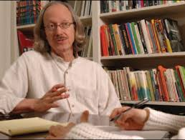
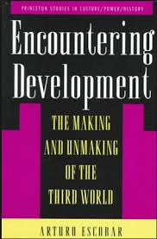
Post-development Theory
2000s
Arturo Escobar (b. 1952)
Colombian-American anthropologist

Slide 26
Some key concepts – and challenges to development “orthodoxy”
The post-development school argue that development was always unjust, never worked, and has clearly failed.
Post-development thought takes inspiration from vernacular societies, the informal sector and “frugal” rather than atavistic/materialistic lifestyles.
It does advocate structural changes. According to Escobar, post-developmental thinking believes that the economy must be based around solidarity and reciprocity; policy must focus on direct democracy; and knowledge systems should be traditional, or at least a hybrid of modern and traditional knowledge.

Slide 27
Post-development: some key ideas
Wolfgang Sachs is a leading writer in post-development thought. In 1992 he co-authored and edited The Development Dictionary: A Guide to Knowledge as Power which contributed greatly to the compilation of post-development literature as a general theory. According to Wolfgang Sachs, "the idea of development stands like a ruin in the intellectual landscape" and "it is time to dismantle this mental structure."
Arturo Escobar has outlined the common features of post-development thought and societal vision. According to Escobar, the post-development school of thought is interested (in terms of searching for an alternative to development) in "local culture and knowledge; a critical stance toward established scientific discourses; and the defence and promotion of localized, pluralistic grassroots movements." Grassroots movements, Escobar argues, are "local, pluralistic, and distrust organized politics and development establishment.“
See: A. Escobar, G. Esteva, M. Rahnema, W. Sachs, J. Ferguson, S. Latouche, G. Rist and F. Sabelli

Slide 28

So, is sustainability enough?
Should we be questioning the growth paradigm?
What is the growth paradigm (the
assumption of more-or-less uninterrupted
growth)?
W W Rostow (1916-2003) Modernisation theory
Truman Doctrine, March 29, 1947: Anti-communism; consumerism

Slide 29
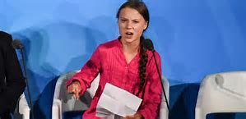
Should we be questioning the growth paradigm?
Greta Thunberg, at the UN Environment Summit, September 2019:
“Fairytales of eternal economic growth”
https://www.bing.com/videos/search?q=Great+Thunberg+fairytales+of+eternal+economic+growth&&view=detail&mid=4531CE4912584F0D43954531CE4912584F0D4395&&FORM=VRDGAR

Slide 30
Sustainable Development in the 21st century: A world-wide issue
Academia, the world of Ideas and the Third World: who and what has really made an impact?
My verdict:
Nkrumah and the concept of Neo-Colonialism?
Gunder Frank and Structuralism?
The IMF, the World Bank and Structural Adjustment?
Amartya Sen and Human Development: the UN General Assembly’s “rank and file”?

Slide 31
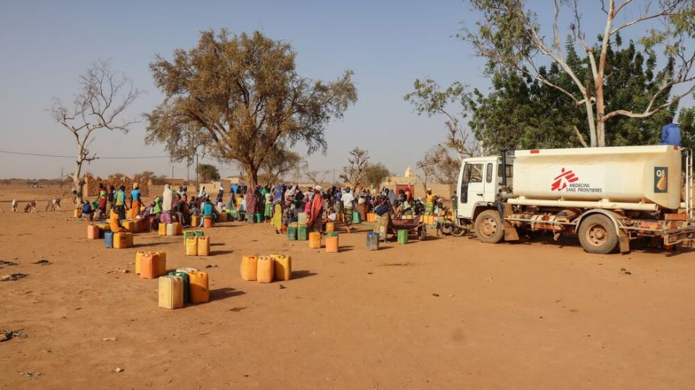
Lessons of Covid-19: A wake-up call?
What would you say this crisis has taught us?
Burkina Faso: MSF: Covid-19 aggravates the existing humanitarian crisis

