Slide 1
Emerging Issues
2019/20
Mike Durke
Senior Lecturer
MA MBA BA (Hons) PGCE (PCET) CMgr FCMI

Slide 2
Emerging Issues in the Public Sector
BMPS 6002
Email - Mike.durke@uwtsd.ac.uk
Website - www.mikedurke.co.uk
Twitter - https://twitter.com/Mikedurke
https://democracy.swansea.gov.uk/mgUserInfo.aspx?UID=392&LLL=-1

Slide 3
Contents
Overview
Level of Study
Aims of Module
Learning Outcomes
Lesson Content
Assessments
Deadline Dates
Referencing
Reading List
You Will Need …
VLE
Your Next Steps …
Q&A

Slide 4
Overview
20 Credits
Weeks 1 – 5 (w/b)
27th January 2020 – 24th February 2020
Assignment 1 – Monday 2nd March 11.59pm
2nd March – no classes, activity week
Weeks 6 - 8 (w/b)
9th March – 27th March
Easter break 30th March – 17th April
Week 9 - 11 (w/b)
20th April – 4th May
Assignment 2 - Friday 8th May 11.59pm

Slide 5
One weekly session
Thursdays 11am – 3pm
ASG13

Slide 6
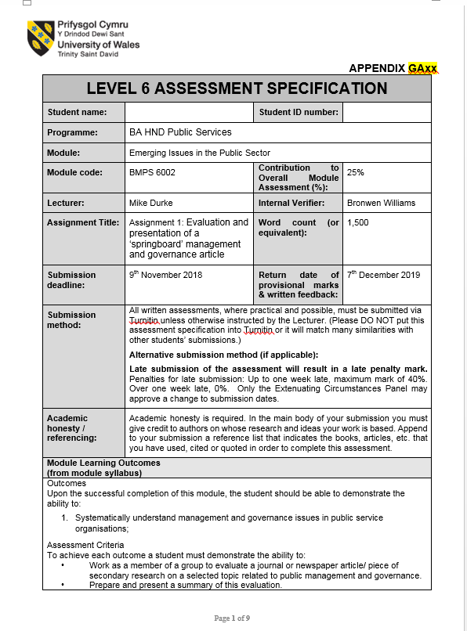
Level of Study

Slide 7
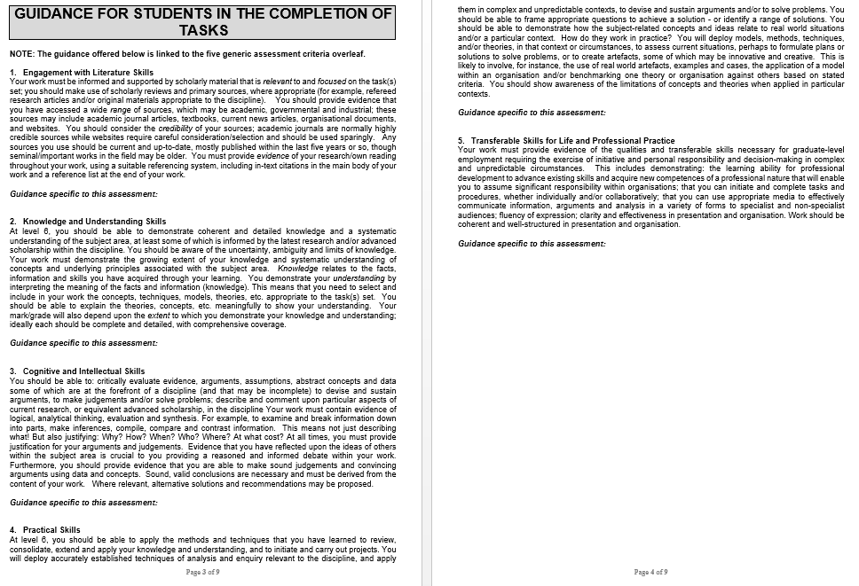

Slide 8
Aims of Module
To examine key aspects of management and governance in the context of public services and policing;
To develop a systematic understanding of the challenges organisations face in the planning and delivery of public services in contemporary Britain and how these challenges might be met.

Slide 9
Learning Outcomes
Upon the successful completion of this module, the student should be able to demonstrate the ability to:
systematically understand management and governance issues in public service organisations;
critically evaluate the emerging trends which impact on public management processes and practices, and the options being explored to deliver high quality services.

Slide 10
Lesson Content
Features of various governance and management practices
Application and impact of ICT in public service organisations
Citizen-centred services and community practice
Ethics and standards of conduct
Inspection and audit processes and practices
Value for money and best value
The challenge of ‘doing it differently’ – de-centralised management and social enterprise
Examination of various topical managerial and public governance issues
Public versus private funding for public assets and services, joint ventures and collaboration.

Slide 11
Assessments
Assessment Component 1 - Practical 25%
Students are required to write a critical evaluation of 1,500 words through which they demonstrate their understanding emerging issues of governance and management within public services, and to summarise their findings in a 5 minute presentation.

Slide 12
Assessments
Assessment Component 2 Coursework 75%
Students are required to produce a 4,500 word report which critically analyses the issues associated with the public management and governance article chosen for assignment 1.

Slide 13
Assignment 1
11.59pm on Monday
2nd March 2020
Assignment 2
11.59pm on Friday
8th May 2020

Slide 14
Referencing
The foundation for all academic success
Bachelor’s (level 6), Master’s (level 7) and PhD levels (level 8)
Author’s surname, initial, (year), title, place of publication: publisher
The basis of good practice in many professional roles

Slide 15
Reading List
Essential
Bovaird, A.G. and Loffler, E. (2015) Public Management and Governance, (3rd edition) Oxford: Routledge.
Davis, R (2016) Responsibility and Public Services, Axminster: Triarchy Press.

Slide 16
Further
Birchall, J. (2014) The Governance of Large Co-operative Businesses, Manchester: UK Co-operatives.
Clarence, E. and Gabriel, M (2014) People Helping People: the future of public services, London: Nesta.
Eliassen, K.A. (2008) Understanding Public Management and Administration. London: Sage Publications Ltd.
Flynn, N (2012) Public Sector Management, (6th Ed.) London. Sage Publications Ltd.
Osborne, S. (2010). The New Public Governance? Emerging Perspective on the Theory and Practice of Public Governance. Oxford: Routledge.
Osborne, D. and Gaebler, T. (1992) Reinventing Government: how the entrepreneurial spirit is transforming the public sector. Reading, MA: Addison-Wesley.
Quirk, B. (2011) Re-imagining Government: public leadership and management in challenging times, Basingstoke: Palgrave Macmillan.

Slide 17
You will need
Attendance
Commitment
Notes from many sources
Time management
Admin Organisation
READING READING READING
Support
Virtual Learning Environment

Slide 18


Virtual Learning Environment

Slide 19
Your Next Steps
Focus on what success will look and feel like: timely submission, none late, at least a pass mark!!
Attend all lectures and tutorials
Actively participate – speak up! There are no wrong answers in class discussions
Commit to your studies

Slide 20
Q&A
Any questions?

