Slide 1

Module: Living Well: A Life-Course Approach To Health And Wellbeing (BMNS4014)
MINA AFZALI - 2415274

Slide 2
Content
Definition of life course approach to health and wellbeing.
Why is childhood diabetes considered a life course concern.
How to care for a child with diabetes using a life course approach.
Why it is important.

Slide 3

What is A Life-Course Approach?
“A life course approach to health aims to ensure people’s well-being at all ages by addressing people’s needs, ensuring access to health services, and safeguarding the human right to health throughout their life-time. It emphasizes addressing people’s health needs across life phases, including maternal, newborn, child and adolescent health, and healthy adulthood and ageing.” (World Health Organization, 2025).
Being diagnosed with diabetes as a child is challenging and it could be an issue as they grow up. However, there are many solutions that could help change that.

Slide 4
Why is childhood diabetes considered a life course concern?
Early childhood circumstances:
Lack of care for diabetes in early childhood can cause long-term difficulty and can be life-threatening. These involve acute hypoglycemia that results in seizures. Alongside heart and kidney disease. Fox et al. (2018) state that “DKA (Diabetic Ketoacidosis) DKA causes vomiting and dehydration, often leads to hospitalization in the intensive care unit, and can cause brain swelling, stroke, or even death.”
Inconsistent routine – Lack of exercise and an unhealthy diet can result in bad outcomes as the child is not receiving the right nutrients to have a healthy development and without physical activity, the child's health will worsen over time as it can cause excess weight gain, blood pressure levels rising and may affect the heart.
“Diabetes in children is a chronic disease that affects the way your child's body processes sugar (glucose) for fuel. Without treatment, the disorder causes sugar to build up in the bloodstream, which can lead to serious long-term consequences.” (Mayo Clinic, 2025).

Slide 5
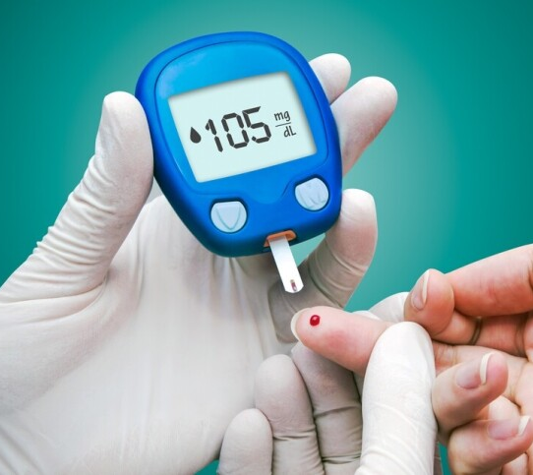
The crucial periods for developing long term routines are childhood and adulthood.
Parents educating their children on how to manage their diabetes as they get older will be very beneficial for their early adulthood stages as it will be easier for them to manage stress and gives them the ability to have greater control as adults. As well as guiding them to have a healthier diet plan.
Freestyle Libre. (2024) advises to “Explain that when they feel their symptoms aggravate, they should inform you. If they’re old enough, explain their glucose monitoring needs to them as well. Explain how to use a diabetes device and when and how often they should use it to check their glucose levels.”

Slide 6
How to care for a child with diabetes using a life course approach
It is important that parents do regular checks and keep an eye on their child that may show any early symptoms of diabetes and beginning treatment right away to avoid any life-long risks. According to (Mayo Clinic, 2025). The signs and symptoms of type 1 diabetes in children usually develop quickly, and may include:
Increased thirst
Frequent urination, possibly bed-wetting in a toilet-trained child
Extreme hunger
Unintentional weight loss
Fatigue
Irritability or behavior changes
Children diagnosed with diabetes need love, support and patience from their loved ones including teachers and caretakers as it is better for their mental health. Children with diabetes tend to feel alienated, sad or even frustrated with their condition and could feel like a nuisance. “It's normal for children or adolescents to feel sad, angry and fed up with their diabetes at times. After all, diabetes is a lifelong condition, so the tasks and skills needed to manage it must be continued over a lifetime.” (Better Health, 2024).

Slide 7

Lifestyle: It is crucial for parents to educate their child on staying active as (Diabetes UK, 2025). states “Physical activity is an important part of a healthy lifestyle, and all children and young people should do at least an hour of moderate to vigorous physical activity each day. This includes things like brisk walking, very active play, and most sports and games (e.g. skipping, dancing and swimming).”
Physical activity also lowers blood pressure, reduces the risk of heart disease and improves blood glucose. It also helps reduce stress and this way: children can cope with stress. “Even taking a walk can help reduce the blood sugars and stress response.” (Children With Diabetes, 2025).

Slide 8
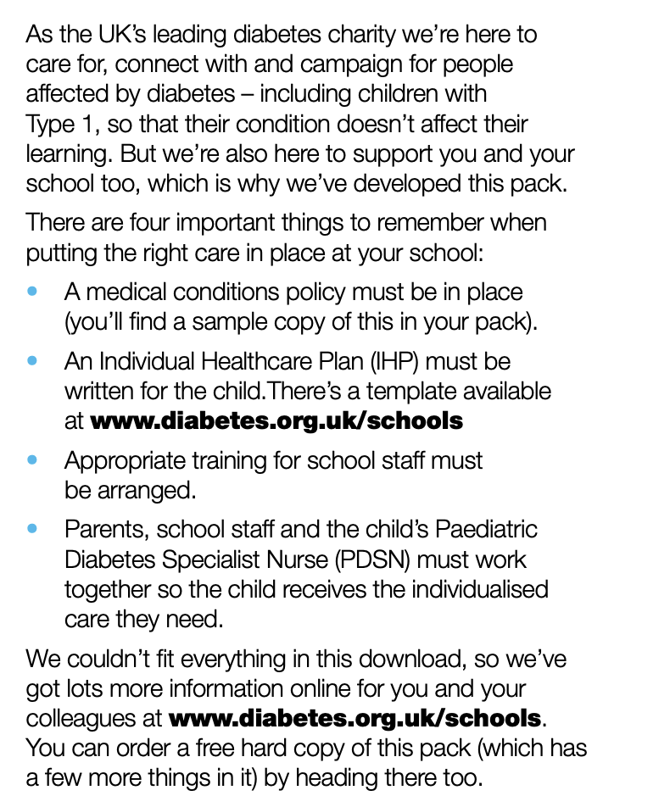
Educational aid
“No parent should be relied on to go into school to treat their child’s diabetes and every child with diabetes should be allowed to inject insulin, in public or in private, depending on their wishes. Every school should have a medical condition at school policy, which is updated every year.” (Diabetes UK, 2025).
Diabetes UK offers a school pack which is a policy to support children with diabetes in school.
Benefits – providing a safe environment, engage in school activities and it won't affect their ability to learn alongside building the confidence of the school staff.

Slide 9
Conclusion
Why this is important:
Diabetes is a life-long condition, and it is crucial for parents to gain knowledge and understanding towards their child’s health and wellbeing. Teaching children the importance of monitoring their insulin, participating in physical activities and managing their emotions .i.e. stress, anger, sadness and frustration minimizes future complications.
Diabetes can have an affect on the parents as well as the children, mentally and physically and with the solutions provided and the correct support, it could improve their lifestyle. Alongside avoiding high risks factors in adulthood- such as heart disease, seizures, blood sugar levels rising and worsening of the condition.
Using the life course approach, we can learn to manage diabetes better in order to provide a more beneficial future for children.

Slide 10

References
World Health Organization. (2025). Life Course. Available at: https://www.who.int/our-work/life-course (Accessed 14.03.25).
Fox, L.A., Pfeffer, E., Stockman, J., Shapiro, S. And Dully, K. (2018) ‘Medical neglect In children and adolescents with diabetes mellitus’, Journal of child and adolescent trauma. Available at: https://pmc.ncbi.nlm.nih.gov/articles/PMC7561625/#Sec3 (Accessed 14.03.25).
Mayo Clinic. (2025). Type 1 diabetes in children. Available at: https://www.mayoclinic.org/diseases-conditions/type-1-diabetes-in-children/diagnosis-treatment/drc-20355312 (Accessed 14.03.25).
Freestyle Libre. (2024). How to talk to your child about diabetes. Available at: https://www.freestyle.abbott/in-en/discover/blog/how-to-talk-to-your-child-about-diabetes.html#:~:text=Explain%20that%20when%20they%20feel,to%20check%20their%20glucose%20levels. (Accessed 14.03.25).
Mayo Clinic. (2025). Type 1 diabetes in children. Available at: https://www.mayoclinic.org/diseases-conditions/type-1-diabetes-in-children/symptoms-causes/syc-20355306 (Accessed 14.03.25).
Better Health. (2024). Diabetes – issues for children and teenagers. Available at: https://www.betterhealth.vic.gov.au/health/conditionsandtreatments/diabetes-issues-for-children-and-teenagers (Accessed 14.03.25).
Diabetes UK. (2025). Physical activity and your child. Available at: https://www.diabetes.org.uk/living-with-diabetes/life-with-diabetes/children-and-diabetes/physical-activity#:~:text=For%20children%20with%20diabetes%2C%20being%20active%20and,blood%20glucose)%20and%20prevent%20excess%20weight%20gain.&text=Being%20active%20helps%20your%20child%20maintain%20a,in%20turn%20will%20help%20their%20diabetes%20control. (Accessed 14.03.25).
Children With Diabetes. (2025). Stress and blood sugars. Available at: https://childrenwithdiabetes.com/clinical-director/stress-and-bgs/ (Accessed 14.03.25).
Diabetes UK. (2025). Diabetes in schools. Available at: https://childrenwithdiabetes.com/clinical-director/stress-and-bgs/ (Accessed 14.03.25).
Diabetes UK. (2014). Type 1 diabetes at school: school pack. Available at: https://elibrary.cumbria.gov.uk/elibrary/Content/Internet/537/17241/17246/17268/17288/4297611465.PDF (Accessed 14.03.25).

