Slide 1
PE and Aquatic Activities
Discussion Sessions
(BMPE4005) Level 4
Kate Piper
Introduction and Experiences

Slide 2
Semester 1 Plan
Two semester module.
Tuesday 10-12
Practical sessions with Karin (next semester) and Dylan
Discussion focused
PE – Aims, role and place in the curriculum

Slide 3
Assignment 1
“In order for PE to be relevant for every child and young person who experiences it, regardless of the context in which it is delivered, we argue that it is important to be clear about the aims of the subject”
(Capel and Blair, 2019: 56)
Considering the quote above and drawing on relevant academic literature, take part in an academic interview, in which you identify and justify what you consider to be the most important aims for Physical Education in the 21st century.

Slide 4
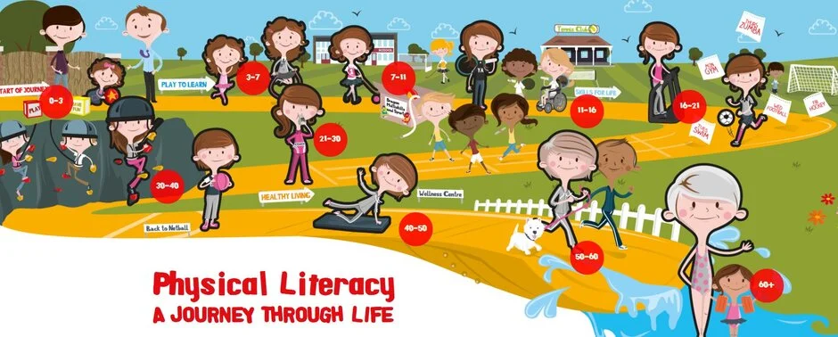

Slide 5
Experiences
What did PE look like in your schools?
  Primary/ Secondary
  Activities
  Ways of teaching and learning
  Negatives
Perspectives of others on PE?
  Peers/ other teachers/ school culture and SLT
  Reasons for these attitudes: positive/negative
Notes:
What experiences have you had in the past to want to become a PE teacher
What led you to enrol in this degree
What impact did you teachers have on you

Slide 6
Kate’s questions
How did you find the reading?
  What strategies did you put in place?
  How long do you think it took you?
Interesting points…
Agreements and disagreements
Any other key points you want to raise?

Slide 7

Physical Activity
Physical Education
School Sport
Recreational Sport
What do the terms mean individually?
What are the similarities and differences?
What are the relationships between them?
Notes:
Are you a physical educated person? Did PE contribute to this?

Slide 8
Reading for next week:
Aims of physical Education – Small article readings. Choose three to read.
Advantages of including this in PE
Disadvantages of including this in PE
Should this be a main aim for PE? Why/ Why not?
Why has this been asked for in PE?

