Slide 1
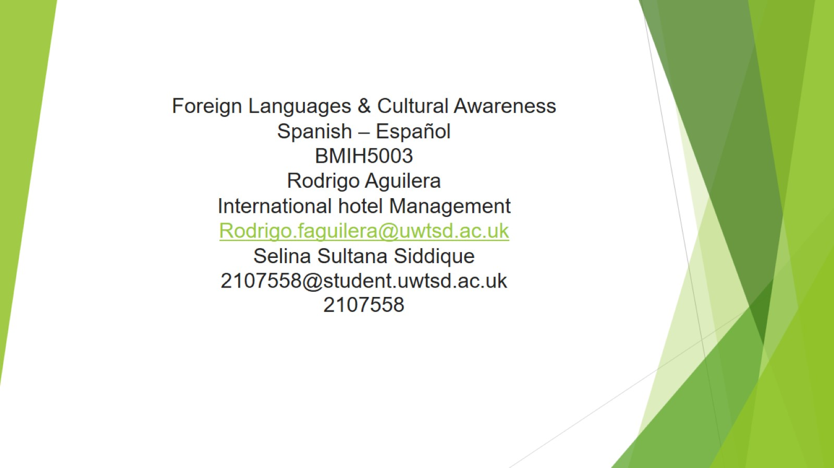
Foreign Languages & Cultural Awareness
Spanish – Español
BMIH5003
Rodrigo Aguilera
International hotel Management
Rodrigo.faguilera@uwtsd.ac.uk
Selina Sultana Siddique
2107558@student.uwtsd.ac.uk
2107558

Slide 2


