Slide 1

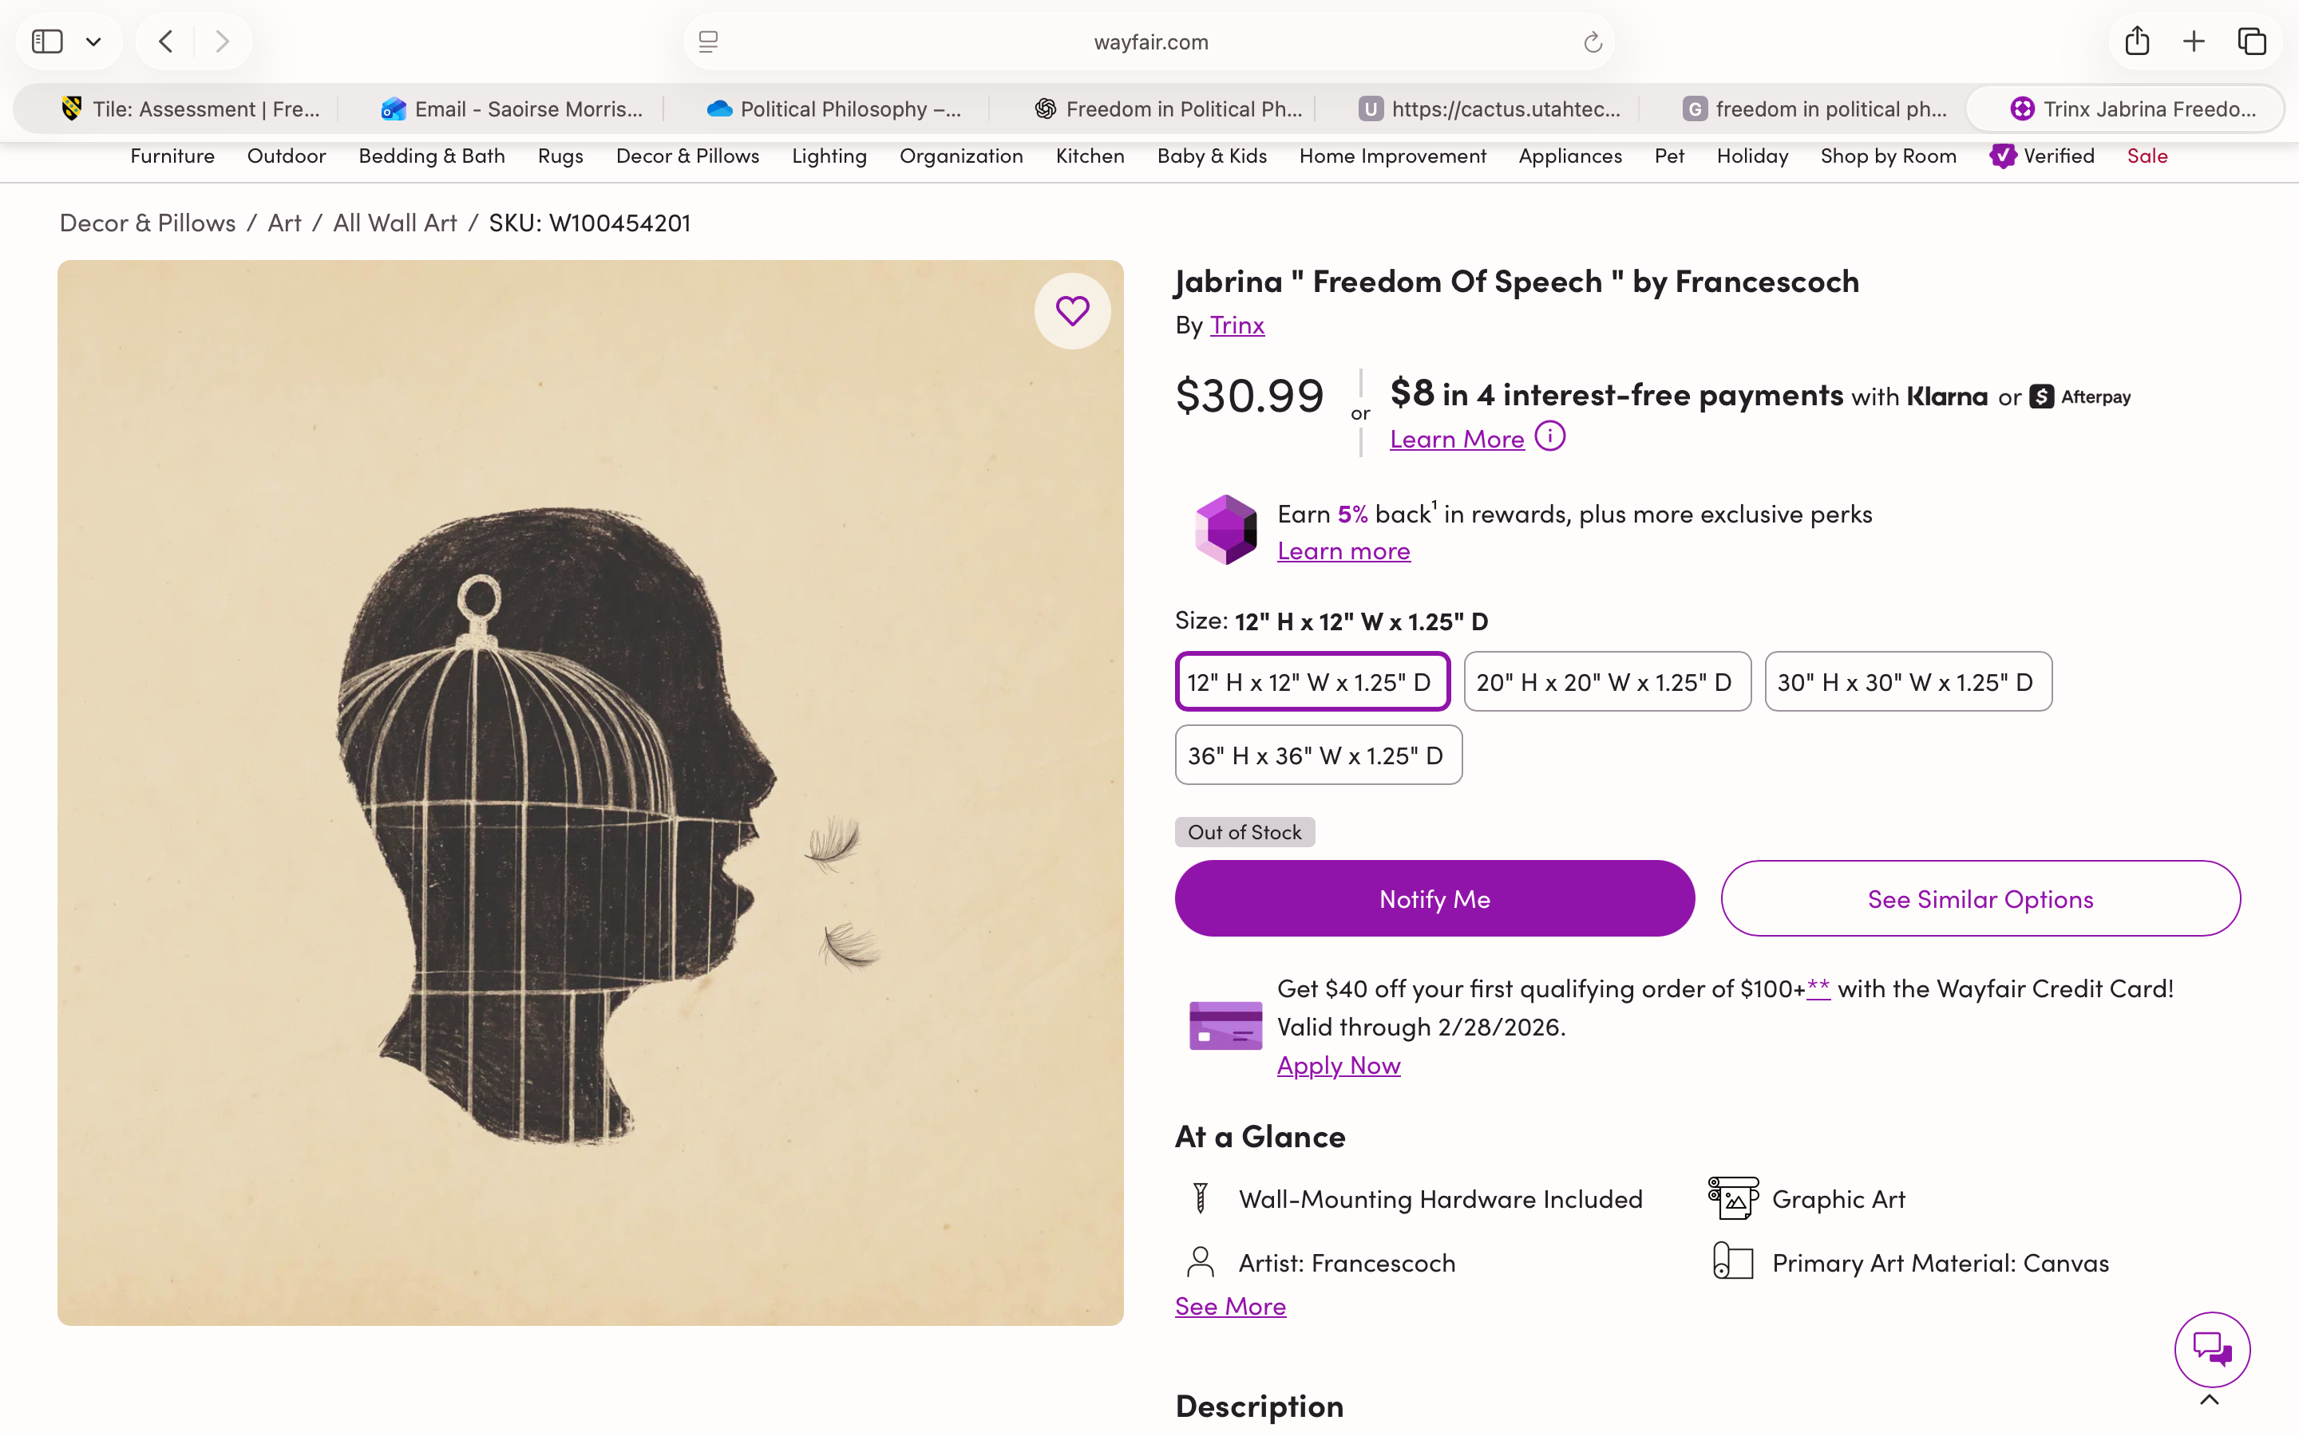
Political Philosophy: Freedom, Equality & Justice
What constitutes a free society?
Saoirse Morris

Slide 2
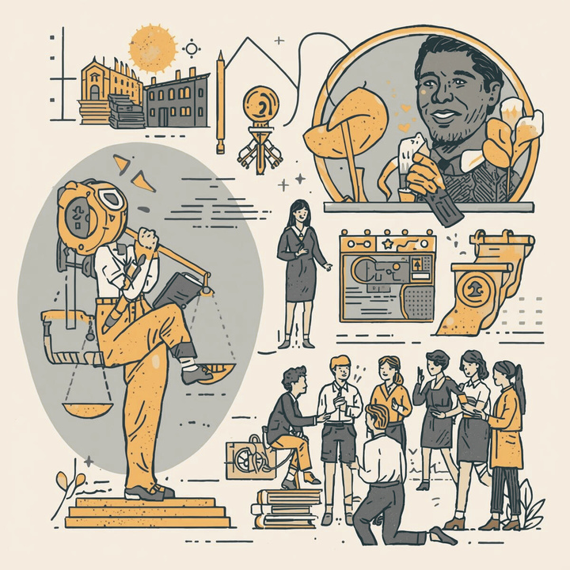
The disagreement within political philosophy regarding freedom
Competing Interpretations
  Freedom as non-interference
  Freedom as self-rule
  Freedom as security
  Freedom as equal opportunity
So, what must society guarantee for its members to be truly free?

Slide 3
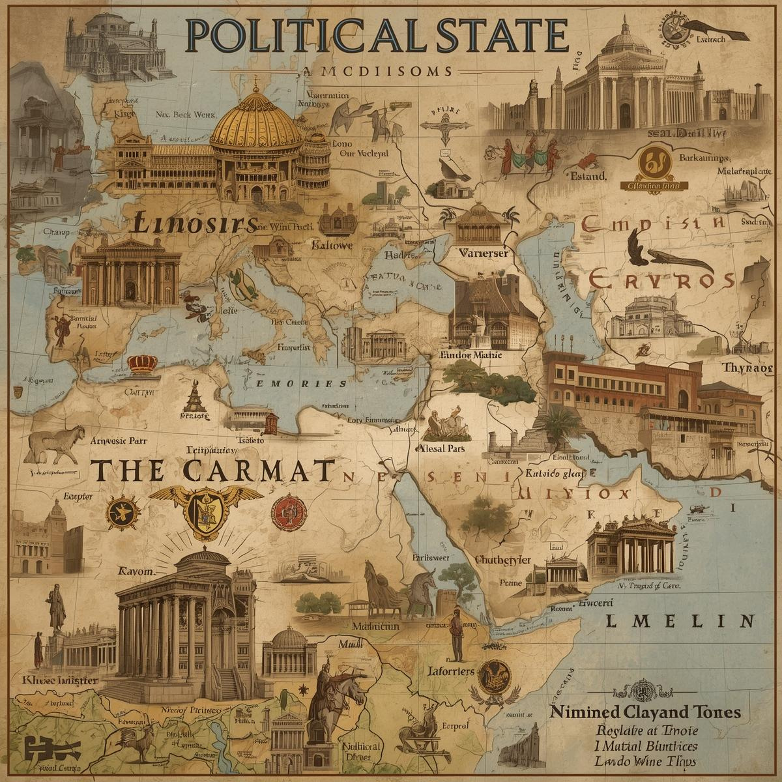
Two Meanings of Freedom
Negative Freedom
  ‘Freedom from’
  No interference
  Absence of legal constraints
Positive Freedom
  ‘Freedom to’
  Power to act on complete free will
  Master of the self
Does a real free society prioritise protection from interference OR the ability to control one’s own life collectively?

Slide 4
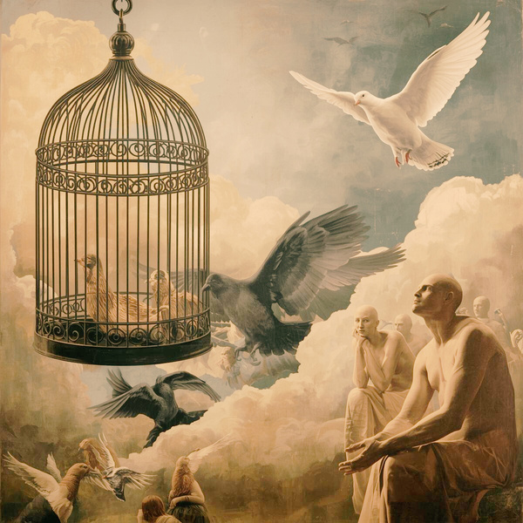
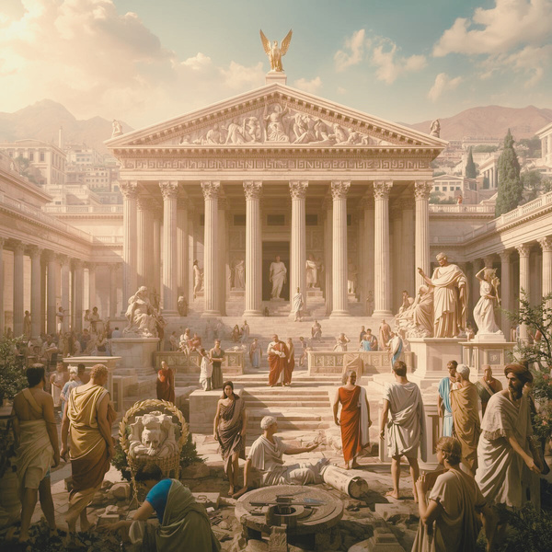
What is the tension?
The Role of the State
Negative Freedom
→ Minimal state
→ Sole aim to protect individuals from coercion
Positive Freedom
→ State intervention
→ Collective > Individual basis for choices
What are the implications?
Negative Freedom
Positive Freedom
  Protects individual rights
  No one can obstruct you
  Protects exisiting possessions
  Intervention can provide education, healthcare etc
  Redistribution of resources
  Empowering the self
Good:
  Inequality of opportunity
  Domination by private power
  Marginalisation
  Neglect of public goods
  Coercion disguised as liberty
  Totalitarianism
  Paternalism
  Tyranny of the masses
Bad:

Slide 5

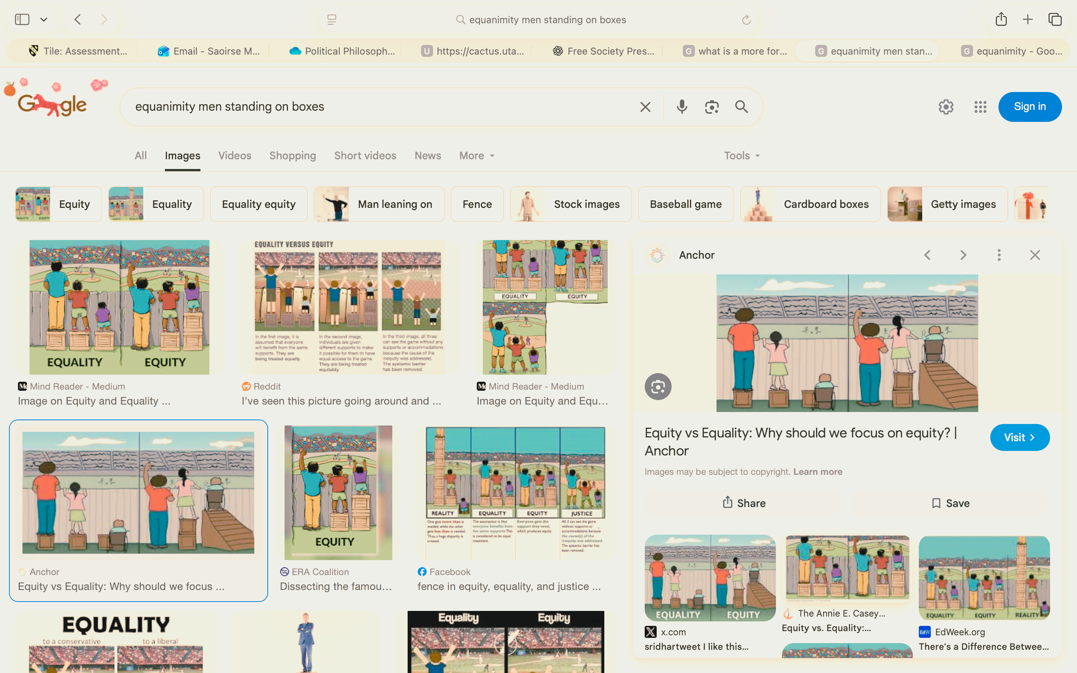
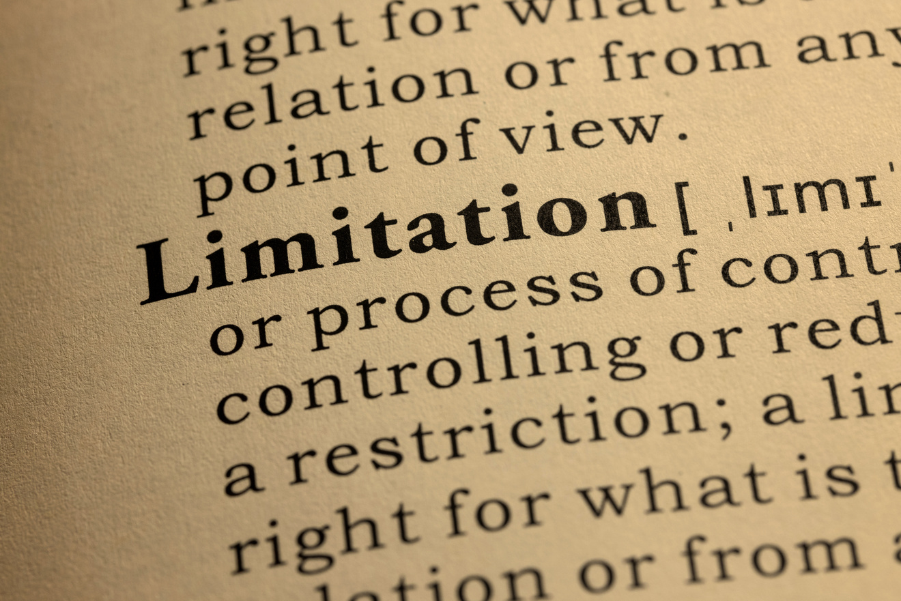
Where should we land?
a pluralist liberal view of freedom with social justice commitments
Protected Individual Autonomy
A sphere of non-interference allowing plural ways of life (negative freedom - Berlin)
A society is truly free not when no one is restrained, but when no one lacks the real power to choose their own life.
Real Capacity to Act
Social conditions that enable individuals to pursue their goals (fair opportunity - Rawls)
Justified Limits on Freedom
Restrictions are legitimate when they expand meaningful actual freedom overall (harm principle - Mill)

Slide 6
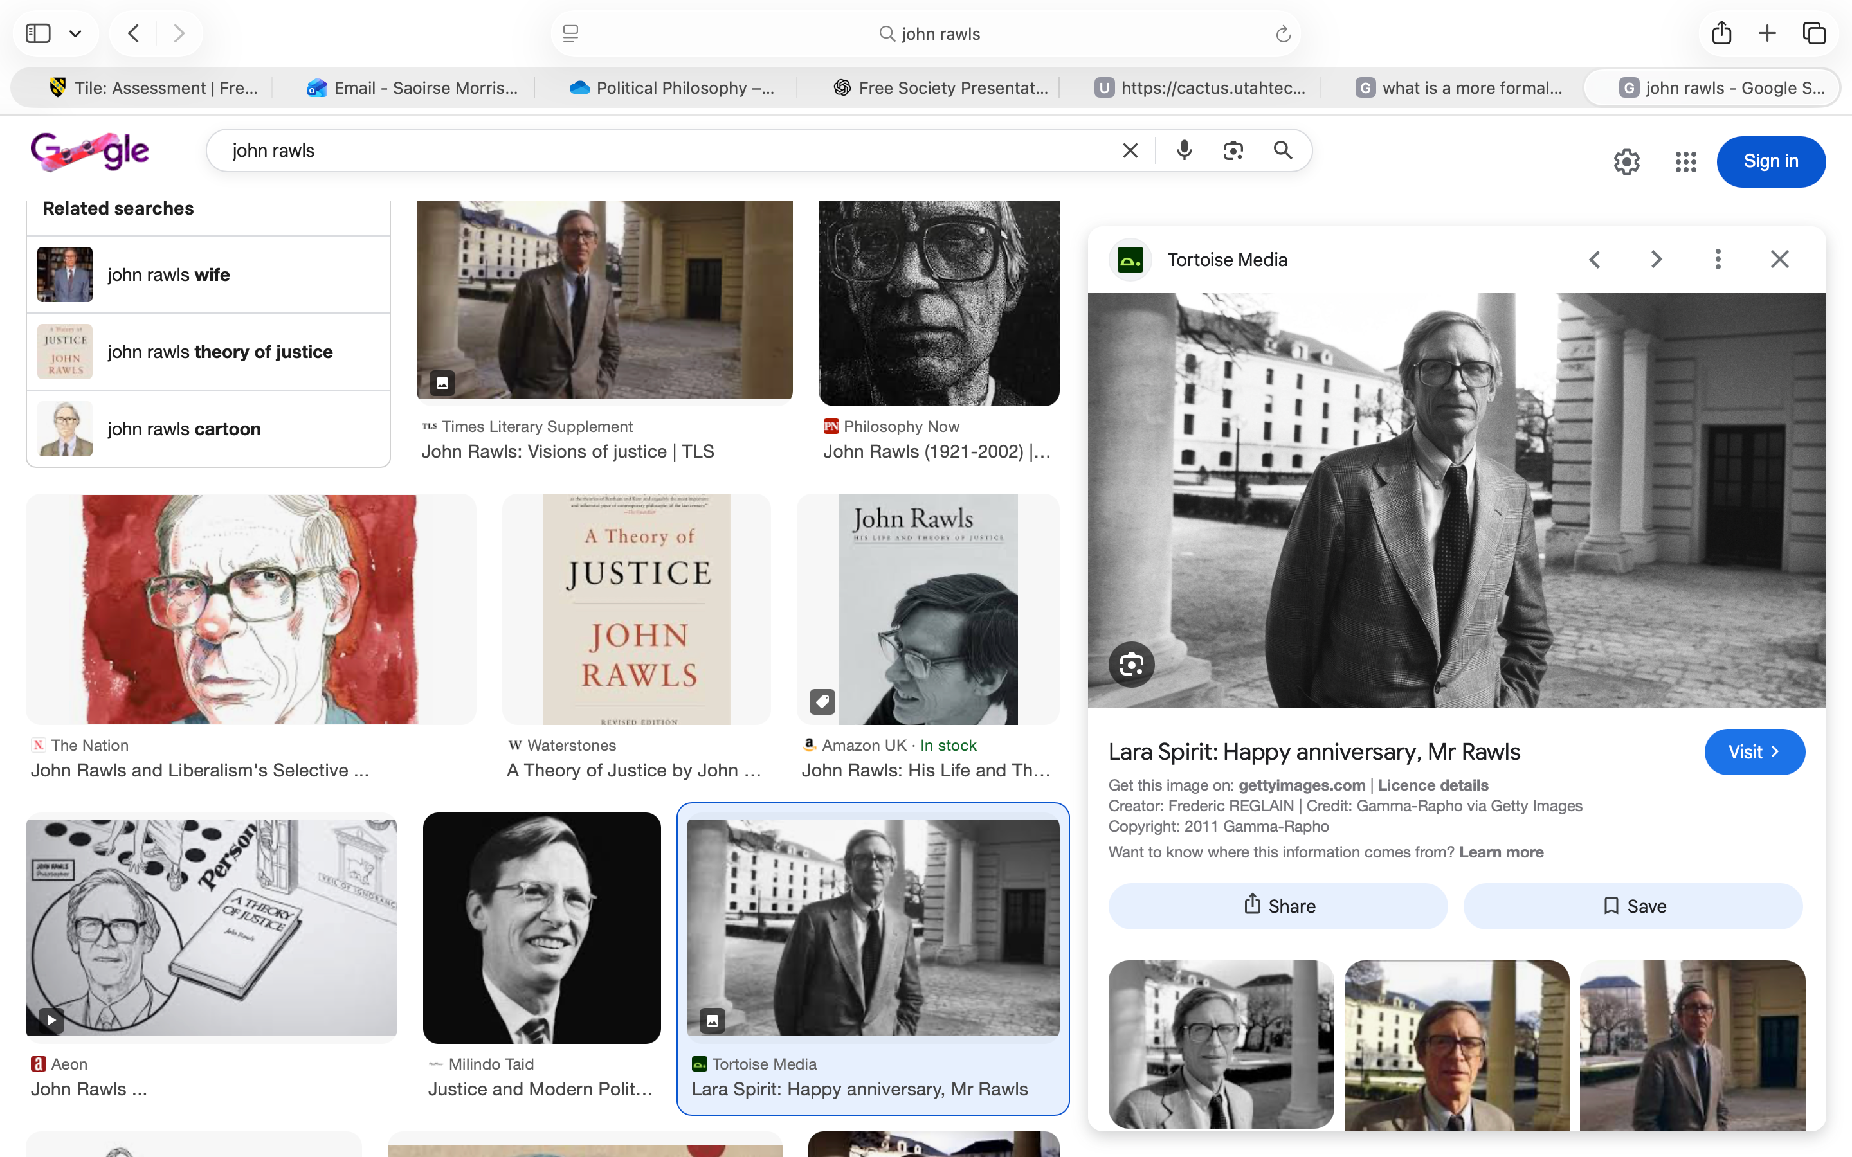
My free society and where it aligns
Rawls - A Theory of Justice
  Theory of Justice
Freedom needs fairness.
  Problem of Luck
Benefits from society are outside of your control creating unfairness and biased political discourse.
  Thin Theory of the Good
There are intrinsic values of liberty, opportunity, money and social basis of respect - idea of autonomy.
  Difference Principle
Social inequalities should be arranged to benefit the least advantaged - allows limitations on individual freedom.
  Fair Opportunity Principle
Should be comparable resources to accomplish things - avoids natural inequalities.

Slide 7
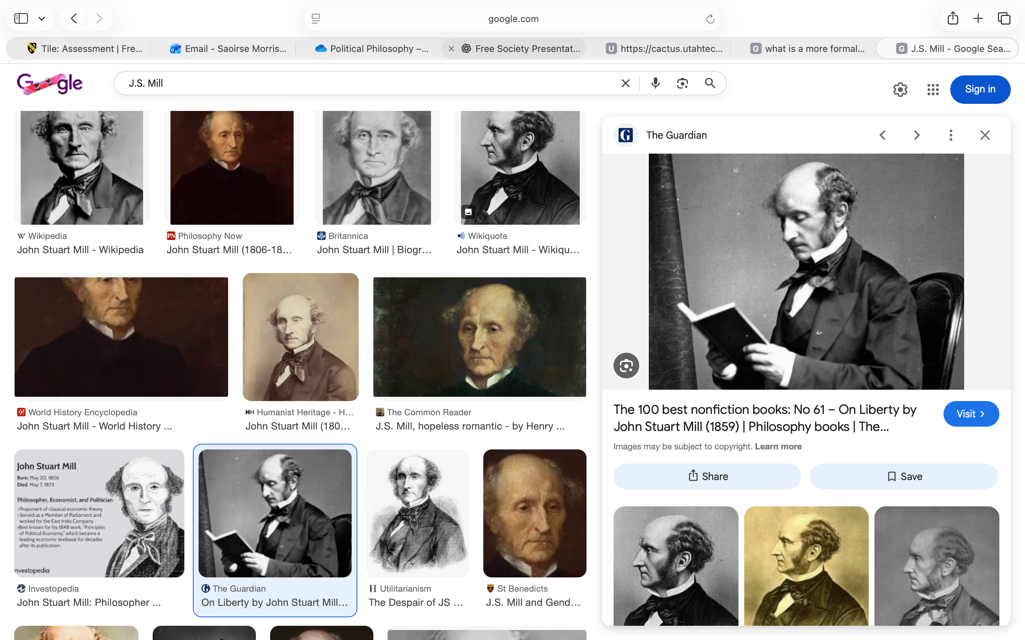
My free society and where it aligns
Mill - On Liberty
  Liberty of Thought & Individuality (III)
Limited intervention in private life, diversity of life plans is a social good, not a threat - autonomy, pluralism and resistance to elite control.
  Of the Limits to the Authority of Society (IV)
Society cannot impose a particular conception of the ‘good life’ and this doesn’t justify coercion - a limited state.
  Harm Principle (I)
Liberty should not include a right to actions that undermine anyone else’s ability to live freely - endorses limitations to individual freedom for the flourishing of many.
  Applications (V)
Regulation to prevent exploitation, limits on actions which reduce the security of others - support of certain legal constraints that protect a broader freedom.

Slide 8
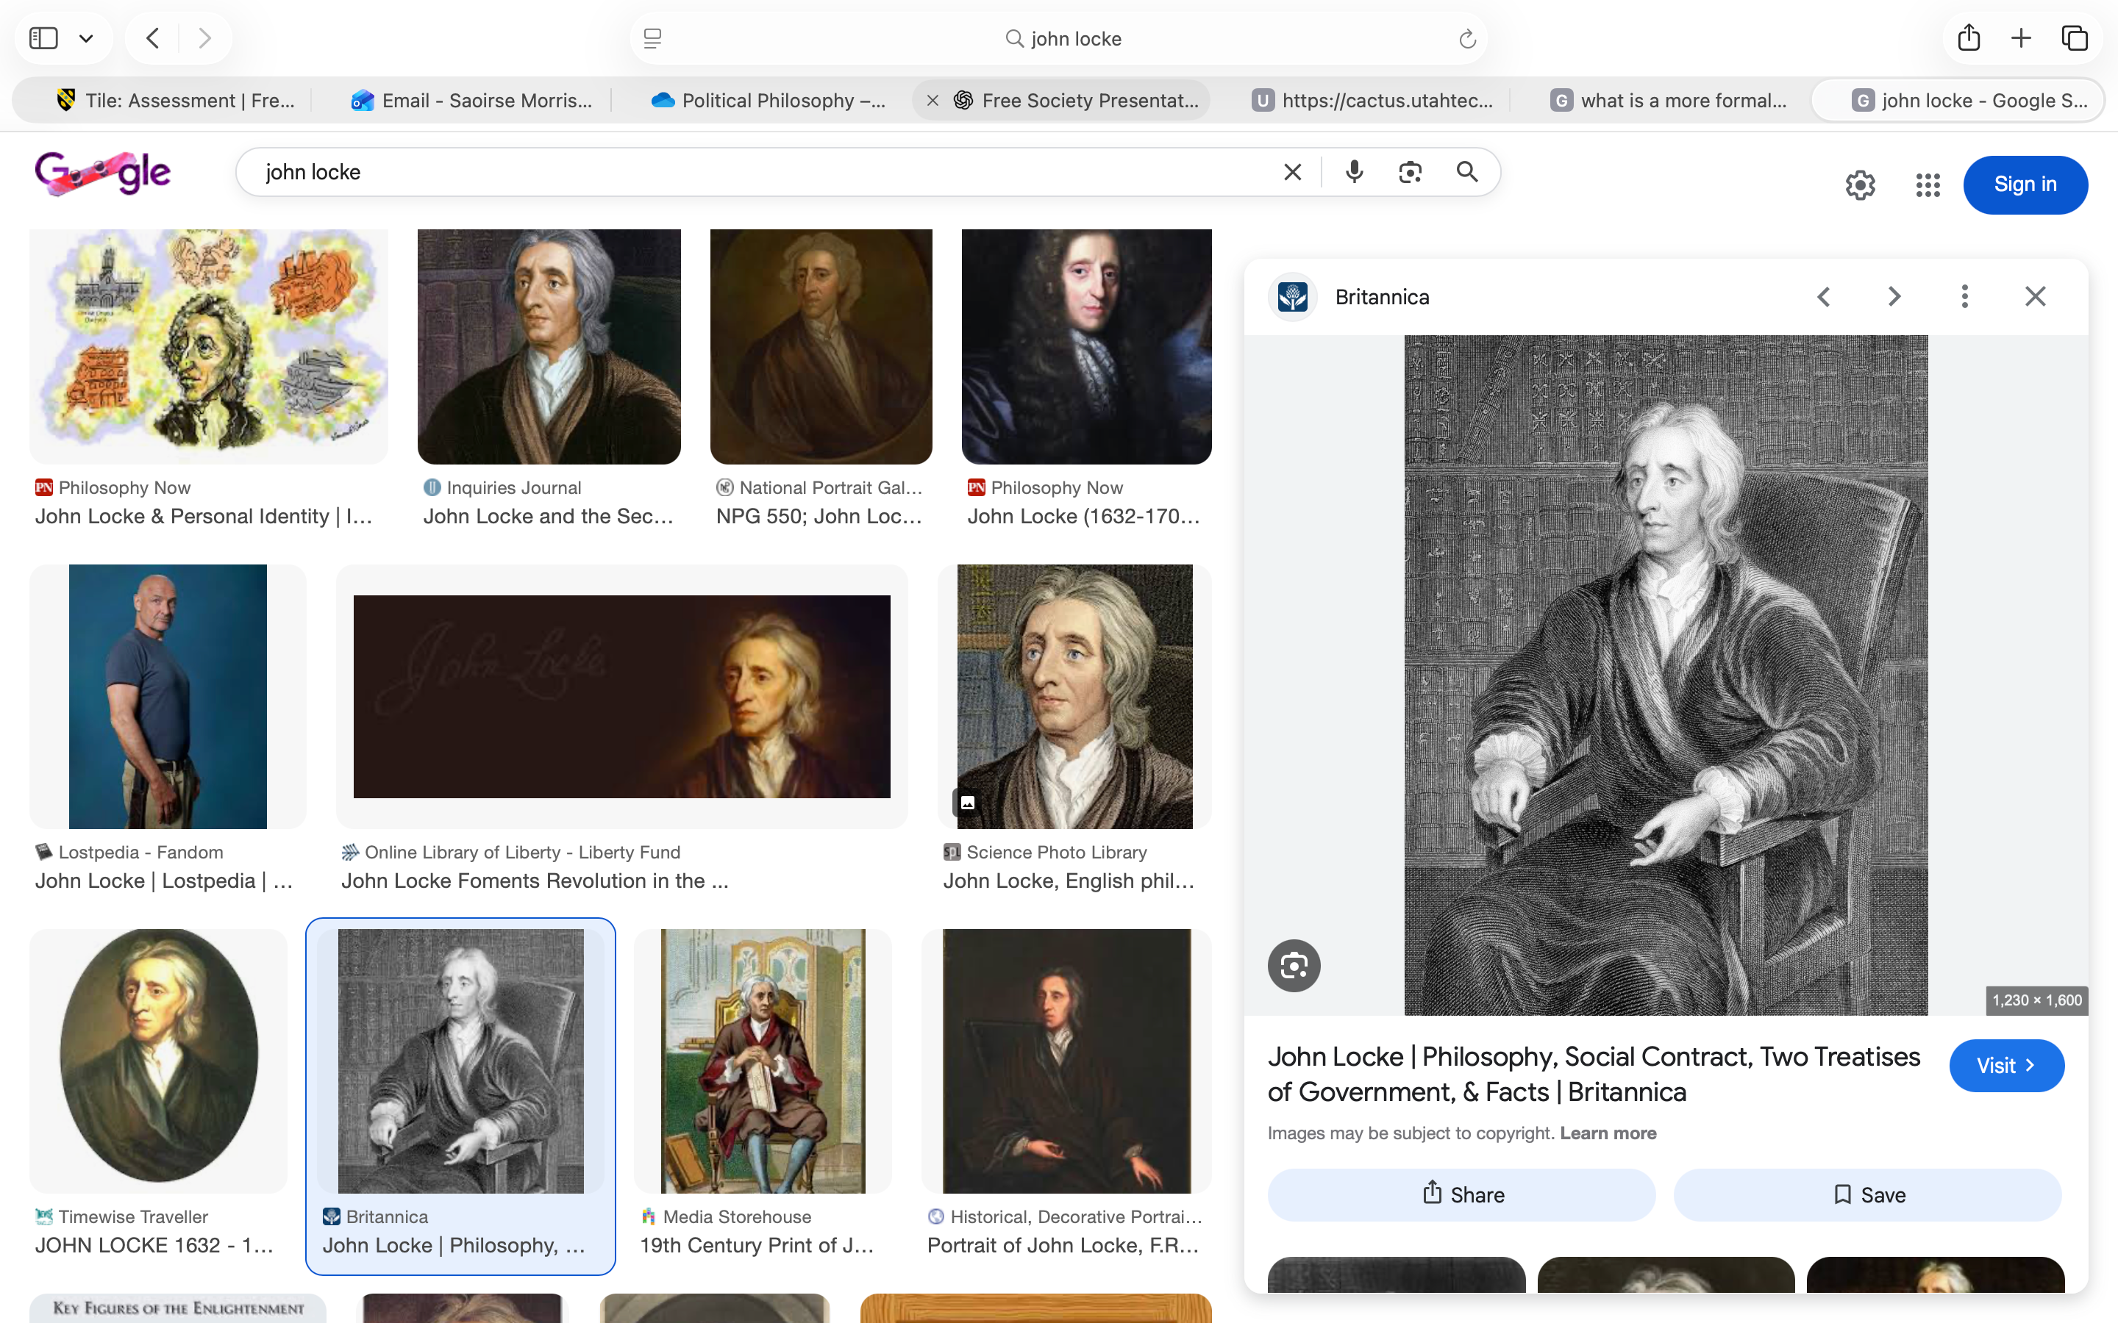
My free society and where it aligns
Locke - Two Treatises of Government
  State of Nature (II)
Core rights that the government are first and foremost called to protect - emphasis on individual autonomy.
  Of Political or Civil Society (VII)
The authority does not extend outside of securing natural rights - non-interference and avoiding domination.
  Of the Extent of Legislative Power (XI)
Power of the government cannot be absolute, it is about protection over control - the state should have a limited role HOWEVER, the redistribution of resources should be added as to make freedom meaningful to all.

Slide 9
Conclusion
A free society is constituted by:
  A protected sphere of individual autonomy.
  Not dominated or overridden by power or coercion in argument for a ‘higher good life’.
  Non interference to ensure a plurality of ways of life.
  All people possess a genuine ability to shape their own lives.
  Autonomy does not maintain natural inequalities and is made real for all people.
  A level of intervention for the sake of redistributing resources and achieving equity from the starting point.
  If sacrificing individual freedom expands the accessibility of being free for the most people, it is justified.

Slide 10
Bibliography
Berlin, I. (1969). ‘Two Concepts of Liberty’. Four Essays on Liberty. Oxford University Press. Pages 118-172. Available at: https://cactus.utahtech.edu/green/B_Readings/I_Berlin%20Two%20Concpets%20of%20Liberty.pdf. (Accessed 14/02/26).
Carter, I. (2016). ‘Positive and Negative Liberty’. Stanford Encyclopedia. Available at: https://plato.stanford.edu/entries/liberty-positive-negative. (Accessed 14/02/26).
MacCallum, G. (1967). ‘Negative and Positive Freedom’. The Philosophical Review. Pages 312-334. Available at: https://www.jstor.org/stable/2183622. (Accessed 14/02/26).
Warburton, N. (2018). ‘Two concepts of freedom’. Open University. Available at: https://www.open.edu/openlearn/history-the-arts/philosophy/two-concepts-freedom/content-section-3.4. (Accessed 14/02/26).
Rawls, J. (1999). ‘A Theory of Justice: Revised Edition’. Harvard University Press. Available at: https://doi.org/10.2307/j.ctvkjb25m. (Accessed 17/02/26).
Mill, J.S. (1859). ‘On Liberty’. Cambridge Univeristy Press. (2011). Available at:
https://doi-org.uwtsd.idm.oclc.org/10.1017/CBO9781139149785. (Accessed 17/02/26).
Locke, J. (1689). ‘Two Treatises of Government’. Neeland Media LLC Version. (2011). Available at: https://www-vlebooks-com.uwtsd.idm.oclc.org/Product/Index/1679609?page=0&startBookmarkId=-1. (Accessed 17/02/26).

