Slide 1
Group presentation student name: Petko Petkov student number: 2125440 student name : Slavina Stoyanova student number: 2127720 module code: bmsw4003_birm
Lecturer name: Adbi Rahman
Research topic - How do students in UWTSD use technology to collaborate?

Slide 2


Research chosen question: Is there a need to provide training on how to use technology to collaborate in UWTSD?
Introduction
In this research we will investigate if people who study in UWTSD require training on how to use technology in order to collaborate in the university.
This research is related to the difficulties of online studying during the covid-19 pandemic for example. The students of UWTSD had to quickly adapt to technology because face to face teaching was not provided and they had to carry out zoom/teams classes instead.
This allowed people to advance their skills in using technology and all the Microsoft apps in order to collaborate with the lecturers as well as other students.

Slide 3
Relevant research
Through repository of UWTSD we established that students have been provided with sessions which examine and break down the use of technology and apps that are required in UWTSD.
At the start of the course students are asked if they are knowledgeable on technology and if they are comfortable using apps such as microsoft teams, powerpoint, word ect.

Slide 4
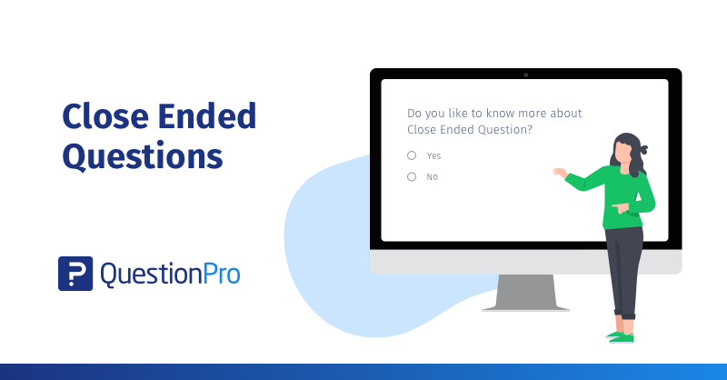
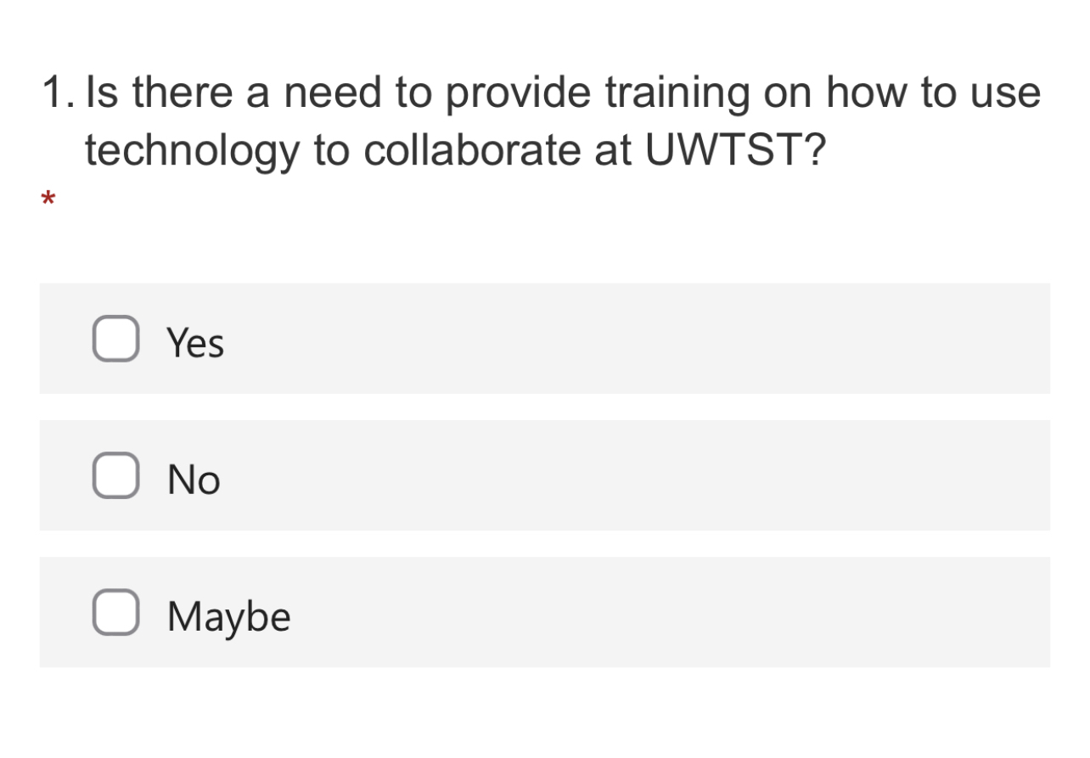
Ethical Considerations
In this presentation we intend to respect all ethical considerations and no data will be shared or used for any commercial purposes.
According to the data protection act from year 2018 General Data Protection Regulation (GDPR), all data will be kept safe and confidential.
This is a brief view of how the questionnaire will look. The question is simple, with a simple closed YES or NO answer.

Slide 5
Proposed method
What questionnaire will include in this research: Is there a need to provide training on how to use technology to collaborate in UWTSD?
Who will you ask : This research will involve a closed answer question which will be posed to a group of 100 students who study in UWTSD.
How: This questionnaire will be available for students to answer on forms. The answers are YES, NO or MAYBE.
The method will include quantitative data collecting to establish if students require extra help with the use of technology in the university.

Slide 6
Hypothesis of this research
The hypothesis regarding this research, almost all people are aware of the new technology and are able to use it well enough to graduate in uwtsd without a problem. If they require any extra training on how to use technology, enough is provided for them already in the sources on Moodle.
In fact that all the people who studied in uwtsd during the covid pandemic 2020-2021 had to suddenly quit jobs (most of them) and start working from home. Also the lectures in uwtsd were entirely online, which gave an opportunity for people to learn and advance their digital skills.

Slide 7
Reference list
Barnes, J., Greenway, C. and Morgan, C., 2021. How has Covid-19 affected how teacher educators engage their students in learning?.
Spencer, A. and Patel, S., 2019. Applying the data protection act 2018 and general data protection regulation principles in healthcare settings. Nursing Management, 26(1).

