Slide 1

Feedback from last Semester
Post it feedback:
1- What did you enjoy last year in this module?
2- What did you find challenging?
3- What do you need more experience in to improve your coaching?

Slide 2
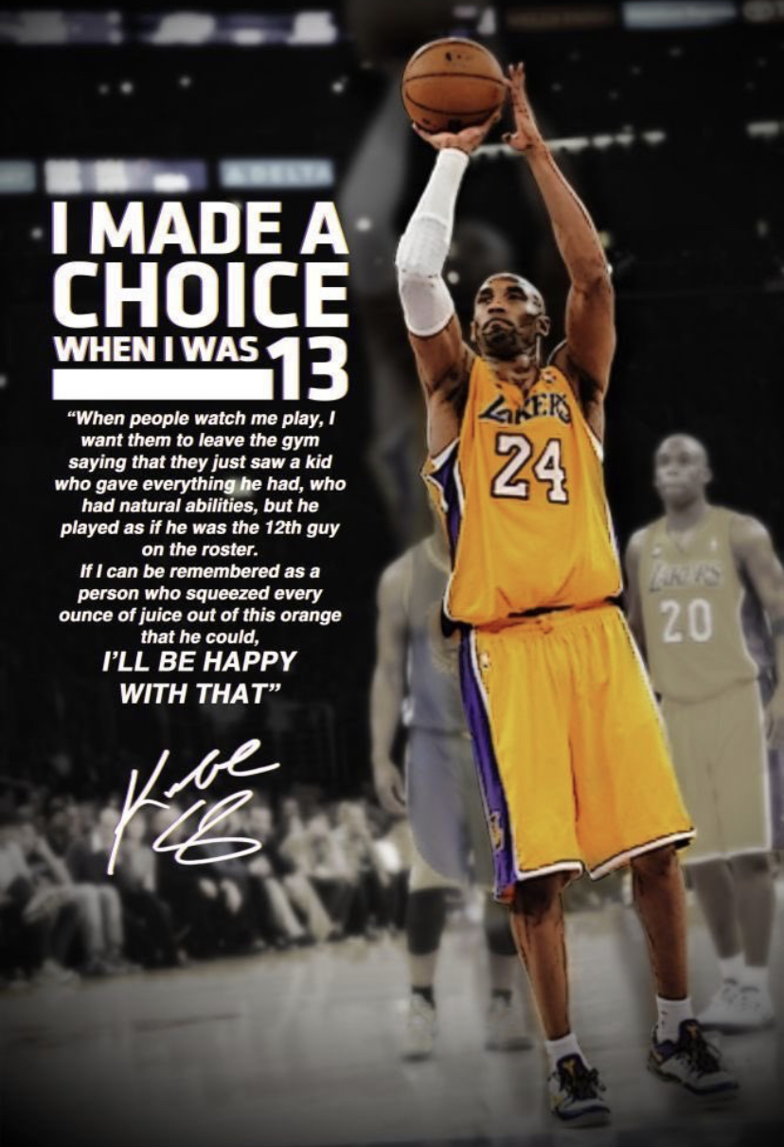
Notes:
https://www.youtube.com/watch?v=lUcdx4W8Xes

Slide 4
Advanced Coaching
&
Mentoring
https://www.youtube.com/watch?v=tlMBUtyOqUM

Slide 5
Introduction
What are the aims of this block? (Improve your coaching, learn how to mentor successfully and evidence this, complete mentor assessments and to be confident in completing the assignment)
What is expected of you? Coaching / mentoring
How will you achieve your grade?
40% theory
60% related to practical
Notes:
Aims- Improve your coaching, learn how to mentor successfully and to evidence this, complete a mentor assessment and to be confident in completing the assignment

Slide 6
Organisation
Monday Theory (information needed to successfully mentor / complete assignment / planning practical / feedback from previous week)
Monday Practical coaching-TBC- will update you as soon as we know confirmed schools

Slide 7
How will I get my grade?
5 Mentee Assessment forms- 40%
3 mentoring competencies signed off (verbal feedback to another member of the group) and a written reflection- 20%
Mentoring an athlete- producing a schedule -20%
A written piece- 20%

Slide 8
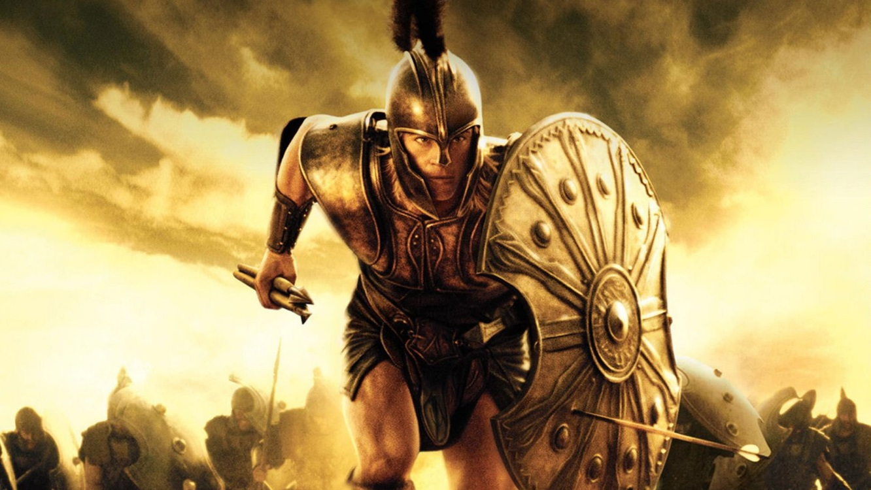
What is Mentoring?
The word was inspired by the character called Athene in Homers Odyssey (the story of a 10 year struggle for Homer to return after the Trojan war- Athene was left to look after Homers son Telemachus) (Lattimore, 1965)

Slide 9
What is Mentoring?
A planned relationship between an experienced person and one who has less experience for the purpose of achieving identified outcomes (Dorsey & Baker, 2004)
Case Study- Alex Ferguson / Martin Johnson / Nurses

Slide 10
Ferguson
Playboy Lee Sharpe had a rude awakening when Ferguson turned up at the winger’s house to angrily break up a party towards the end of the 1991-92 season. A fresh-faced Ryan Giggs also got a clip around the ear for breaking curfew.
Read more: http://metro.co.uk/2013/05/08/sir-alex-ferguson-retires-top-10-fergie-falling-outs-3733789/#ixzz3yFB5Mv1f

Slide 11
Martin Johnson
Hired a minibus and went around clubs picking up players on a night out to ensure they did not miss their Curfew.

Slide 12
Nursing
Why is mentoring heavily used in nursing?

Slide 13
Mentoring
In this module we are looking at two types of Mentoring:
1- Mentoring an athlete (assignment related)
2- Mentoring a coach (practical related)

Slide 14

Mentoring
Task- Mentimeter
1- What are the qualities of a good mentor
2- What happens when mentoring goes wrong? (feedback to front)

Slide 15
A good mentor:
Willingness to share skills, knowledge and expertise
Acts as a role model and is respected
Has a positive attitude
Takes a personal interest in the mentoring relationship
Enthusiastic in their field
Values ongoing learning and growth in their field
Provides guidance and constructive feedback
Sets ongoing goals
Values the opinions of others
Motivates others

Slide 16
Mentoring gone wrong:
Can create long lasting damage:
Decrease motivation
Encourage bad practice
Can lead to harassment
To much pressure placed on an individual
(The Wall Street Journal, 24 May 2010)

Slide 17
Research
Look on Moodle / online library- Look wider than mentoring in sport as many other theories can be applied / adapted

Slide 18
Next Week
Badminton Festival
Mentoring year 1
Analyzing performance
Providing feedback
Setting a good example
Supporting – How?

Slide 19
Practical Today
You coach a shot- Net shot, drop shot or smash. 1-2-1 coaching 25 mins
Break
I will look at games to play with large numbers / fun games modified from the game

Slide 20
Activity progressions:
Throwing- throw shuttles to a partner to mimic shot
Shadow- Coach shadows the shot without hitting
Shadow then hit
Target practice- Mark an area for shuttles to land
One hit work- One feed one shot
Hit then hit- Serve then shot / start again
Conditioned rally – make sure it flows
Notes:
Expectations- Must do a shadow, 1 other and definitely a conditioned rally

