Slide 1
BMIH4006: Operating Hotel Facilities
Elevating Housekeeping Excellence: A Training Session on our New Room Cleaning Checklist
Student number: 2231922
Module name: Operating Hotel Facilities
Module Code: BMIH4006
Lecturer: Neil Dyer

Slide 2

Introduction
Our focus today is on achieving unparalleled consistency in room cleaning, directly impacting guest satisfaction.
As we explore the new checklist, remember that each task contributes to our commitment to excellence.
Our brand is synonymous with unparalleled service, and your dedication to maintaining high standards ensures we not only meet but exceed guest expectations.
Let's embark on this training with enthusiasm, knowing that every detail matters in creating an exceptional guest experience.

Slide 3
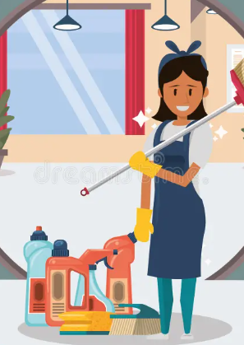
Ensuring Rooms are Cleaned to Brand Standards.
Alignment with brand standards is paramount for guest satisfaction and loyalty.
A meticulous approach is essential, emphasizing attention to every detail in room cleaning.
For instance, if the brand leans towards a minimalist aesthetic, tasks such as maintaining clutter-free surfaces and adhering to a consistent color palette become integral.
Industry best practices showcase success stories, illustrating how other hotels or brands have excelled by strictly adhering to and even surpassing established brand standards, thereby enhancing their reputation and guest experience.
(Fallon, and Rutherford, 2010).

Slide 4

Implementation of Clear Communication Strategy
Effective communication is a center for enhancing team effectiveness within the housekeeping department.
Regular team meetings play a pivotal role in fostering open channels for feedback and suggestions, ensuring a collaborative environment.
In the industry, successful examples abound; renowned hotels attribute improved guest satisfaction directly to transparent communication practices.
By discussing expectations, addressing challenges, and sharing insights during team meetings, housekeeping teams can enhance their collective performance and, ultimately, elevate the overall guest experience.
Clear communication becomes a cornerstone in aligning team efforts and reinforcing a commitment to excellence.
(Raghubalan, and Raghubalan, 2009).

Slide 5

Mentorship Program
Implementing a mentorship program within our housekeeping team offers multifaceted benefits.
It enhances individual and collective performance by providing a structured platform for skill transfer and continuous learning.
Drawing on a success story from the industry, we see how mentorship positively impacted housekeeping teams, fostering a supportive environment and elevating overall service quality.
Encouraging our experienced team members to share insights into efficient cleaning techniques not only empowers mentees but also enriches the entire team's skill set.
This collaborative learning approach not only improves performance but also strengthens bonds, creating a culture of shared responsibility for maintaining excellence.
(Raghubalan, and Raghubalan, 2009).

Slide 6

Optimizing Workflow
Efficient workflows not only save time but also contribute to a seamless and consistent guest experience.
The logical sequence of tasks in the room cleaning checklist ensures that no step is overlooked, promoting thoroughness.
An industry example showcasing successful workflow optimization is evident in the streamlined processes adopted by renowned hotel chains.
By strategically organizing tasks, these establishments have significantly reduced turnaround time between guest check-out and check-in, maximizing room availability and guest satisfaction.
(Jones, 2010)

Slide 7
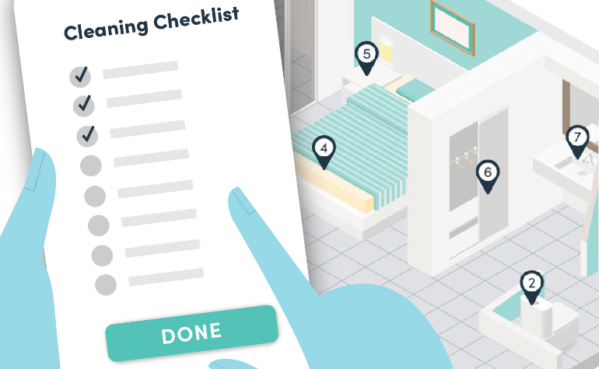
Considerations for Checklist Effectiveness.
Clarity, Conciseness, and User-Friendliness: A streamlined checklist simplifies tasks, minimizing the chance of errors and contributing to the overall efficiency of the cleaning process.
Importance of Visual Aids: Best industry practices show that visual cues significantly enhance understanding, helping the team consistently achieve the desired cleanliness and presentation levels.
Encouraging Active Participation in Reviews and Updates: Soliciting feedback ensures that the checklist remains relevant and adaptive to changing brand standards or guest expectations. This collaborative approach strengthens the team's commitment to maintaining high cleanliness standards and encourages continuous improvement.
(Tesone, 2012)

Slide 8

Integration into Daily Routine
By incorporating user-friendly mobile applications or digital checklists, our team can experience a more streamlined and efficient workflow. This integration not only enhances the accessibility and convenience of the checklist but also allows for real-time updates and monitoring.
A compelling success story to share is that of a renowned hotel that witnessed a substantial increase in operational efficiency following the adoption of digital checklists.
The change not only made it less likely that something would be missed, but it also gave the team the power to get things done quickly, which increased total productivity.
This example shows how using technology in daily operations can really help, showing how it can be a key factor in meeting brand standards and going above and beyond what guests expect.

Slide 9
Conclusion
The checklist is a strong tool that helps us provide the best service ever by making sure it is in line with brand standards and best practices in the industry.
We stress that the checklist is only a guide and that it is very important for building an atmosphere that fits with our brand and goes above and beyond what our guests expect.
Finally, we want to thank the team from the bottom of our hearts for their unwavering commitment to greatness.
They have been a huge part of making the brand's promise of a memorable and perfect guest experience come true. We can consistently provide excellent service and improve our reputation in the hospitality business only if everyone on the team works together.

Slide 10
References
Fallon, M. and Rutherford, D. 2010. Hotel Management and Operations. London: Pearson
Jones, T. 2010. Professional Management Housekeeping Operations. London: Wiley.
Raghubalan, G. and Raghubalan, S., 2009. Hotel housekeeping: Operations and management. Oxford University Press.
Tesone, D., 2012. Principles of management for the hospitality industry. Routledge.

