Slide 1

Module Title: Psychology in Health and Social Care:
Module Number : LCHS4010
Student Name : Rosa Santos
Student ID: 2512863
Lecture’s Name: Peace Ukachukwu
I use AI only to check grammar, correct errors, and to help me make my writing more concise. The ideas ,analysis ,and content are my own.

Slide 2

Introduction
This presentation applies Bowlby's Attachment Theory to analyse Isaac's case and explain how his early experiences may have affected his social, emotional, and language development, before outlining a suitable support plan.
Understanding how early experiences shape child development is essential in early years practice. Developmental theories help practitioners identify children's needs and provide appropriate support (NHS, 2023).

Slide 3
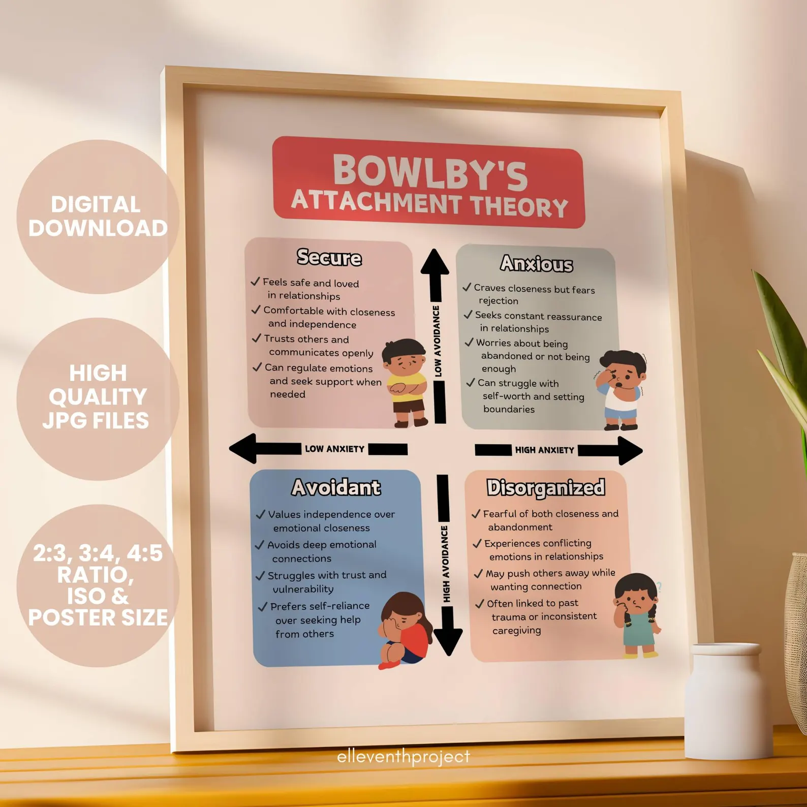
Bowlby’s Attachment Theory and Isaac’s case
Bowlby (2026)

Slide 4

Isaac’s Case Summary
Isaac’s family has just settled in London, and he has experienced many changes in childcare.
He lives with his mother, who is a single parent facing post‑natal depression, low confidence and little support.
Staff see that Isaac is very quiet, becomes distressed when his mother leaves, finds group activities difficult and shows slow language development.
His mother also says he is clingy, sleeps badly and rarely plays on his own.

Slide 5

Bowlby’s Attachment Theory
Isaac’s behaviors are strongly linked to attachment and emotional security.
Bowlby’s theory is relevant because it explains how early relationships with caregivers influence a child’s confidence, behavior and overall development.
Factors such as postnatal depression, inconsistent childcare and family stress can affect the quality of attachment and a child’ sense of security (UNICEF, 2023).

Slide 6

Developmental Assumptions
Attachment influences many areas of development.
Securely attached children explore confidently, regulate their emotions more effectively, and develop stronger social skills.
Disruptions in early caregiving can affect language development, independence and emotional wellbeing.
Consistent, sensitive and stable caregiving supports healthy development (NHS, 2023).

Slide 7
Bowlby’ Attachment Theory : Key Concepts
Bowlby’s believed that children form an emotional bond with their primary caregiver.
When the caregiver is consistent and responsive, the child develops a secure attachment.
If the caregiver is stressed, depressed or inconsistent , the child may develop an insecure attachment.
Bowlby also explained that children form an internal working model, which shapes how they understand relationships and manage emotions (Bowlby,1988).
Notes:
Isaa

Slide 8
Isaac’s mother ‘postnatal depression may have affected her emotional availability.
Frequent changes in childcare and the recent move to London may have reduced stability in his early experiences.
Distress during separation, quiet behavior and language delay. His difficulty joining group activities
May also be linked to low confidence and emotional insecurity (Murray, Cooper, 2021).
Applying the Theory to Isaac

Slide 9

Nature vs Nurture
Biological influences (Nature): Isaac’s temperament and early brain development play a role in how he responds to stress and forms attachments during key early years.
Biological factors can influence emotional regulation and sensitivity to changes in caregiving.
Environmental Influences (Nurture): Caregiving and mother’s mental health affected her responsiveness and emotional availability .
Social interaction was limited due to isolation after moving to London .
Frequent changes in childcare disrupted stability and consistency.
Interaction of Nature and Nurture:
Both biological and environmental factors interact to chape Isaac ‘s development.
His behaviors may reflect a combination of innate temperament and the impact of early experience (Murray and Cooper, 2021).

Slide 10
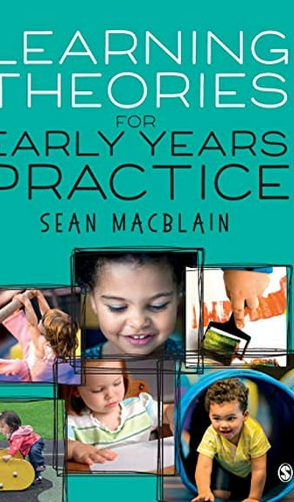
Theory –informed Strategies for early year practice
Linked Directly To Bowlby’ Theory: Attachment assign a consistent key worker to build trust, emotional security and reduce separation distress.
Parental Support: Signpost Isaac’s mother to mental health and parenting services (NICE, 2022)
Multi-agency-working: work with heath visitors and social care to provide coordinated and holistic support.
Play-based learning: use play to develop confidence, communication, and social skills play supports emotional regulation and secure relationships (skill for care,2023).
Language Support: encourage talking , reading , and singing to promote language development and strengthen caregiver-child interaction (NHS,2023).

Slide 11

  Critical Evaluation & London Context
Strengths: Attachment theory clearly explain how early relationships influence children’s behavior, emotional wellbeing and confidence (Bowlby,1969).
Limitations: The theory focuses mainly on mother and gives less attention to fathers , extended family members and other wider caregiving network. It may not fully reflect the diversity of modern families.
London Context: In London‘s diverse communities ,attachment may be expressed differently across cultures.
Cultures .The EYFS encourages inclusive and culturally responsive practice that respect different caregiving styles and family backgrounds (Department for Education,2024).
Usefulness: Attachment theory helps practitioners understand children’s behavior as a sign of emotional needs and plan appropriate support to promote security , confidence and development (Bowlby,1969).

Slide 12
Conclusion
Isaac’s case shows how attachment theory helps practitioners understand his behaviour and offer child‑centred, culturally sensitive support, while Erikson’s Stage 3 reminds us that he also needs encouragement to explore and build confidence.
Bowlby highlights that disrupted secure relationships can create emotional difficulties, and early help planning strengthens bonds and emotional safety for healthy development across the lifespan (UNICEF, 2023; Bowlby, 1988; Erikson, 1963).

Slide 13
REFERENCES
Bowlby, J. (1988) ‘The nature of the child’s tie to his mother’, International Journal of Psycho-Analysis, 39(5), pp. 350–373.
Bowlby (2026) Bowlby Attachment Theory Printable Poster, Digital Psychology Tool, School Counsellor, Psychologist, Therapist Office Decor, Calming Corner. Available at: https://www.etsy.com/uk (Accessed: 30 June 2026).
Erikson, E.H. (1963) Childhood and society. 2nd edn. New York: W. W. Norton & Company.
GOV.UK (2024) Early years: child development guidance. Available at: https://www.gov.uk (Accessed: 3 July 2026).
Murray, L. and Cooper, P.J. (1997) ‘Effects of postnatal depression on infant development’, Archives of Disease in Childhood, 77(2), pp. 99–101. doi:10.1136/adc.77.2.99.
NHS (2023) Understanding child development. Available at: https://www.nhs.uk (Accessed: 3 July 2026).
UNICEF (2023) Child development and early childhood. Available at: https://www.unicef.org (Accessed: 3 July 2026).
National Institute for Health and Care Excellence (2022) Mental health problems in children and young people: recognition, management and support. NICE Guideline NG229. London: NICE. Available at: https://www.nice.org.uk (Accessed: 4 April 2026). Skills for Care (2023) Supporting children's learning and development through play. Leeds: Skills for Care. Available at: https://www.skillsforcare.org.uk (Accessed: 4 April 2026).

