Slide 1
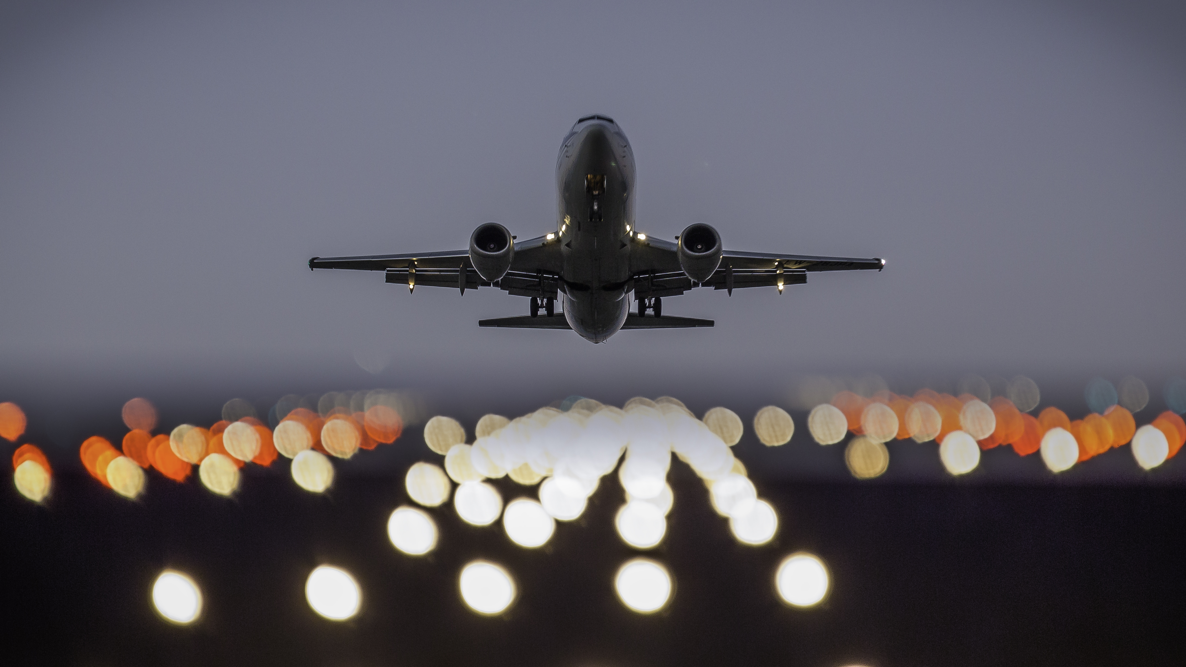
Ryanair Presentation
Developing Culture and Ethics at Ryanair
Allison Cullen (2218746)

Slide 2
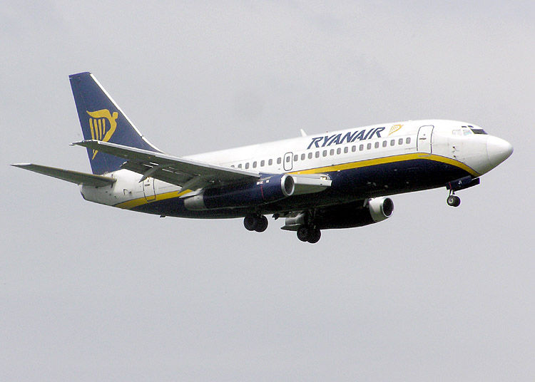
Introduction
This presentation will examine Ryanair's workplace culture and organisational structure, focusing on ethical and unethical behaviours that affect its employees. The goal is to explore Ryanair's internal operations to provide a better understanding of how the company works.
This Photo by Unknown Author is licensed under CC BY-SA

Slide 3
3 Organisational Culture
Sarah Bioznalis (2022). Workplace culture refers to the shared values, beliefs, attitudes, and behaviours that shape how people interact. It defines an organisation's personality and provides a framework for decision-making, communication, and problem-solving. A positive workplace culture can improve productivity, boost employee satisfaction, and enhance the organisation's overall success.
(Mullins and Mclean, 2019, pgs. 560-571).
This Photo by Unknown Author is licensed under CC BY-SA

Slide 4
4 Organisational Structure
Spritzer (2017). Ryanair follows Maslow’s theory of the hierarchy of needs with many levels within the company. The business has ineffective communication methods, which create a weak culture. Employees feel insecure and lack trust and motivation in each other. As a result, productivity is low, and many people leave Ryanair.
(Ryanair,2022).
This Photo by Unknown Author is licensed under CC BY-SA

Slide 5
5 Classifications of Organisational Culture
Commonly used classifications are those by Charles Handy or Deal and Kennedy. Charles Handy identified four main types of organisational cultures: power culture, role culture, task culture, and person culture.
Ryanair follows a task culture in its organisation.
(Slideshare, 2022) and (Bartleby research, 2018).
This Photo by Unknown Author is licensed under CC BY-SA

Slide 6
6
Schein's (2004) Culture Theory divides organisational culture into three levels based on 1980s research. The model examines culture from an observer's standpoint.
Artefacts: Schein's model identifies a company's external values, which are visible to the public. Ryanair's success has been attributed to its low-cost strategy.
Espoused Values: When examining Ryanair’s invisible culture, it is vital to address its goals, values, and beliefs. Ryanair has clear goals that revolve around cost-cutting and operating efficiently.
Deep Rooted Cultural Assumptions: To understand Ryanair's corporate culture, we must explore the level of underlying assumptions. Schein states, ‘An organisation's underlying assumptions stem from its values until they become so ingrained that they are taken for granted and ignored.
(Manager.org, 2018).
This Photo by Unknown Author is licensed under CC BY-SA

Slide 7
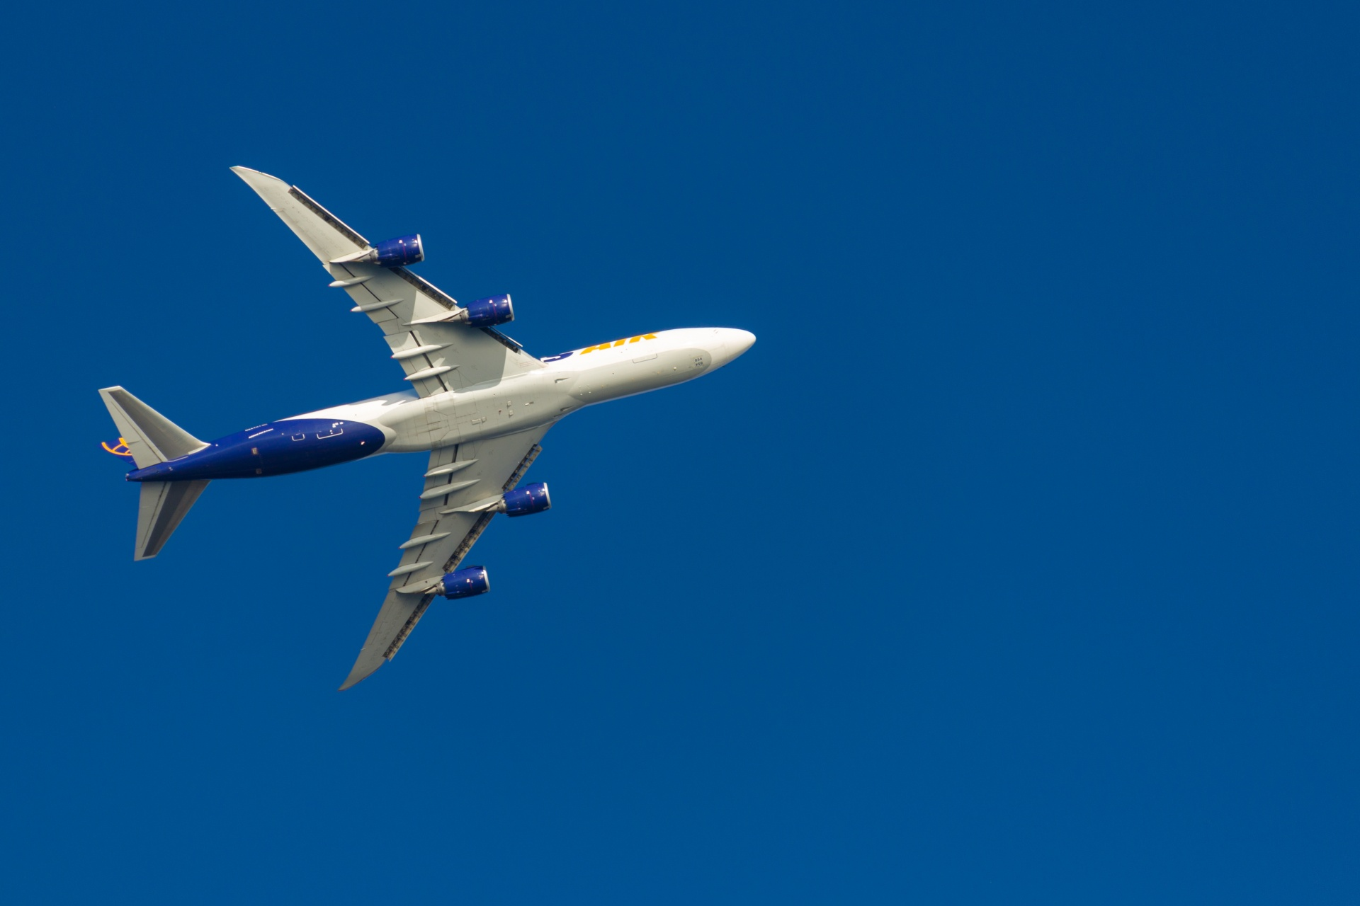
7 Cultural Web:
The cultural web is a work environment model developed by Johnson and Scholes. It includes six connected elements: Rituals and routines, Stories, Symbols, Control systems, Power structure, and Organisational Structure. Examining each element, you can better understand the working culture, identify issues, and decide on crucial changes.
Power Structure:
Ryanair is known for its cost-cutting culture, which extends to its power structure and hierarchy. Employees at Ryanair have no say in the company's decision-making process and are expected to follow instructions without question.
(Boyle, 2023), and (Boland, 2023).its

Slide 8
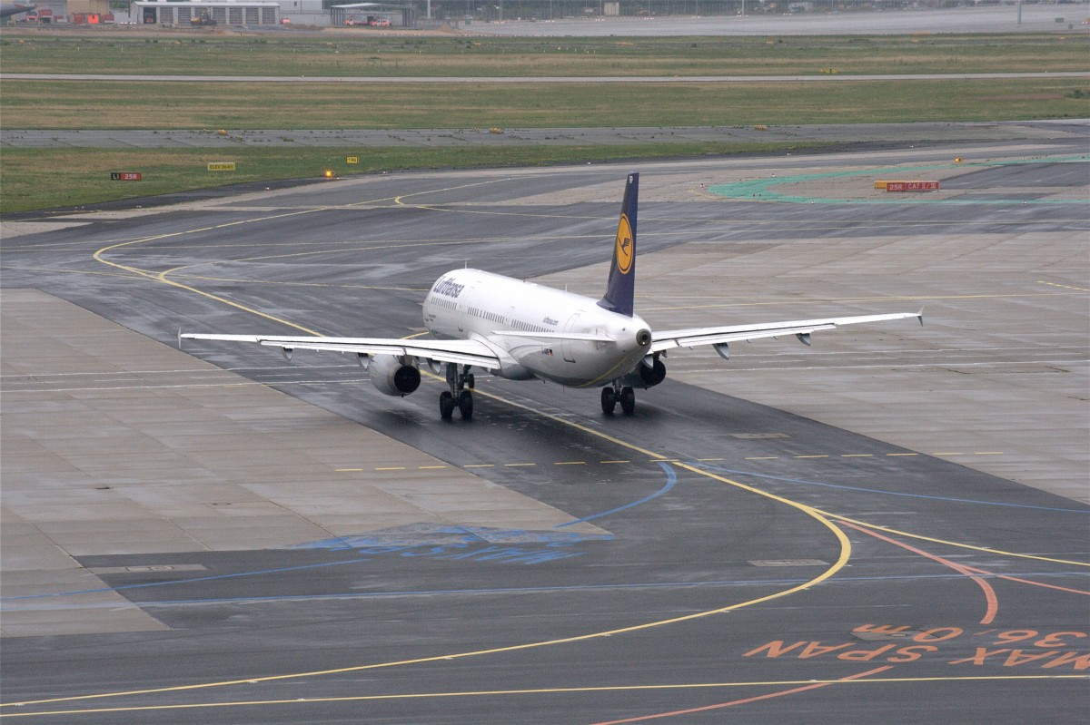
8 Ryanair’s Discrimination & Harassment Policy
The working environment at Ryanair aims to provide equal opportunities to all employees and candidates. Unfair practices, such as harassment (sexual, physical, or verbal), are strictly prohibited. The company evaluates the credentials of employees and candidates based solely on their ability to perform their job duties, irrespective of their race, gender, religion, disability, age, marital status, sexual orientation, political beliefs, or any other characteristic protected by laws.
. (Investor.Ryanair.com (2022).

Slide 9
9 Ryanair's Commitment to Customers, Suppliers & Shareholders
Ryanair provides transparent, fair, and honest services. They offer competitive prices and high-quality services and fulfil commitments. They maintain an open relationship with suppliers, ensuring the best value. Receiving timely reports, managing environmental growth, and providing reasonable returns to our shareholders. Their communication and business dealings are apparent and to the point.
(Investor.Ryanair.com (2022).
Unethical practises.
Ryanair was accused of greenwashing in a banned ad campaign claiming the lowest carbon emissions of any major European airline. The budget airline ran a TV, press, and radio campaign stating that the company had "Europe's lowest emissions and fares.“
(Sweney,2023).
This Photo by Unknown Author is licensed under CC BY-SA

Slide 10
            10 Conclusion
Ryanair's negative reputation in the media, poor corporate culture, and negative customer feedback are causing customers to turn away. To prevent further damage to the business, Ryanair is trying to stop frustrating practices and improve its corporate culture to provide a better service beyond just low fares. If Ryanair successfully implements a unique cultural platform with low fares and high-quality customer services, it has the potential to become a market leader and provide superior service compared to its competitors.
      (Corporate Ryanair,2023)
This Photo by Unknown Author is licensed under CC BY-SA

Slide 11
References, p1
Bartleby research (2018) The Corporate Culture of The Air Travel Firm Ryanair. Available at: https://www.bartleby.com/writing/document/FK92NRQKPVDX/ (Accessed: 23rd November 2023).
Bioznalis, S. (2022) ‘Workplace Culture: What Is it and Why Is it Important in 2023’? Workhuman [Blog]. 23 August. Available at: https://www.workhuman.com/blog/workplace-culture/ (Accessed: 22nd November 2023).
Bodell, L. (2023) ‘Ryanair Fires Chief Pilot Over Unacceptable Behaviour with Women’, Simply Flying 15th June. Available at: https://simpleflying.com/ryanair-fires-chief-pilot-inappropriate-behavior-women/ (Accessed: 24th November 2023).
Boland, R. (2023) ‘Best and Worst Airlines in 2023’, Which? 17th August. Available at: https://www.which.co.uk/reviews/airlines/article/best-and-worst-airlines-a5EhC8N851et/ (Accessed: 24th November 2023).
Boyle, S. (2023) ‘Ryanair bosses don’t treat the crew like humans. The Mail Online, 14th September. Available at: https://www.dailymail.co.uk/news/article-5192355/Ryanair-bosses-dont-treat-crew-like-humans-say-staff.html/ (Accessed: 24th November 2023).
Corporate Ryanair (2023) Welcome to Ryanair Corporate. Available at: https://corporate.ryanair.com/ (Accessed: 27th November 2023).

Slide 12
References, p2
Investor.Ryanair.com (2022) Ryanair Holdings PLC: Code of Business Conduct and Ethics. Available at: https://investor.ryanair.com/wp-content/uploads/2023/01/Ryanair-Holdings-plc-Code-of-Business-Conduct-and-Ethics.pdf/ (Accessed: 24th November 2023).
Managers.org (2018) Understanding Organisational Culture. Available at: https://www.managers.org.uk/~/media/Files/PDF/Checklists/CHK-232-Understanding-organisational-culture.pdf/ (Accessed: 20th November 2023).
Mullins, L.J. and Mclean, j. (2019) Organisational Behaviours in the Workplace. 12th Ed. Harlow, London: Pearson.
Ryanair (2022) Corporate Governance Annual Report. Available at: https://investor.ryanair.com/wp-content/uploads/2022/08/Ryanair-2022-Corporate-Governance-Report.pdf/ (Accessed: 20th November 2023).
Slideshare (2022) Organisational Behaviours: Organisational Cultures, Politics and Power and Motivating Teams and Individuals. Available At: https://www.slideshare.net/FairFASST/organisational-behaviour-task-1docx/ (Accessed: 23rd November 2023).
Spritzer, J. (2017) Ryanair: An Investigation into Organisational Culture and Management Strategy. Available at: https://jakespritzer.wordpress.com/2017/02/03/ryanair/#:~:text=Cost%2Dcutting%20seems%20to%20be,as%20a%20Top%2DDown%20model. (Accessed: 22nd November 2023).
Sweney, M. (2020) ‘Ryanair accused of greenwash over carbon emissions claim’, The Guardian 5th February. Available at: https://www.theguardian.com/business/2020/feb/05/ryanair-accused-of-greenwash-over-carbon-emissions-claim/ (Accessed: 24th November 2023).

