Slide 1
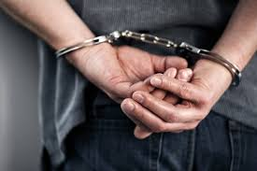


Welcome!
Criminal Litigation – Introduction

Slide 2
Your lecturer
Cerys Davies – Senior Lecturer, Qualified Solicitor and former Police Officer
Former specialism: Employment Law
Trained with a large commercial firm in Cardiff
Over 15 years teaching experience.
My email – cerys.davies@uwtsd.ac.uk

Slide 3
Agenda/Topics to Be Covered in Week 1
Course structure
Assignments
Recommended Reading
Useful Websites
Key Concepts of Criminal Litigation
Human Rights Act
Classification of Offences

Slide 4
Course structure:
Course Goal :To develop your understanding of criminal litigation and to provide relevant underpinning knowledge and understanding towards giving legal advice
Structure : Weekly lectures (key aspects of the topic) + tutorials/workshops (develop understanding and skills)

Slide 5

Assessment
First Assignment due by 23:59 on the 7th of March 2025– 1500 word essay. Copy on Moodle ( 50% of overall mark)
Exam – May 2025 – 1 hour ( combination of multiple choice questions and provision of written legal advice) (50% of overall mark)
Full guidance will be given in class in advance of each of these assessments
Scheme of Work is available on Moodle.

Slide 6
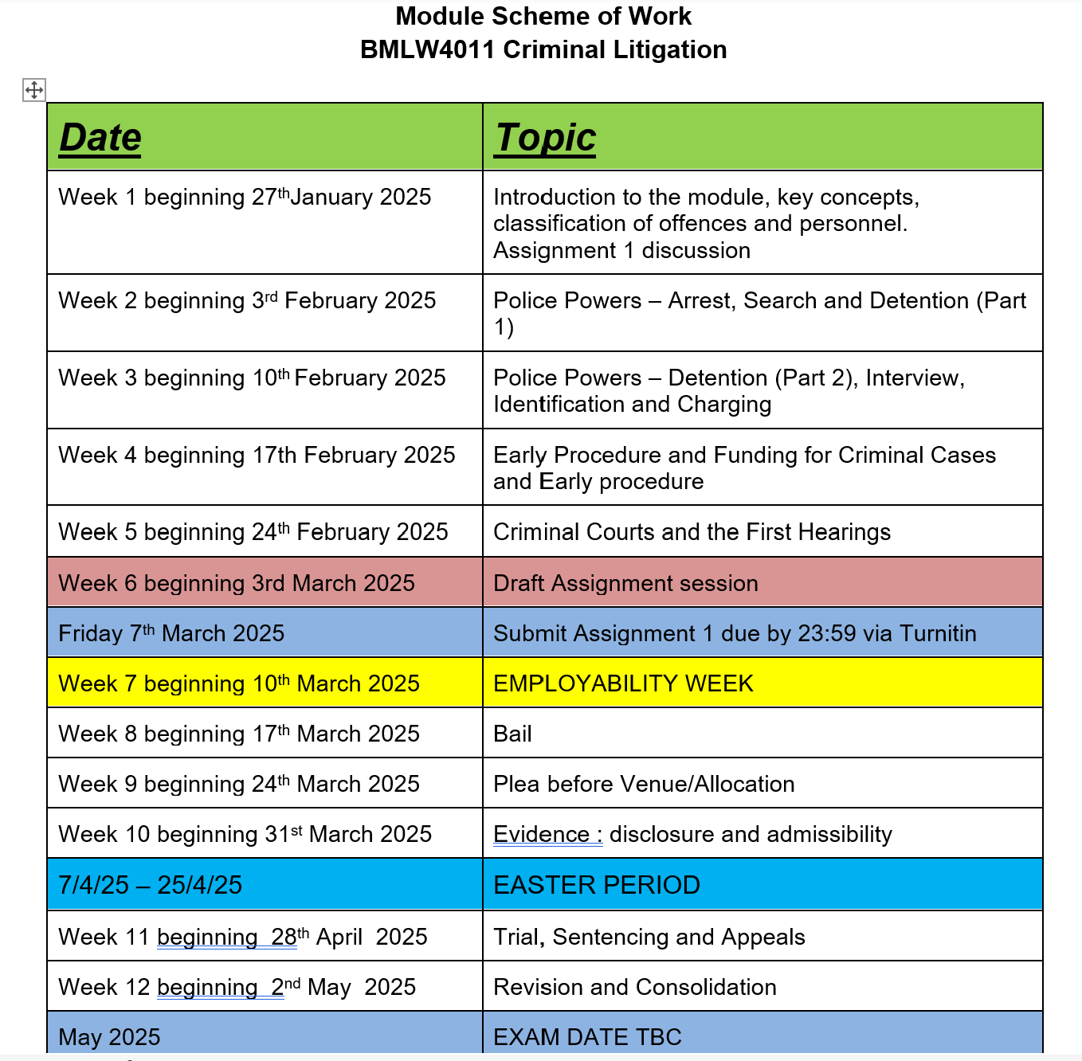

Slide 7
Recommended Reading
See Leganto Online Resource list on Moodle.
Use the latest versions of the textbooks.
Other materials:
  Lecture Slides
  Tutorial Materials

Slide 8
Useful Websites
www.justice.gov.uk – the website of the Ministry of Justice
www.sentencingcouncil.co.uk – the website of the Sentencing Council which contains sentencing guidelines issued by the Council
www.cps.gov.uk – the website of the CPS which contains the Code for Crown Prosecutors and a useful summary of various evidential matters
www.gov.uk – this website gives access to the Legal Aid Agency
www.judiciary.gov.uk – the website of the Judicary in England and Wales

Slide 9
Criminal Law and the Civil Law
The 2 systems serve different purposes and have different functions and priorities
Civil law: private law - rights and duties owed by individuals and organisations to each other’
Criminal law: public wrongs – wrongs against the ‘state’
Some incidents will involve potential of legal proceedings under both systems e.g battery
Different standards of proof

Slide 10


What is Criminal Litigation?

Slide 11

Key Concepts
Litigation is the process of taking a case to a court of law.
Criminal litigation is the application of criminal law in practice.
The objectives of the criminal justice system are to punish and deter conduct that is prohibited by law.
This unacceptable conduct is referred to as a crime.
The state is responsible for the bodies that are involved in the protection of the interests of society. E.g. Police and CPS.
Most prosecutions for criminal offences are brought by the state in the name of the King and the prosecutor is referred to as Rex (R)

Slide 12
Key Concepts
Prosecution of a crime is governed by procedural and evidential rules.
A person accused of a crime has protection against unfair prosecution and to prevent oppression.
The prosecution must prove matters “beyond a reasonable doubt” – this is the burden of proof in criminal proceedings.
Higher standard of proof than civil matters as the outcome of criminal matters can result in a custodial sentence.

Slide 13
Safeguards for the Suspect/the Accused
Presumption of Innocence: innocent until proven guilty.
Burden of proof rests with the prosecution
Standard of proof: beyond a reasonable doubt.
Accused has the right to publicly funded legal advice.
Accused has the right not to answer questions posed by police and, if charged, not to give evidence at trial.

Slide 14
Safeguards for the Suspect/the Accused
Any evidence found during police investigation must be in accordance with the Police and Criminal Evidence Act 1984 PACE rules.
Accused has the right to see the evidence against them.
At least 10 out of 12 jurors must agree guilt at trial in Crown Court.
Right of Appeal.
Human Rights Act and European Convention on Human Rights.

Slide 15
The Human Rights Act 1998
European Convention on Human Rights (ECHR)creates basic human rights in 14 Articles.
HRA 1998 incorporates the ECHR into domestic law.
Article (Art) 3 – prohibition of torture and inhuman or degrading treatment – this is an absolute right;
Art 5 – the right to liberty and security of the person, the right not to be arrested or detained by the police without lawful authority – this is a limited right;
Art 6 – the right to a fair trial (fair and public hearing, is presumed innocent until guilt is proved, should have the nature of the accusation explained to them without delay and should have the time and facilities to prepare defence);
Art 8 – the right to respect for a private life, family life, home and correspondence – this is a qualified right.

Slide 16
Types of Rights under ECHR
Absolute Rights – can never be departed from.
Limited Rights – may be breached without infringing upon ECHR provided the breach is permitted in line with specific circumstances. Art 5 Right to liberty
Qualified Rights – are those which require a balance between rights of the individual and other rights – they can be interfered with to protect other rights. E.g. Article 10: freedom of expression the state could interfere with this right if this was necessary and in a way which was proportionate.

Slide 17

Criminal Procedure Rules (CrPR)
These rules along with the Criminal Practice Direction provide the Criminal Procedure Code.
Regulates the conduct of all criminal cases.
Latest rules can be found at Criminal Procedure Rules and Practice Directions 2020 - GOV.UK (www.gov.uk)
Task
What is the overriding objective of the CrPR?

Slide 18
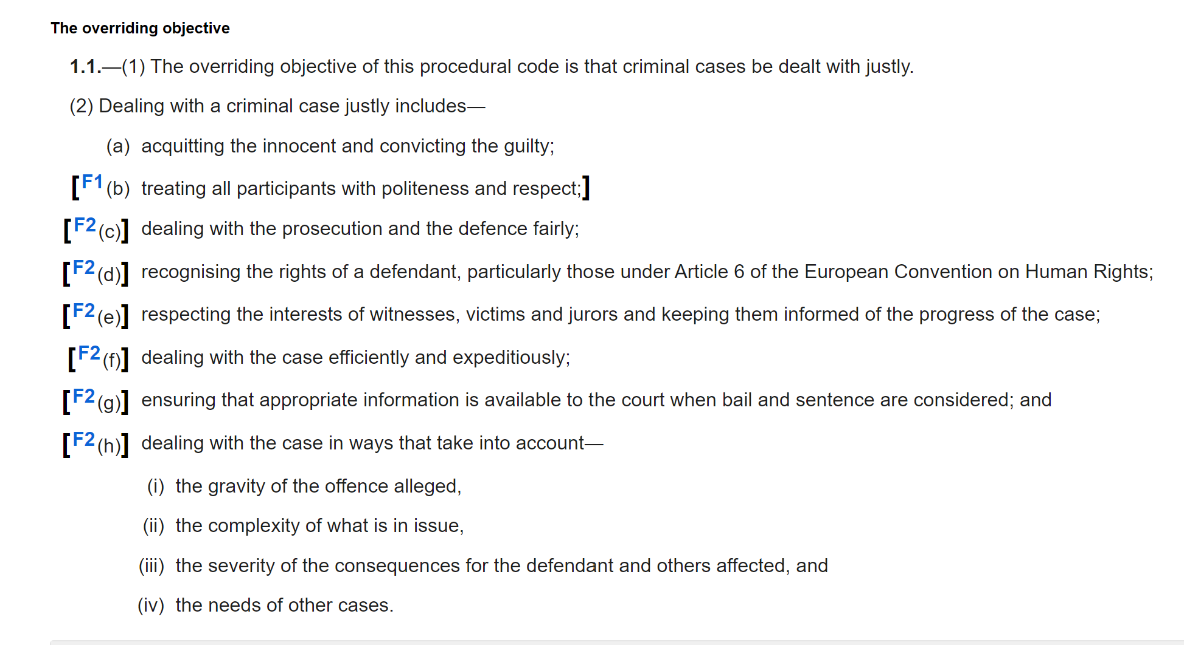
Criminal Procedure Rules 2020 – Overriding Objective

Slide 19
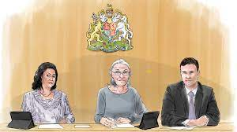
Classification of Offences
Magistrates’ Court Act 1980 (MCA 1980) provides that all criminal offences fall into one of three categories:
Indictable-only;
Either way; or
Summary offences.

Slide 20
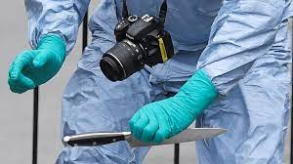
Indictable Only Offences
Most serious form of criminal offence.
Dealt with by the Crown Court.
Examples include murder, rape and robbery.

Slide 21

Either-way Offences
These offences can be dealt with either by the Magistrates’ Court or by the Crown Court.
Magistrates may decide that the case is too serious for them to deal with.
Defendants can choose whether to go to the Crown Court for trial.
Examples include theft, assault occasioning actual bodily harm and burglary.

Slide 22
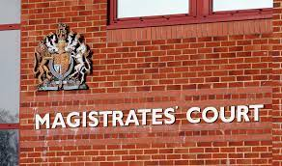
Summary Offences
Least serious forms of criminal offences
Examples include, common assault and road traffic offences.

Slide 23
Tasks
List five safeguards in the criminal justice system for persons accused of a crime.
Which rights under ECHR are likely to be invoked in criminal matters?
You are consulted by Phil James. He has been charged in connection with careless driving which is a summary only offence. Phil wants to know which court will hear his case. What do you tell him?
Assume Phil has been charged with theft which is an either-way offence. He intends to plead not guilty. Explain which court he may be tried in.
Assume Phil has been charged with murder. Explain which court he will be tried in.

Slide 24

Key Personnel of the
Criminal Justice System
Can you name some of the key players in the Criminal Justice System?

Slide 25
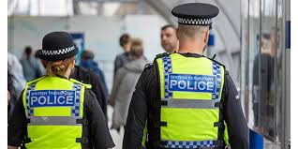
The Police
Responsible for the investigation of suspected criminal offences
Apprehending suspects
Police possess a wide range of powers which we will discuss in week 2.
Although the police investigate the majority of alleged offences, other agencies exist to investigate particular types of crime (e.g. HMRC, Health and Safety Executive)
National Crime Agency (NCA) established to prevent and investigate serious, organised and complex crime. (e.g. drug importation, firearms, cybercrime, exploitation of children and human trafficking)

Slide 26

Defence Solicitors
Defendants can represent themselves; however, it is likely that they will be represented by a solicitor/lawyer.
Solicitors provide advice and assistance to a suspect in the police station, before the suspect is charged with an offence.
If the suspect is charged, the solicitor will then represent the person in proceedings before the Magistrates’ Court (and if necessary, the Crown Court.)
At Crown Court the solicitor will instruct a barrister or solicitor advocate to act as the client’s advocate in court.

Slide 27

The CPS
The Crown Prosecution Service (CPS) is responsible for prosecuting individuals charged with having committed a criminal offence.
Head of the CPS is the Director of Public Prosecutions.
Responsible for deciding whether to charge a suspect.
CPS prosecutes the case in court and will collate evidence to be presented at trial.
It is independent from the police.

Slide 28
The Magistrates’ Court
After a suspect has been charged with an offence, they will make a first appearance in court before the Magistrates’ Court (MC)
If under the age of 17 the suspect will appear in the Youth Court
Depending on the offence, the case may either remain in the MC or be sent to the Crown Court for trial.
Approximately 95% of criminal cases are dealt with the MC.
Summary offences tried in MC and some either-way offences
Deal with bail applications
No jury – only magistrates and legal advisor (clerk to the justices)

Slide 29
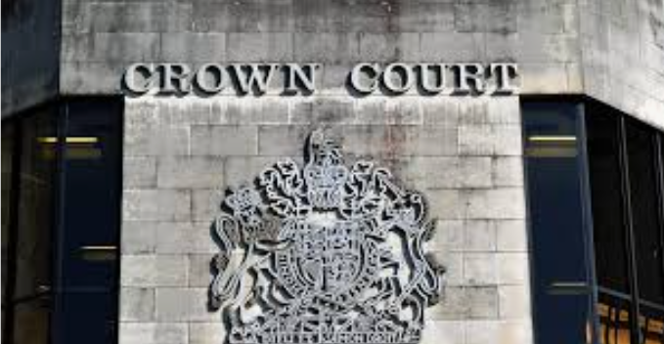
The Crown Court
The CC is the venue that deals with offenders charged with the most serious types of criminal offences.
Main functions of the court are:
-to conduct the trial and to sentence the offenders if convicted of all indictable only and some either-way offences
To determine the question of bail, appeals against the refusal of bail at the Magistrates’ Court.
To hear appeals against convictions and/or sentence from the Magistrates’ Court.
Judges and juries.

Slide 30

The Probation Service
A representative from the PS will always be present in court when a case is being heard.
PS responsible for compiling reports on defendants who have been convicted (pre-sentence reports). These reports focus on the defendant’s background, previous convictions and likelihood of re-offending.
Also responsible for the administration of various types of community order which may be imposed by the court as per of the sentence the defendant receives.

Slide 31

Criminal Legal Aid
Since 1 April 2013, the funding for legal services for those suspected of having committed a criminal offence or facing criminal proceedings is administered by the Legal Aid Agency (LAA)
Provides funding for defendants

Slide 32

Any Questions?

Slide 33
Next Steps
Next week we will be looking at Police Powers
Read up on the subject in readiness for the session.

