Slide 1
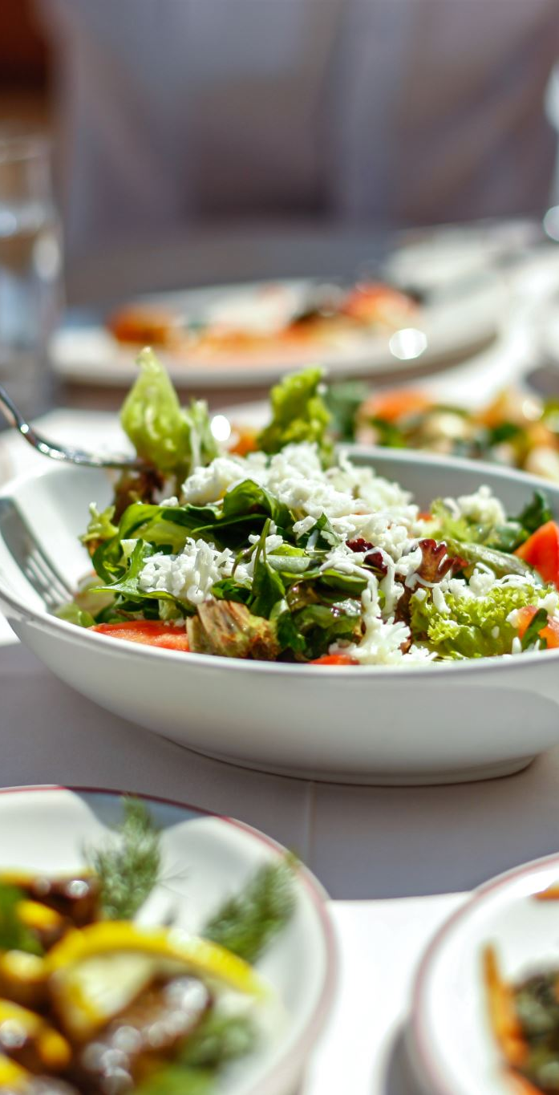
Italian Food Culture
Exploring Regional Diversity, Culinary Traditions, and Wine Culture

Slide 2
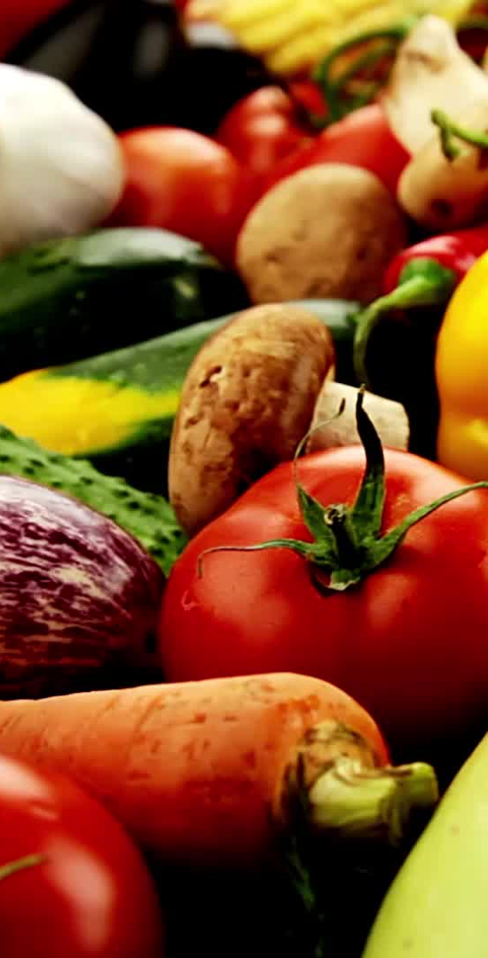
Introduction
Italian food culture is renowned for its diversity, simplicity, and use of fresh, high-quality ingredients. Rooted in centuries of tradition, it varies significantly by region, reflecting local history, climate, and geography.

Slide 3
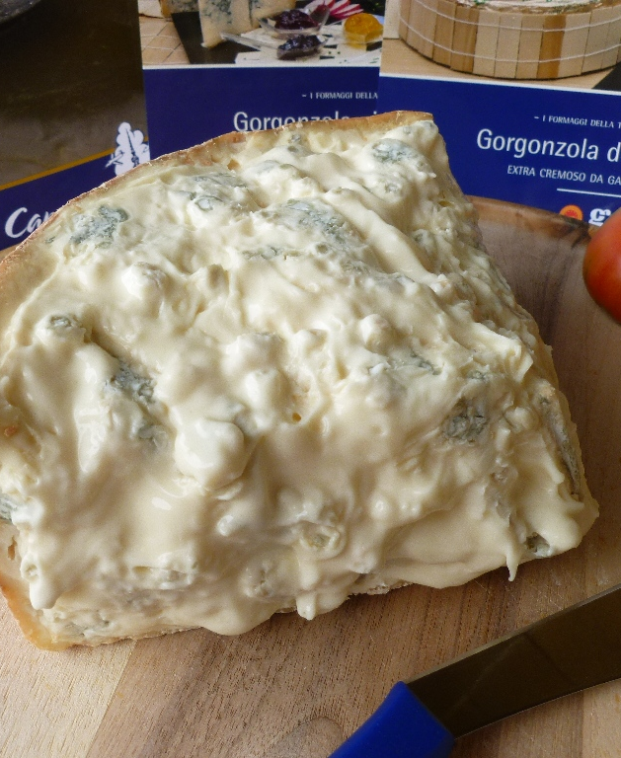
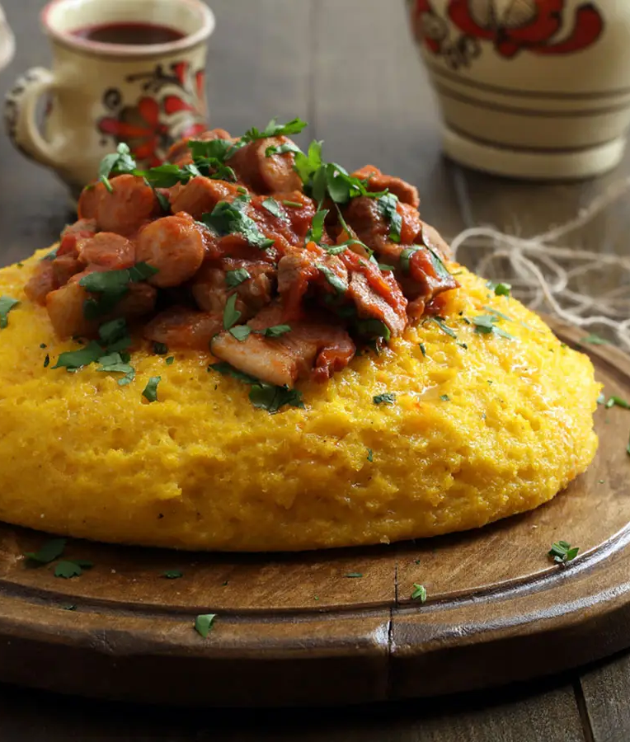
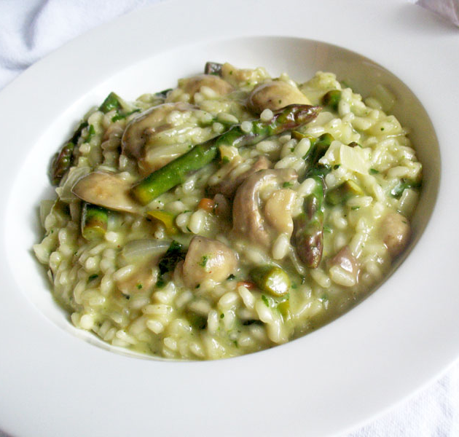
Northern Italy Overview
The cuisine of Northern Italy is influenced by its alpine climate and proximity to Central Europe. Key characteristics include:
- Creamy dishes like risotto and polenta
- Rich cheeses such as Parmigiano-Reggiano and Gorgonzola
- Meats like Prosciutto di Parma
This Photo by Unknown Author is licensed under CC BY-NC-ND
This Photo by Unknown Author is licensed under CC BY
This Photo by Unknown Author is licensed under CC BY-NC-ND

Slide 4
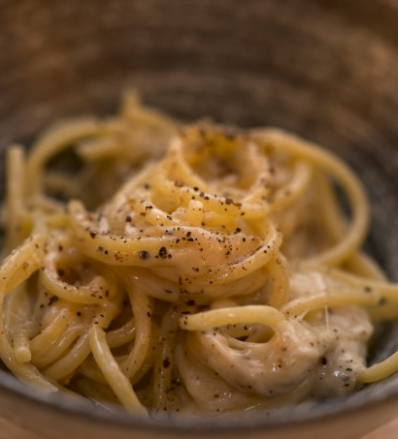
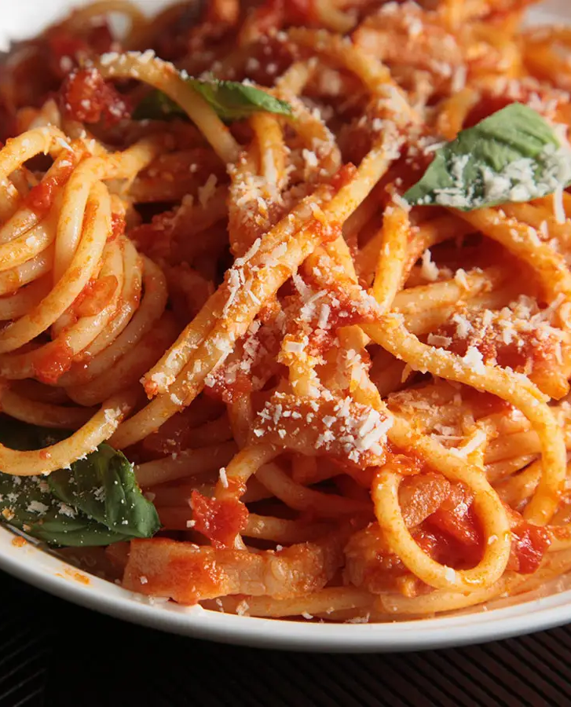
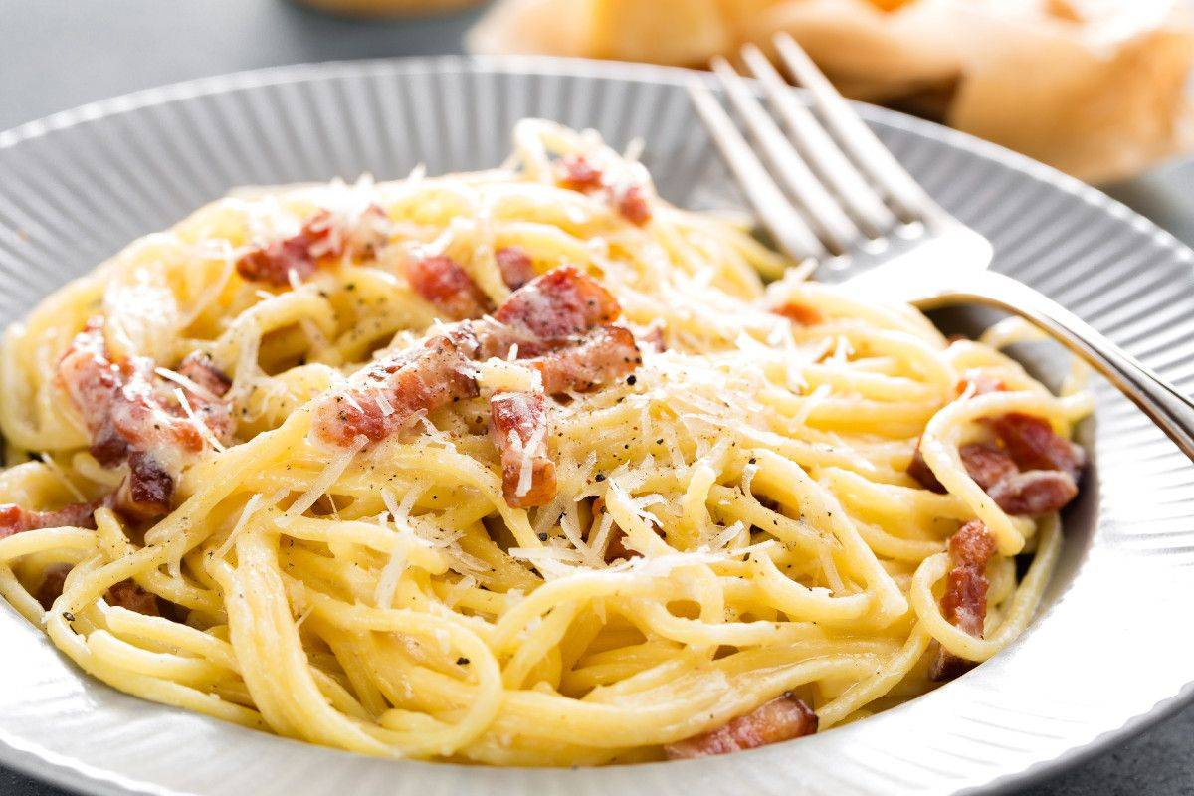
Central Italy Overview
Central Italy showcases a balance between hearty and light dishes. It is known for:
- Iconic pasta dishes like Carbonara, Amatriciana, and Cacio e Pepe
- Robust wines like Chianti and Brunello
- Traditional soups such as Ribollita and Pappa al Pomodoro.
This Photo by Unknown Author is licensed under CC BY-NC-ND
This Photo by Unknown Author is licensed under CC BY-NC-ND
This Photo by Unknown Author is licensed under CC BY-NC-ND

Slide 5
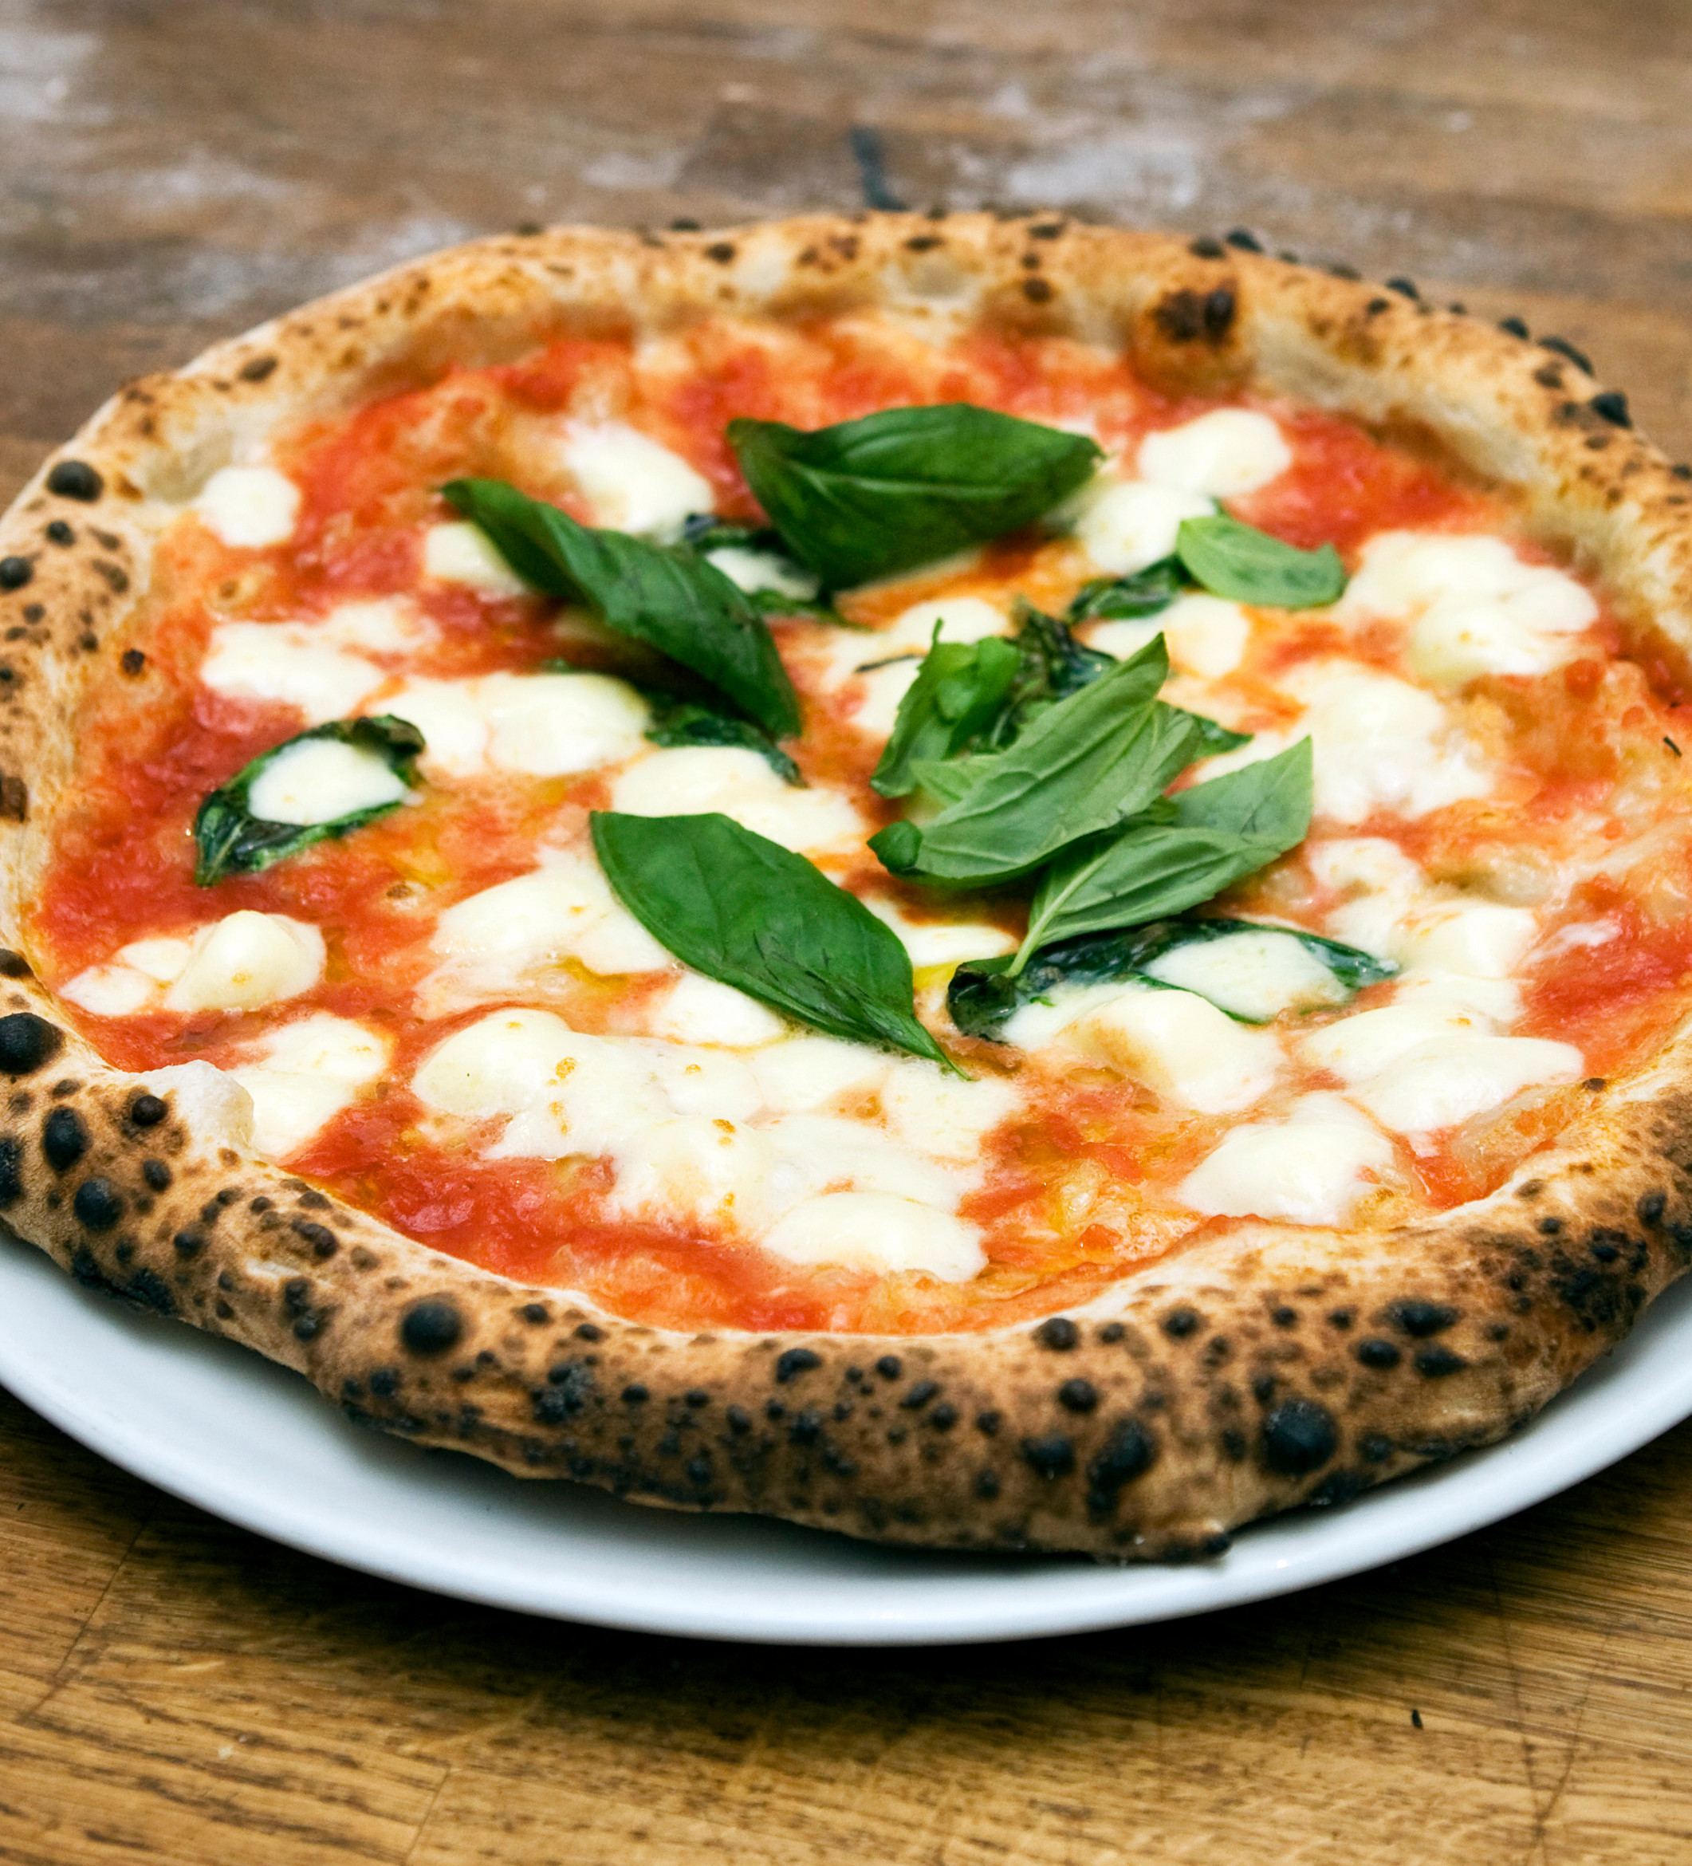
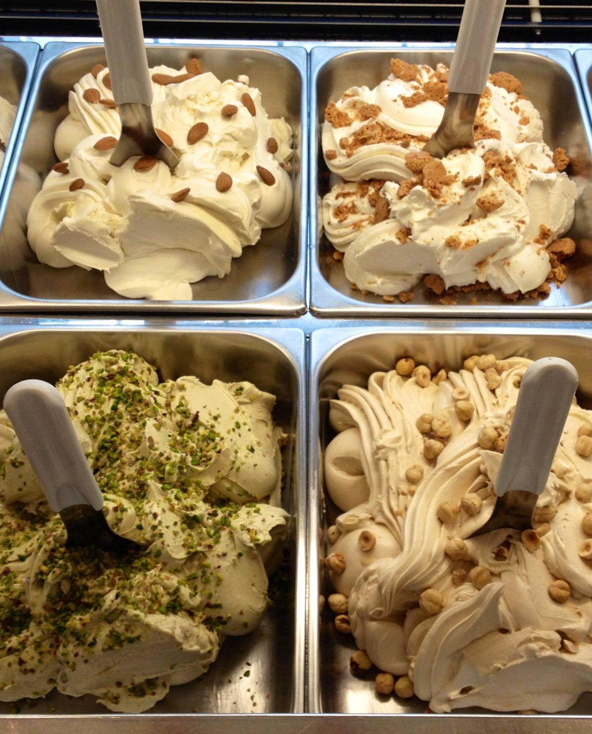
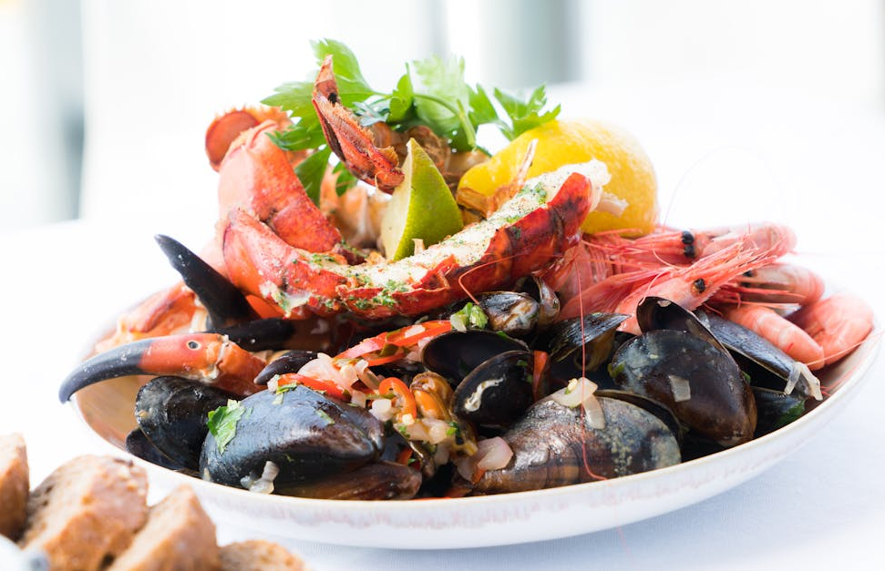
Southern Italy Overview
Southern Italy emphasizes Mediterranean flavors with fresh, sun-ripened ingredients. Key highlights:
- Pizza, especially Neapolitan-style, originating from Naples
- Olive oil, tomatoes, and seafood as staples
- Desserts like cannoli and gelato from Sicily.
This Photo by Unknown Author is licensed under CC BY-NC-ND
This Photo by Unknown Author is licensed under CC BY-NC-ND

Slide 6
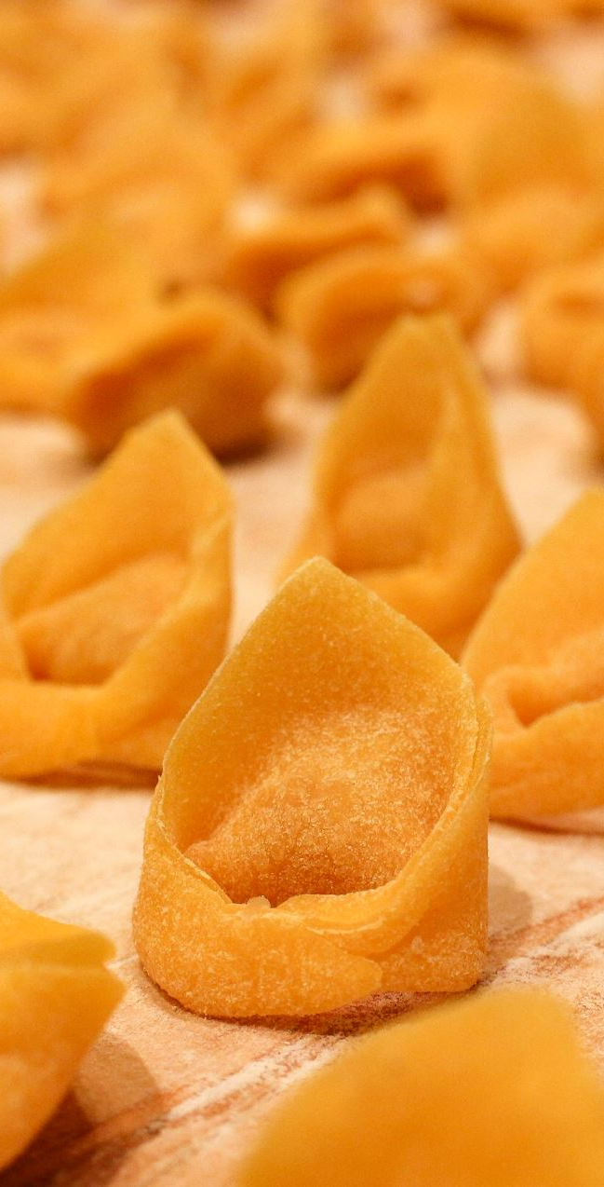
Pasta Varieties
Pasta is central to Italian cuisine, with over 300 types across regions. Examples include:
- Spaghetti and Penne (national staples)
- Tortellini from Emilia-Romagna
- Pici from Tuscany.
Each shape is paired with specific sauces for optimal flavor.

Slide 7
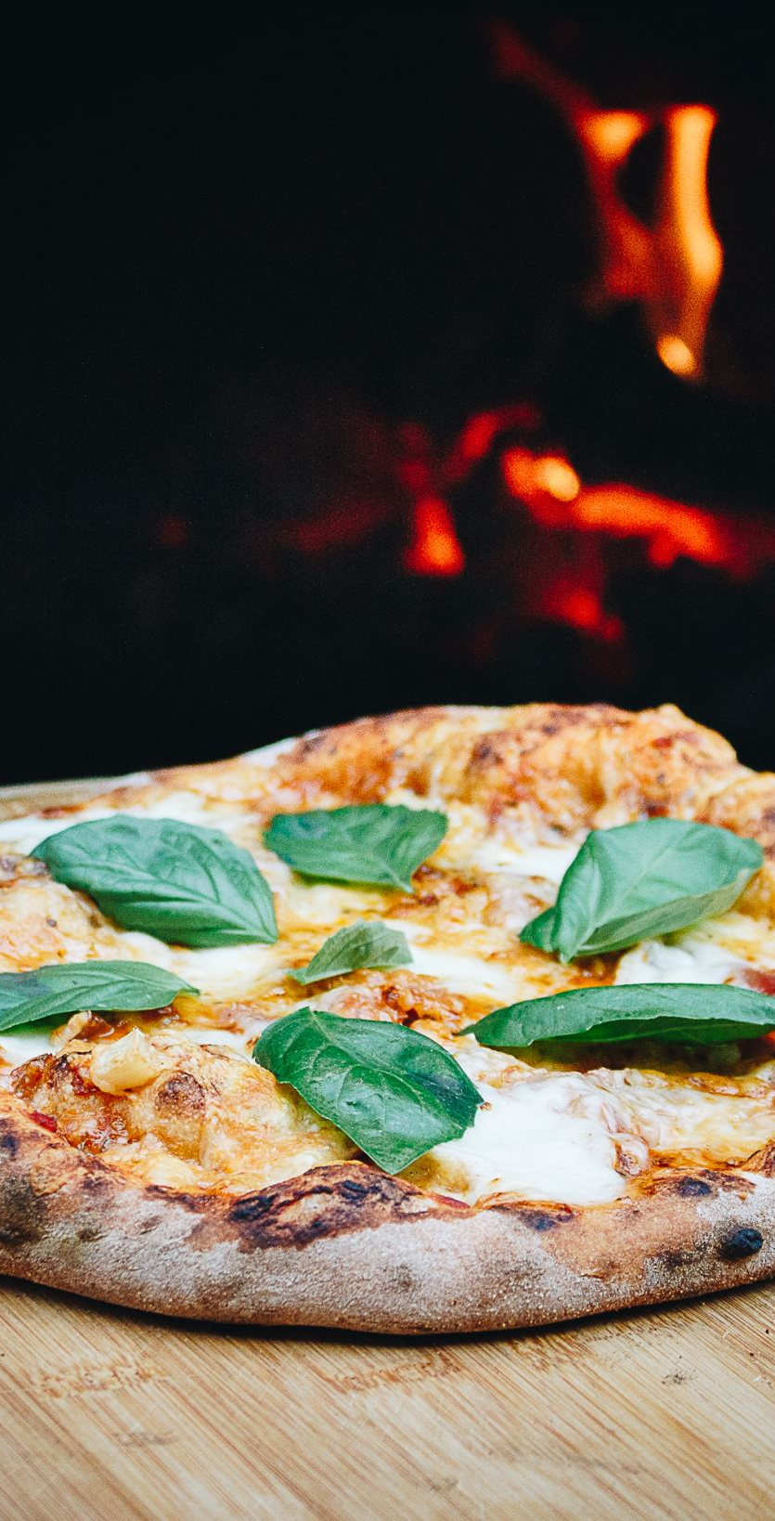
Pizza and Its Origins
Pizza originated in Naples and has become a global phenomenon. Traditional styles include:
- Margherita: Tomato, mozzarella, and basil
- Marinara: Tomato, garlic, and oregano
Neapolitan pizza is protected by UNESCO as an intangible cultural heritage.

Slide 8
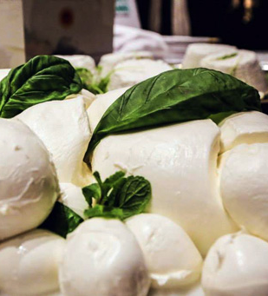
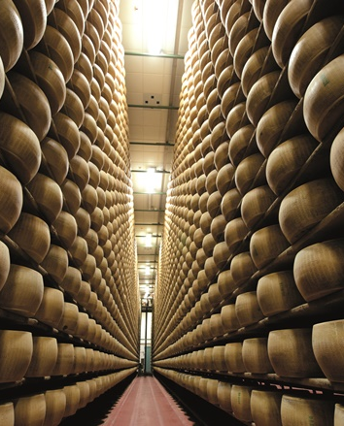
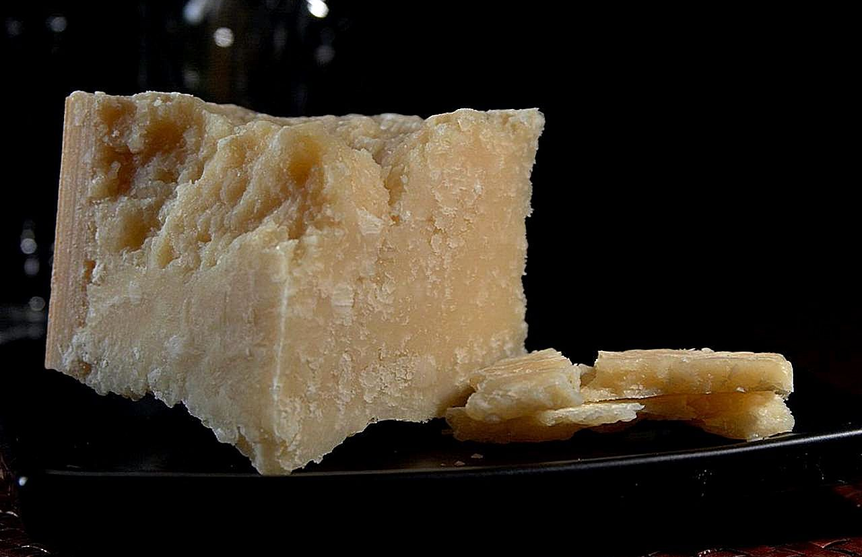
Italian Cheeses
Italy is famous for its wide range of cheeses. Iconic varieties include:
- Parmigiano-Reggiano (hard, nutty flavor)
- Mozzarella di Bufala (soft and creamy)
- Pecorino Romano (salty and tangy).
Cheeses often serve as ingredients, garnishes, or standalone delicacies.
This Photo by Unknown Author is licensed under CC BY-NC-ND
This Photo by Unknown Author is licensed under CC BY-NC

Slide 9
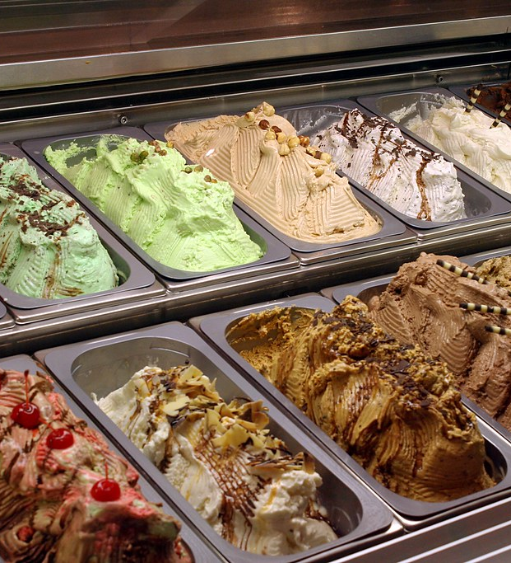
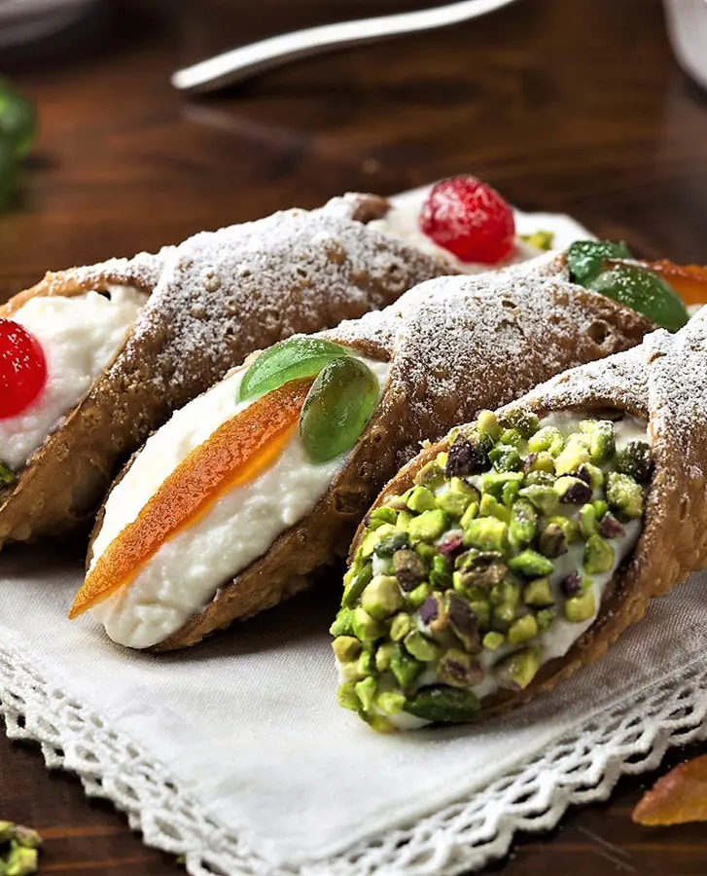
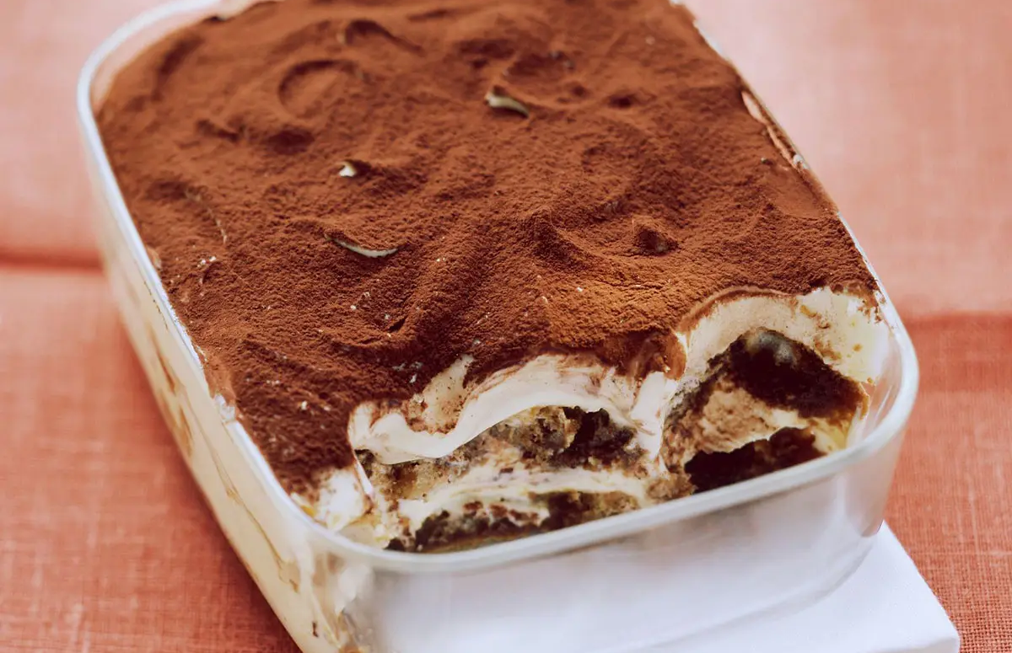
Desserts and Sweet Treats
Italian desserts celebrate rich flavors and textures. Popular options include:
- Tiramisu: Layers of mascarpone, coffee-soaked biscuits, and cocoa
- Cannoli: Crispy pastry filled with sweet ricotta
- Gelato: Creamy Italian-style ice cream.
This Photo by Unknown Author is licensed under CC BY
This Photo by Unknown Author is licensed under CC BY-NC-ND
This Photo by Unknown Author is licensed under CC BY-NC-ND

Slide 10

Italian Wines
Italy is the world's largest wine producer, offering a variety of styles:
- Red Wines: Chianti, Barolo, Brunello di Montalcino
- White Wines: Pinot Grigio, Soave
- Sparkling Wines: Prosecco, Franciacorta.
Each region has unique terroirs influencing the flavors.

Slide 11


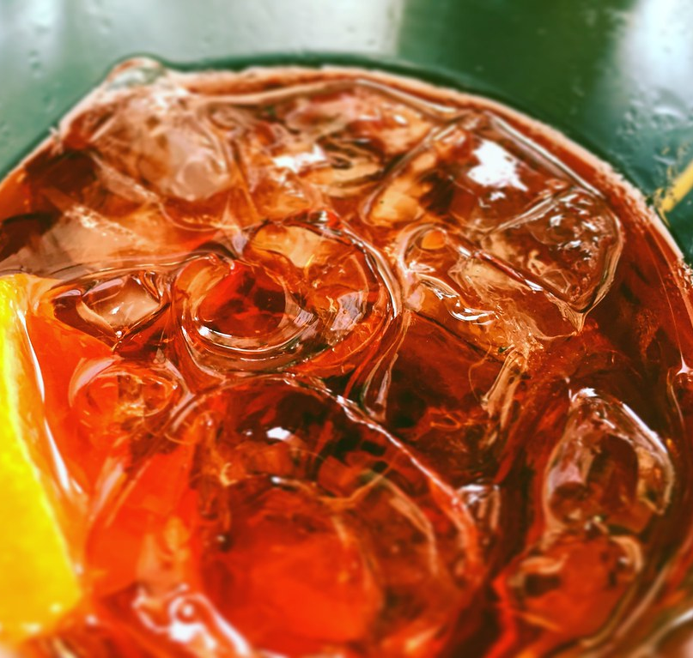
Aperitivo Culture
Aperitivo is a social tradition that begins the evening with light drinks and snacks. Common drinks include:
- Aperol Spritz
- Negroni
- Campari-based cocktails.
This ritual encourages relaxation and conversation.
This Photo by Unknown Author is licensed under CC BY
This Photo by Unknown Author is licensed under CC BY
This Photo by Unknown Author is licensed under CC BY-NC-ND

Slide 12
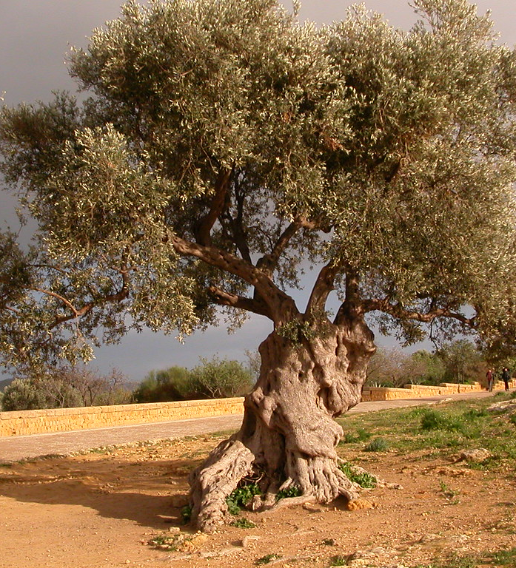
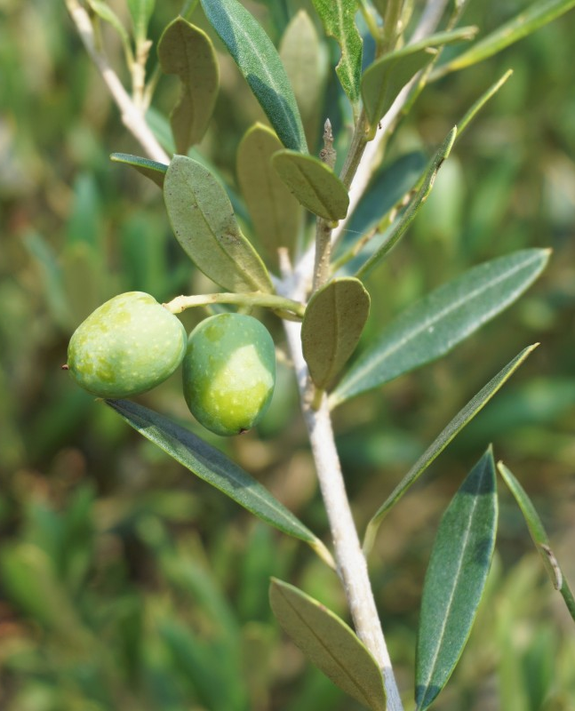
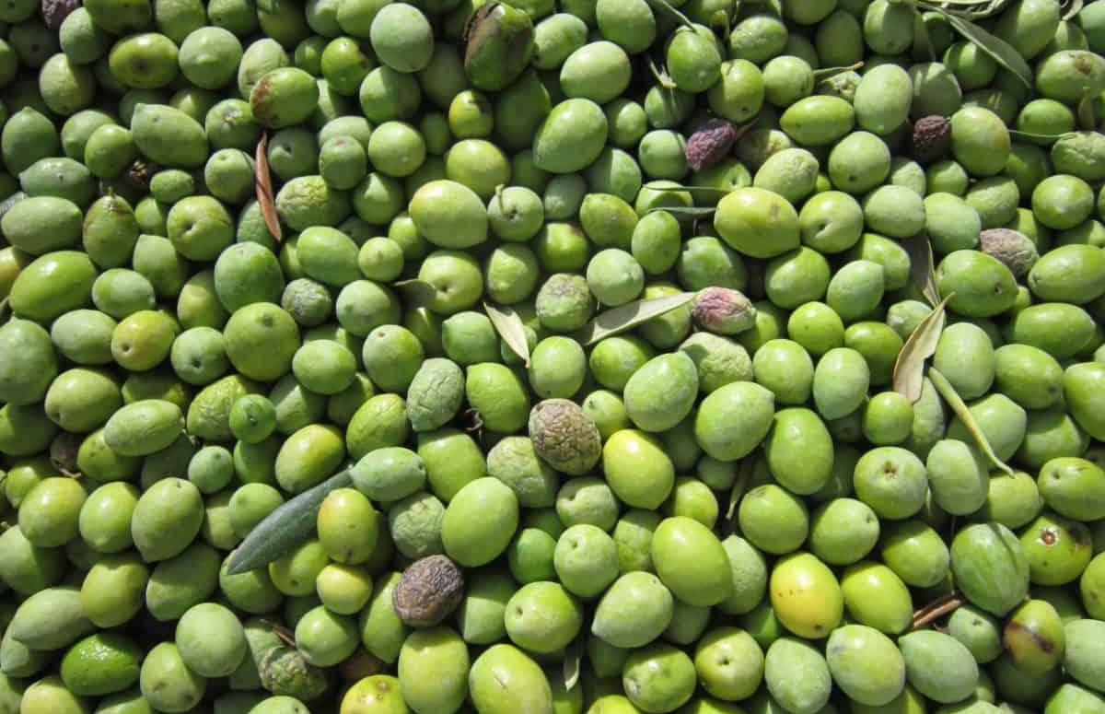
Olive Oil and Its Significance
Olive oil is a staple of Italian cooking, particularly in the south. It is used for:
- Cooking and frying
- Salad dressings and marinades
- Drizzling over fresh bread or pasta dishes.
This Photo by Unknown Author is licensed under CC BY-SA-NC

Slide 13

Coffee Culture
Coffee plays a significant role in Italian daily life. Key points:
- Espresso is a quick, concentrated shot of coffee enjoyed throughout the day
- Cappuccino is typically consumed in the morning only
- Coffee culture emphasizes quality over quantity.

Slide 14
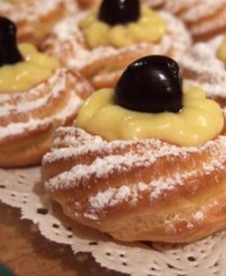
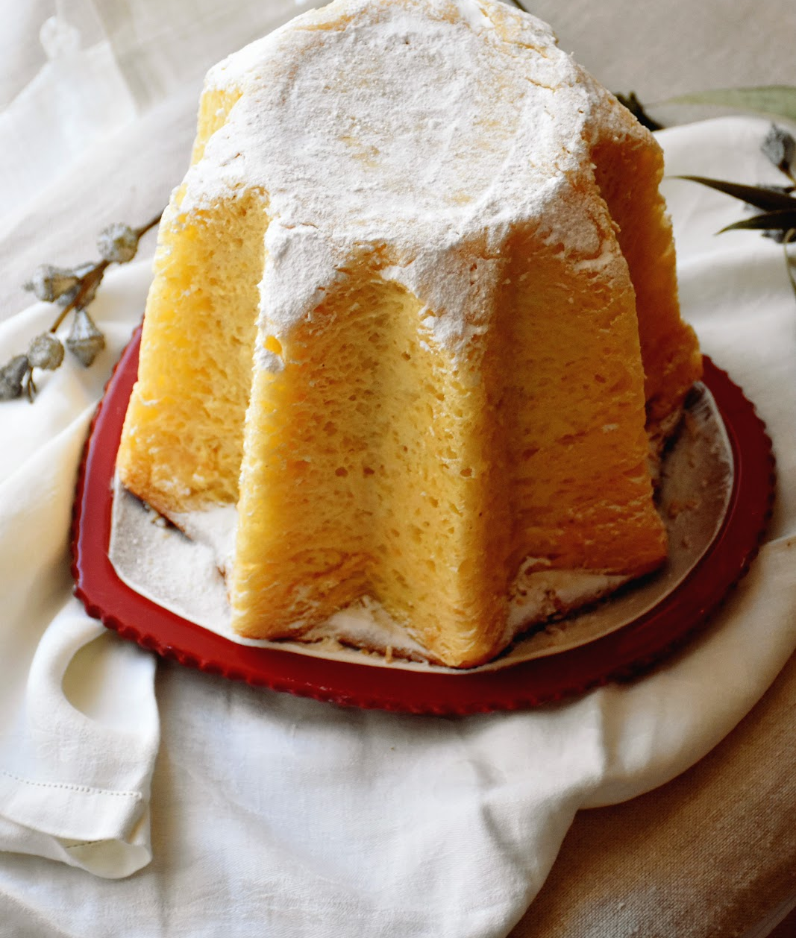
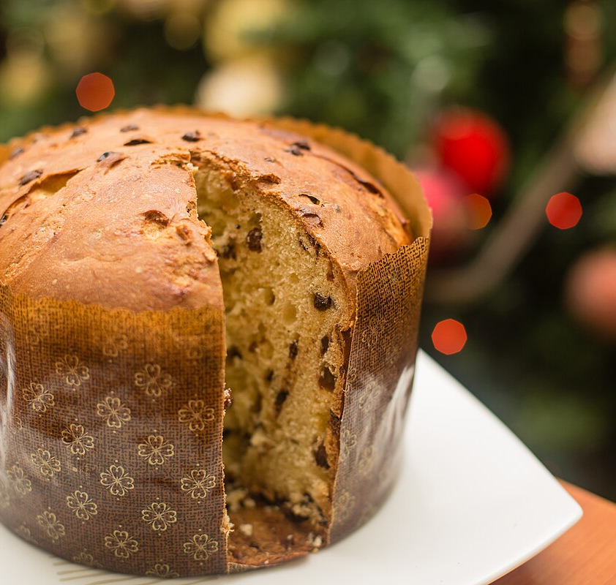
Seasonal and Festival Foods
Italian cuisine celebrates seasonal ingredients and festivals. Examples include:
- White truffles during autumn in Piedmont
- Panettone and Pandoro at Christmas
- Zeppole during the Feast of Saint Joseph.
This Photo by Unknown Author is licensed under CC BY-NC-ND
This Photo by Unknown Author is licensed under CC BY-SA
This Photo by Unknown Author is licensed under CC BY-NC-ND

Slide 15
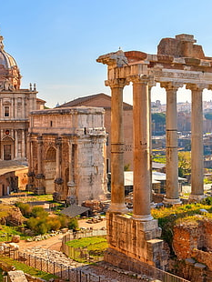
Conclusion
Italian food culture is a vibrant celebration of diversity, tradition, and craftsmanship. From regional specialties to global staples, it continues to inspire and bring people together.

