Slide 1
Speech and Language Therapy- working with pre-school children
Hannah Murtagh- Specialist Speech and Language Therapist, Flying Start, Swansea

Slide 2
What do SLT’s do?
Speech and language therapy is concerned with the management of disorders of speech, language, communication and swallowing in children and adults.
Speech and language therapists work in these areas:
  community health centre's,
  hospital wards outpatient departments,
  mainstream and special schools,
  children's centers, day centers,
  clients' homes,
  etc

Slide 3
Paediatric SLT work with:
  Babies /children with feeding and swallowing difficulties (Specialist role)
  and
  Children with:
    mild, moderate or severe learning difficulties
    disorders/syndromes
    brain injury
    language delays
    specific language impairments
    specific difficulties in producing sounds
    hearing impairment
    cleft palate
    stammering
    autistic Spectrum Disorder
    social interaction difficulties
    voice disorders
    selective mutism

Slide 4
Why – is SALT provision so important within Flying Start areas?
In areas of social deprivation the percentage of children with language and communication difficulties is significantly higher than the average (Communication Champion 2011).
At school entry, low income children lag behind by 16m in vocabulary (Waldfogel and Washbrook, 2010).
Vocabulary at age 5 = best predictor of of whether children who experienced social deprivation in childhood were able to ‘buck the trend’ and escape poverty in later adult life (Blanden, 2006).
More than half of children starting Nursery in socially deprived areas have delayed language (Communication Champion, 2012).
Notes:
I feel that it is important to constantly remind the team the reason that our jobs are funded so that we don’t lose sight of what direction we are heading towards.
Communication champion, for children and young people aged 0-19 in England, was appointed by Government in response to the 2008 Bercow Report on services for children and young people with SLCN.
Speech bubble 1: Low income children lag behind their high income counterparts at school entry by six months in vocabulary. The gap in language is very much larger than gaps in other cognitive skills (Waldfogel and Washbrook, 2010).
Summarise by stating two points.

Slide 5
Role of SALT within Flying Start
Early intervention and prevention of Speech and Language Difficulties
  Building early speech and language awareness in the communities we work in.
  Training other early years professionals in SLCN
  Empowering parents so that they feel confident to develop their child’s speech and language skills
  Assessment of identified children in their homes
  Offer specialist packages of care (1:1 and groups)
  Working as part of a multi-disciplinary team

Slide 6
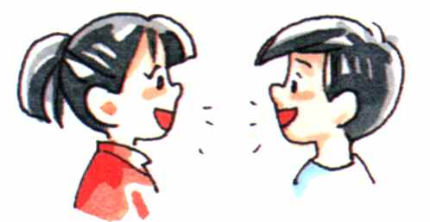
What is communication?
Communication is about giving and receiving messages
Successful communication needs –
A speaker and a listener
A language they both understand
Rules to guide the conversation

Slide 7

Language and conversation help children to develop friendships
Language and conversation are essential for learning. Learning depends on understanding what someone says, thinking and responding. All these things need language.
Where do reindeer come from?
Cold countries

Slide 8
Terminology
Activity
There are seven terms and seven definitions
Please can you match them up.
(5 minutes).

Slide 9

What skills do we use to understand spoken language?

Slide 10


looking
Demonstration
Children need to look at the speaker to....
Get all the information
Help them to concentrate and listen
Children who do not look at the speaker will miss important information
We need to encourage children to look at us when we talk to them

Slide 11
hearing
Children need good hearing for speech and language
If he cannot hear, he may not learn to say them correctly
Become tired, restless and may switch off so he does not listen. This is sometimes misunderstood as bad behaviour
We need to encourage children to listen
If a child has problems learning to listen, understand or talk it is a wise precaution to have their hearing checked

Slide 12
Listening and concentrating
Children have to learn how to listen and concentrate
- Consequences maybe difficulty attending to the person who is talking
- Remembering what he has been told
- Listening to long sentences
- Following instructions
- Sometimes appear naughty but perhaps he cannot listen or understand
-We need to make listening easier for example, turn off all background noise
-We need to help children learn to listen

Slide 13
remembering
Children need good memories to remember what they have been told
Poor memory means that a child....
may not remember what has been told
Learn new information easily
Find information he has stored somewhere in his mind
Poor memory can affect ALL areas of learning
We need to be realistic about the amount of information a child can remember
We need to help children to learn to use their memories

Slide 14
Understanding words
Children have to know what words mean
Learn a big vocabulary (14,000 words by 6yrs old)
Have to understand words before they can use them to talk
If he does not understand a word, he will have difficulty following an instruction
Understanding what was said to him
Recognise when children do not understand certain words
Know how to help children learn new words
Use simple words in short sentences to help children understand what we say

Slide 15
Understanding sentences
This means children have to learn the rules about how a sentence is constructed
By 5yrs, sentences can have more than one meaning
If a child does not understand sentences then the child may switch off, become quiet or misbehave because he cannot understand
Insist on routine and may hate change because he does not understand the explanations
Be late talking and become very frustrated perhaps having temper tantrums
Find it harder to make friends and play with his peers
Recognise when children do not understand what we say
Change the way we say things to help children understand

Slide 16

What skills do we use to use spoken language?

Slide 17
Having ideas and deciding what to say
Children have to have an idea before they have something to talk about
Some children find it hard to think of new words or have different things to say.
Some children NEED TIME to think about what to say
Sometimes children do not feel confident about talking and avoid it
Keep our questions simple and clear so the children know what information or ideas we want from them
We need to give them lots of different things to do, look at and experience so they have a variety of things to talk about
Spend time listening to children to show that we are interested in their ideas

Slide 18
Finding the right words
To talk, children need to know the words for things. Children need to find the words in their head quickly when they want to say something. Children are less likely to find words when they are tired, upset or excited.
Some children do not know the words or cannot find the words. This is very frustrating. Sometimes they may hit out as it is the only way they can express themselves. Or, some children can be quiet and withdrawn
Help children learn new words
Make sure they understand what words mean
Give children the confidence to talk so they can learn how to sue their language

Slide 19
Putting words into sentences
Children have to learn how to put words into sentences following quite complex rules
Some children can be late in talking in sentences. This may cause frustration
If a child has delayed language he can become withdrawn or find it hard to play with friends. This means they may have less opportunities to talk an learn how to use words in sentences
Listen to children when they try to talk to us
Talk to children in short sentences so we give examples of sentences that the child can copy
Repeat what children say correctly so that they hear examples of how to use words in sentences
Understand that behaviours can be linked with speech and language. The child is not being naughty!

Slide 20
Saying words clearly
Learning how to say speech sounds is not easy
Children need to hear speech sounds, move the muscles of the mouth and listen to check that the sounds are correct
Some children find learning how to say sounds and use them in words difficult
This can make their speech difficult to understand
This can cause frustration or can mean a child is reluctant to talk to friends and adults
Be realistic and know how clear a child’s speech should be at different ages
Spend time talking to the child so you can “tune in”
Repeat back words so he can hear good examples
Encourage the child to point, show you or act out things we do not understand to reduce frustration

Slide 21
Speaking appropriately
By school age, children need to start being aware of how and when to speak appropriately. (have good social skills)
A child who does not know these subtle rules may seem “odd” in the way he talks and behaves
Find it difficult to play and talk with friends
Be aware of children who find learning social skills difficutl
Encourage all children to learn about these skills by listening and talking to them and showing them how to hold conversations.
Provide opportunities for children to have conversations about things which interest them
We may need to play games to encourage turntaking or good listening

Slide 22
Common Confusion
Speech vs. Language
Speech is the production of words - an intricate process involving lots of muscles of the mouth working together
Language refers to how we use words and how we understand them.

Slide 23
Communication chain
Can you draw the communication chain based on the processes discussed here?

Slide 24
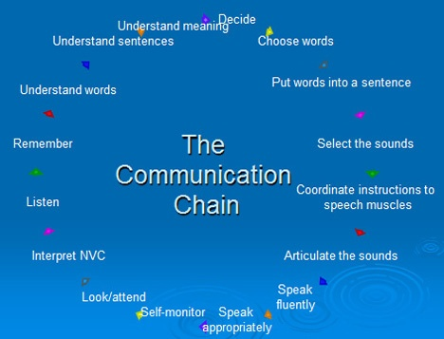
The Communication Chain

Slide 25
How children acquire Speech and Language
Babies must have a need to communicate with others and realise sounds mean something.
Babies cannot learn language if they cant hear it around them.
They need a partner with whom they can communicate.
Babies have to be able to make the sounds that they will use to form words.
Babies have to be able to pick out the differences between sounds they hear.

Slide 26


Developmental norms

Slide 27
Twelve months
Likely to be able to:
Understand own name
Understand the names of some people and objects as long as they are heard in their usual setting
‘sing along’ with music
Shake head for ‘no’
Use one to three words
Relate objects e.g. put spoon in cup, doll in bed
Possible Cause for concern
Never looks around for familiar objects e.g. shoes, when they are talked about
Does not turn towards a speaker when name is called
Does not produce lots of babble

Slide 28
Eighteen Months
Likely to be able to:
Find an object you name e.g. ‘where’s your coat?’
Point to some body parts
Understands some keywords
Look with interest at picture books
Use gestures to make his wants known
Uses 10-20 words
Recreates own or others action e.g. pretends to feed self with spoon
Possible Cause for concern
Never takes it in turn to make sounds
Does not respond by looking in the right direction with questions like ‘where’s your hat?’
Does not babble with lots of different sounds
Never concentrates on anything for more than a few seconds
No attempt at saying first words, accompanied by poor early interaction skills or other difficulties

Slide 29
2 ½ years old
Likely to be able to:
Identify objects by use e.g. 'which one do we eat?’
Use as many as 200 words or more
Use 3-4 word sentences
Ask What? And Where? Questions
Refer to self as ‘me’
Begin to use past tense e.g. ‘me falled over’
Carry out sequences of pretend play
Understands first verbs
Leaves out ‘little’ words
Difficulties with some sounds e.g. ‘f’, ‘sh’
Possible Cause for concern
The number of words being used is not increasing
Mainly using single words
You often cant understand what is said
Not interested in you joining in play
No pretend play
Doesn’t understand what you say
Short attention span for most of the time

Slide 30
Three Years
Likely to be able to:
Understand instructions with 3 key ideas e.g. put the knife and the fork in the sink
Talk about what is happening in a long monologue
Take part in a conversation about what is happening
Knows some colours
Talks about past events, but tenses may be confused e.g. ‘ I goed to the park’
Possible Cause for concern
Frequently doesn’t seem to understand what you have said
Only uses single words or very short phrases
Unintelligible most of the time to the family
Never asks questions
Shows no interest in playing with other children
Very short attention span
Often says things that are irrelevant
Dysfluency
Habitually hoarse voice

Slide 31
Looking at speech
How do you make a “d” sound?
Repeat for “t”
Finally “s”
Making a “new” S sound at sound, word and sentence level.

Slide 32
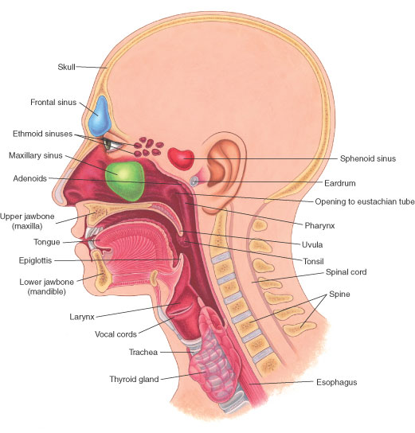
Head and neck anatomy

Slide 33
Unclear Speech
By the age of 2½ your child’s speech should be understood by his close family.
By the age of 3 your child’s speech should be understood by familiar adults outside the home but it will not be perfect.
By the age of 4 your child’s speech should be understood most of the time.

Slide 34
What sounds do children say and when?
Age | Your child will probably use these sounds
1 ½ - 2 years | m, n, p, b, t, d sounds
2 ½ - 3 years | m, n, p, b, t, d, f, s, w, x, y, h sounds
3 - 4 years | m, n, p, b, t, d, f, s, w, x, y, h, v, perhaps sh sounds
4 – 5 years | m, n, p, b, t, d, f, s, w, x, y, h, v, sh, z, ch, j, l. Blends may start to develop e.g. ‘sp’, ‘st, ‘bl’, ‘cr’ sounds

Slide 35
Inty Winty Exercise
Read the paragraph
Can you work out what the child is saying?
Underline each incorrect sound and write the correct sound above it
Can you see a pattern?

Slide 36
Unclear speech
Listen to the child with unclear speech

Slide 37
What is involved in the development of communication?
Language pyramid activity - Please match up where you think these skills fit into the pyramid provided.
Understanding Language
Using Language
Speech
Attention and Listening
Play

Slide 38
Language Pyramid
Speech
Using Language
Understanding Language
Social skills
Play
Attention and listening

Slide 39
How the child learns to talk
Children need to:
Play
Listen
Understand words and sentences
Then they will start to talk
Finally they will learn to articulate the words correctly

Slide 40
We have talked about what you would expect of a normally developing child.
Can you think of any reasons why this might go wrong- where children might not follow this normal pattern of development?
Use the venn diagram to put your ideas into it

Slide 41
Hearing loss
Specific Language Impairment
Learning Difficulties
Family history (Dysfluency)
Environmental factors
Underlying disorder e.g. autism, genetic syndromes
Structural abnormalities (cleft lip/palate, VPI)
Coordination difficulties (DCD)

Slide 42
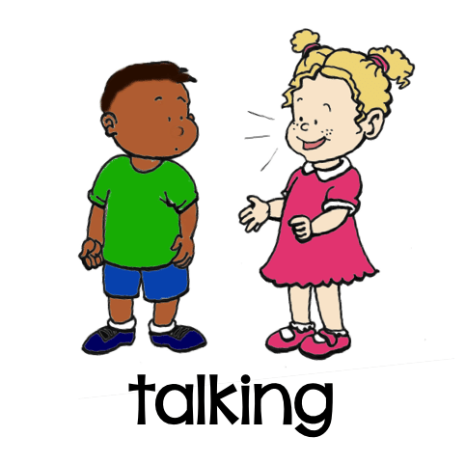
Causes of communication difficulties
Developmental
General developmental delay
Environmental
Limited opportunities for communication
Physical
Hearing problems
Specific speech and language delay
Limited awareness of a child’s difficulties and the support he needs
Difficulties moving the muscles of the mouth and structural difficulties e.g cleft palate

Slide 43
DVD examples
Some children with communication difficulties
Can you identify which part of the communication chain/ pyramid is affected?

Slide 44
Social skills
Using language is as important as understanding and speaking
Engaging in co-operative play
Turntaking
Eye contact
Withdrawn and uncommunicative
Talking about a topic beyond the here and now

Slide 45
Complex needs- social communication difficulties
Communication
Interaction
Imagination

Slide 46
Stammering
Stammering terminology
5% of under 5yrs are likely to stammer (Conture, 1994)
Why?- access to words, sentences
Different patterns (blocks, prolongations, repetitions)
Episodes of non-fluency under 4yrs
Risk factors
Helpful and non-helpful strategies

Slide 47
Strategies- how to help

Slide 48
Natural Language Modelling
  Repeat
    Simply imitate their words and sentences
    This will show them that your valuing their words and will encourage them to keep on talking
  Expand
    Talking very clearly, add more words to the child’s sentence.
    Build on what they say , child: “on” adult: “okay, lets turn the water on”
    child: “mammy apple” adult: “mammy’s eating an apple
        Stress keywords but include correct grammar
  Comment/explain
    Comment on their and your actions, things you see, etc

Slide 49
Be careful with questions
Try not to ask too many questions, especially ones that sound like you are constantly testing the child.
More comments – less questions
The best questions are those that challenge the child to think rather then give an instant answer, like yes or no.
Too many questions can easily block the flow of natural conversation.
Levels of difficulty:
  What
  Where
  Who
  When
  Why
  How

Slide 50
Using non-verbal communication
To support understanding
Using visual aids alongside the words to increase understanding
Using gestures
Can help to understand a routine or can ask a positive motivator
Some examples

Slide 51
Other ways to help...
Use “Stop, Observe, Respond”
Use books
Use simple words and sentences
Sing nursery rhymes
Allow for a quiet environment for child to focus on talking
Limit TV

Slide 52
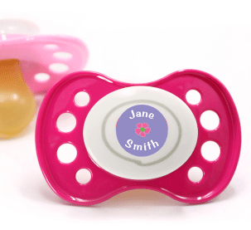

Quick word about Dummies
Fewer opportunities to babble
Talking at the back of the mouth
Dental problems
Hearing problems

Slide 53
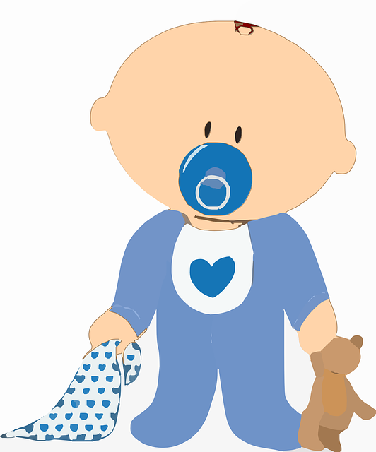
Advice parents on using a dummy sensibly
Restrict the dummy to when your baby really needs comforting
See it as a short term lifesaver
Discourage talking with dummy in mouth

Slide 54
Information
I CAN (www.ican.org.uk)
AFASIC
www.earlysupport.org.uk

