Slide 1
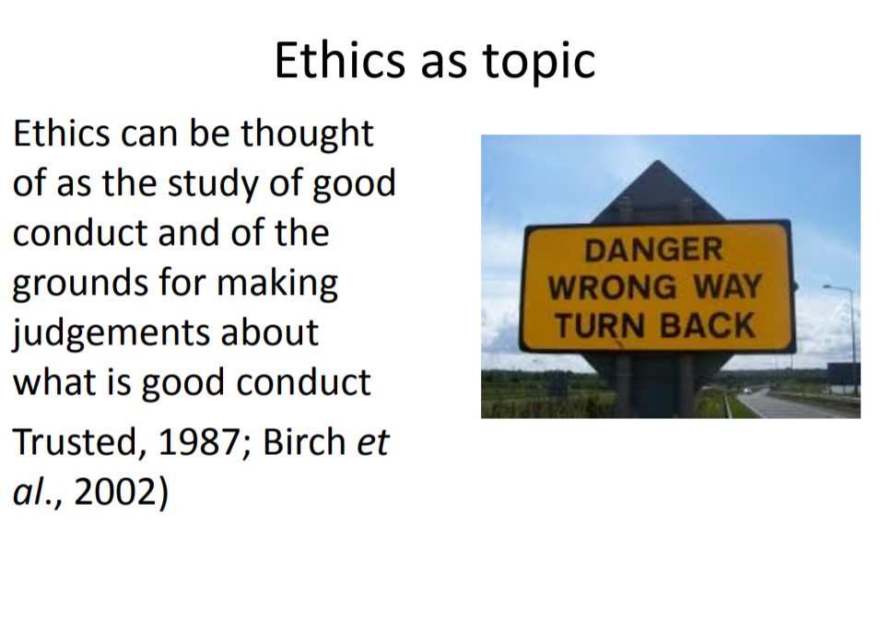

Slide 2
Ethics and Qualitative Research
Ethical considerations are more complex than quantitative
– More personal methods
– More intrusive – into the everyday world of the participant
– Greater role for the researcher-participant relationship (therefore ethical interaction)
Only ethical research is good research?

Slide 3
Research Ethics - Principles
‘Research is essential to the successful promotion of health and well-being’ ‘The dignity, rights, safety and well-being of participants must be the primary consideration in any research study’. Source
– Department of Health Research Governance Framework

Slide 4
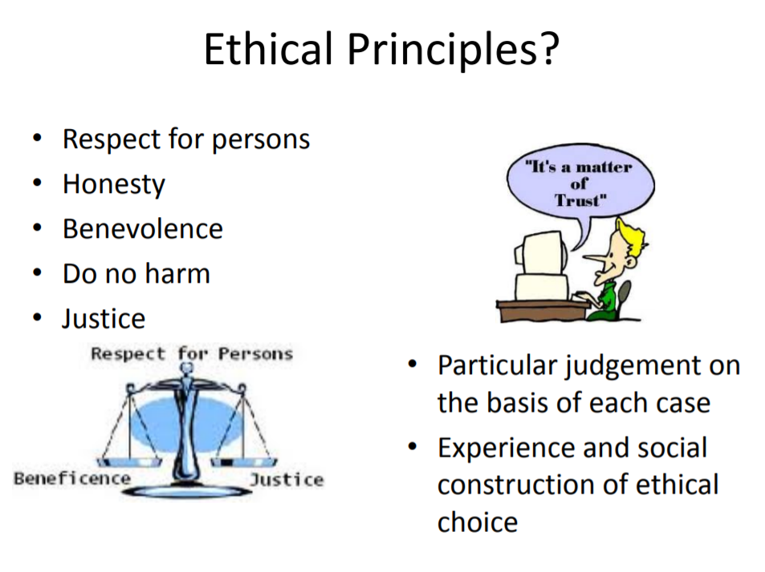

Slide 5
Ethical considerations of qualitative research
They are empirical and theoretical and permeate the qualitative research process. The complexities of researching private lives and placing accounts in the public arena raise multiple ethical issues for the researcher that cannot be solved solely by the application of abstract rules, principles or guidelines. Rather, there are inherent tensions in qualitative research that is characterized by fluidity and inductive uncertainty and ethical guidelines that are static and increasingly formalized (Dence et al 2004: 10)
http://www.respectproject.org/ethics/guidelines.php

Slide 6
The value of ethics codes and frameworks and guidelines
• Usually combine different ethical reasoning and approaches
• A pragmatic set of ethical considerations
• A useful overarching guideline
• Help develop consistent practice
• Not a fixed set of rules
• Researchers can depart from – only after deliberation

Slide 7
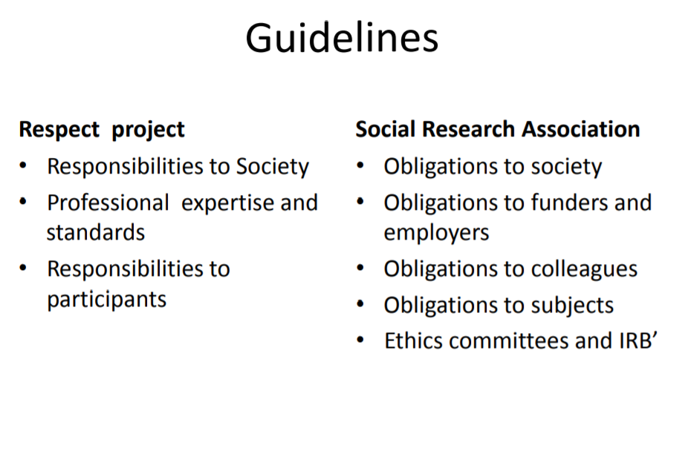

Slide 8
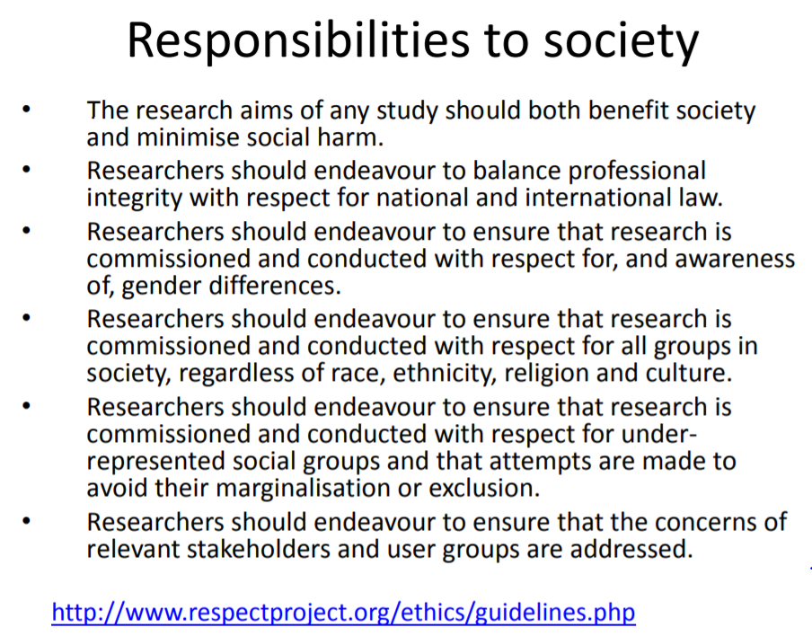

Slide 9
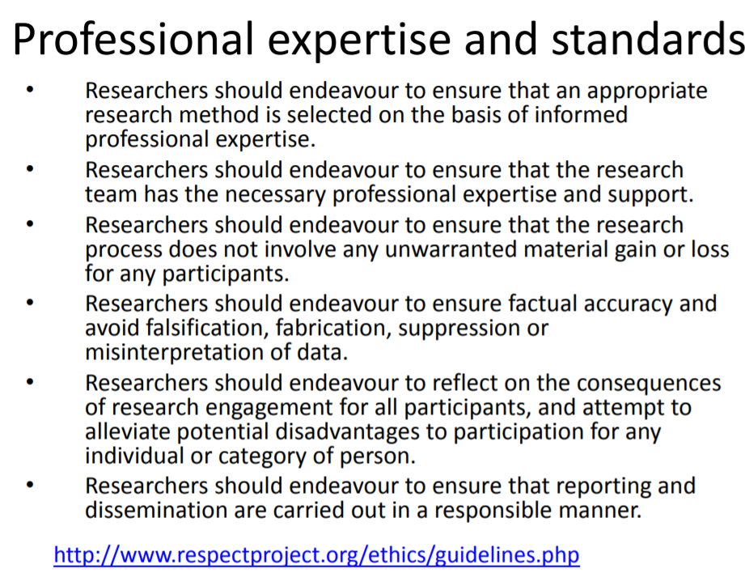

Slide 10
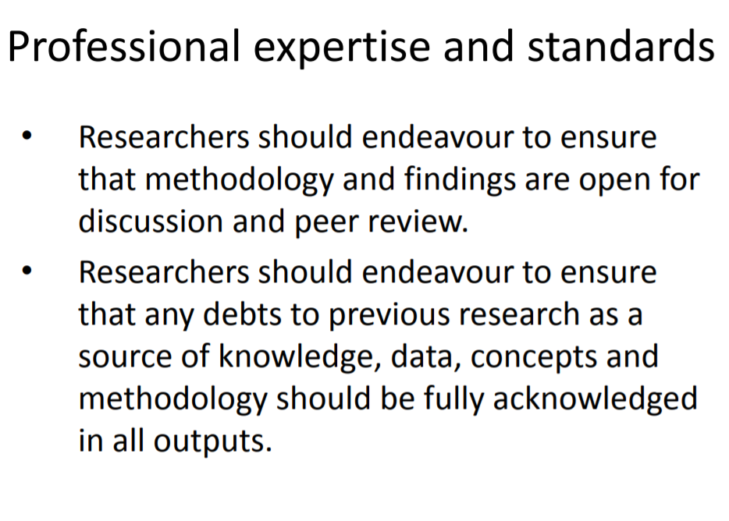

Slide 11
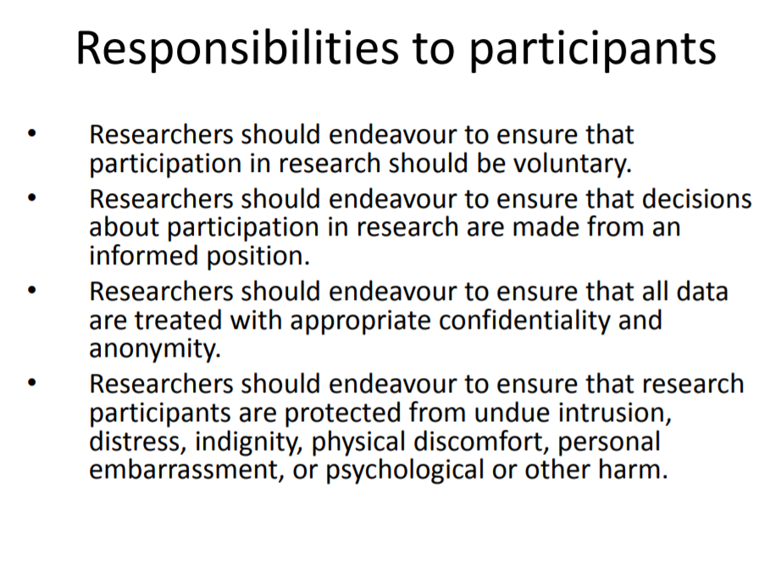

Slide 12
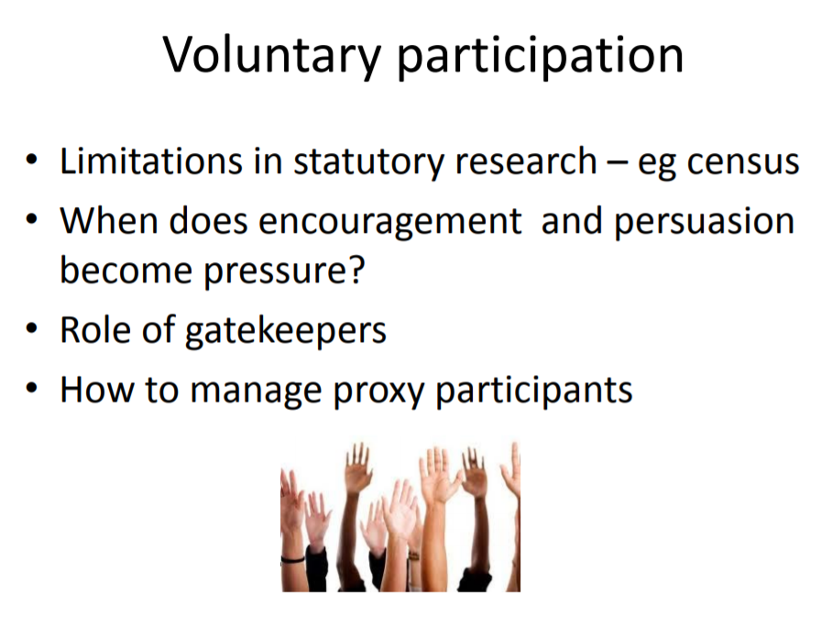

Slide 13
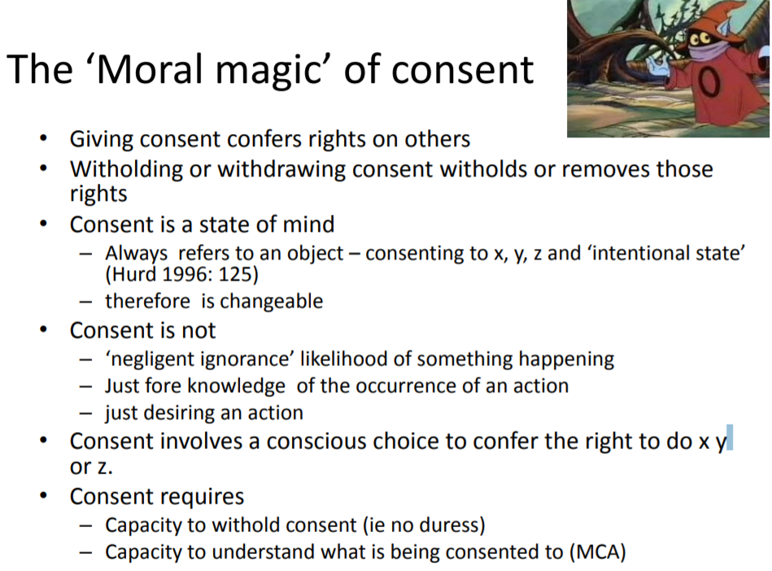

Slide 14
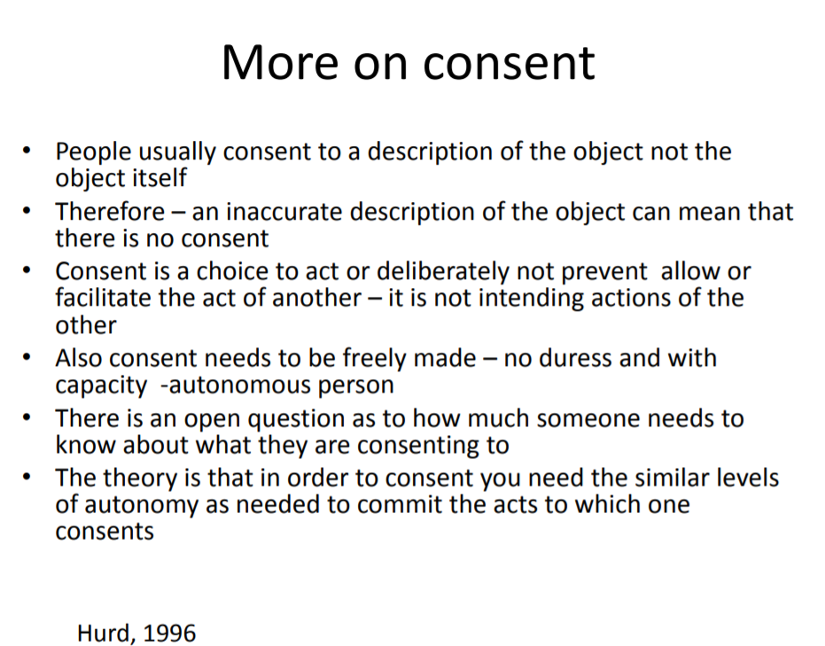

Slide 15
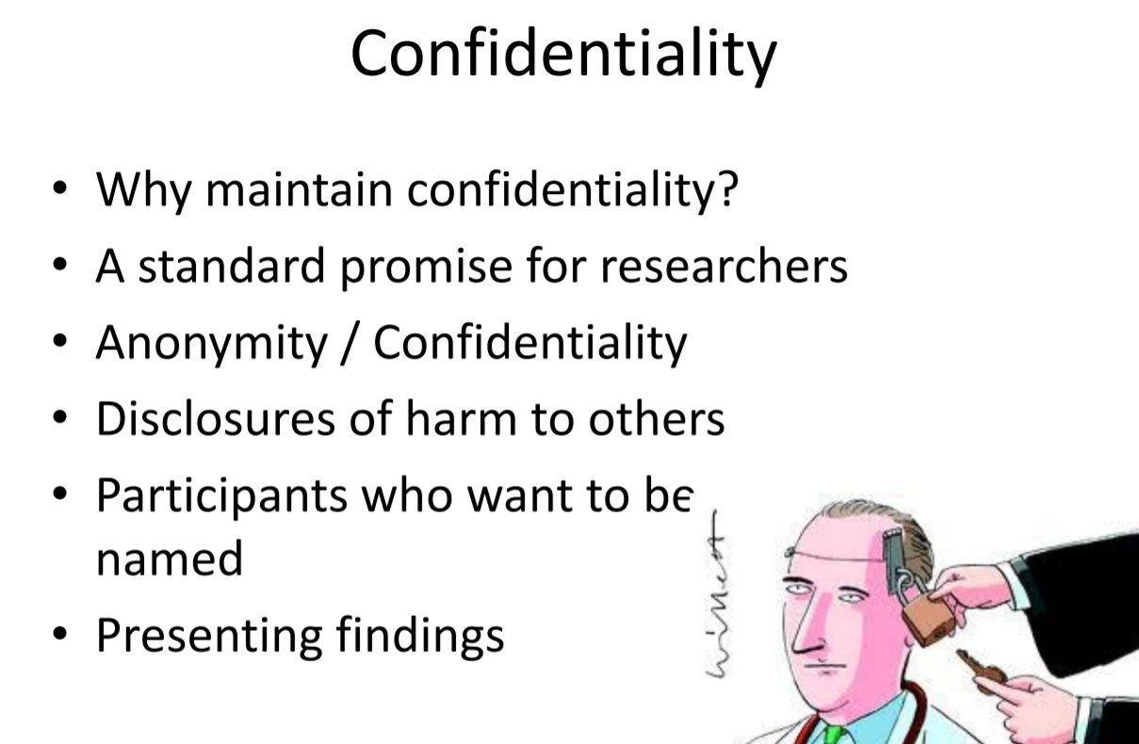

Slide 16
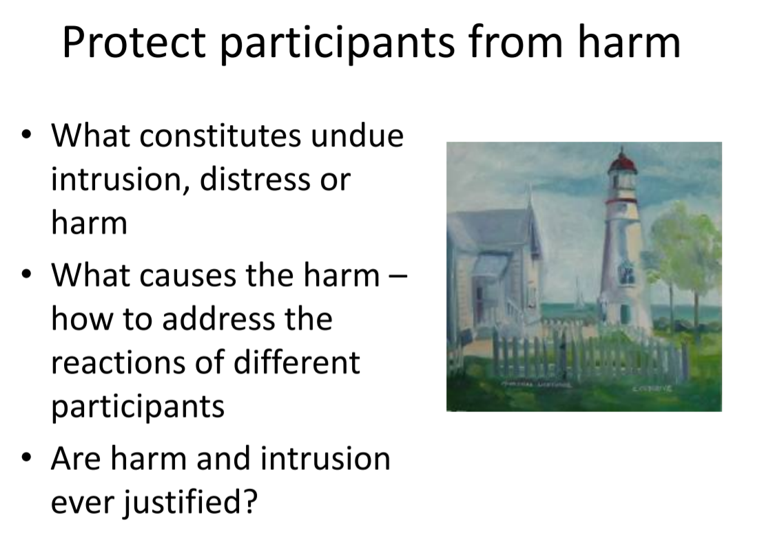

Slide 17
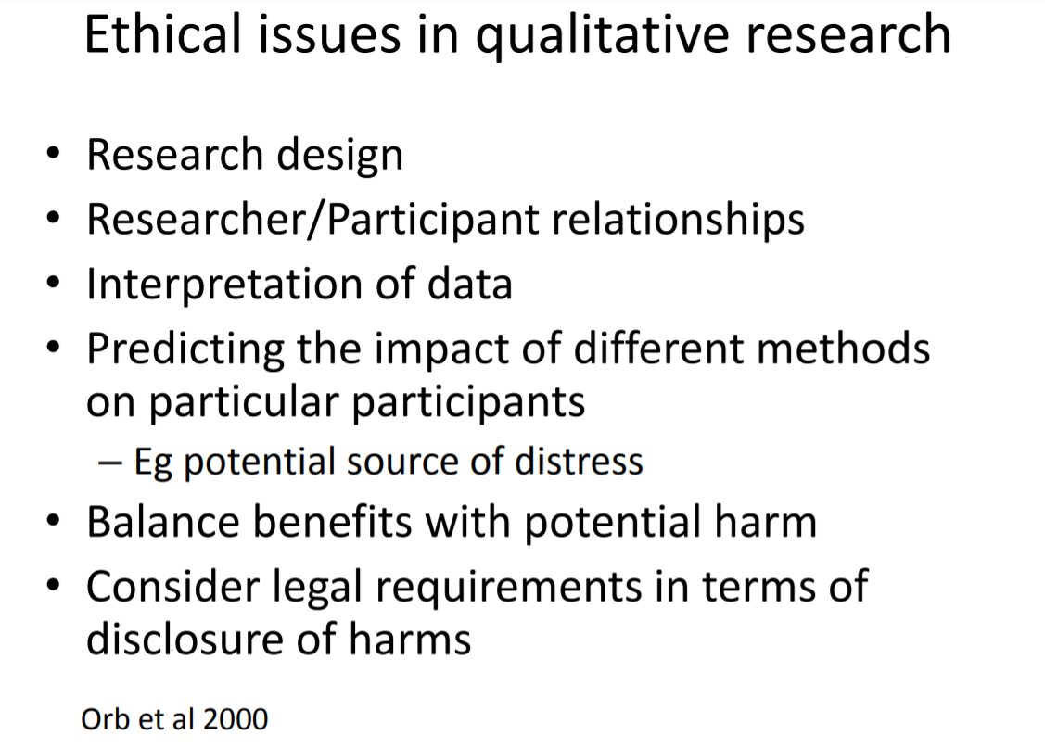

Slide 18
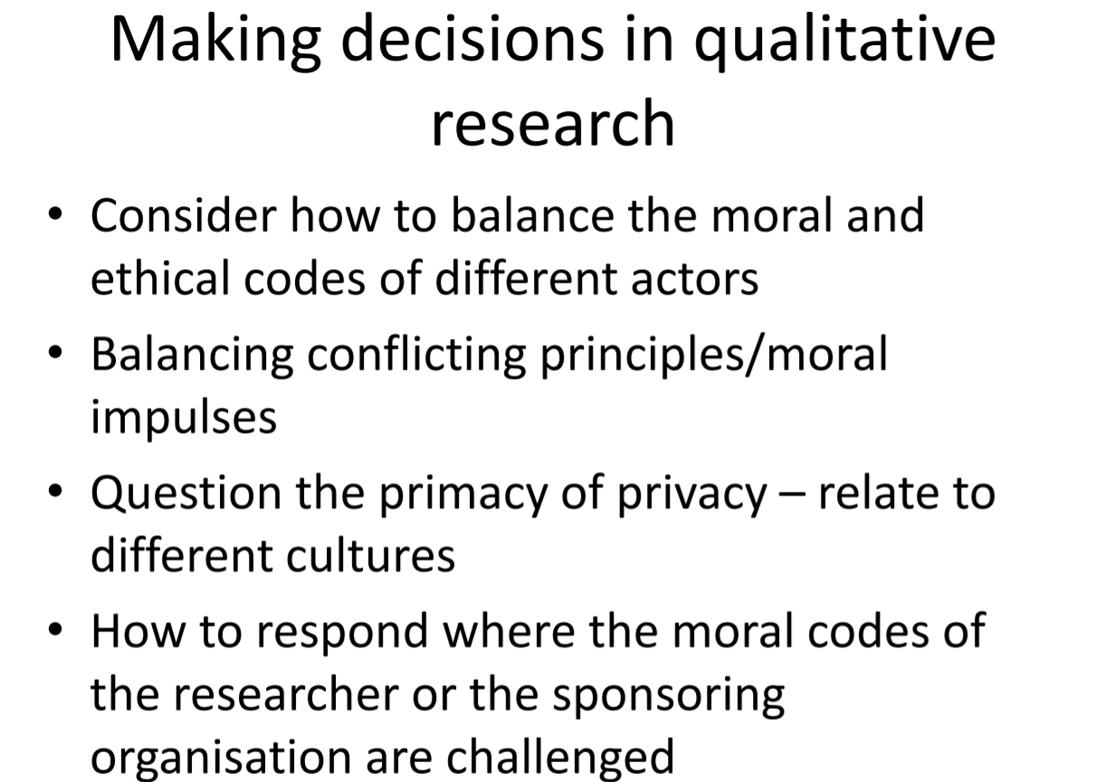

Slide 19
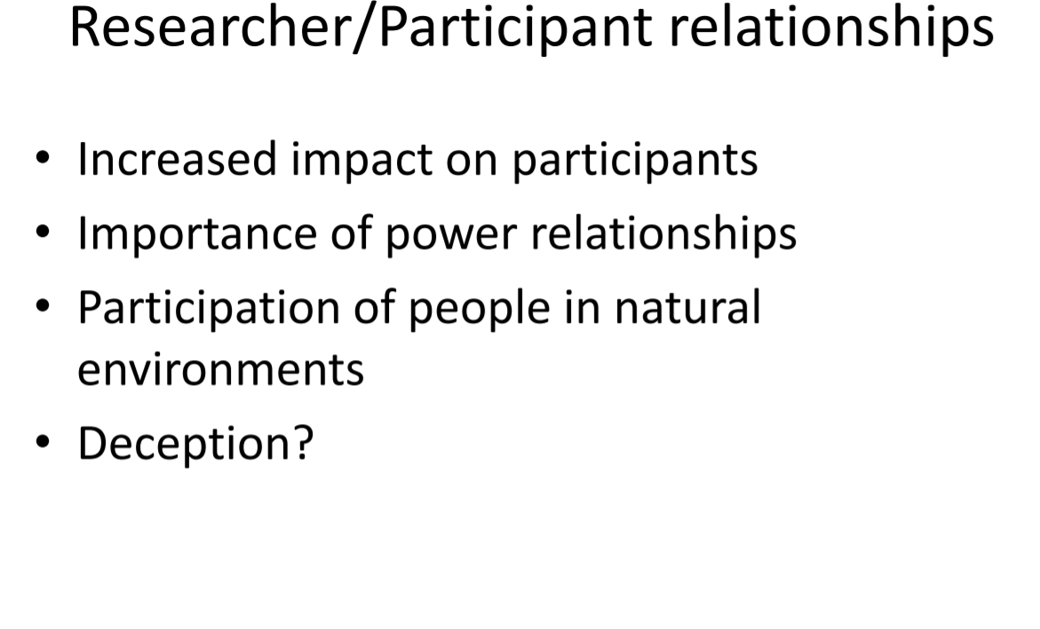

Slide 20
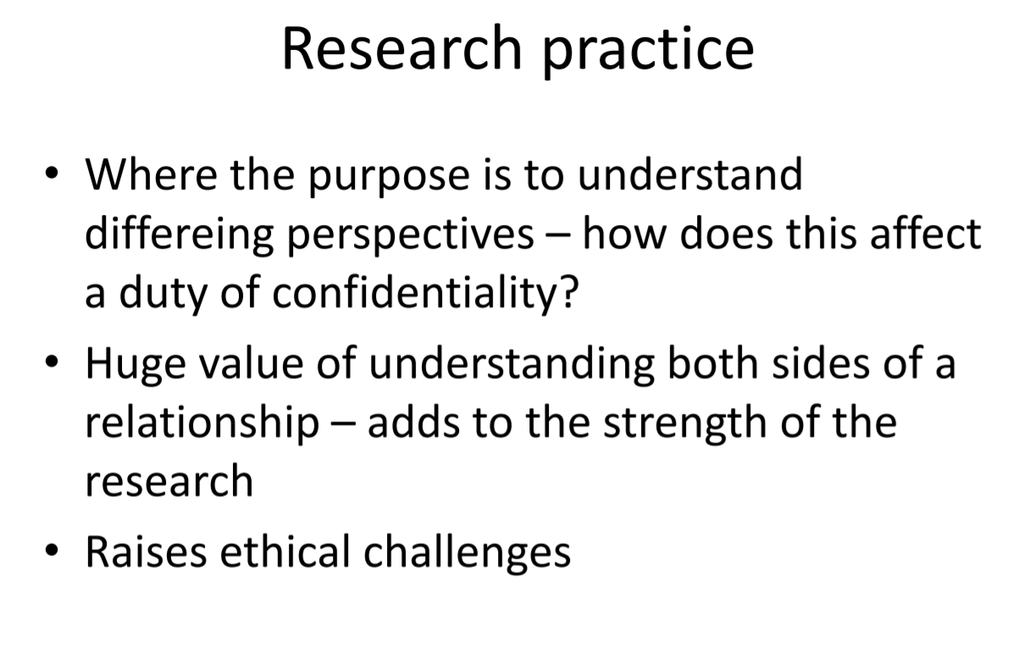

Slide 21
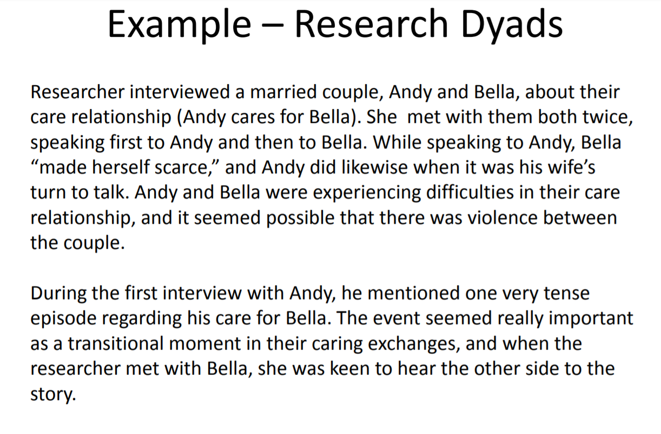

Slide 22
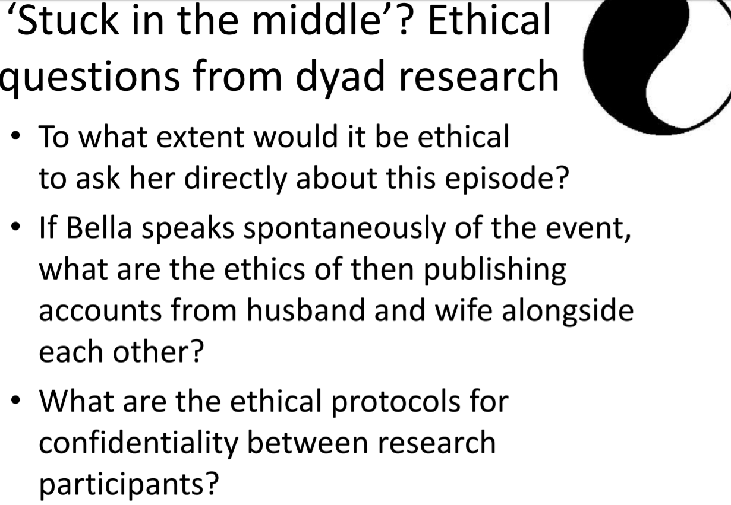

Slide 23
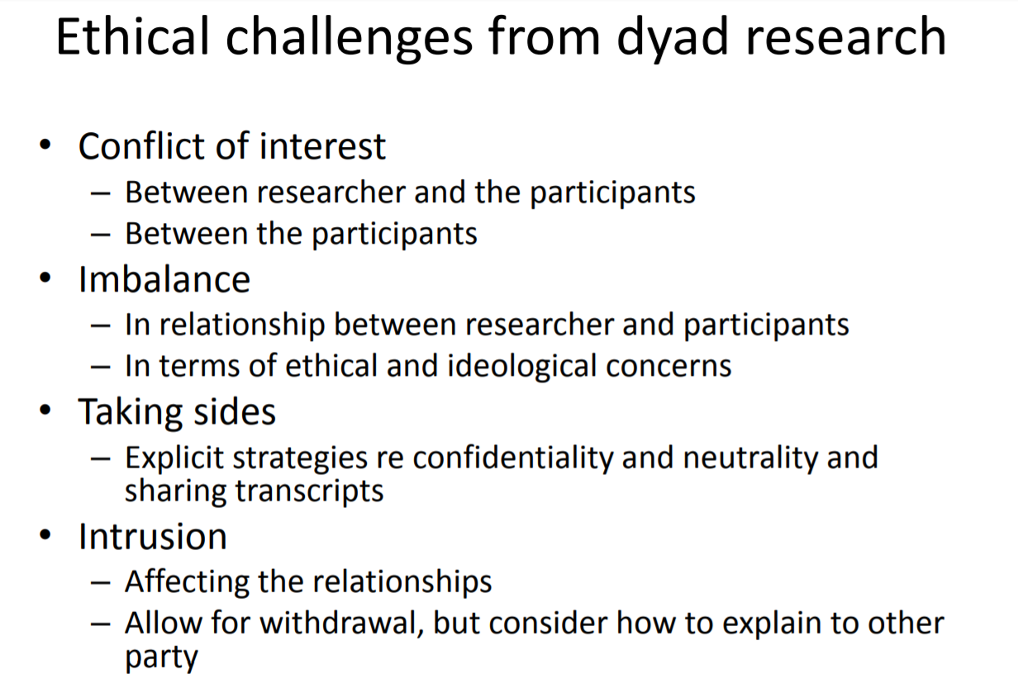

Slide 24
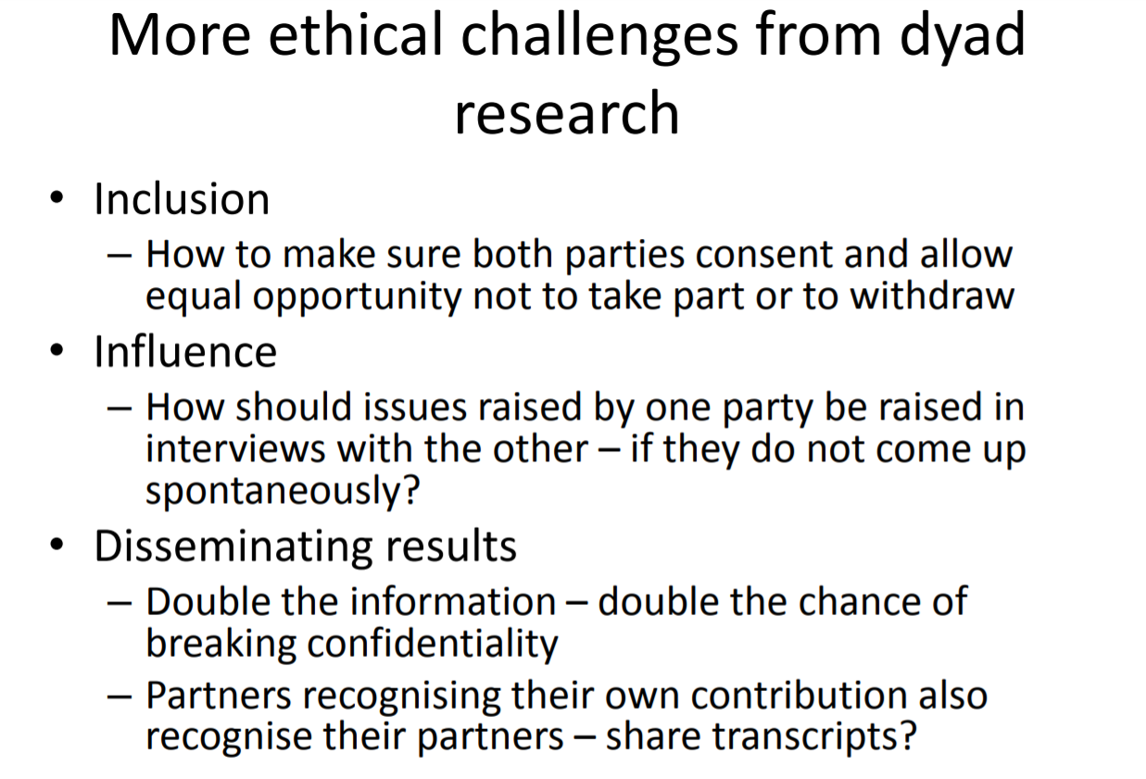

Slide 25
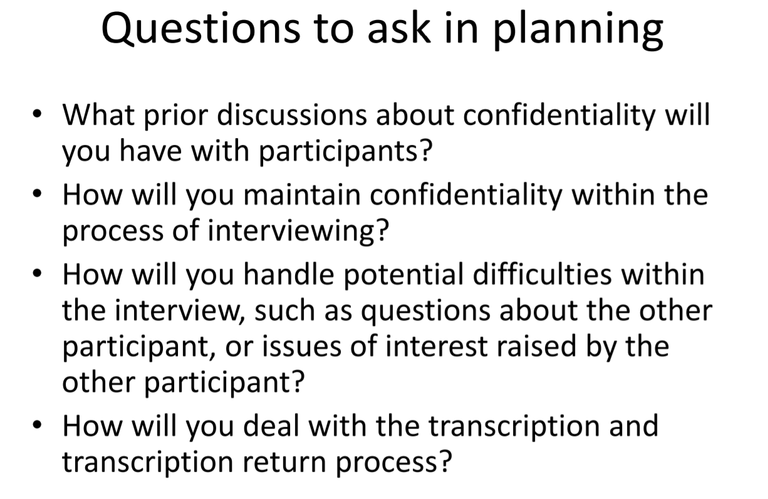

Slide 26
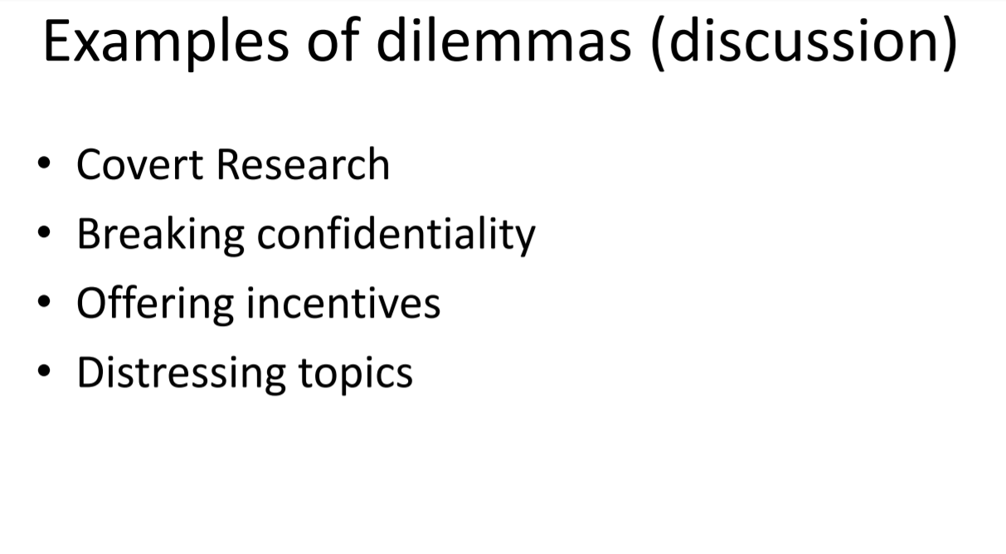

Slide 27
The Respect Project – www.respectproject.org/ethics
The Social Research Association – www.the-sra.org.uk
KCL Research Ethics – www.kcl.ac.uk/innovation/research/support/ethics/i ndex.aspx
Department of Health Research Governance Framework – www.dh.gov.uk
National Research Ethics Service (www.nres.nhs.uk)
Social Care Research Ethics Committee (www.screc.org.uk)
University Research Ethics Committees http://www.arec.org.uk/
National Offender Management Service (www.justice.gov.uk/publications/researchand-analysis/noms)

