Slide 1
Medieval Manuscript studies
Jordanne Gray

Slide 2
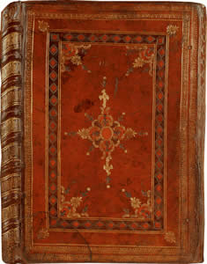
Introduction
This presentation discusses the Luttrell Psalter as part of the medieval manuscript studies.
This will pay attention to the different aspects and representations of the Luttrell Psalter as a significant example.

Slide 3
What is a psalter?
A Psalter is a prayer book filled with psalms. Psalters would have been written by a scribe using a quill on parchment made of vellum.
Illuminated Psalters would be illustrated with scenes from the bible, everyday life, plants, animals and sometimes grotesque beings.
The 309-page Psalter (618 pages) has attributed to numerous different collaborators. The initial texts of this manuscript starts with a large number of calendars before the beginning of the Psalms.
The Psalms itself is art which has used the scenes of historical abbreviations, peripheral illustrations, and several other scenes of medieval life and local agriculture (Camille, 2013).

Slide 4
Overview and background
The Luttrell Psalter was commissioned by Lord Geoffrey Luttrell.
It is said that the Luttrell Psalter was worked on by a singular scribe and at least five artists. Most medieval manuscripts were produced by more than one person.
Several diverse colors of ink are generously used to draw the order of rural agriculture and many grotesque images.
Luttrell Psalter was produced in the rural domain which was managed by the local Luttrell family in the memorial in Irnham Parish.

Slide 5
Components and aspects
Luttrell Psalter was commissioned by and for Sir Geoffrey Luttrell as a devotional book and a record of his life.
Sir Geoffrey's work shows a productive practice of gold ink which exhibits his status as a royal aristocracy in terms of the entire manuscript.
The illustrations in The Luttrell Psalter are very detailed. The artists of The Luttrell Psalter seems to even be concerned with facial expression, hair and fashion.
One of the few surviving manuscripts which explains life in England in the middle ages.
The documentation of what happened on the Luttrell’s estate acts as a calendar. The pages show month by month what would have happened on the Luttrell’s estate.

Slide 6
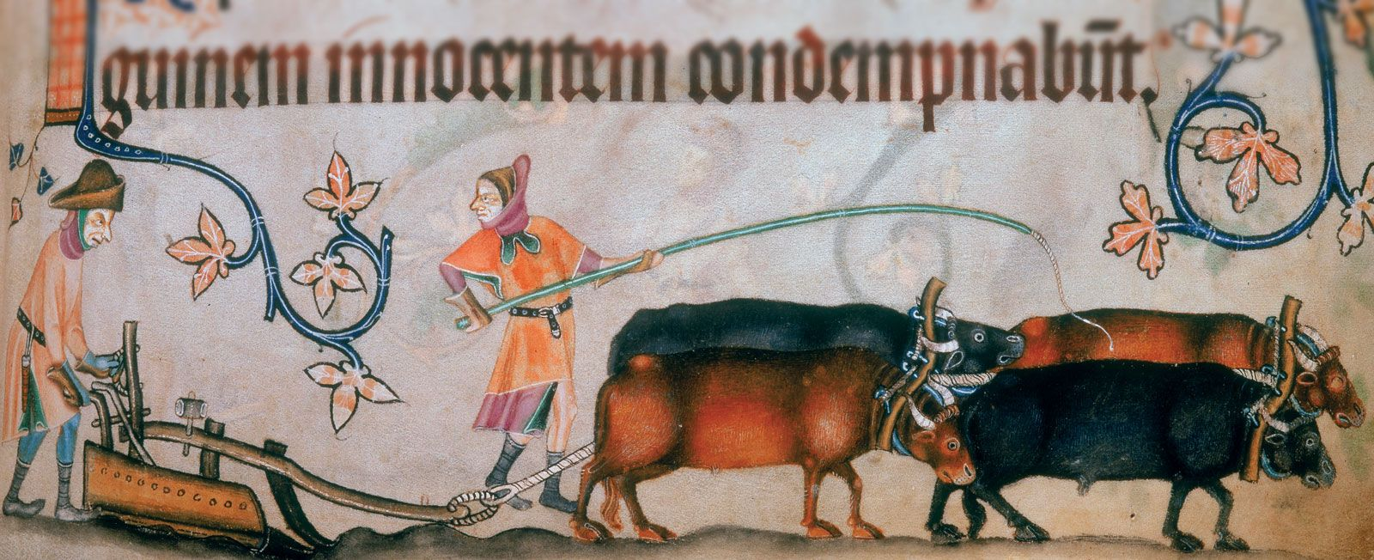
Scenes of everyday life
The depiction of the ploughman is one of many images that gives great detail into how harvesting worked in the middle ages.
The plough is drove by four oxen. The peasants are using an iron ploughshare to break up hard soil.
The Luttrell Psalter highlights the importance of the harvest. Everyone on the Luttrell families estate would have relied on the success of the harvest.
The Luttrell Psalter paints an unrealistic depiction of what peasants would be wearing at the time
The individuals that are ploughing are seen in finer clothing than they would have actually worn. Their tunics are vibrant in colour, one can be seen wearing a fancy multi-coloured headdress and a black belt with a buckle.
Peasants would have worn that would have been hand spun and made by the wool from the sheep that they tended.
This could be due to the artists desire to exaggerate the wealth of the Luttrell family and their whole estate
From the Luttrell Psalter

Slide 7
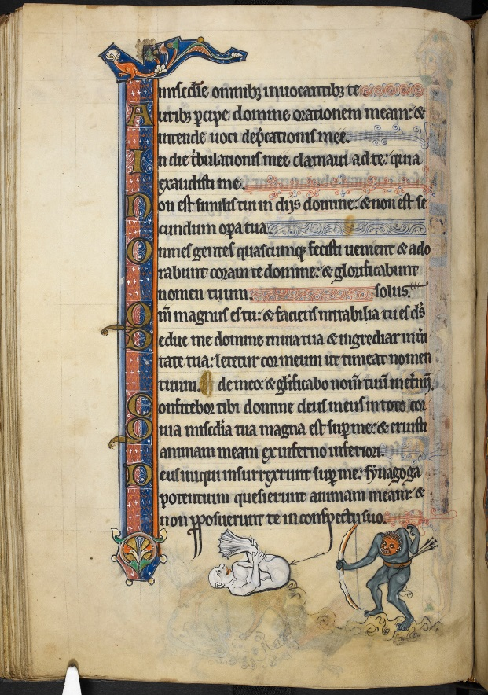
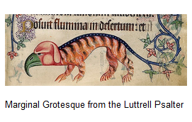
Medieval monsters
This script had been the very large official gothic book with its highest quality in contradiction with the graphic visual images and lurid colors of the grotesques (Catholic Church and Millar, 1932).
Creatures with human features on animal bodies and distorted figures linger in the margins of the Psalter
The Luttrell Psalter is not alone with its monsters, this can be seen also in the Rutland Psalter.
In the middle ages, people had an extremely literal belief in heaven and hell. The monstrosities can be seen as a reminder of what lingers in hell. Also, it is thought that creatures like the ones seen in the Luttrell Psalter were actually thought to exist in unexplored lands in the middle ages.
From the Rutland Psalter
From the Luttrell Psalter

Slide 8
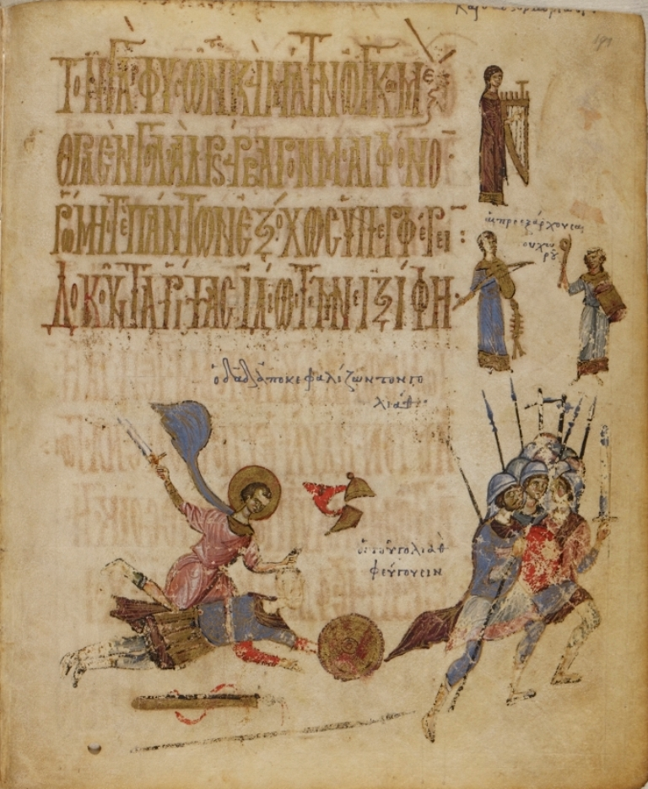
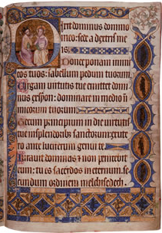
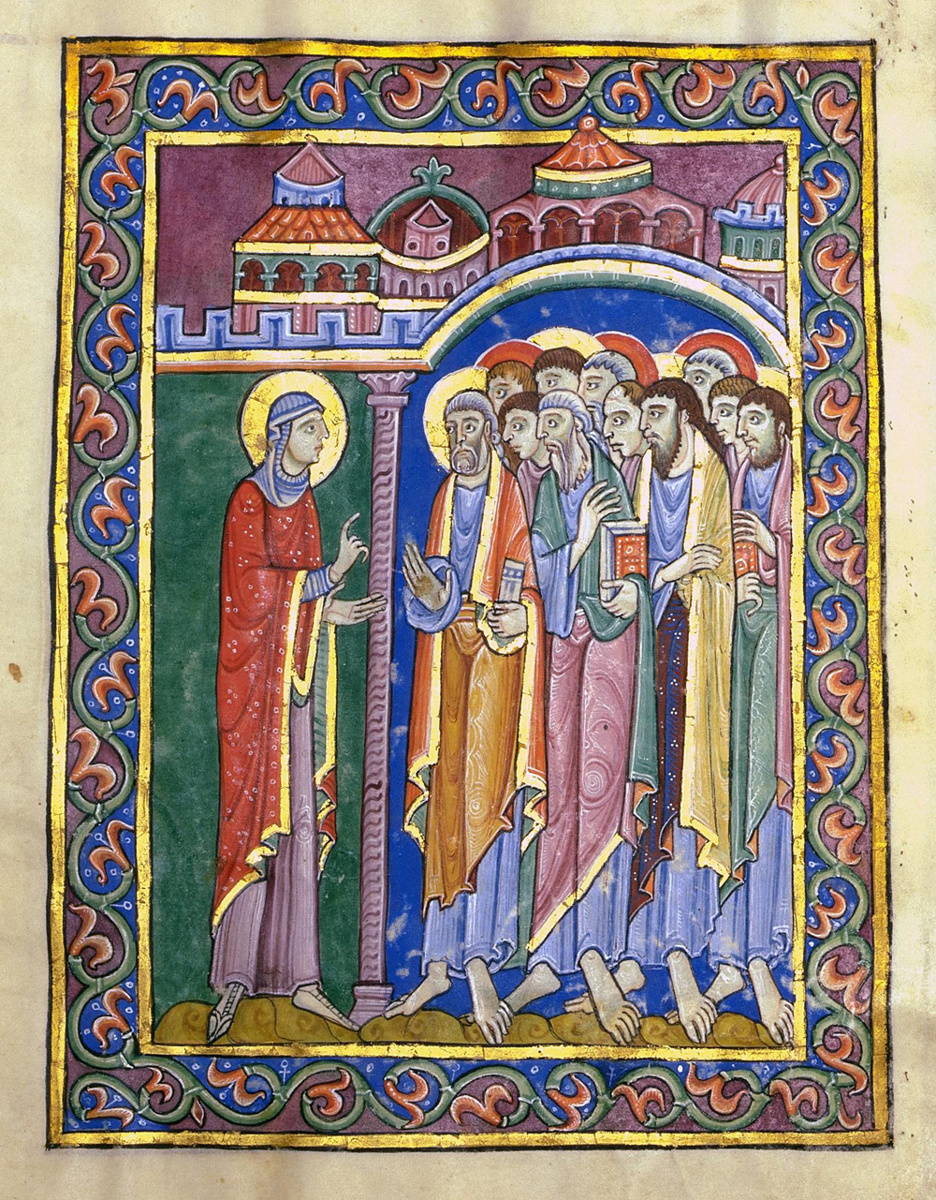
Comparisons
Detail
The intricate detail, the richness of colour and the use of gold and silver attribute to why the Luttrell Psalter is so highly regarded.
The Byzantine Psalter shows a contrast in illuminations.
The Byzantine Psalter has not got as much colour and detail in its illustrations.
Marginalised or full-page
Both The Luttrell Psalter and the Byzantine Psalter are decorated marginally.
Full page miniatures can be found within the St. Albans Psalter.
St Albans Psalter is filled with extravagant, Romanesque decoration.
From the Byzantine Psalter
From the Luttrell Psalter
From St. Albans Psalter

Slide 9
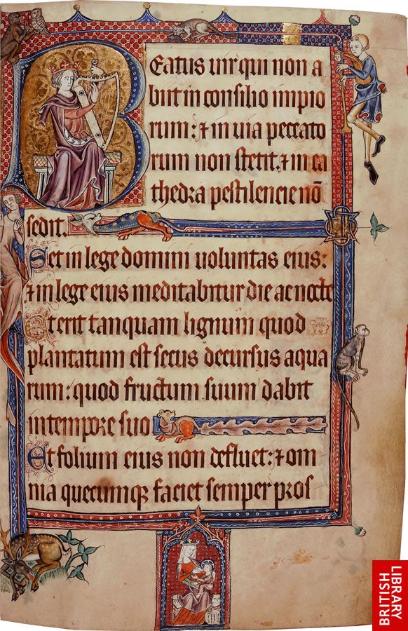
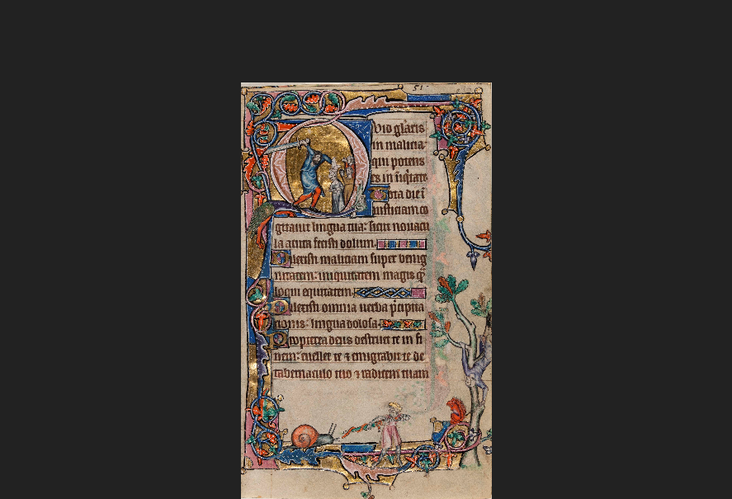
Comparisons
Historiated Initials
Historiated initials are a common feature of medieval psalters.
A historiated initial is an enlarged letter often found at the beginning of Psalters and contains a picture within it.
The artists have included historiated initials within the Luttrell Psalter. King David can be found in the initial of the first psalm, playing a harp.
Examples of historiated initials being used outside the Luttrell Psalter is within the Macclesfield Psalter. Doeg is seen killing the priest of Nob.
From the Luttrell Psalter
From the Macclesfield Psalter

Slide 10
References
Backhouse, Janet, The Luttrell Psalter (London: British Library, 1989)
Backhouse, Janet, Medieval rural life in the Luttrell Psalter. (University of Toronto Press, 2000)
Camille, M., Mirror in Parchment: the Luttrell Psalter and the making of medieval England. (Reaction Books, 2013)
Catholic Church, & Millar, E. G. The Luttrell Psalter (1932)
Geddes, Jane, The St Albans Psalter: a book for Christina of Markyate (London: British Library, 2005)
Kathleen Corrigan, Visual Polemics in the Ninth-Century Marginal Psalters (Cambridge, 1992)
Panavotova, Stella, The Macclesfield Psalter (Cambridge, 2008)

