Slide 1
Online Library: Basic Skills
Getting Started!
Ellie Downes
Academic Liaison Librarian
Library & Learning Resources

Slide 2

Students who use library resources outperform those who don’t…

Slide 3

What you’ll learn today…
How to navigate the library website
What’s in the Online Library?
What is a journal?
Identifying & evaluating different types of resources
How to search the library catalogue
Setting up alerts & building your e-shelf
How to find & access e-books
Need more?
Where & who to ask for help!

Slide 4

Navigating the library website
Catalogue
Online library
Access your account
Contact information
Opening hours
Library guide
Services
Report a problem
http://uwtsd.ac.uk/library/

Slide 5

The Online Library includes…
Library catalogue
Specialist databases
E-Books
Full-text Journals
Full-text newspapers
And much more…!

Slide 6

But did you know you can also…
Build a personalised e-shelf
Receive publication alerts
Save favourite resources
Access your search history
View citation help
Access resources from your mobile device

Slide 7




The benefits of your UWTSD Online Library…

Slide 8
Different types of Information
JOURNALS
TECHNICAL PAPERS
COMPANY REPORTS
STANDARDS
BOOKS
LEGISLATION
CONFERENCE PROCEEDINGS
NEWSPAPERS
INDUSTRY REPORTS
STATISTICS
Video – What is a journal?

Slide 9

Evaluating Information
Currency (Is it up-to-date?)
Relevance (Who is the intended audience?)
Authority (What are the author’s credentials?)
Accuracy (Can the information be verified?)
Purpose (Is the information objective/impartial?)

Slide 10

Library Catalogue
Our version of Compare-the-market.com!
Search print & online
Set alerts
Save to e-shelf
Create folders
Add notes
My Account
http://librarycatalogue.uwtsd.ac.uk

Slide 11

Finding and accessing E-books
Many core texts are available as e-books
24/7 multiple user access
View in browser or download
Contents search by keyword
Locate them via the catalogue…
…or via online library/e-books/search
http://www.uwtsd.ac.uk/library/online-library/e-books/

Slide 12

Need More?
Can’t find what you need
Need advice
Book an appointment
Request a resource
Report a fault
Borrowing schemes
http://www.uwtsd.ac.uk/library/library-guide/need-more/

Slide 13

Information on the move
Our library catalogue and other databases are mobile friendly
E-Books can be downloaded onto mobile devices
Some useful apps are also available
Access library resources when and where it’s most convenient for you!

Slide 14
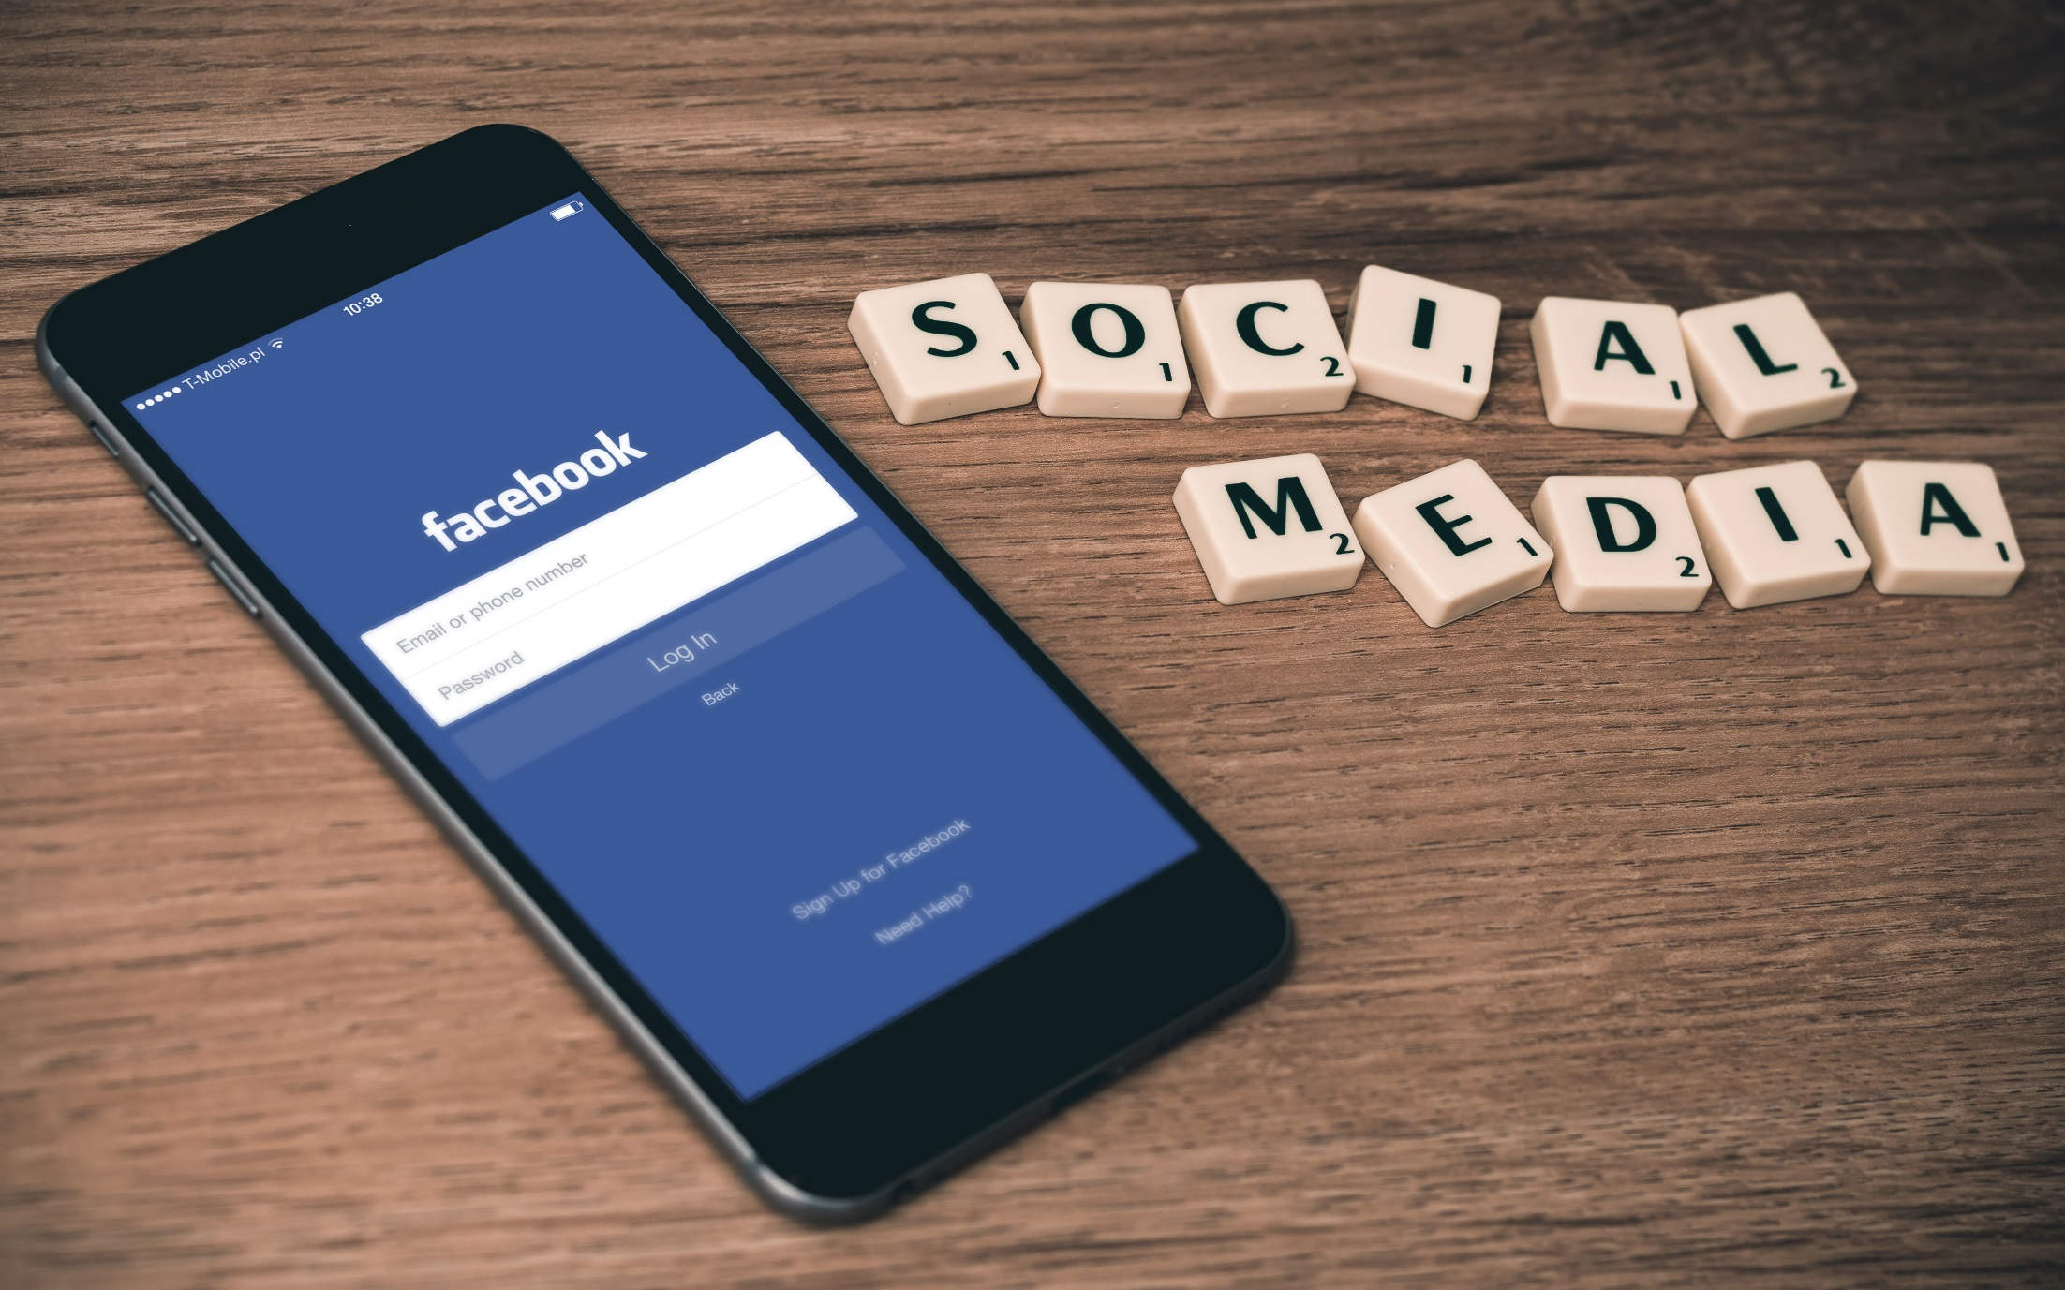


Get social…
Follow us to find out what’s new…
Share what you’re reading!
@UWTSDLib

Slide 15

Further sessions coming soon…!
Basic referencing skills
Advanced skills – Specialist Databases
Pop-Up Libraries

Slide 16
For More information
Please contact your Academic Liaison Librarian:
Faculty of Art and Design
Emily Hywel
emily.hywel@uwtsd.ac.uk
Faculty of Architecture, Computing and Engineering
Samantha Scoulding
samantha.scoulding@uwtsd.ac.uk
Faculty of Business and Management
Ellie Downes
e.downes@uwtsd.ac.uk
Faculty of Education and Communities
Alison Evans
alison.evans@uwtsd.ac.uk
Faculty of Humanities and Performing Arts
Rachael Whitfield

