Slide 1
Research Methods & Data Analysis
Lecture 5:Linear Regression

Slide 2
Introduction
Today we’ll look at
  Regression Equations
  Standard Error of the Estimate
To this point we have looked at the properties of data – describing its size and shape, and whether variables are related to each other
Now we can go on to start using that data to make predictions

Slide 3
Introduction
A prediction is simply a best guess at the value of something
We aim to make the prediction good enough that the difference between the value we predict and the actual value is as small as possible
If we have no further information about a value then the best guess we can make is that it will equal the mean value
  If I want to predict Bob’s score on a test and I know that the mean score for students like Bob who take that test is 50, I can predict that Bob’s score will also be 50
Over lots of predictions, predicting that someone’s score will equal the mean gives you a good chance of getting close to a correct answer
A better prediction can be made if we have more information

Slide 4
Introduction
Suppose we also know that there is a strong positive correlation between scores in test X and test Y
  People who score high in X tend to score high in Y, while people who score low in X tend to score low in Y
This allows us to improve our prediction
  If Bob scored 70 in test X we might predict that he will score 70 in test Y
  If Bob scored 30 in test X we might predict that he will score 30 in test Y
When two variables are correlated it is possible to use a regression equation to predict with greater than chance accuracy the score on one variable given the score on the other variable
The higher the correlation, the better the prediction will be
If the correlation is low then the prediction will be closer to chance

Slide 5
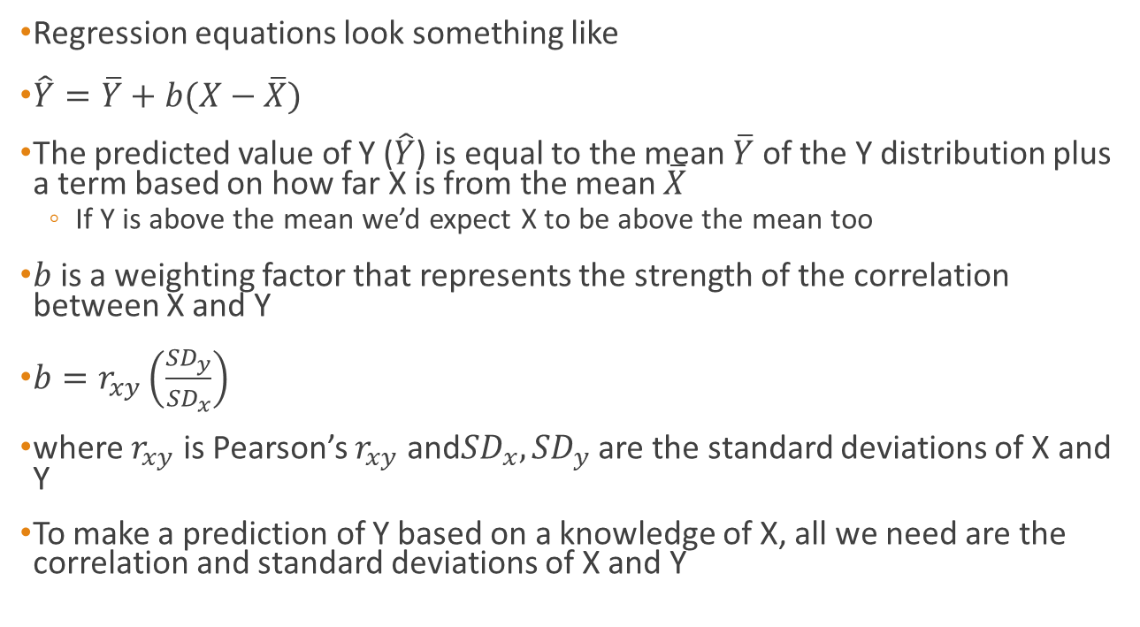
Regression Equations
Regression equations look something like
$\hat{Y}=\overline{Y}+b(X−\overline{X})$
The predicted value of Y ($\hat{Y}$) is equal to the mean $\overline{Y}$ of the Y distribution plus a term based on how far X is from the mean $\overline{X}$
  If Y is above the mean we’d expect X to be above the mean too
$b$ is a weighting factor that represents the strength of the correlation between X and Y
$b=r_{xy}\left(\frac{{SD}_{y}}{{SD}_{x}}\right)$
where $r_{xy}$ is Pearson’s $r_{xy}$ and${SD}_{x}, {SD}_{y}$ are the standard deviations of X and Y
To make a prediction of Y based on a knowledge of X, all we need are the correlation and standard deviations of X and Y

Slide 6
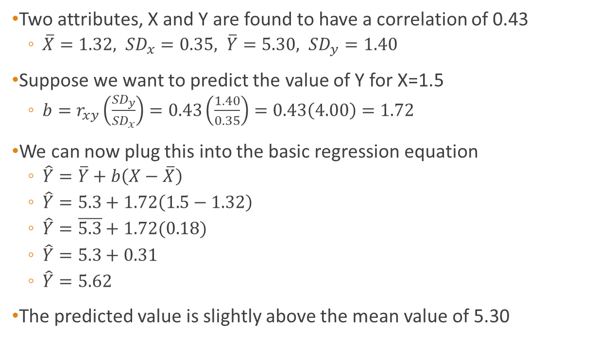
Example
Two attributes, X and Y are found to have a correlation of 0.43
  $\overline{X}=1.32, {SD}_{x}=0.35, \overline{Y}=5.30, {SD}_{y}=1.40$
Suppose we want to predict the value of Y for X=1.5
  $b=r_{xy}\left(\frac{{SD}_{y}}{{SD}_{x}}\right)=0.43\left(\frac{1.40}{0.35}\right)=0.43\left(4.00\right)=1.72$
We can now plug this into the basic regression equation
  $\hat{Y}=\overline{Y}+b\left(X−\overline{X}\right)$
  $\hat{Y}=5.3+1.72\left(1.5−1.32\right)$
  $\hat{Y}=\overline{5.3}+1.72(0.18)$
  $\hat{Y}=5.3+0.31$
  $\hat{Y}=5.62$
The predicted value is slightly above the mean value of 5.30

Slide 7

Problem
Two attributes, X and Y are found to have a correlation of 0.43
$\overline{X}=1.32, {SD}_{x}=0.35, \overline{Y}=5.30, {SD}_{y}=1.40$
Suppose we want to predict the value of Y for X=0

Slide 8
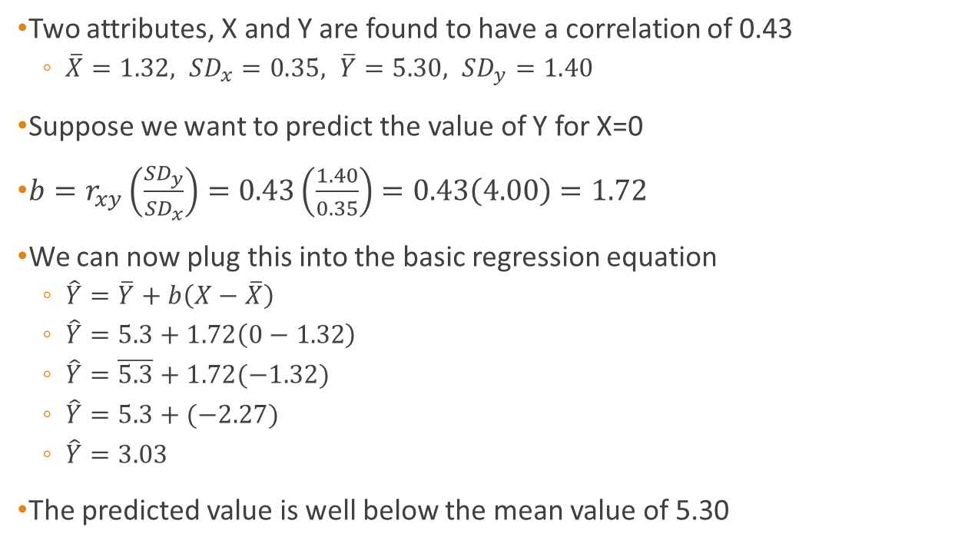
Problem
Two attributes, X and Y are found to have a correlation of 0.43
  $\overline{X}=1.32, {SD}_{x}=0.35, \overline{Y}=5.30, {SD}_{y}=1.40$
Suppose we want to predict the value of Y for X=0
$b=r_{xy}\left(\frac{{SD}_{y}}{{SD}_{x}}\right)=0.43\left(\frac{1.40}{0.35}\right)=0.43\left(4.00\right)=1.72$
We can now plug this into the basic regression equation
  $\hat{Y}=\overline{Y}+b\left(X−\overline{X}\right)$
  $\hat{Y}=5.3+1.72\left(0−1.32\right)$
  $\hat{Y}=\overline{5.3}+1.72(−1.32)$
  $\hat{Y}=5.3+(−2.27)$
  $\hat{Y}=3.03$
The predicted value is well below the mean value of 5.30

Slide 9
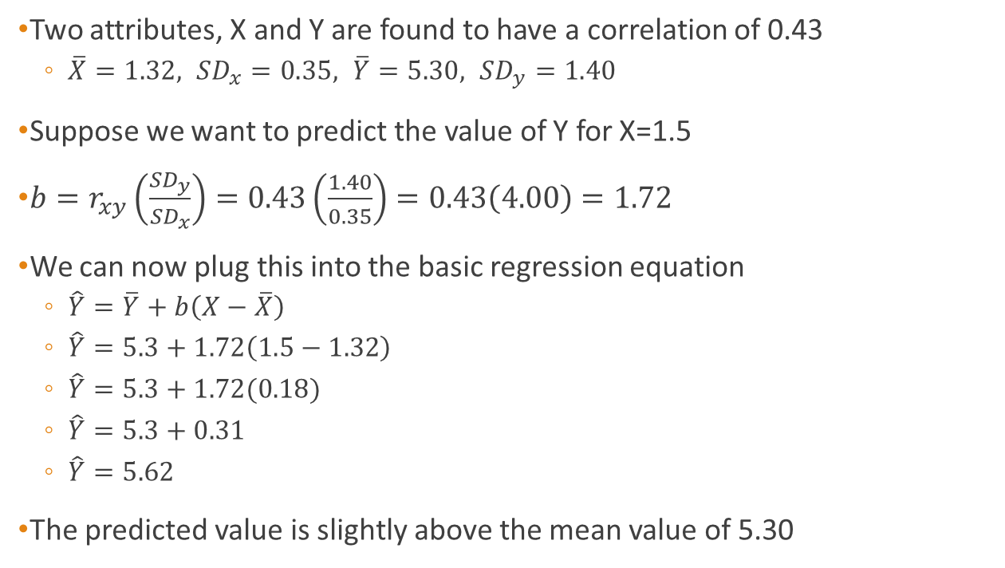
Example
Two attributes, X and Y are found to have a correlation of 0.43
  $\overline{X}=1.32, {SD}_{x}=0.35, \overline{Y}=5.30, {SD}_{y}=1.40$
Suppose we want to predict the value of Y for X=1.5
$b=r_{xy}\left(\frac{{SD}_{y}}{{SD}_{x}}\right)=0.43\left(\frac{1.40}{0.35}\right)=0.43\left(4.00\right)=1.72$
We can now plug this into the basic regression equation
  $\hat{Y}=\overline{Y}+b\left(X−\overline{X}\right)$
  $\hat{Y}=5.3+1.72\left(1.5−1.32\right)$
  $\hat{Y}=5.3+1.72(0.18)$
  $\hat{Y}=5.3+0.31$
  $\hat{Y}=5.62$
The predicted value is slightly above the mean value of 5.30

Slide 10
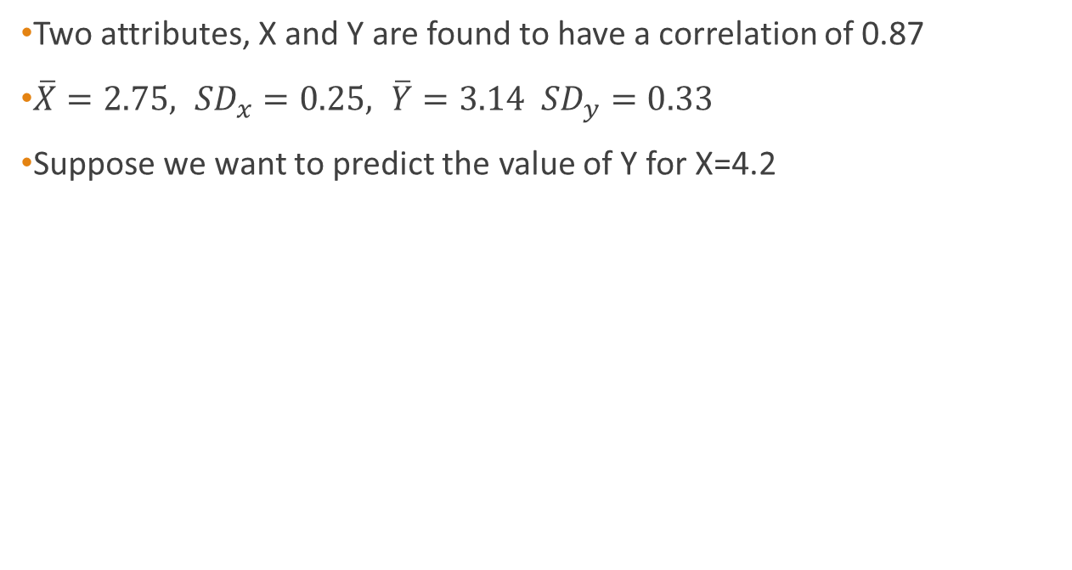
Problem
Two attributes, X and Y are found to have a correlation of 0.87
$\overline{X}=2.75, {SD}_{x}=0.25, \overline{Y}=3.14 {SD}_{y}=0.33$
Suppose we want to predict the value of Y for X=4.2

Slide 11
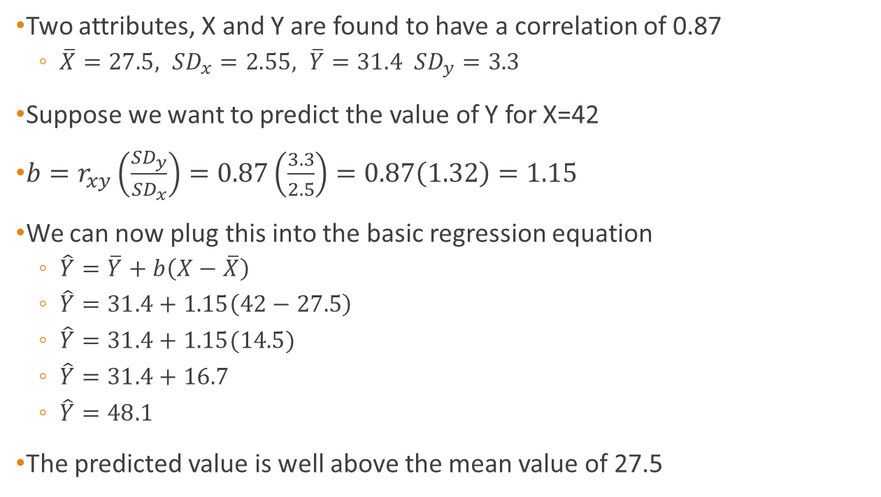
Problem
Two attributes, X and Y are found to have a correlation of 0.87
  $\overline{X}=27.5, {SD}_{x}=2.55, \overline{Y}=31.4 {SD}_{y}=3.3$
Suppose we want to predict the value of Y for X=42
$b=r_{xy}\left(\frac{{SD}_{y}}{{SD}_{x}}\right)=0.87\left(\frac{3.3}{2.5}\right)=0.87\left(1.32\right)=1.15$
We can now plug this into the basic regression equation
  $\hat{Y}=\overline{Y}+b\left(X−\overline{X}\right)$
  $\hat{Y}=31.4+1.15\left(42−27.5\right)$
  $\hat{Y}=31.4+1.15(14.5)$
  $\hat{Y}=31.4+16.7$
  $\hat{Y}=48.1$
The predicted value is well above the mean value of 27.5

Slide 12
Graphical interpretation
Note that although we’ve made a prediction, we’re not likely to be exactly right
  We just want to be closer than chance
We are effectively fitting a line through our correlated data and making a prediction along that line
Y
X

Slide 13
Standard error
How likely is it that we are going to be correct in our prediction?
Suppose X and Y in the last question had been test scores
  If Bob got 42 on test Y will he definitely get 48 in test X? No
Because the correlation is based on numbers that are spread about a ‘best-fit’ line, it is likely that all of the people who were predicted to get 48 got a range of different scores
  They would form a normal distribution around 48 (mean of 48)
If they form a normal distribution then we can calculate the standard deviation of their distance from the mean
  This is called the standard error
About 68% of all people will fall between the standard error and the predicted value (mean ± 1 standard deviation)

Slide 14

Standard Error
The standard error is defined as
$σ_{est}=\left({SD}_{y}\sqrt{1−r_{xy}^{2}}\right)\sqrt{\frac{N−1}{N−2}}$
Where $σ_{est}$ is the standard error of the estimate, ${SD}_{y}$ is the standard deviation of Y, $r_{xy}^{2}$ is the square of the correlation coefficient, and $N$ is the number of pairs of observations
If $N$ is large then the term in $N$ is reduced to 1 and drops out of the equation
  “Large” is normally defined as greater than or equal to 30 ☺

Slide 15
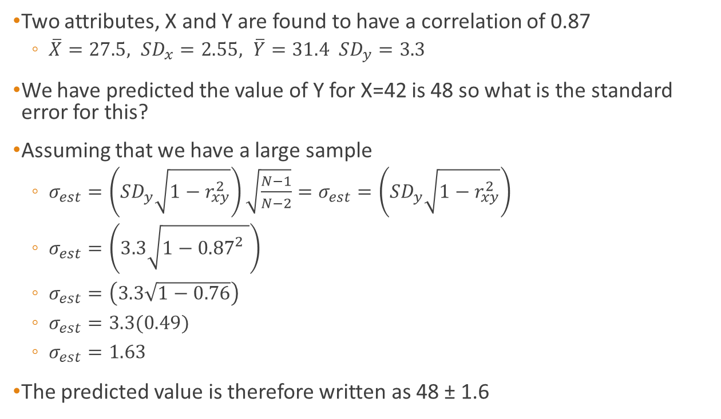
Standard Error
Two attributes, X and Y are found to have a correlation of 0.87
  $\overline{X}=27.5, {SD}_{x}=2.55, \overline{Y}=31.4 {SD}_{y}=3.3$
We have predicted the value of Y for X=42 is 48 so what is the standard error for this?
Assuming that we have a large sample
  $σ_{est}=\left({SD}_{y}\sqrt{1−r_{xy}^{2}}\right)\sqrt{\frac{N−1}{N−2}}=σ_{est}=\left({SD}_{y}\sqrt{1−r_{xy}^{2}}\right)$
  $σ_{est}=\left(3.3\sqrt{1−{0.87}_{}^{2}}\right)$
  $σ_{est}=\left(3.3\sqrt{1−0.76}\right)$
  $σ_{est}=3.3(0.49)$
  $σ_{est}=1.63$
The predicted value is therefore written as 48 ± 1.6

Slide 16
Problem
Suppose the average number of rats in a set of dockside warehouses is 57 per warehouse with an SD of 12, The average number of packages of rat poison purchased per warehouse per year is 4.2. The correlation between rats in warehouses and packages of rat poison purchased is 0.5
  Kleensite bought 12 packages of rat poison last year. How many rats would you predict are in their warehouse?
  SpicNSpan have 83 rats in their warehouse. What would be your best prediction of the number of packages of rat poison their bough over the last year?
  Remember to calculate the standard error as well as the predicted value

Slide 17
Summary
Topics covered
  Regression Equations
  Standard Error of the Estimate
Next week we will cover
  The Sampling Experiment
  Sample Values (statistics) and Population Values (Parameters)
  The Null Hypothesis
  Type I and Type II Errors
  Statistical Significance and Type I Errors
Inferential statistics allow us to make predictions based upon the sampling of a large population

Slide 18
Coming soon
Next session: Introduction to Inferential Statistics
Homework: Read chapter 9 of Statistics for the Terrified.

