Slide 1
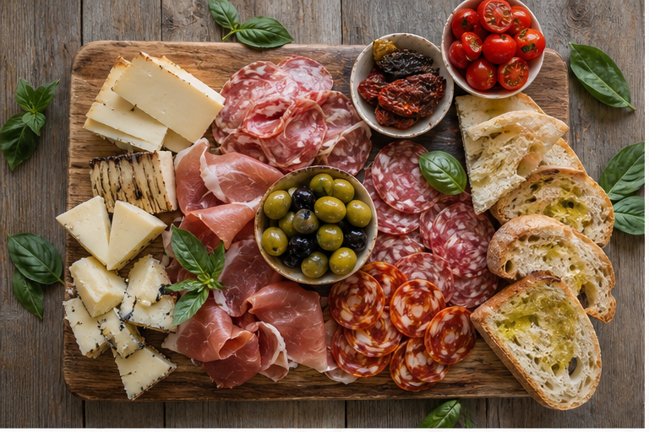
ANTIPASTO
FRESH
Business Plan Presentation
ENTERPRISE AND ENTREPRENEURSHIP
(LCLM4006.LON)
Student ID 2525854
London, United Kingdom
www.antipastofresh.co.uk
Fresh Italian food, made for everyday life.

Slide 2
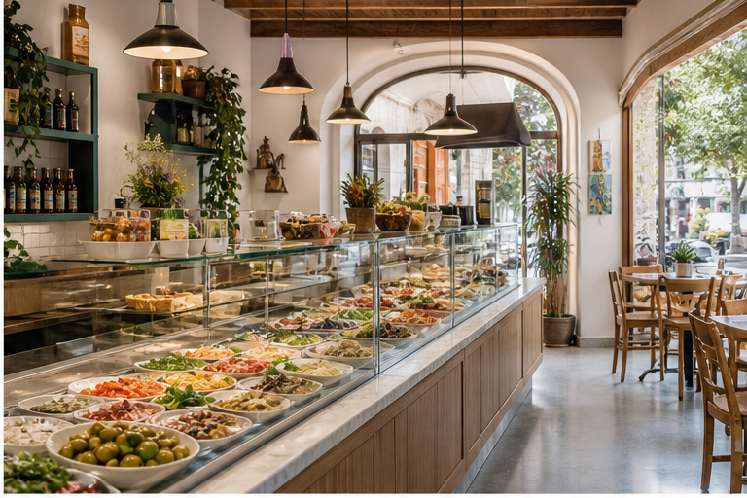
ANTIPASTO FRESH
A fresh Italian deli with a clear first-year plan
Antipasto Fresh will serve convenient, authentic Italian food from a small London deli in Zone 3 or 4.
Fresh antipasto, salads, bread and drinks
Local residents, students, office workers and tourists
Simple service: in-store, takeaway and online promotion
£10.000
£84,400
START-UP
YEAR 1 SALES
www.antipastofresh.co.uk
02

Slide 3
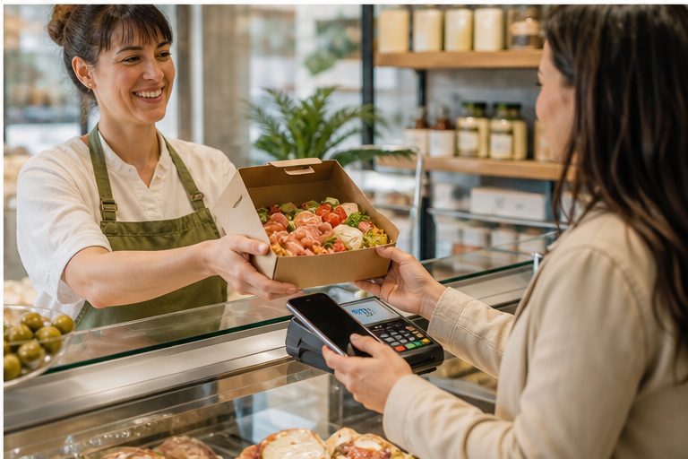
ANTIPASTO FRESH
Quality, convenience and friendly service define the offer
Mission
To provide fresh, authentic Italian antipasto at affordable prices with excellent customer service.
Vision
To build a trusted local brand and a loyal customer base in London.
Fresh
Authentic
Affordable
www.antipastofresh.co.uk
03

Slide 4
ANTIPASTO FRESH
A focused menu makes the business easy to understand
CHEESE
MEATS
Italian cheeses
Prosciutto & salami
SIDES
BAKERY
Olives & salads
Artisan bread
DRINKS
BOXES
Cold drinks
Takeaway platters
Average selling price: £11 per item
www.antipastofresh.co.uk
04

Slide 5
ANTIPASTO FRESH
Four customer groups support steady local demand
35%
LOCAL RESIDENTS
Fresh meals close to home
30%
OFFICE WORKERS
Quick lunch and takeaway
20%
STUDENTS
Affordable, convenient food
15%
TOURISTS
Authentic Italian flavours
The mix reduces reliance on one type of customer.
www.antipastofresh.co.uk
05

Slide 6
ANTIPASTO FRESH
External risks are manageable with simple actions
POLITICAL
ECONOMIC
SOCIAL
Follow UK food rules
Control food costs
Offer fresh choices
TECHNOLOGY
ENVIRONMENT
LEGAL
Use website and POS
Reduce waste
Train staff safely
Result: follow the law, control costs and use technology to grow safely.
www.antipastofresh.co.uk
06

Slide 7
ANTIPASTO FRESH
Digital promotion and local offers will build awareness
WEBSITE
Menu, location and contact
SOCIAL MEDIA
Instagram and Facebook
LAUNCH OFFERS
Trial and first visits
LOYALTY
Encourage repeat customers
Marketing budget: £2,000 in Year 1
www.antipastofresh.co.uk
07

Slide 8
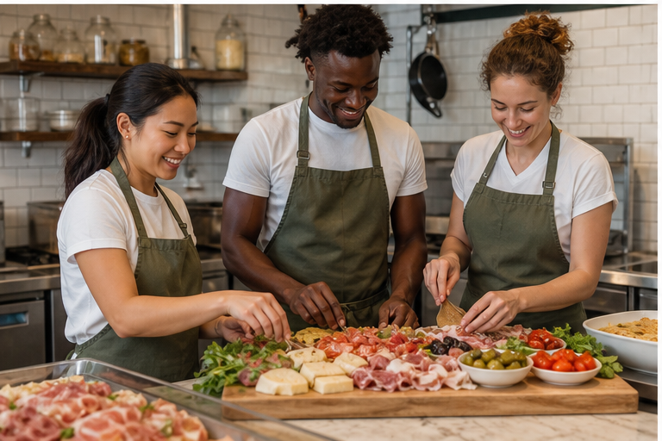
ANTIPASTO FRESH
A lean team keeps responsibilities clear
OWNER / MANAGER
CHEF
SALES ASSISTANT
MARKETING ASSISTANT
KITCHEN ASSISTANT
External accountant supports finance and tax.
www.antipastofresh.co.uk
08

Slide 9
ANTIPASTO FRESH
The plan targets a modest £7,000 first-year profit
£84,400
£77,400
£7,000
£10,000
ANNUAL SALES
TOTAL EXPENSES
ESTIMATED PROFIT
START-UP COST
Funding mix
Personal savings
£10,000
Bank loan
£2,000
Family investment
£2,000
Government grant
£1,000
www.antipastofresh.co.uk
09

Slide 10
ANTIPASTO FRESH
Sales build gradually and peak during December
£84,400
TOTAL YEAR 1 SALES
Forecast based on an average £11 spend and growing customer awareness.
www.antipastofresh.co.uk
10

Slide 11
ANTIPASTO FRESH
Cash turns positive as sales grow through the year
£84,400
CASH IN
£77,400
CASH OUT
£7,000
NET CASH FLOW
www.antipastofresh.co.uk
11

Slide 12
ANTIPASTO FRESH
The business breaks even at about 6,448 items
£37,400
£11.00
£5.20
£5.80
FIXED COST
AVERAGE PRICE
VARIABLE COST
CONTRIBUTION
£37,400 ÷ (£11.00 − £5.20)
≈ 6,448 items per year
After this point, each additional sale contributes to profit.
www.antipastofresh.co.uk
12

Slide 13
ANTIPASTO FRESH
The opportunity is attractive, but cost control is essential
STRENGTHS
WEAKNESSES
Fresh food
Authentic flavours
Friendly service
New brand
Small first-year profit
Limited team
OPPORTUNITIES
THREATS
Online orders
Healthy food demand
Catering boxes
Food inflation
Strong competition
Higher rent and bills
www.antipastofresh.co.uk
13

Slide 14
CONCLUSION
Antipasto Fresh has a realistic path to launch and grow
Clear offer for a broad local market
£10,000 start-up funding is fully identified
£84,400 sales support a £7,000 first-year profit
Next step: secure the location and complete registration
Thank you — Questions?
Key references
www.antipastofresh.co.uk
Kotler, P. and Keller, K.L. (2016) Marketing Management, 15th Global edn. Pearson.
GOV.UK — Set up a business. Food Standards Agency — Food safety for businesses.
www.antipastofresh.co.uk
14

