Slide 1
Study Skills
In this presentation I will be talking about study skills helpful for future employment.
Notes:
This presentation will hopefully help you have a better understanding of study skills and what they can be used for. I will be focusing on 3 study skills specifically in this presentation which I believe can be useful in future employment for me.

Slide 2
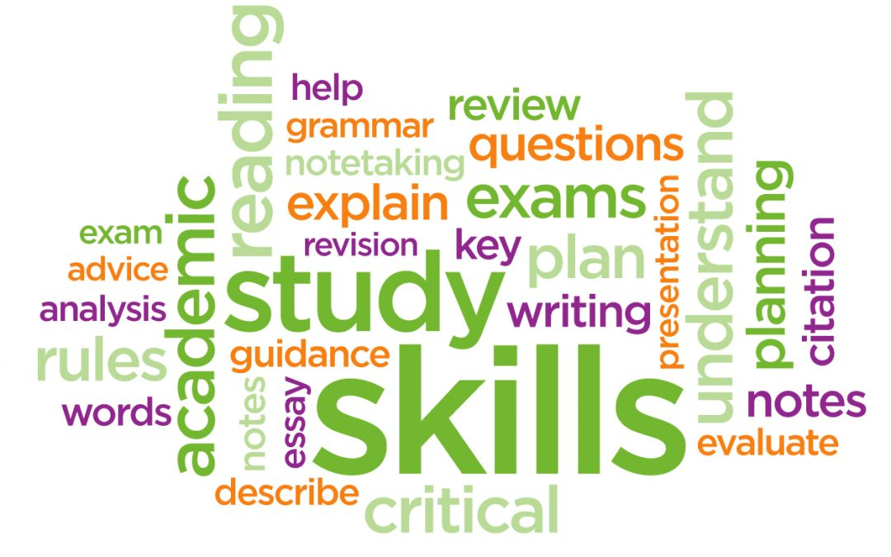
Types of Study skills
Research Skills
Thinking Skills
Reflective Skills
Writing Skills
Communication Skills
Time and Task management
Team Building
( Fick,E , 2017)
(Cottrell,S, 2019, PP.22&23
Notes:
Study skills are very important skills to obtain, throughout your life. Mosts study skills are helpful and useful throughout education especially higher education such as university but they can also be used after education and into employment. There are many types of study skills that are often used in employment, for example : reflection- reflection can be used very often throughout any education and career. Digital skills- digital skills are often used in most jobs when writing reports or even reflecting on your career and experiences within the youth work sector.

Slide 3
Study skills I'll be looking at in detail
The three study skills I will be looking at in detail are communication, researching and referencing.
Notes:
Even though there are many study skills that are very important within the youth work sector, I have chosen three study skills to look at in detail. I am looking at these three in detail because I believe that they are very important skills that can be used in employment after education. Communication is used throughout our lives and always gets improved due to the constant learning and conversations with many different people including young people and colleagues. Researching is also important as when working in the youth work sector means there are many laws and information that often change every few years meaning by researching information can help you keep up to date with any important information. Referencing is a very serious skills as it can cause you problems if it is not done correctly in any piece of work for education or jobs.

Slide 4
Communication
Precision
Audience Awareness
Understanding
Turn-taking
Contributing constructively
(Cottrell,S, 2019, PP.22-23)
Notes:
Communication is a very important skill to have in your life no matter what job you choose. Communication is used in all life situations, especially within the youth work sector as there are many different people that you can come across within the job. Some tips when communicated with different people are:
Precision- when working with young people and colleagues it is very important to use data accurately to provide correct information. This is very important when working with young people because it can cause a lot of problems within the community.
Audience awareness- when talking to anyone it is very important to be aware of your audience, by being aware of your audience it helps you communicate in a way that they would understand, examples like using words that they would understand rather than using professional words when talking to young people.
Understanding- similar to precision, understanding can often be related to information when relating it to communication. When communication with colleagues it can often be about important information which means everything you communicate about you would have to understand because when talking about a sensitive subject within the youth work sector it can become hard to talk about information that you don’t completely understand.
Turn- taking – communication can often be in groups or group activities which means their will be lots of people wanting to talk within the group. Communication in a group will mean that everyone will take turns talking about different topics and it can often be hard to be active within the group but also not be taking over the conversation and letting other people contribute in the group.
Contributing constructively- contributing constructively links very well with the turn taking point, when being in conversation with anyone which can become aggressive or someone doesn‘t listen actively, it can be very important to contribute to the conversation constructively making points that you believe in but also doing it in a friendly and nice way.

Slide 5
Researching
“Research skills allow you to find information and use it effectively. It includes creating a strategy to gather facts and reach conclusions so that you can answer a question” (reference)
Enable you to locate appropriate information
They can be highly transferable
Make a good use of information to resolve problems
Gaining the ability to communicate your ideas in spoken formats
Why do I need researching skills?
Think about your topic
Read Broadly
Evaluate your resources
Reach considered conclusions
(University, S, 2021).
Notes:
Quote- explain quote, this quote is a definition of researching. Researching is very important for education for all essays and work that includes information that you are not entirely sure off.
According to (reference) a way to research starts off by thinking about the topic you want to research, after that the researching starts but when starting to research it is easier to research broadly about your topic as you will then have a lot of different sources and they will all be slightly different about the topic. When finishing research and having a wide variety of research, younwill be able to evaluate all the sources you have gathered to get the information most relevant to the topic that is being researched. After all the evaluated is done you will have reached a suitable amount of research that is relevant to include within your work, but after researching all the information it will have to be referenced.

Slide 6
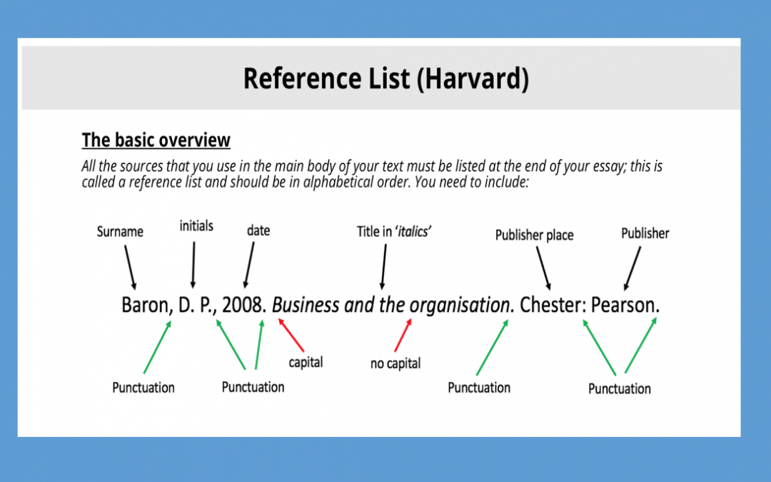
Referencing
Don't need to reference things that are considered common knowledge
In-text Citations
Quotations
Direct Quotations
Summarising
(Pears,R, 2019, P28)
(AEUK, 2017)
“Referencing is the process of acknowledging other people's work when you have used it in your assignment or research” (Pears,R, 2019, P28).
Notes:
Referencing is a crucial study skill that anyone in education will have learnt or will learn. There are many different types of references which can be used within the text that you are writing, such as ( the list). The picture I have included is an example of what the reference list should look like at the end of every text that includes any sort of referencing. Explain picture.
Talk about the quote explaining what referencing is.

Slide 7
Overall information
Communication is very important throughout life.
Researching is a big part of education.
Referencing can cause a lot of problems if not done properly.
Notes:
Overall I believe that all three of the study skills I looked at are very important for everyday life. Communication is a skill that can be developed on an everyday basis as well as research ways to improve you communication skills. Communication skills are clearly helpful within any future employment in any kind of sector.
Researching is very big within education but can be sometime used with employment. For example within the youth work sector research can be used to look up new group activities for a youth club, also could be used for researching about laws or new important information that you may not be 100% sure about.
Referencing is one of the most important study skills that are sued through education and employment. Referencing is very important as when referencing it needs to be done correctly to avoid any consequences if it is not done properly. Also referencing, lets people reading your work know that you understand that the work referenced is not yours and you are able to give the credit that the original author deserves.

Slide 8
From researching all the skills I believe I have a better understanding of them. I also believe that these study skills are a few of the most transferable in different situation.
How I hope to use these study skills in the future.
Notes:
I hope to use the skills in the future in my future employment within the youth work sector to help young people who can also use these skills within their education(if that‘s what they want to do). Also I believe I can constantly learn more about the skills as I use them as well as many other study skills I didn‘t look at in this presentation.

Slide 9
Reference List
AEUK. (2017) Harvard Reference List. Available at: https://academic-englishuk.com/harvard-reference-list/ (22/11/2021)
Cottrell, S. (2019) The Study Skills Handbook. 5th edn. London: Red Globe Press.
Fick, E. (2017) Study Skills. Available at: https://fickeducation.com/2017/12/07/study-skills/(22/11/2021)
Pears, R. (2019) Cite them right: the essential referencing guide. 11th edn. London: Red Globe Press
University, S. (2021) Introduction to research skills. Available at : Library.soton.ac.uk/sash/introduction-to-research-skills (19/11/2021).

