Slide 1
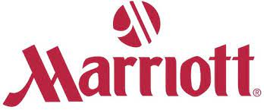
MARKETING PLAN FOR MARRIOTT HOTEL
Student name: mariana Burcea
Student id: 2128501

Slide 2

OVERVIEW OF MARKETING PLAN
The marketing plan will start by looking at the goal of the Marriot new hotel to be established.
The marketing mix showing the hospitality services, prices, places and promotions offered by Marriot will be assessed.
The micro and macro market analysis will be asses to ensure smooth operations.
Finally, consumer engagement strategies to be employed by Marriot and their digital marketing techniques will be analysed
Notes:
The marketing strategy will begin with an examination of the hotel's intended purpose. The marketing mix for Marriot's hospitality offerings, prices, locations, and promotions will be evaluated. The micro and macro market analyses will be evaluated to ensure operations run smoothly. Finally, the consumer engagement tactics and digital marketing techniques that Marriott will utilise will be evaluated.

Slide 3
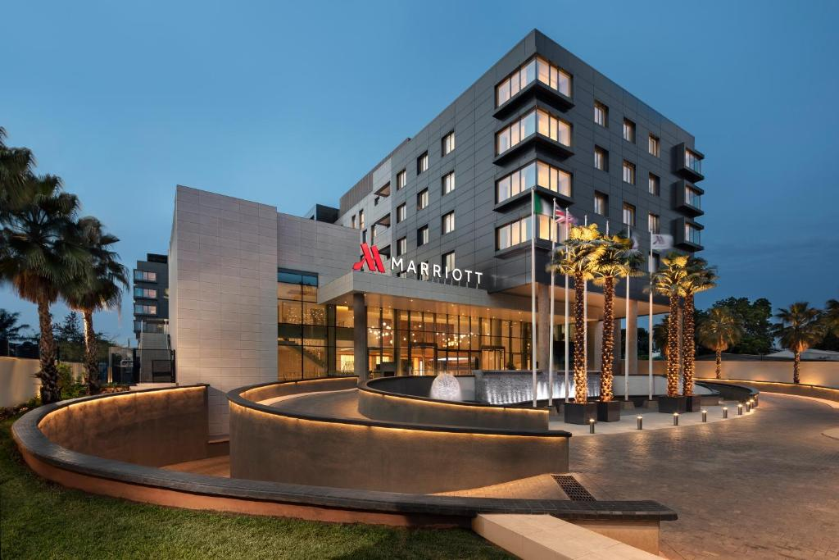
INTRODUCTION
This marketing plan seeks to offer a marketing strategy for a new branch of Marriot International Hotel to be opened in London, UK.
The primary business to be done is the hotel, franchising, and licencing of hotels, condominiums, and timeshares (Bonet & Cánovas, 2018. p.1).
Marriott's goal in introducing a new hotel in the United Kingdom is to introduce its services to customers in the country.
Notes:
This marketing plan aims to provide a marketing strategy for a new London, United Kingdom branch of the Marriot International Hotel. The principal business to be done is the hotel, franchising, and licencing of hotels, condominiums, and timeshares. The purpose of Marriott's introduction of a new hotel in the United Kingdom is to expose its services to local clients.

Slide 4
MARKETING MIX
Product
The UK hotel will seek to provide a variety of amenities, including guest rooms, restaurants, spas, salons, and gambling establishments.
Price
It will charge high costs because it gives its VIP customers the finest service available. It will embrace a premium pricing approach (Vũ et al., 2022, p.1).
Place
It will be based in London, UK. London attracts businesspeople from all over the globe.
Promotions
Marriot hotel will be running very visible advertising campaigns in UK.
Notes:
Product - Marriott hotel will operate in the hospitality business and controls a big and varied collection of hotels and resorts. The hotel in the United Kingdom will offer a variety of amenities, including as guest rooms, restaurants, spas, salons, and gambling establishments.
Price - Marriott will embrace a premium pricing approach since it provides exceptional service and food at reasonable charges. It will demand exorbitant prices since it provides its VIP clientele with the highest quality service.
Place - The hotel will be located in London, United Kingdom. As the premier financial centre in the world, London attracts businesses from throughout the world.
Promotion - For the objective of expanding its consumer base, the hotel will be undertaking very noticeable advertising campaigns in UK. The hotel will also employ UK influencers in its marketing efforts.

Slide 5
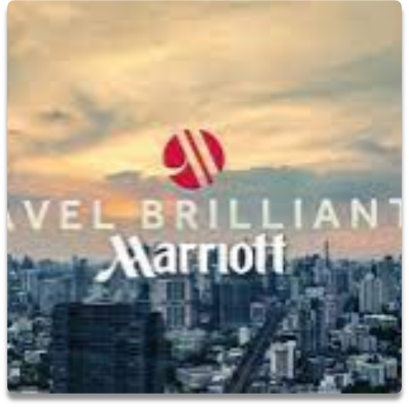
SWOT ANALYSIS
Strengths
High levels of hospitality.
They have many employees.
Stringent code of conduct.
Weaknesses
Geared towards serving wealthy people only.
Negative publicity from other branches.
Procedures taking too long to complete (Martinez, 2017, p.1)
Notes:
Strengths
The hotel will provide unparalleled hospitality. It will employ a large workforce to guarantee operations run smoothly. The rigorous code of conduct of Marriott will ensure the supply of all success-related elements, including cleanliness, courtesy, and prompt service.
Weaknesses
From its market position to its administration, Marriott's marketing and organisational structure indicate that it is primarily concerned with serving only families and the wealthy. A few years ago, Marriott's corporation received poor press due to its decision to prioritise the safety of its hotel guests above everything else. Due to their scope, certain procedures require a great amount of time and money to complete.

Slide 6
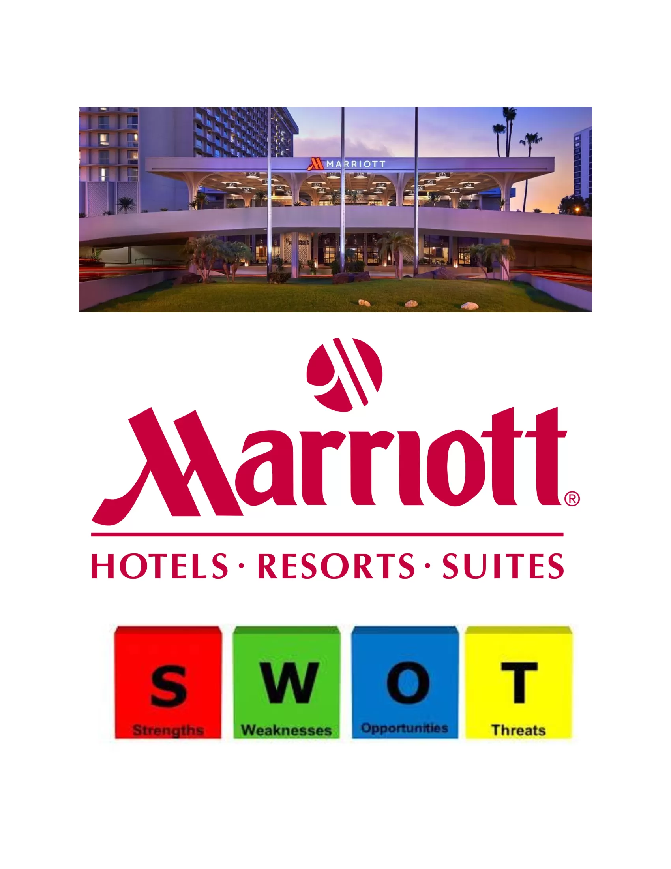
SWOT ANALYSIS (CONT’D)
Opportunities
Rising demand for hospitality
Offers several services
Provide Airbnb
Threats
Shifting rules and regulations
High competition
Notes:
Opportunities
Prospects for luxury hotel chains like Marriott are available in emerging nations due to rising demand for these services. This includes the tourism and hospitality businesses, the food and beverage industry, the real estate market, and numerous others. Marriott might offer short-term house rentals as an alternative to hotels; Airbnb.
Threats
There is a continual threat of shifting norms and restrictions on the international stage. Hospitality is a Fiercely Competing Industry. If given the chance, well-known hotel chains such as Hilton and many others might drastically erode Marriott's market share.

Slide 7
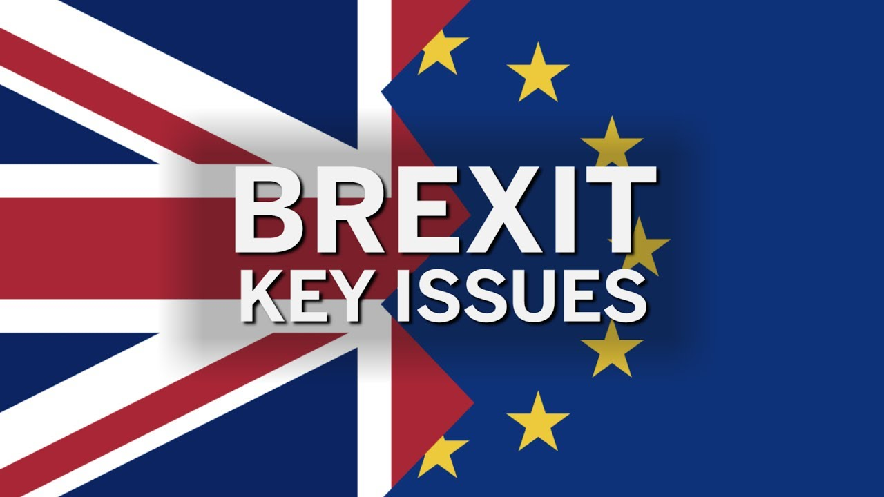
PESTLE ANALYSIS
Political factors
International relations, and political conditions in UK such as Brexit.
Economic factors
The collapse of the stock market and the ongoing Ukraine war
Social factors
Attitude towards Authority – Different companies have various ways of relating to those in charge.
Notes:
Political factors
Marriott could be impacted by foreign relations and political conditions in their tourist destination hotels. Brexit difficulties can damage operations of the corporation since international air travel might be disrupted and passengers could be scared away.
Economic factors
One of the issues is the upheaval in Europe's economy. The fall of the stock market and the ongoing Ukraine crisis has led to limited people's ability to spend money and travel. This leads in a major decline in business travel, upon which Marriott depends heavily.
Social aspects
There are a variety of ways in which businesses interact with people in authority. Before initiating marketing initiatives, it is essential for Marriott to ascertain the opinions of influential persons.

Slide 8
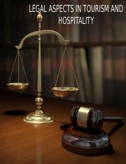
PESTLE ANALYSIS (CONT’D)
Technological factors
Online Airbnb booking availed by Marriot.
Legal factors
Mandatory increase in minimum wages might affect operations
Environmental factors
Increase in the cost of jet fuel might be detrimental to Marriott's business operations.
Notes:
Technological factors
Online Airbnb booking, a website that allows average people to rent rooms or entire houses directly to tourists, has the potential to disrupt the hotel industry.
Legal factors
A potential increase in the minimum wage in the United Kingdom to $15 per hour could have an impact on Marriott. It is feasible that this will increase labour costs while simultaneously diminishing service quality.
Environmental factors
It is possible that lower oil prices will reduce travel costs and increase hotel demand. Therefore, any rapid spike in jet fuel prices could be damaging to Marriott's operations.

Slide 9
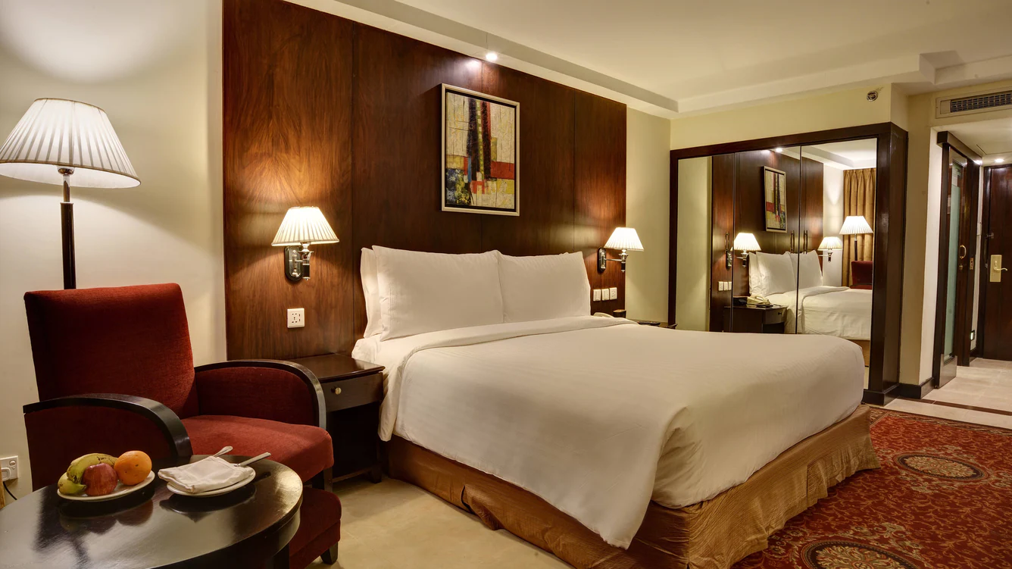
CUSTOMER VALUE & ENGAGEMENT
Paying attention to detail
Marriott will provide its staff with all the insights they need to provide excellent service to guests.
At each point in the customer's interaction, any member of the team may provide them with a tailored experience
Collecting data from customers through surveys
Surveys will give Marriott's consumers a voice and help the company improve.
In order to better anticipate their guests' demands, hotels often ask patrons to rate a number of hypothetical travel situations (Rahimi &Gunlu, 2016, p.1).
Notes:
Marriott will offer a streamlined, personalised service that caters to each individual visitor by paying close attention to the smallest of details.
Marriott will give its employees with all the knowledge necessary to provide superior service to its guests. At each interaction point with the consumer, every member of the team can give a personalised experience.
Obtaining information from clients via questionnaires
Surveys will provide Marriott's customers with a voice and aid the company in its development. In order to better anticipate their visitors' needs, hotels frequently ask their guests to rank a variety of hypothetical travel conditions and indicate which ones would encourage them to spend more money or exert more effort.

Slide 10

DIGITAL MARKETING STRATEGIES
Marriott’s app
The customer app will streamline their stays without requiring too much guidance from personnel.
Influencer marketing
This marketing narrows its attention on influential individuals within that group (Emelda, 2018, p.1).
Marriott International’s M Live
The M Live team monitors trending hotel issues throughout the globe and uses this information to improve services.
Notes:
The use of Marriott’s app
Marriott will implement a customer app, since guests like applications that streamline their stays without requiring too much of their time.
Influencer marketing
Instead of focusing on the target market as a whole, this kind of marketing narrows its attention on influential individuals within that group who will inturn attract a huge audience.
Marriott International’s M Live
The M Live program at Marriott Hotels is the wave of the future in the hotel business. The M Live team monitors trending issues throughout the globe and uses this information to categorise and provide material on the M Live platform.

Slide 11
Conclusion
Establishing a strong brand for a new product or service, as well as launching a company, are both major endeavours that need careful planning and execution of a marketing strategy
Marriott has chosen to enter the UK hotel industry with brand-new features that will have a wide range of services, from high-quality accommodations to upscale restaurants and a lively nightlife scene
Marriott International will integrate a digital marketing into a carefully crafted plan, capitalising on the company's large worldwide network and unique digital platform to position itself as the go-to option for anyone seeking a luxurious vacation..
Notes:
Establishing a strong brand for a new product or service and starting a new business are both significant endeavours that require careful preparation and implementation of a marketing strategy. Marriott has chosen to enter the hotel sector in the United Kingdom with brand-new features that will offer a variety of services, from high-quality lodgings to premium restaurants and a vibrant nightlife. Marriott International will incorporate digital marketing into a well-thought-out strategy, capitalising on the company's extensive global network and unique digital platform to position itself as the go-to destination for everyone seeking a sumptuous holiday.

Slide 12
References
Emelda, N., 2018. The Strategies of Marketing Used for Increasing Number of Wedding Events at Sheraton Bandung Hotel and Towers (Manage by Marriott International). Novi Emelda: 147010007 (Doctoral dissertation, Sastra Inggris).
Bonet Escura, L. and Cánovas Escayola, A., 2018. Business plan for a review platform about hospitality internships.
Chi, L.Y., 2019. Business Plan Daydream Hotel (Doctoral dissertation, President University).
Widardi, J., Syah, T.Y.R., Indradewa, R. and Pusaka, S., 2020. Marketing Mix Strategy Implementation for Business Plan at LH Hotel. Journal of Multidisciplinary Academic, 3(5), pp.166-170.
Rahimi, R. and Gunlu, E., 2016. Implementing customer relationship management (CRM) in hotel industry from organizational culture perspective: case of a chain hotel in the UK. International Journal of Contemporary Hospitality Management.
Vũ, T.L.A., Nguyễn, Q.H., Nguyễn, L.T.T., Dương, Q.B. and Nguyễn, H.D., 2022. A business plan for the Villa Song Saigon in 2023: The feasible solutions with the purpose of attracting more potential customers throughout guest’s service experience (Doctoral dissertation, FPTU HCM).
Leite, R.A. and Azevedo, A., 2017. The Role of Digital Marketing: A perspective from Porto Hotels’ Managers. International Journal of Marketing, Communication and New Media, (2).
Edelman, D. and Heller, J., 2015. How digital marketing operations can transform business. McKinsey Digital, p.20036.
Martinez, B., 2017. A SWOT analysis on Millennials in the workplace: increasing manager success with Millennial employees in the hotel industry.

