Slide 1
Introduction to Human Nutrition
BMHN4002
session One

Slide 2
Module Lead
Dr Chris Cashin
Registered Dietitian and Registered Nutritionist (AfN)
Practitioner – Sport and Exercise Nutrition Register (SENr)
Doctorate in Professional Practice

Slide 3
Session one - content
The module - its content
Expectations
Assignments
The Nutrition Industry - who is who!
An overview of a balanced diet
Introduction to the Dietary Reference Values – UK Guidelines

Slide 4
The module
The aim of this module is to cover the subject from individual nutrients to what is a balanced diet
We will look at dietary assessment and individual foods
This will mainly be looking at the normal requirements – modules in future years will deal with disease and physical activity

Slide 5
Expectations
Attendance at lectures
Lets take a look at what is on Moodle

Slide 6
House keeping
Health and safety
Fire evacuation
Degree notice boards in Dafydd Rowland Building
Use of your handbook
Use of the Nutrition Lab

Slide 7
Learning Outcomes
They are listed on the module specification – this applies to all modules
The Learning Outcomes are as follows:-
identify the importance of a healthy diet in disease prevention/management and gain familiarity with current evidence based dietary guidelines and Dietary Reference Values;
demonstrate an understanding of the role of the macronutrients; carbohydrate, protein and fat in the diet and the non-nutrient alcohol, outlining the optimal intakes in the maintenance of health and in the prevention or causation of disease;
demonstrate an understanding of the roles of vitamins and minerals in the diet, outlining the optimal intakes in the maintenance of health and in the prevention or causation of disease.

Slide 8

Book Lists
Refer to module specification
Look at the Leganto Reading List on Moodle – there should be a list for each module that may be updated from time to time.
You should try to read widely – textbooks, journals
CAUTION
Beware social media – there are many experts
Read and critically review!

Slide 9
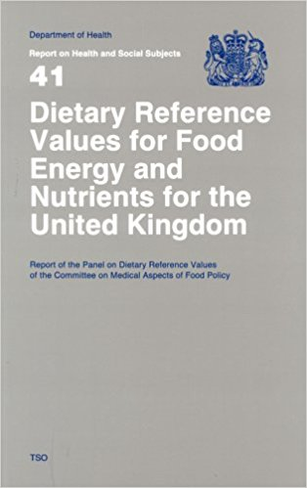
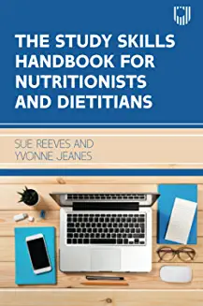
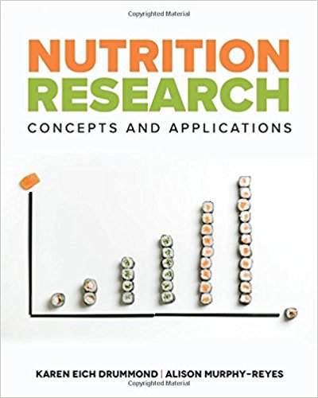

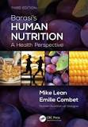

Books

Slide 10
Assignments
Handbook
Important to read as it explains the grades you will get, deadlines and late penalties
Upload to Turnitin – by 11.59 pm usually on a Friday
Plan work – or you might end up with a lot of work to do at the same time!

Slide 11
The assignment – shown on Moodle
An essay – with reference to an age group – you will have to discuss the Dietary Reference Values, dietary guidelines and evidence.
Due on 08/01/2027 at 11.59pm via Turnitin
Allow 20 working days for the marks!

Slide 12
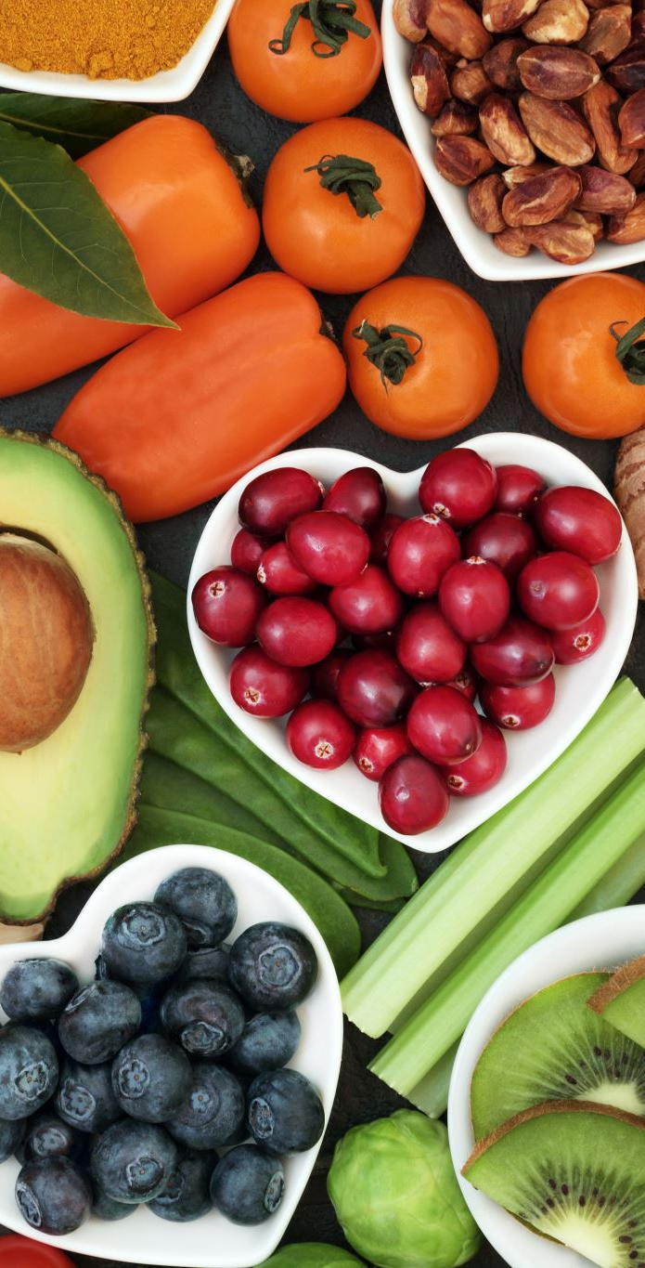
WHAT IS NUTRITION?
It can be described as the study of foods and nutrients vital to health and how the body uses these to promote and support growth, maintenance and reproduction of cells”
OR
The study of the relationship between people and their food.
Source – Barasi, M. (2003) Human Nutrition , A Health Perspective
Hodder Arnold Publishers.

Slide 13
Why is Nutrition Important?
There has been a huge increase in interest in nutrition in recent years.
The Covid 19 pandemic has intensified this interest – obesity and metabolic diseases have been highlighted.
The weight loss jabs – what about support?
It crosses a lot of disciplines and is taught at different levels.
Health issues have had a huge impact.
What sort of health impacts?

Slide 14
Nutritionist
A nutritionist is concerned with the study of nutrients in food, how nutrients are used in the body, and the relationship between diet, health and disease.
Nutritionists work with individuals and groups
The Association for Nutrition – Afn for professional issues – http://www.associationfornutrition.org/
The Nutrition Society for research
www.nutritionsociety.org

Slide 15
Dietitian
Registered Dietitians (RDs) are uniquely qualified to translate scientific information about food into practical dietary advice. As well as providing impartial advice about nutrition and health, dietitians also advise about food related problems and treat disease and ill health. Many work in the National Health Service (NHS) and may work in one or more specialist areas e.g. diabetes, children's health, cancer, whilst others work with people in the community, often visiting them in their own homes. They are a key part of the healthcare team.
British Dietetic Association 2022

Slide 16
Public Health Nutritionist
Work in a preventative role – Public Health Departments
Disease prevention

Slide 17
Sports Nutritionist
Performance nutrition – elite or recreational athletes.
Sport and Exercise Nutrition Register
http://www.senr.org.uk/

Slide 18
Others
Everyone is a food expert!
Some are unqualified, poorly trained.
Examples are Nutritional Therapist, Nutrition Consultants – a telltale sign is that they do not display any qualifications.
Class discussion!

Slide 19
So where could you work?
NHS and public health
Health promotion
Individuals – advice on diet , weight management, sports nutrition
Nutritionists to food companies etc
PTs and sports scientists can give simple advice about nutrition
It is an exciting time in nutrition and health

Slide 20
Some may want to be a DIETITIAN
You can do a post graduate qualification if you have a nutrition degree
BUT
You need to do a 20 credits of Biochemistry (Science of Nutrition) and 20 credits of Physiology – Plus 20 credits in something like psychology or sociology.
There will more discussion in Semester 2

Slide 21
What is a Healthy Diet?
Take 10 minutes and work in pairs
Class discussion

Slide 22
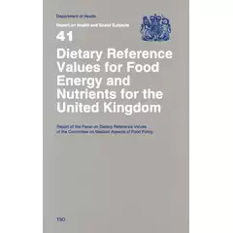
DIETARY REFERENCE VALUES
This is an important book to buy – it is the Nutritionists Bible
You can get it from Amazon
Published by the Committee on Medical Aspects of Food Policy – known as Coma.

Slide 23
DRV
Also available online from :-
https://assets.publishing.service.gov.uk/government/uploads/system/uploads/attachment_data/file/743786/Dietary_Reference_Values_for_Food_Energy_and_Nutrients_for_the_United_Kingdom__1991_.pdf

Slide 24
SACN
Scientific Advisory Committee on Nutrition
Now taken over from COMA
They have updated a few nutrients – Vitamin D, Sugar and some energy requirements for young males
https://www.gov.uk/government/groups/scientific-advisory-committee-on-nutrition

Slide 25
Dietary Reference Values - DRV
Dietary Reference Values (DRVs) comprise of a series of estimates of the amount of energy and nutrients needed by different groups of healthy people in the UK population.
In your assignments always reference these – try not to use secondary references for them
They should be referenced as follows:-
Great Britain: Department of Health (1991) Dietary Reference Values for food energy and nutrients for the United Kingdom: Report of the panel on dietary reference values of the committee on medical aspects of food policy: 5TH edn. LONDON: Stationary Office Books
Public Health England (2016) Government Dietary Guidelines: Available at: https://www.gov.uk/government/uploads/system/uploads/attachment_data/file/618167/government_dietary_recommendations.pdf (Accessed: 4 December 2017).

Slide 26
In assignments
(Department of Health, 1990)
(Public Health England, 2016)
Ensure you use these as references – they are the primary reference!!

Slide 27
DRV
Included within this definition are three types of estimates:
Reference Nutrient Intakes (RNIs),
Estimated Average Requirements (EARs) and
Lower Reference Nutrient Intakes (LRNIs).
Try to remember these terms

Slide 28
DRV
• RNIs are used for protein, vitamins and minerals, and are an estimate of the amount that should meet the needs of most of the group to which they apply. They are not minimum targets.
• The EAR is used in particular for energy.
• Intakes below the LRNI are almost certainly not enough for most people.

Slide 29
DRV
Population groups for which dietary reference values have been set include:
• Boys and girls (aged 0-3 months; 4-6 months; 7-9 months; 10-12 months; 1-3 years; 4-6 years; 7-10 years)
• Males (aged 11-14 years; 15-18 years; 19-50 years; 50+ years)
• Females (aged 11-14 years; 15-18 years; 19-50 years; 50+ years; pregnancy and breastfeeding)

Slide 30
DRV – Reminder!
Dietary Reference Values (DRVs) comprise a series of estimates of the amount of energy and nutrients needed by different groups of healthy people in the UK population.
• Included within this definition are three types of estimates: Reference Nutrient Intakes (RNIs), Estimated Average Requirements (EARs) and Lower Reference Nutrient Intakes (LRNIs).
• RNIs are used for protein, vitamins and minerals, and are an estimate of the amount that should meet the needs of most of the group to which they apply. They are not minimum targets.
• The EAR is used in particular for energy.
• Intakes below the LRNI are almost certainly not enough for most people.

Slide 31
DRV
Reference Nutrient Intake (RNI): The RNI is the amount of a nutrient that is enough to ensure that the needs of nearly all the group (97.5%) are being met. By definition, many within the group will need less.
This includes Protein and most vitamins and minerals

Slide 32
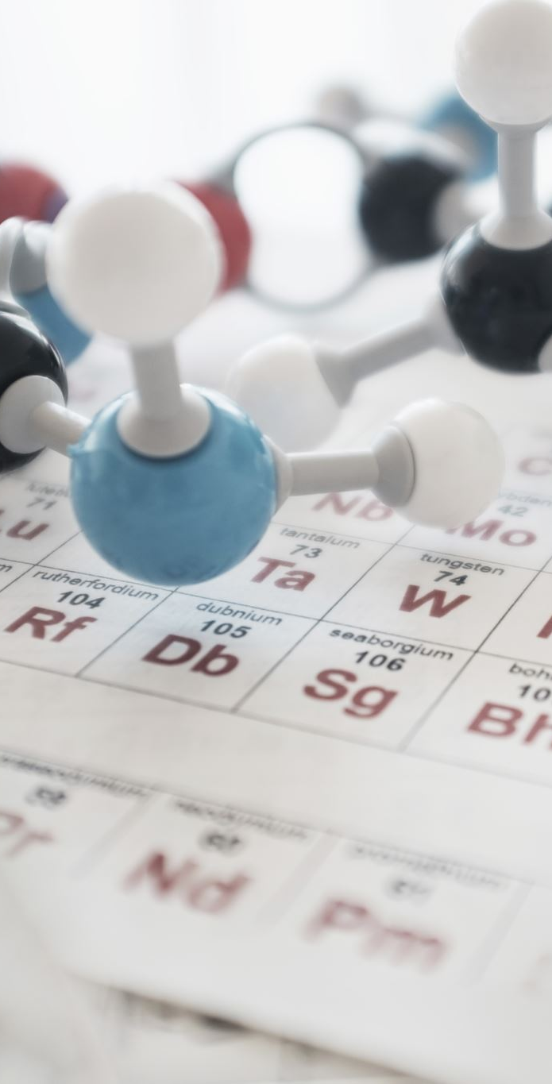
DRV
Estimated Average Requirement (EAR): This is an estimate of the average requirement for energy or a nutrient - approximately 50% of a group of people will require less, and 50% will require more. For a group of people receiving adequate amounts, the range of intakes will vary around the EAR.
Reference Nutrient Intake (RNI): The RNI is the amount of a nutrient that is enough to ensure that the needs of nearly all the group (97.5%) are being met. By definition, many within the group will need less.

Slide 33
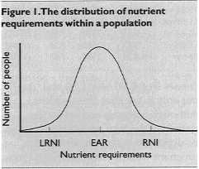
DRV

Slide 34
DRV
Lower Reference Nutrient Intake (LRNI): The amount of a nutrient that is enough for only the small number of people who have low requirements (2.5%).The majority need more.

Slide 35

DRV
Reference Nutrient Intake (RNI): The RNI is the amount of a nutrient that is enough to ensure that the needs of nearly all the group (97.5%) are being met. By definition, many within the group will need less.

Slide 36
DRV
Safe intake:
This is used where there is insufficient evidence to set an EAR, RNI or LRNI. The safe intake is the amount judged to be a level or range of intake at which there is no risk of deficiency and is below the level where there is a risk of undesirable effects. There is no evidence that intakes above this level have any benefits - and in some instances they could have toxic effects.

Slide 37
DRV
The COMA panel set EARs for energy, an EAR for dietary fibre for adults, and desirable (adult) population average intakes for fat and carbohydrate. EARs and RNIs were set for protein, whilst LRNIs, EARs and RNIs were set for 9 vitamins and 11 minerals. Safe intakes were set for a further four vitamins (pantothenic acid, biotin, vitamin E and vitamin K) and four minerals (manganese, molybdenum, chromium and fluoride).

Slide 38
DRV
How should DRVs be used?
For practical purposes, the RNI should be used when assessing the dietary intake of a group. The nearer the average intake of the group is to the RNI, the less likely it is that any individual will have an inadequate intake. The nearer the average to the LRNI, the greater the probability that some individuals are not achieving adequate intakes. For example, if 20% of a group is typically consuming less than the LRNI, it is likely that most have an inadequate intake. When planning a diet for a group the aim should be to provide the RNI.

Slide 39
Food Guides in the UK
We will look at some in more detail in future weeks.
The Balance of Good Health
The Eat well Plate
The Eat well Guide

Slide 40
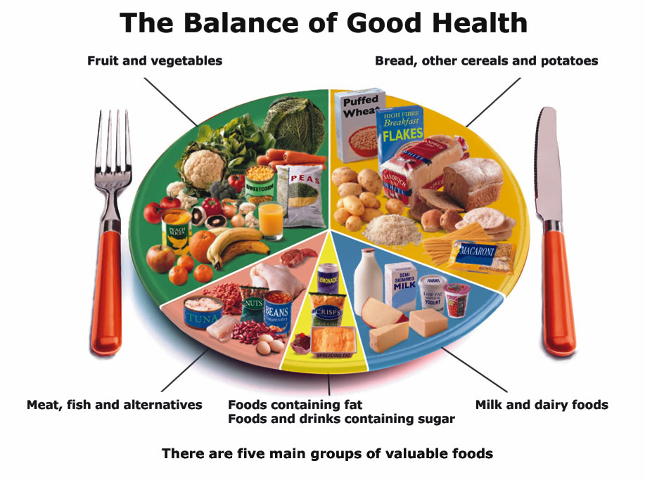
The Balance of Good Health
First pictorial Guide in the Uk published in 1994

Slide 41
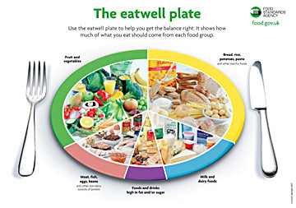
The Eat well Plate
Published in 2007

Slide 42
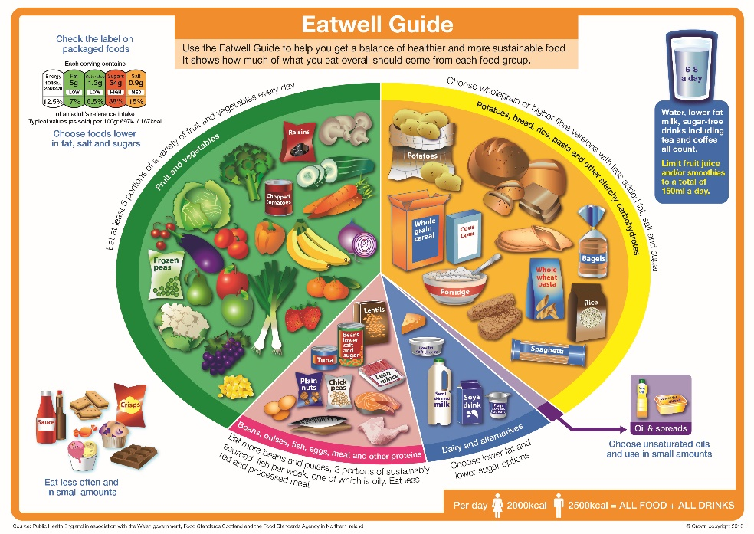
The Eat Well Guide
Published in 2016

Slide 43
homework
On moodle – look up some DRV
You will need to learn some of the key requirements

