Slide 1

Name: Addis Richardson lecturer: SUJEEWA HERATH
STUDENT : 2028001
MOODLE: BMSW4004

Slide 2
introduction
Analysing the factors of Work-Related Stress
•A Research-informed discussion on the nature and impact of the complex problem on employees and their organizations.
•A Research –informed cause-and-effect analysis of the complex problem.
•A PESTLE analysis of the macro-environmental factors contributing to the complex problem.
•An evaluation of alternative solutions to work-related stress with an aim of choosing the most appropriate solution among these alternatives.

Slide 3
Question 1: nature of work related stress
Stress is a psychological state with both cognitive and emotional constituents. In other words stress includes a significant amount of demands and pressures that typically affects the well-being of an individual.
Additionally the importance of an individual failing to cope, otherwise unmanageable. (Mackay et.all, 2004, p.93)
According to HSE
"the adverese reaction people have to excesssive pressures or other types of demand places on them at work" (HSE' webnmar,2020)

Slide 4
BENEFITS OF ADDRESSING WORK-RELATED STRESS
BUSINESS
Increased turnover
Enhance customer service
Fewer days lost from sickness absence
Increased productivity and improved work quality
Improves work satisfaction

Slide 5
impact of work related stress
Physical and phycological symptoms such as headaches anxiety depressions
Clinical disorders and cardio vascular and any other type of heart disease
The threat of losing the job
Lost of income
Lack of work life balance

Slide 6
PESTEL Analysis
Political | Economic | Social | Technological | Environmental | LEGAL
Tax Policy | Economic recovery | Population growth rates | Automatic technology | Weather | Environmental laws
Policies of the government | pandemic | Population pyramid | R-D Activity | Climate change | Anti trust laws
dishonest | Brexit | Career attitudes | Technological change | Heaviness from NGO | Consumerism laws
International trade policy | Unemployment rates | Cultural norms | Technological awareness | Climate | Copyright and patent laws
Trade ban | Interest rates | Health consciousness | Level of innovation | Environmental Policies | Health and safety laws

Slide 7
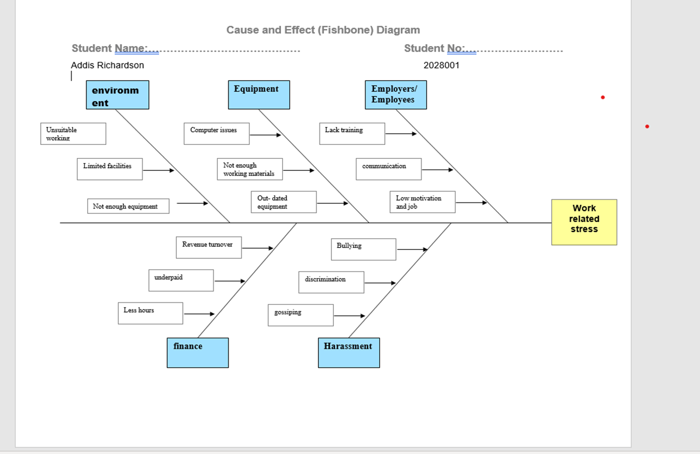
Fishbone Analysis

Slide 8
Possible solutions
Requesting more flexible hours
Revamp of habitat.
Replacement of the job with a new job
Requesting more support from the employer
Seeking medical support such as counselling
Requesting more support from the employer and Seeking medical support such as counselling can be chosen as my best solutions.

Slide 9
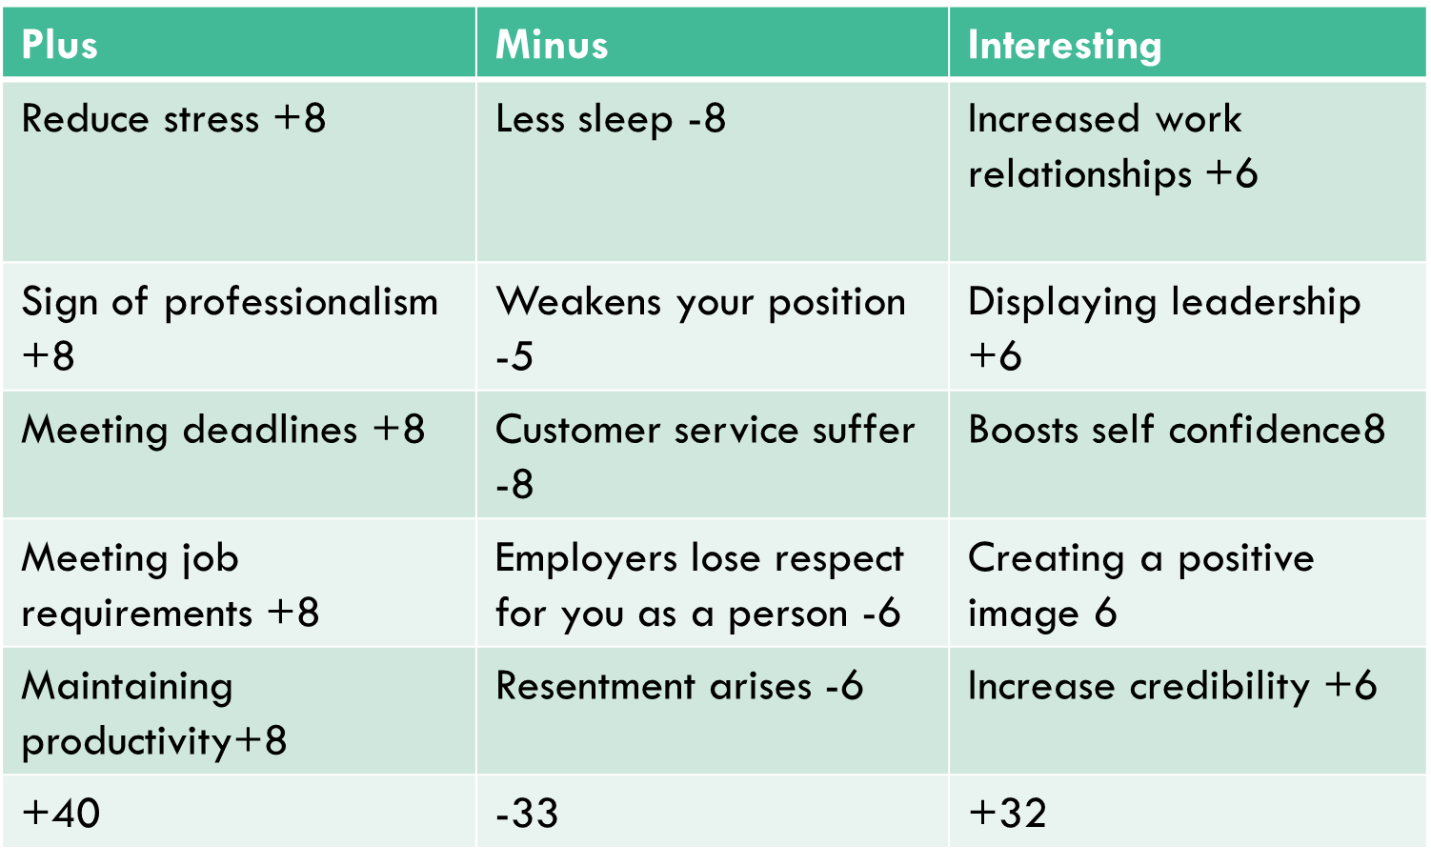
PMI Analysis for my chosen best solutions.
40+32-33=39

Slide 10

conclusion
•work related stress is harmful for both employees and employers
•with proper action plans and attention from management the work related stress issue can be resolved
•have multiple negative consequences for both workers and employers

Slide 11
reference
MacKay*, C.J., Cousins, R., Kelly, P.J., Lee, S. and McCAIG, R.H., 2004. ‘Management Standards’ and work-related stress in the UK: policy background and science. Work & Stress, 18(2), pp.91-112.
HSE' WEBNAR, AVAILABLE ON Mental Health - Work Related Stress - YouTube

