Slide 1


Managing Enterprise in the 21st Century
BMSW 4006
Business Plan Presentation

Slide 2

Submitted To
Submitted By

Slide 3

Introduction
The business plan presentations aim to provide an extensive look at the specific steps that the proposed digital-first business concept “PharmaAve” is required to release itself as well as serve as a guideline for achieving short and long-term objectives of the business.
As per a standard business plan, the presentation will go through discussing the proposed business, its offerings, and target market, conducting market analysis as well as developing plans for marketing, future financials and team management.
Notes:
The business plan presentations aim to provide an extensive look at the specific steps that the proposed digital-first business concept “PharmaAve” is required to release itself as well as serve as a guideline for achieving short and long-term objectives of the business. As per a standard business plan, the presentation will go through discussing the proposed business, its offerings, and target market, conducting market analysis as well as developing plans for marketing, future financials and team management.

Slide 4


Overview Of PharmaAve
PharmaAve is a UK-based digital pharmacy that is headquartered in London and specializes to offer prescriptions at the best price with free home delivery with a wide range of selected medications.
The business is integrated with a digital-driven model and leans more so on IT in its key operations. The brand offers its customers the opportunity to purchase medicines online, sitting at home, while the medicine is delivered to them at their doorsteps.
PharmaAve is similar to that Pharmacy2u.co.uk, Blink RX, Amazon Pharmacy, Select RX etc. (Williams, 2022).
Notes:
PharmaAve is a UK-based digital pharmacy that is headquartered in London and specialises to offer prescriptions at the best price with free home delivery with a wide range of selected medications. The business is integrated with a digital-driven model and leans more so on IT in its key operations. The brand offers its customers the opportunity to purchase medicines online, sitting at home, while the medicine is delivered to them at their doorsteps. PharmaAve is similar to that Pharmacy2u.co.uk, Blink RX, Amazon Pharmacy, Select RX etc. (Williams, 2022).

Slide 5
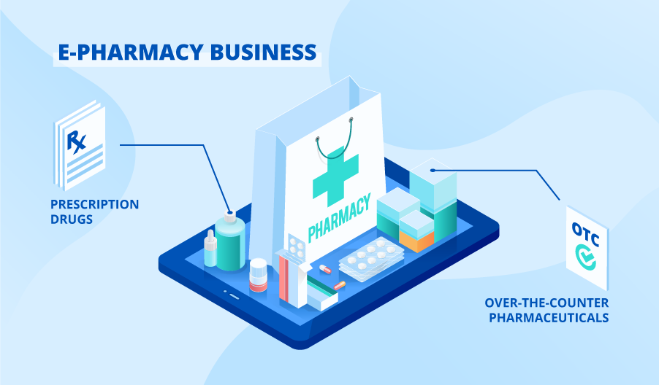
Products And Services
As an eCommerce pharmaceutical business, the main product and service of the brand are to offer its target audiences the convenience of getting in contact with a licensed practitioner that writes them prescriptions within 24 hours and sells the prescribed medicines and delivers them to their home without any hassle from the perspective of the customer.
The medicines are at the best prices and PharmaAve offers free shipping on selected products.
From prescribed to none prescribed medicines, health and wellness products, protein shakes, vitamin and protein pills etc. a wide variety of goods that are common to a physical pharmacy are offered at PharmaAve
Notes:
As an eCommerce pharmaceutical business, the main product and service of the brand are to offer its target audiences the convenience of getting in contact with a licensed practitioner that writes them prescriptions within 24 hours and sells the prescribed medicines and delivers them to their home without any hassle from the perspective of the customer. The medicines are at the best prices and PharmaEve offers free shipping on selected products. From prescribed to none prescribed medicines, health and wellness products, protein shakes, vitamin and protein pills etc. a wide variety of goods that are common to a physical pharmacy are offered at PharmaAve

Slide 6
Marketing Audit
SWOT Analysis
Strengths
PharmaEve provides medicines at the best price in the market
The service is convenient and offers rapid delivery
Licensed practitioners on board 24/7
Free shipping for a few selected products
Being a digital business saves the cost of operating and maintaining a physical pharmacy (Cohan, 2018)
Weaknesses
Lack of business experience of the entrepreneurs
The nature of online businesses might raise concerns to some regarding fraudulent
Opportunities
The support is provided by the governments in the form of start-up grants of £20,000 each
The size of the global online pharmacy market (68,382.3 million USD) as of 2021 (PSMarketResearch, 2022)
The advancements sustained in the ICT environment lead to better consumer engagement
The emergence of a new pandemic can be an opportunity for growth
Threats
The increasing threat, especially from the likes of Pharmacy2u.co.uk, Blink RX, Amazon Pharmacy, and Select RX etc. (Williams, 2022).
Notes:
Strengths-
PharmaEve provides medicines at the best price in the market
The service is convenient and offers rapid delivery
Licensed practitioners on board 24/7
Free shipping for a few selected products
Being a digital business saves the cost of operating and maintaining a physical pharmacy (Cohan, 2018)
Weaknesses-
Lack of business experience of the entrepreneurs
The nature of online businesses might raise concerns to some regarding fraudulent
Opportunities-
The support is provided by the governments in the form of start-up grants of £20,000 each
The size of the global online pharmacy market (68,382.3 million USD) as of 2021 (PSMarketResearch, 2022)
The advancements sustained in the ICT environment lead to better consumer engagement
The emergence of a new pandemic can be an opportunity for growth
Threats-
The increasing threat, especially from the likes of Pharmacy2u.co.uk, Blink RX, Amazon Pharmacy, and Select RX etc. (Williams, 2022).

Slide 7
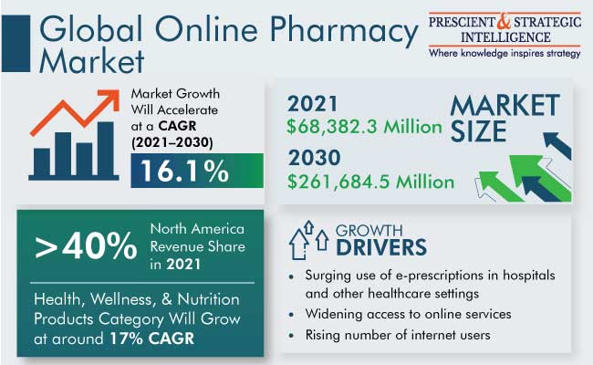
PEST Analysis
Political- The stability of the UK’s political environment. The regulatory system regarding the eCommerce industry is overall less strict than that of the EU.
Economic- The size of the global online pharmacy market (68,382.3 million USD) as of 2021 and the economy in the UK exhibit growth potential for eCommerce businesses (PSMarketResearch, 2022). This has led eCommerce brands such as Pharmacy2u.co.uk to achieve their status quo and generate a revenue of 184 million USD.
Socio-logical- Nowadays people are accustomed to online shopping as a vast majority browse and purchase online frequently. The convenience of being checked, and prescribed and the medicines getting delivered to their homes, are major selling points of the business. Although societal norms and beliefs such as the concern with the eCommerce businesses being mostly fraud will hurt the growth of PharmaAve (Morrison, 2017).
Technological- The advancements in the ICT environment paving the way for better e-commerce infrastructure, better communication, engagement and operational efficiencies (Deiss & Henneberry, 2021).
Notes:
Political- The stability of the UK’s political environment. The regulatory system regarding the eCommerce industry is overall less strict than that of the EU.
Economic- The size of the global online pharmacy market (68,382.3 million USD) as of 2021 and the economy in the UK exhibit growth potential for eCommerce businesses (PSMarketResearch, 2022). This has led eCommerce brands such as Pharmacy2u.co.uk to achieve their status quo and generate a revenue of 184 million USD.
Socio-logical- Nowadays people are accustomed to online shopping as a vast majority browse and purchase online frequently. The convenience of being checked, and prescribed and the medicines getting delivered to their homes, are major selling points of the business. Although societal norms and beliefs such as the concern with the eCommerce businesses being mostly fraud will hurt the growth of PharmaAve (Morrison, 2017).
Technological- The advancements in the ICT environment paving the way for better e-commerce infrastructure, better communication, engagement and operational efficiencies (Deiss & Henneberry, 2021).

Slide 8
Competitor Analysis- Porter’s Five Forces
Rivalries in the industry- Amazon Pharmacy, Pharmacy2u.co.uk, Blink RX, BioPlus Select RX, Express Scripts Pharmacy etc.
Threat from new entrants- The strict drug-related legislation and usage of health and safety medicines in the UK can further enforce the entry barriers for potential new players (Warden, 2018).
Bargaining power of the customers- The customers of the pharmaceutical industry has relatively low to no bargaining power.
Bargaining power of the suppliers- Due to the plenty of pharma companies, the brand can switch easily from one to the other.
Threat from the substitutes- Substitutes such as herbal alternatives can pose a moderate rate.
Notes:
Rivalries in the industry- Amazon Pharmacy, Pharmacy2u.co.uk, Blink RX, BioPlus Select RX, Express Scripts Pharmacy etc.
Threat from new entrants- The strict drug-related legislation and usage of health and safety medicines in the UK can further enforce the entry barriers for potential new players (Warden, 2018).
Bargaining power of the customers- The customers of the pharmaceutical industry has relatively low to no bargaining power.
Bargaining power of the suppliers- Due to the plenty of pharma companies, the brand can switch easily from one to the other.
Threat from the substitutes- Substitutes such as herbal alternatives can pose a moderate rate.

Slide 9
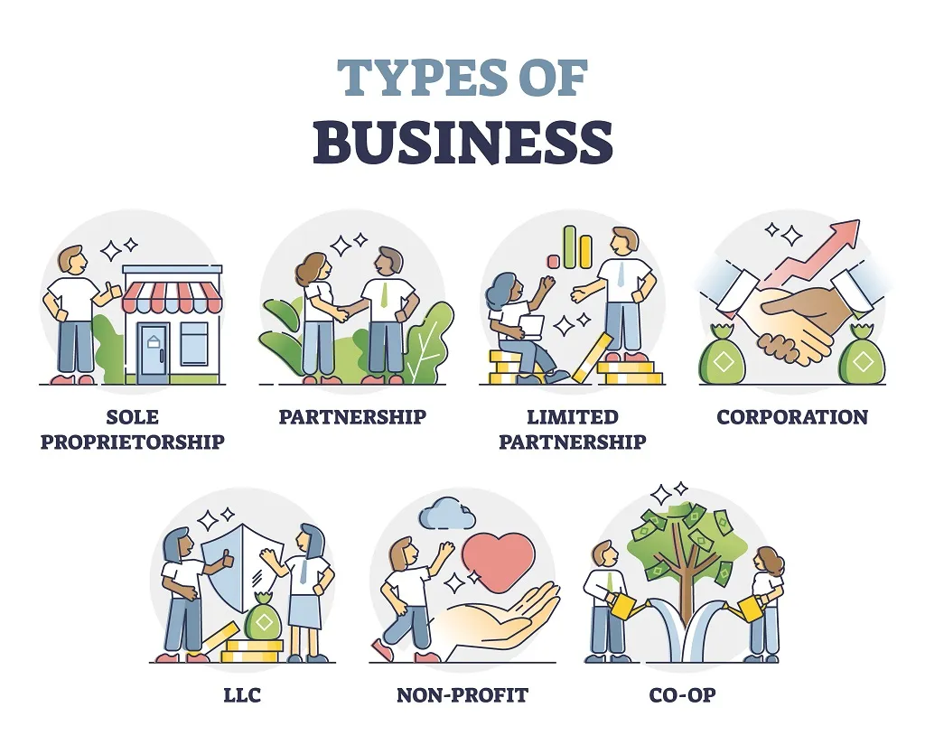
Legal Structure- Partnership
In terms of legal structure and ownership, the brand will be owned and operated by a set of partners. A formal agreement between the partners will serve as the foundation of the business. The profits, risks, liabilities and responsibilities of the business will be equally divided and distributed between the partners. PharmaAve will be benefitted from additional knowledge, skills and resources shared by the pool of partners.
Notes:
In terms of legal structure and ownership, the brand will be owned and operated by a set of partners. A formal agreement between the partners will serve as the foundation of the business. The profits, risks, liabilities and responsibilities of the business will be equally divided and distributed between the partners. PharmaAve will be benefitted from additional knowledge, skills and resources shared by the pool of partners.

Slide 10
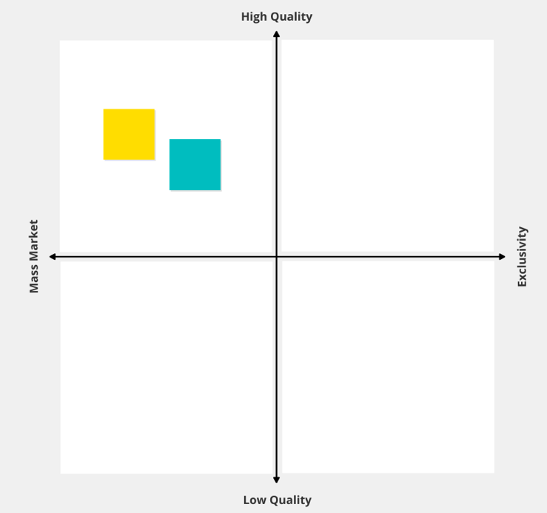
Positioning
Positioning strategy enables a brand to design its offerings and formulate an image of the company from the perception of the consumers to establish a distinctive place in their minds.
The marketing campaign of the start-up will indicate that the e-pharmacy brand offers high-quality products at a relatively lower price than its competitors in the market.
With a combination of offering discounts and free shipping, the value might be created for the mass market.
Notes:
Positioning strategy enables a brand to design its offerings and formulate an image of the company from the perception of the consumers to establish a distinctive place in their minds.
The marketing campaign of the start-up will indicate that the e-pharmacy brand offers high-quality products at a relatively lower price than its competitors in the market.
With a combination of offering discounts and free shipping, the value might be created for the mass market.

Slide 11
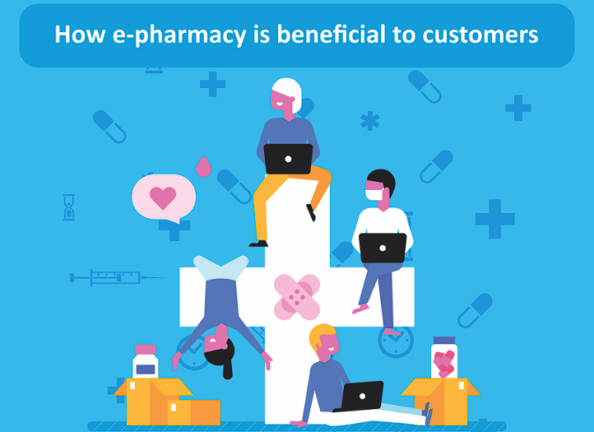
Target Market
Primarily the people of the UK who seeks convenient and urgent check-up with health practitioners, are prescribed necessary medicines to help with their illness or sickness, and purchase medicines and healthcare products online to save time and energy.
The target age demographic is people in the age between 30-50 and older (PSMarketResearch, 2022).
Contrary to many'd beliefs, baby boomers are considered a major fuel for the American e-pharmacy market.
Notes:
The target market of PharmaAve is primarily the people of the UK who seeks convenient and urgent check-up with health practitioners, are prescribed necessary medicines to help with their illness or sickness, and purchase medicines and healthcare products online to save time and energy. The target age demographic is people in the age between 30-50 and older (PSMarketResearch, 2022). Contrary to many’s beliefs, baby boomers are considered a major fuel for the American e-pharmacy market.

Slide 12
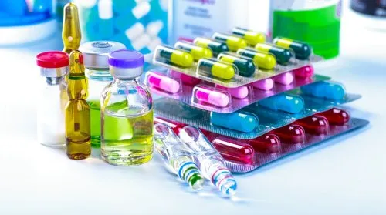

Marketing Plan
The marketing Mix
Product
From prescribed to none prescribed medicines, health and wellness products, skincare, protein shakes, vitamin and protein pills etc. a wide variety of goods that are common to a physical pharmacy are offered at PharmaAve.
Price
The business will adopt a competitive pricing model to set the prices of its services and products which means it will offer the best price in the market to establish and retain competitiveness (BDC Editorial, 2022).
Place
The target location strategy for PharmaAve is centered around London. The brand won’t have a dedicated store or pharmacy that supports visiting rather will have warehouses and a head office. The Digital model is integrated as it is an e-pharmacy.
Promotion
A mixture of digital marketing and traditional marketing. Digital approaches such as social media marketing, influencer marketing, email marketing and SEO (Harrison, 2020). Traditional approaches i.e., print media, billboards, posters, banners, radio advertisements etc. Discounts will be offered on almost every product and selected products will be paired with free shipping.
Notes:
Product- From prescribed to none prescribed medicines, health and wellness products, skincare, protein shakes, vitamin and protein pills etc. a wide variety of goods that are common to a physical pharmacy are offered at PharmaAve.
Price- The business will adopt a competitive pricing model to set the prices of its services and products which means it will offer the best price in the market to establish and retain competitiveness (BDC Editorial, 2022).
Place- The target location strategy for PharmaAve is centred around London. The brand won’t have a dedicated store or pharmacy that supports visiting rather will have warehouses and a head office. The Digital model is integrated as it is an e-pharmacy.
Promotion- A mixture of digital marketing and traditional marketing. Digital approaches such as social media marketing, influencer marketing, email marketing and SEO (Harrison, 2020). Traditional approaches i.e., print media, billboards, posters, banners, radio advertisements etc. Discounts will be offered on almost every product and selected products will be paired with free shipping.

Slide 13
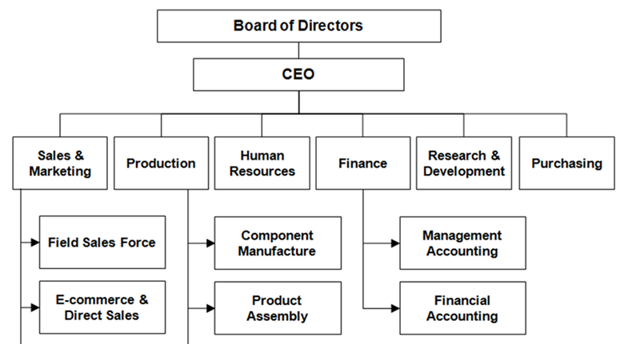
Management Team
Functional Organizational Structure
PharmaAve will integrate a functional organisational structure where the business is divided into distinct divisions and teams such as sales, marketing, IT, finance, HR and administration (Polskii, 2021).
Chief Technology Officer will be in charge of the IT division and the Chief marketing officer will manage sales and marketing while an HRIS specialist will be brought in to deal with recruitment, performance management and compensation.
At the top of the management, hierarchy would be the Chief Executive Officer.
Notes:
PharmaAve will integrate a functional organisational structure where the business is divided into distinct divisions and teams such as sales, marketing, IT, finance, HR and administration (Polskii, 2021). Chief Technology Officer will be in charge of the IT division and the Chief marketing officer will manage sales and marketing while an HRIS specialist will be brought in to deal with recruitment, performance management and compensation. At the top of the management, hierarchy would be the Chief Executive Officer.

Slide 14
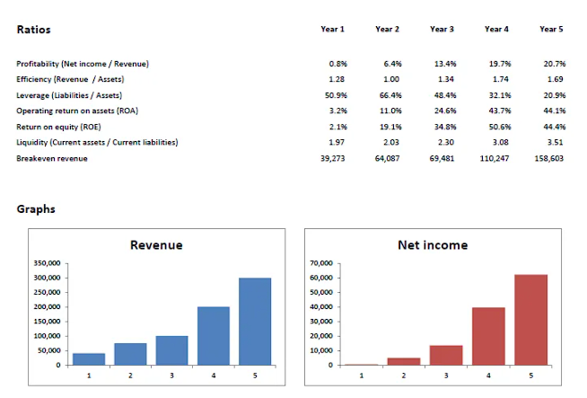
Financial Plan
Notes:
The cost of establishment and basic operations for PharmaAve is estimated to be around £35000. To gather the investment required, the most viable source of funding has been decided as the form of a Government Start-up grant and bank loans. The first exhibits the lowest profitability 0.85% while year 2 picks up quite the speed at 6.4%. Then the number gradually grows between years 3-5. The ROI for year 1 is low but the later years have been projected to bring in big numbers such as the case with years 4 and 5 which entail 43.7% and 44.1%. The investment shows potential for long-term viability.

Slide 15
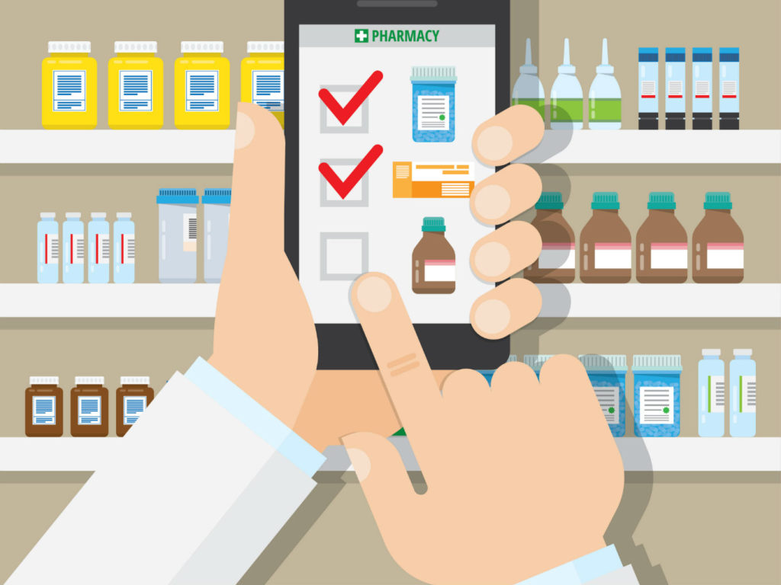
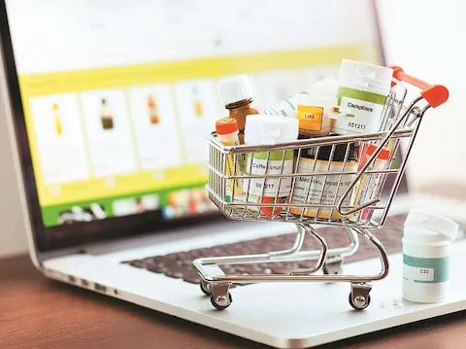
Conclusion
With a detailed business plan, the executives of PharmaAve may achieve a successful start-up, given if necessary strategic actions are taken with a certain amount of risks involved. A risk-taking mentality is required in start-ups as the higher the risk, the bigger the profit. Growth via the innovation model will be sustained and technological advancements will be prioritized to maximize communication and operational excellence.
Notes:
With a detailed business plan, the executives of PharmaAve may achieve a successful start-up, given if necessary strategic actions are taken with a certain amount of risks involved. A risk-taking mentality is required in start-ups as the higher the risk, the bigger the profit. Growth via the innovation model will be sustained and technological advancements will be prioritized to maximise communication and operational excellence.

Slide 16
References
BDC Editorial (2022) The 5 most common pricing strategies, BDC.ca. Available at: https://www.bdc.ca/en/articles-tools/marketing-sales-export/marketing/pricing-5-common-strategies (Accessed: October 31, 2022).
Cohan, P.S. (2018) “Creating startup-friendly shared values,” Startup Cities, 44(12), pp. 181–215. Available at: https://doi.org/10.1007/978-1-4842-3393-1_7.
Deiss, R. and Henneberry, R. (2021) Digital Marketing. 2nd edn. Hoboken, NJ: Deiss Henneberry, Inc.
Harrison, S. (2020) “Upgrading Digital Marketing Strategy: Strategic platform for digital marketing,” Marketing Strategy in the Digital Age, pp. 49–124. Available at: https://doi.org/10.1142/9789811216985_0002.
Leontiades, J.C. (2015) Managing the global enterprise: Competing in the information age. Harlow, Engl.: Financial Times Prentice Hallu.a.
Morrison, J. (2017) The Global Business Environment: Challenges and Responsibilities. London: Palgrave.
Mutel, D. (2019) Business plan. Orchamps, France: Atelier Didier Mutel.
Polskii, M. (2021) Best Startup Organizational Structure: JetRuby Agency, Jetruby development company. Available at: https://jetruby.com/blog/startup-organizational-structure/ (Accessed: October 31, 2022).
PSMarketResearch (2022) Online pharmacy market size, and Growth Insights Report, 2030, P&S Intelligence. Available at: https://www.psmarketresearch.com/market-analysis/online-pharmacy-market (Accessed: October 31, 2022).
Williams, V. (2022) Best online pharmacies of 2022, Forbes. Forbes Magazine. Available at: https://www.forbes.com/health/body/best-online-pharmacies/ (Accessed: October 31, 2022).

