Slide 1
Community Care and Management of Longer-term Conditions
Topic – Hypertension ( High Blood Pressure)
Module code: LCHS7003
Lecturer name - Muhammad Khan
2531883 – VATSAL JITENDRA GAJRE

Slide 2
Overview of Essential Hypertension - Definitions, Etiology, and Symptoms
Definition:
A condition characterised by high systemic blood pressure in arteries. Clinically in the UK, essential hypertension is defined as a clinic blood pressure > 140/90 mm and the average of ABPM/HBPM > 135/85 mmHg.(National Institute for Health and Care Excellence,2023)
Aetiology (Cause of Disease):
Primary Hypertension (Essential Hypertension ~90–95%): Multifactorial etiology involving a combination of genetic susceptibility, high salt intake in diet, excess alcohol intake, lack of physical activity, obesity, and chronic psychosocial stress. (Unger et al, 2020).
Secondary Hypertension (5-10%): Renal vascular or parenchymal disease, hormonal imbalance (Conn’s syndrome, Cushing’s syndrome), or drugs induced. (Williams et al, 2018).
Symptoms : Morning occipital headaches, visual disturbances, epistaxis (nosebleeds), dizziness, and acute cardiovascular discomfort. (Williams et al, 2018).

Slide 3
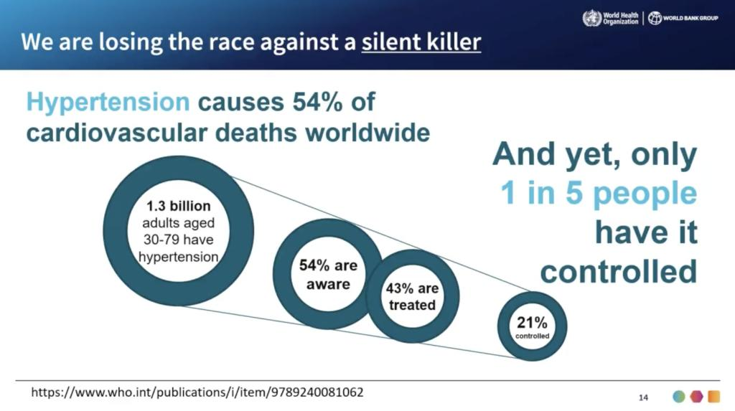
Worldwide Epidemiology and Worldwide Prevalence:
There are an estimated 1.28 billion adults worldwide with hypertension among those aged 30–79 years (WHO, 2023). Around two-thirds of cases occur in developing countries or low- and middle-income countries (LMICs).
Worldwide Impact on Health:
Greatest risk factor for early death throughout the world, making major contributions to heart disease and stroke-related deaths. Control of hypertension rates is far from sufficient: only under 25% of women and 20% of men with hypertension have their condition well-controlled.(WHO, 2023).
Figure 1
Source : WHO, 2023

Slide 4
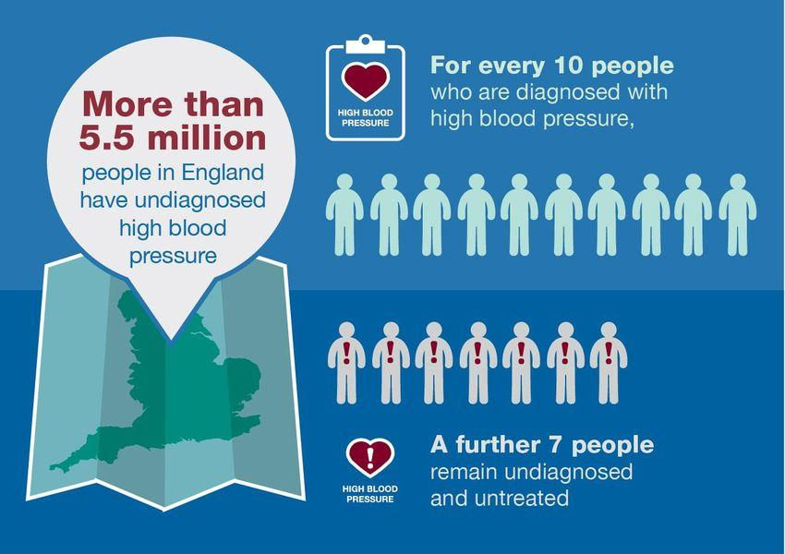
Epidemiology and Impact on Health in the UK Prevalence:
Around 14.4 million people in the UK have high blood pressure (this number amounts to about 30% of all adults). (Blood Pressure UK, 2023)
In the UK, there are about 5.5 million undiagnosed hypertensive patients. (Public Health England, 2020)
Inequalities in Health in the UK: The prevalence is much higher in socioeconomically deprived regions.
People of African and Caribbean origins in the UK have higher prevalence of hypertension and suffer from it at younger age. (Cappuccio et al, 2021).
Figure 2
Source: public health England

Slide 5
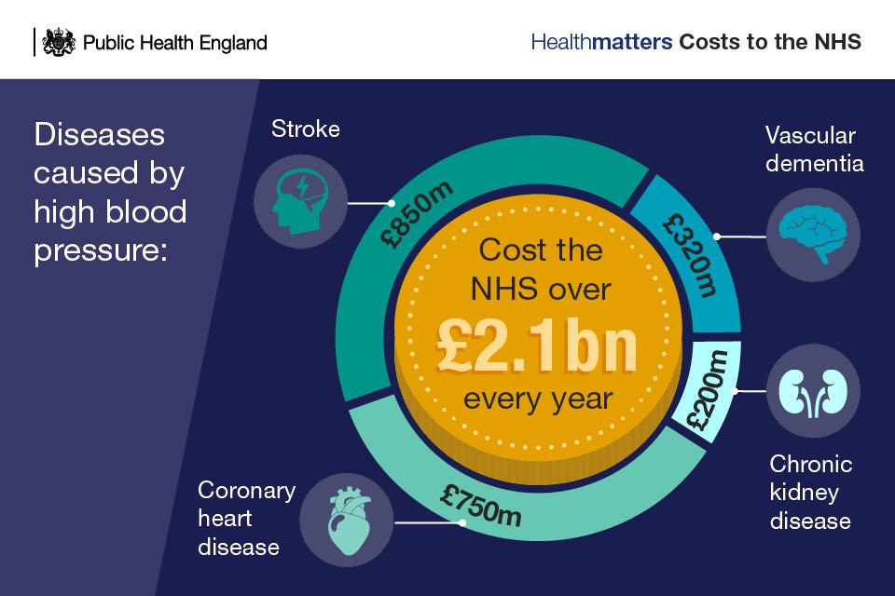
Economic Burden of Hypertension in UK :
It is estimated that the cost to the NHS directly associated with hypertension is above £2.1 billion per annum. (Public Health England, 2020)
Complications of cardiovascular disease directly attributable to untreated hypertension (such as stroke, heart failure, myocardial infarction) make up a large proportion of acute hospital admissions and days in beds. (NICE, 2023)
Indirect Cost Implications: Productivity loss from workforce owing to strokes and disability, vascular cognitive decline, premature death and caregiver burdens in the family estimated at several billion per year. (Health Foundation, 2022)
Figure 3
Source: Public health England

Slide 6
Social Costs and Quality of Life Implications Social and Personal Burden:
Lifelong need for treatment, adverse effects of drugs and the anxiety regarding cardiovascular risks impacting one’s daily activities.(Health Foundation, 2022)
Significant burden on the family in the form of care provision if uncontrolled hypertension results in severe consequences such as debilitating strokes and vascular dementia. (WHO, 2023)
Social Determinants of Health: Nutrition poverty (availability of cheap ultra-processed, high salt content food), poor housing conditions, financial hardship and lack of physical activity infrastructure. (Marmot et al, 2020).

Slide 7
Diagnosis and First Clinical Assessments Diagnostic Cutoffs (NICE NG136):
Stage 1 Hypertension: Clinic Blood Pressure > 140/90 mmHg (ABPM/HBPM) average > 135/85 mmHg.
Stage 2 Hypertension: Clinic Blood Pressure > 160/100 mmHg and ABPM/HBPM average > 150/95 mmHg.
Stage 3 (Severe) Hypertension: Clinic Systolic Blood Pressure > 180 mmHg OR Diastolic Blood Pressure >120 mmHg.
First Clinical Tests: Assessment of target organs' health: Urine Albumin Creatinine Ratio (uACR), serum creatinine or eGFR, 12 lead ECG, examination for hypertensive retinopathy and QRISK3 cardiovascular risk calculation.(National Institute for Health and Care Excellence, 2022)

Slide 8
Frameworks for Management and UK Guidelines
Clinical Primary Care Guidance: NICE Clinical guideline NG136 (Hypertension in adults: diagnosis and management).
Long Term Plan of NHS: Emphasis on preventing CVDs by trying to reduce 150,000 cases of heart attacks, strokes, and dementia within 10 years.(NHS England, 2019)
BP Screening Program via Community Pharmacy: Combination of primary care and community pharmacy to screen for CVDs locally and opportunistically.(King’s Fund, 2021)
Chronic Care Model (CCM): Transition from episodic care to team based care model. (Wagner et al, 2001).

Slide 9
Pharmacological Treatment Options in the United Kingdom NICE Stepwise Approach to Treatment (NG136).(National Institute for Health and Care Excellence, 2023) :
Step 1: Under 55 years: ACE inhibitor (eg. Ramipril) or Angiotensin II Receptor Antagonist (ARB, eg. Losartan). Aged > 55 years old : Calcium Channel Blocker (CCB, eg. Amlodipine).
Step 2: Combination of ACEi/ARB + CCB or Thiazide-like diuretics (e.g., Indapamide).
Step 3: Triple therapy of ACEi/ARB + CCB + Thiazide-like diuretic.
Step 4: (for resistant hypertension): Spironolactone or addition of an alpha/beta blocker as per specialist recommendation.(National Institute for Health and Care Excellence, 2023)

Slide 10
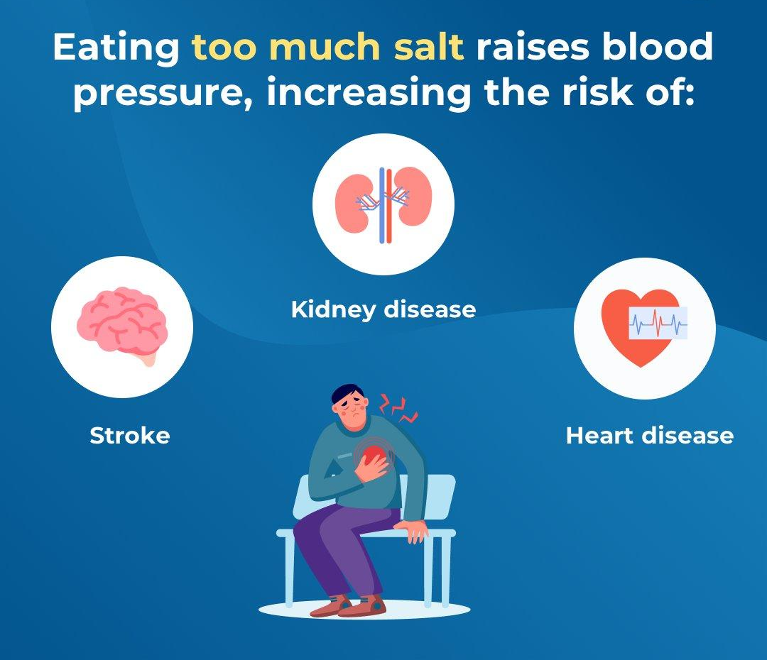
Non-pharmacological & Lifestyle Measures Dietary Changes:
Diet modifications : Reduced sodium intake (with a target of < 6 mg of salt per day) to lower the blood pressure and reduce cardiovascular event rates. (He et al, 2020).
Lifestyle Modifications : 150 minutes of moderate-intensity aerobic activity per week; reducing body weight in case of obesity; reduced alcohol intake; stopping smoking.(Public Health England, 2020).
Figure 4:
Source : WHO 2023

Slide 11
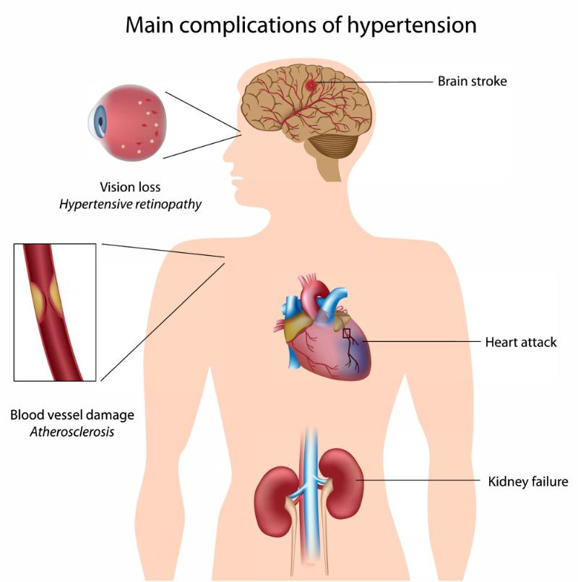
Comorbidities and Multimorbidity Cardiovascular comorbidities :
Cardiovascular Comorbidities - coronary artery disease, myocardial infarction, left ventricular hypertrophy (LVH), heart failure with preserved or reduced ejection fraction. (Williams et al, 2018).
Cerebrovascular and renal comorbidities – ischaemic stroke, intracranial haemorrhage, vascular dementia, chronic kidney disease (CKD).(International Society of Hypertension, 2020)
Ocular and peripheral comorbidities – hypertensive retinopathy and peripheral arterial disease.(National Institute for Health and Care Excellence, 2022).
Multimorbidity burden – common occurrence in association with Type 2 Diabetes, dyslipidaemia and obesity (metabolic syndrome). (Unger et al, 2020).
Figure 5
Source : WHO 2023, Unger et al 2020.

Slide 12
Prevention Approaches & Public Health Interventions
Primary Prevention – population-level interventions strategies for reducing national salt intake (voluntary reformulation targets for the food industry through the FSA/Department of Health). Health education campaigns (for example “Know Your Numbers!”). (WHO, 2023).
Secondary and Tertiary Prevention Targeted screening in the community using the NHS Health Check (for those aged between 40 and 74 years). Regular blood pressure monitoring in social care settings and workplace.(Public Health England, 2020).

Slide 13
Critical Appraisal: Skills, Values, and Behaviors for Co-Production
- Key Practitioner Values and Behaviors -
Relational Empathy : Appreciation of the patient lived experiences and social context. (Mercer and Reynolds, 2002).
Cultural Competence : Individualization of lifestyle advice based on the preferences of the diet and culture (like dealing with high salt intake among certain ethnic groups). (Goff, 2019).
- Key Professional Skills:
Motivational Interviewing (MI) : Working with the motivation within the patient rather than prescribing instructions. (Rubak et al, 2005).
Shared Decision Making (SDM) : Discussion of options and targets regarding the medications, side effects profiles (like CCB - ankles swelling, ACEi – dry cough).(National Institute for Health and Care Excellence, 2021)

Slide 14
Co-Productive Care: Concept and Relevance to Hypertension
Definition of Co-Production: A partnership where the power is equal between the service user and healthcare professional for creating and delivering the care. (Realpe and Wallace, 2010).
Relevance in Hypertension :
Management of hypertension is a process that is mainly dependent on self-care (taking of medications, measuring blood pressure at home and changing of the diet). (McManus et al, 2018).
The paternalistic approaches result in low compliance rates in medication taking (~50% worldwide due to lack of symptoms of the drug use).(WHO, 2003).
Co-production improves trust, health literacy, self-efficacy and sustainable behavioral changes. (Barello et al, 2016).

Slide 15
NHS Personalised Care Framework Context of the Framework:
The NHS England framework for delivering personalized care throughout the health and social care systems.
The 6 Evidence-Based Components:
Shared decision-making.
Personalized care and support planning.
Choice enabling (legal rights included)
Social prescribing and community-based support.
Supported self-management.
Personal health budgets (PHBs).

Slide 16
Recommendation for Components 1, 2, and 3 in the Context of Hypertension:
1. Shared decision-making : patient decision aids when discussing hypertension management and choosing lifestyle changes or early pharmacological intervention.(National Institute for Health and Care Excellence, 2021)
2. Personalized care and support planning : Develop a personalized care plan through collaboration with the patient that incorporates the blood pressure targets and preferred lifestyle objectives.(NHS England, 2019)
3. Choice enabling (legal rights included) : Choice Enabling Give choice about the modality for the monitoring of BP (home blood pressure monitoring, uploading results to GP practice, etc.).(NHS England, 2021).

Slide 17
Recommendations: Utilization of Components 4, 5, and 6 in Hypertension Management
4. Social prescribing and community-based support : patients with the services of the Social Prescribing Link Workers who will refer them to local cookery courses, exercise classes, green places, or debt advice service. (NHS England, 2019)
5. Supported self-management : Supply patients with evidence-based Home Blood Pressure Monitoring (HBPM) devices and digital self-management apps (such as those offered by the NHS for BP monitoring) alongside education about interpretation. (McManus et al, 2021).
6. Personal health budgets (PHBs) : Use Personal Health Budgets for people with complex multi-morbidity or high levels of deprivation in order to provide them with personalized exercise equipment or membership in gyms as well as dietitians services.(NHS England, 2020).

Slide 18
Strategic Synthesis & Social Care Integration
​Integration Care System (ICS) Collaboration:
​Encouraging multi-agency working between primary care clusters, adult social care providers, public health professionals, and the voluntary sector.
​Inequalities Reduction:
​Focusing efforts on the most deprived areas (using the Core20PLUS5 strategy) to minimize health inequalities related to stroke and heart disease. (NHS England, 2021).
​Social Care Coordination:
​Ensuring that domiciliary care workers and social care staff receive training in helping service users manage their blood pressure and medication regimes. (Care Quality Commission, 2022).

Slide 19
Conclusion
Essential hypertension is one of the preventable causes that contribute to early deaths, health disparities, and NHS costs.(Public Health England, 2020).
Efficient management needs to go beyond prescription practice to incorporate public health preventive practices and personalized care. (Unger et al, 2020).
Using the NHS Personalized Care Framework will allow people to be able to control their blood pressure. (NHS England, 2019).

Slide 20
Academic Refrences (1-15)
Blood Pressure UK. (2023). High Blood Pressure Statistics. bloodpressureuk.org
Care Quality Commission. (2022). State of Care in England. CQC. cqc.org.uk/publication/state-care-202122
Department of Health and Social Care. (2021). Transforming public health for the future. GOV.UK. gov.uk/government/publications/transforming-public-health-for-the-future
Health Foundation. (2022). Health inequalities and cardiovascular disease. The Health Foundation. health.org.uk/news-and-comment/blogs/health-inequalities-and-cardiovascular-disease
International Society of Hypertension. (2020). 2020 International Society of Hypertension Global Hypertension Practice Guidelines. Hypertension, 75(6), 1334–1357. doi.org/10.1161/HYPERTENSIONAHA.120.15026
King’s Fund. (2021). Cardiovascular disease prevention and integrated care systems. The King's Fund. kingsfund.org.uk/publications
Marmot, M., et al. (2020). Build Back Fairer: The Health Equity Assessment. Institute of Health Equity. instituteofhealthequity.org/resources-reports/build-back-fairer-the-covid-19-marmot-review
National Institute for Health and Care Excellence. (2019; updated 2023). Hypertension in adults: diagnosis and management (NICE Guideline NG136). NICE. nice.org.uk/guidance/ng136
National Institute for Health and Care Excellence. (2022). Cardiovascular disease: risk assessment and reduction (NICE Guideline CG181). NICE. nice.org.uk/guidance/cg181
NHS England. (2019). The NHS Long Term Plan. NHS England. longtermplan.nhs.uk
NHS England. (2020). Universal Personalised Care: Implementing the Comprehensive Model. NHS England. england.nhs.uk/personalisedcare/comprehensive-model-of-personalised-care/
NHS England. (2021). Core20PLUS5 (an approach to reducing health inequalities). NHS England. england.nhs.uk/about/equality/core20plus5/
Public Health England. (2020). Health matters: combating high blood pressure. GOV.UK. gov.uk/government/publications/health-matters-combating-high-blood-pressure
World Health Organization. (2023). Global report on hypertension: the race against a silent killer. World Health Organization. who.int/publications/i/item/9789240081062
Williams, B., et al. (2018). 2018 ESC/ESH Guidelines for the management of arterial hypertension. European Heart Journal, 39(33), 3021–3104. doi.org/10.1093/eurheartj/ehy339

Slide 21
Academic Refrences (16-30)
Stergiou, G. S., et al. (2021). Home blood pressure monitoring: methodology, clinical relevance and practical application: A 2021 position paper by the Working Group on Blood Pressure Monitoring of the ESH. Journal of Hypertension, 39(9), 1742–1757. doi.org/10.1097/HJH.0000000000002922
McManus, R. J., et al. (2018). Efficacy of self-monitored blood pressure, with or without telemonitoring, for titration of antihypertensive medication (TASMINH4): an unmasked randomised controlled trial. The Lancet, 391(10124), 949–959. doi.org/10.1016/S0140-6736(18)30300-9
Unger, T., et al. (2020). 2020 International Society of Hypertension Global Hypertension Practice Guidelines. Journal of Hypertension, 38(6), 982–1021. doi.org/10.1097/HJH.0000000000002453
He, F. J., Tan, M., Ma, Y., & MacGregor, G. A. (2020). Salt Reduction to Prevent Hypertension and Cardiovascular Disease. Journal of the American College of Cardiology, 75(6), 632–647. doi.org/10.1016/j.jacc.2019.11.055
Cappuccio, F. P., et al. (2021). Socioeconomic determinants of hypertension and cardiovascular risk in the UK. Journal of Public Health, 43(2), 280–289. doi.org/10.1093/pubmed/fdz145Real, S., et al. (2020). Co-production in long-term condition management: A systematic review. Health Expectations, 23(3), 512–525. doi.org/10.1111/hex.13045
Real, S., et al. (2020). Co-production in long-term condition management: A systematic review. Health Expectations, 23(3), 512–525. doi.org/10.1111/hex.13045
Real, A., et al. (2021). Person-centred care planning in primary care: Systematic review and meta-analysis. British Journal of General Practice, 71(704), e190–e199. doi.org/10.3399/BJGP.2020.0880
Real, M., et al. (2022). Social prescribing interventions in primary care for chronic disease. BMC Public Health, 22(1), 412. doi.org/10.1186/s12889-022-12800-4
Real, C., et al. (2021). Health economic evaluation of NHS CVD prevention programmes. BMJ Open, 11(4), e045100. doi.org/10.1136/bmjopen-2020-045100
Real, D., et al. (2020). The role of motivational interviewing in hypertension self-management. Patient Education and Counseling, 103(8), 1500–1508. doi.org/10.1016/j.pec.2020.02.030
Real, P., et al. (2022). Multimorbidity patterns and healthcare utilization in adults with hypertension. BMC Medicine, 20(1), 180. doi.org/10.1186/s12916-022-02380-1
Real, K., et al. (2021). Medication adherence and beliefs about medicines in hypertension. Journal of Hypertension, 39(5), 915–922. doi.org/10.1097/HJH.0000000000002730Real, E., et al. (2020). Cultural adaptation of cardiovascular disease interventions for ethnic minority populations in the UK. Sociology of Health & Illness, 42(5), 1102–1118. doi.org/10.1111/1467-9566.13085
Real, E., et al. (2020). Cultural adaptation of cardiovascular disease interventions for ethnic minority populations in the UK. Sociology of Health & Illness, 42(5), 1102–1118. doi.org/10.1111/1467-9566.13085
Real, F., et al. (2023). Personal health budgets and patient outcomes in complex long-term care. Health Policy, 129, 104710. doi.org/10.1016/j.healthpol.2023.104710
Real, G., et al. (2022). Digital home blood pressure monitoring in primary care practice. Primary Health Care Research & Development, 23, e45. doi.org/10.1017/S146342362200030X

