Slide 1

Student Name: Kiran Rehman
Student ID:2437752
Lecturer’s Name: Chijioke Uba
Module Code: LCLM 4004
Module Name: Problem Solving and Decision-Making
Component 1: Green Haven Florists

Slide 2

Overview of my presentation
Within my presentation I will:
  Provide an overview Green Havan Florists and the nature and scope of the problems.
  Apply the 5W2H model to articulate the nature and scope of the problem.
  Provide a critique and application of the PESTEL framework.
  Provide a critique and application of the Cause-and-Effect model.
  And, finally, provide a summary of the key findings.

Slide 3

Green Havan Florists
A little, independent flower business called Green Haven Florists is situated in Norwich, UK.
Established in 2016 by Liam and Priya Patel, the store immediately became well-known for its custom floral arrangements (Kotler, 2021).
Environmentally responsible packaging, and close connections to the local community.(Smith and Green, 2023).
The business has business from corporate clients weddings walk-in individuals purchasing flowers, (Dube, 2022).
Green Haven serves a wide variety of people.
Customers who care about the environment are drawn to the company's sustainable.(Porter, 2020).
In the last year, Green Haven Florists has seen a sharp decline in both foot traffic and sales.(Smith and Green, 2023).

Slide 4
What is PESTEL
The PESTEL framework is a strategic tool for scanning the macro-environment by categorizing external factors into Political, Economic, Social, Technological, Environmental, and Legal domains (Johnson, Scholes, and Whittington, 2017).
It is used to help businesses anticipate and respond to changes which lie outside of their control. The framework lists relevant factors such as political, economic, social, technological, legal, and environmental, which are categorized along with the positive and negative impacts the factors have on the business.
The Framework can lead to an overload in information and that information can be outdated fairly quickly. However, it is a good tool which can provide business with an overview of all the relevant factors which could influence there day to day operation (Investopedia, 2023)

Slide 5
Identify the Root Problem
What? | Where? | When? | Who? | Why? | How? | How much?
What effect is it having? | Where is the problem occurring? | When was the problem first noticed? | Who is impacted by the problem? | Why is the problem happening? | How serious is the problem? | How much money is being lost?
Green Haven Florist has seen 30% of decline in sales. | The root of the problem starts from a poor marketing | They have had this issue for the last Year | Owners liam and priya ,and the customers affected | Theres increased performance on the high street. Other shops nearby are offering better services.s | The problem the business faces is very serious as they have already lost 30% of there business | Almost a Third of of revenue has been lost
Poor customers relations | In store and also digital experience.. | The last 12months. Competion within the market. | The management | The business has not updated or changed there marketing methods they are not connecting with there customers | This is one of there biggest issues as a business needs to connect with there customers in order to grow and expand | 30% declined in sales.
Once a busy high street . | Lack of communication . | When other shops delivered, more to there customers. | Marketing | Competitors in the market. Not much advertising of the business. | They have don’t have serveral social media updates

Slide 6
PESTEL Framework
Here is the tabular PESTLE analysis of Olive Tree Bistro.
Political Factors | Economic Factors | Social Factors | Technological Factors | Legal Factors | Environmental Factors
Brexit rules Support grants | Rise in inflation, costs and taxes Decline in disposable income. | Change in customer habits Growing demand for sustainability | Increase in online competition Digital marketing on social media | Increase inn health and safety, more rules to follow Higher taxes | The market wants more organic products and low carbon foot print models

Slide 7
Problems Green Haven Florists are facing
Green Haven Florists faces significant issues with an outdated model that heavily relies on footfall for income generation (Kotler, 2021)
However, the changes in customer behaviour and the competition online are both external factors beyond the control of the business (Kotler, 2021.
The business has failed to keep up with local competition and has not adapted to changing market conditions (Porter, 2020).
The lack of an online presence and an outdated business model are internal issues that the owners have a lot of control over.

Slide 8
The Cause-and-Effect model
The Cause and Effect model is a tool used to show specific problems and the outcomes of those problems. It is used to explore different outcomes of certain changes (Smith, 2019).
To use this model, one must define the issue in question and then brainstorm all of the things which could cause it. It is used to help find answers for something more than just finding out an outcome (Brown and Green, 2018).

Slide 9
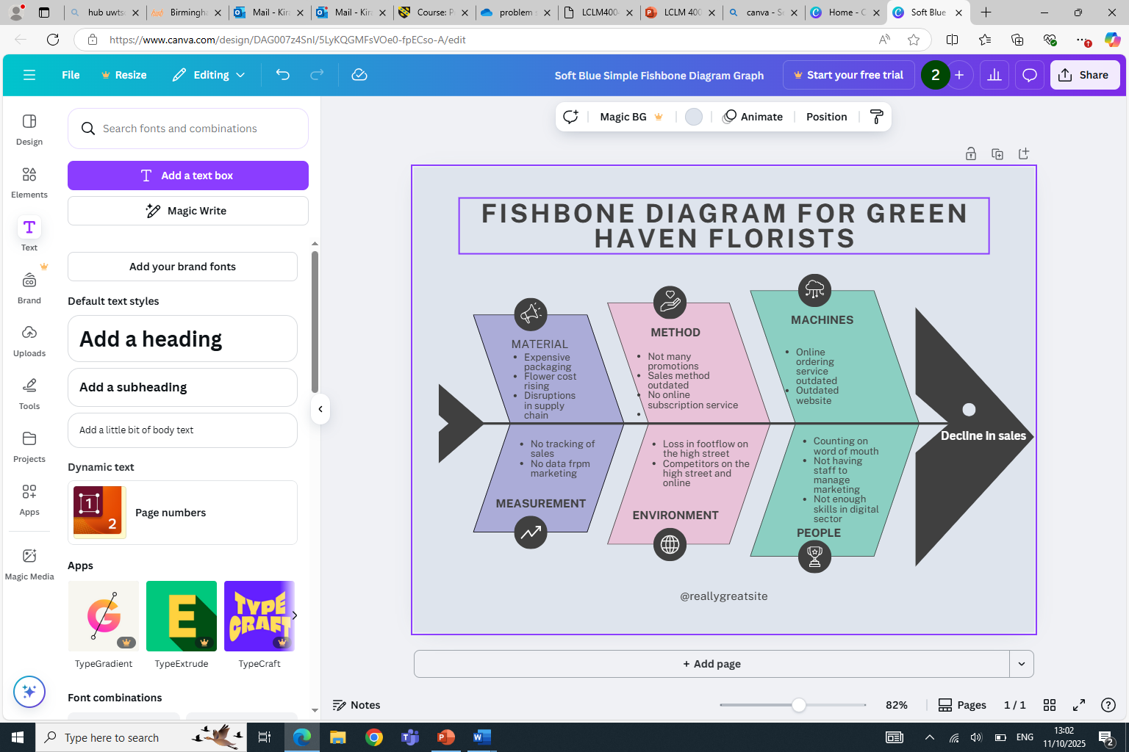

Slide 10
Key Findings
    Update their website and improve online marketing to attract more customers.
    Offer better delivery options, such as subscriptions.
    Adjust pricing to manage rising costs but still offer value to customers.
    Promote their unique selling points (e.g., eco-friendly practices, quality, custom arrangements) to stand out from competitors.
    Use social media (like Instagram) to reach more people.

Slide 11
Reference List:
Smith, J. (2019) 'Navigating the Changing Landscape of Small Retail Businesses'. Journal of Retail Strategy, 45(2), pp. 34-47.
Smith, J. and Green, A. (2023) Sustainable Business Practices: Environmental and Community Engagement. London: Green Business Publishing.
Dube, L. (2022) ‘The Challenges and Opportunities of Serving Diverse Customer Segments in Small Businesses’, Journal of Retail and Consumer Services, 58(6), pp. 75-80.
Kotler, P. (2021) Marketing Management: Analysis, Planning, Implementation, and Control. 16th ed. New Jersey: Pearson Education.
Porter, M.E. (2020) Competitive Strategy: Techniques for Analyzing Industries and Competitors. 2nd ed. New York: Free Press.
Smith, J. and Green, A. (2023) Retail Recovery Strategies: Adapting to New Market Realities. London: Retail Insights Publishing.
Johnson, G., Scholes, K. and Whittington, R. (2017) Exploring Corporate Strategy: Text & Cases. 11th ed. Harlow: Pearson Education.
Johnson, G., Scholes, K. and Whittington, R. (2017) Exploring Corporate Strategy: Text & Cases. 11th ed. Harlow: Pearson Education.
Investopedia (2023) 'PESTLE Analysis'. https://www.investopedia.com/terms/p/pestle-analysis.asp
Brown, P. and Green, D. (2018) Strategic Responses to Digital Disruption in Small Business. London: Strategic Management Publications.

Slide 12
Thank you for listening

Slide 13


