Slide 1

Actus Reus tutorial
LAURA KNIGHT

Slide 2

Recap from lecture 1
What is the Actus reus of an offence concerned with?
How does this differ from the Mens rea of an offence?
What do I mean by the '3 C's'?

Slide 3
Actus Reus
Conduct
Consequences
Surrounding Circumstances
A positive Act – most offences
Factual causation (the 'but for' test). If established consider....
'State of affairs' offences only require proof of surrounding circumstances.
An omission – only some offences (there must be a duty of care to act).
Legal causation. Consider factors that may prevent legal causation.

Slide 4
TASK 1: Can conduct include an omission to act?
First thing to consider is whether the offence is one that allows for commission by omission?
Secondly, Are there any duty situations present?

Slide 5
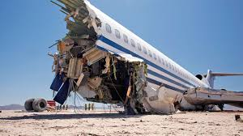
TASK 1: Consider the following scenario where the D has failed to act. Has the D committed an offence by omission and can you identify the duty of care.
Aaron is an air traffic controller who failed to notify an incoming aircraft that another plane was about to land on the runway. The pilot realised at the last minute and in an attempt to avoid the plane, swerved and hit the crash barriers. The pilot died. Aaron was charged with gross negligence manslaughter.
Notes:
- Gross negligence manslaughter can be committed by omission
- The duty of care rose out of a contractual duty as in Pittwood [1902]
Pittwood [1902]: The defendant was employed by a railway company to operate the gate at a level crossing across the track. He lifted the gate to allow a cart to pass across, but then failed to put it back down before going for his lunch break. During his absence, a horse and cart crossed the track through the open gate, and was hit by a passing train. Both the horse and cart driver were killed.
The defendant was thus convicted of manslaughter
- Aarons duty in his employment was to prevent accidents such as this
- Liable

Slide 6
Factual and legal causation
(1) Consider factual causation
But for D's conduct the result would not have occurred?
The result would not have occurred
The result would have occurred anyway
( 2) Consider legal causation: Are there any factors preventing D from being the legal cause?
- D's blameworthy conduct must cause the result
D's conduct must be substantial
Are there other factors to consider? V's own conduct, third party intervention, acts of nature etc.
No factual causation (AR is not established)

Slide 7
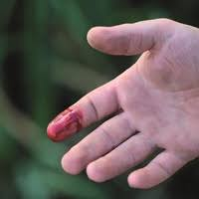
TASK 2: Is the D the cause of the result required by the AR of the offence?
(a) Intending to cause him serious harm, Darren hit Vinnie over the head with a sharp object which caused a large gash. Vinnie was a haemophiliac, and because of this bled so badly that he died from the loss of blood.
Notes:
(a) Factual causation is established: but for D's conduct, V would not have died (White [1910]).
Legal causation – There can be more than one cause. The thin skull rule applies; D takes his victim as he finds him so Darren is also the legal cause of death (Hayward [1908]).

Slide 8
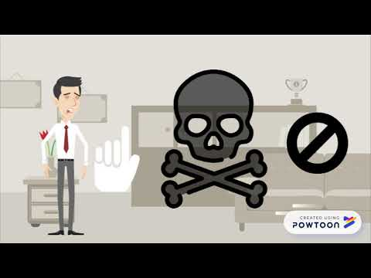
The thin skull rule
Notes:
https://youtu.be/iIf3D6Rjzj4

Slide 9
TASK 3: Use the Westlaw UK database to research the following cases:
R v Jordan [1956] (James Clinton)
R v Cheshire [1991] (David William)

Slide 10
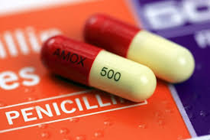
TASK 2: Is the D the cause of the result required by the AR of the offence?
Katie pushed Jenna, who fell over and cut her head on the floor. Jenna was taken to hospital and was given penicillin on discharge to prevent infection to the wound. Jenna was in fact allergic to penicillin, but the nurse had failed to check her notes. Jenna suffered a seizure after taking the penicillin and was hospitalised for a month.
Notes:
Katie – factual causation is established.
The issue with legal causation is the possible intervening act of medical negligence.
Applying Jordan [1956], the treatment would break the chain of causation as Jenna was recovering.
Applying Cheshire [1991], the test is whether Katies conduct was still a significant cause of the result. This would be the case unless the medical negligence was unforeseeable. The nurse broke the chain of causation given that the administration of the drug was a positive act.

Slide 11
Any questions?

