Slide 1
Lecture 3
RFID in Logistics
By
Dr Irina Neaga
School of Engineering and Manufacturing
University of Wales Trinity St David
Cadogan Centre, Swansea, SA1 6ED
E-mail: irina.Neaga@uwtsd.ac.uk

Slide 2
Learning Objectives
Understand RFID definition, principles and systems
Acquire knowledge about the applications
Understand the applications of RFID in logistics such as warehousing, inventory control
Explain the role of RFID to support logistics performance and supply chain efficiency
Articulate and discuss the advantages, obstacles and issues
Challenges and opportunities

Slide 3
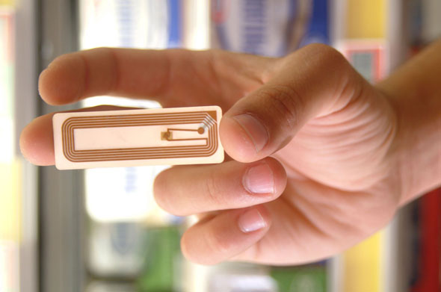
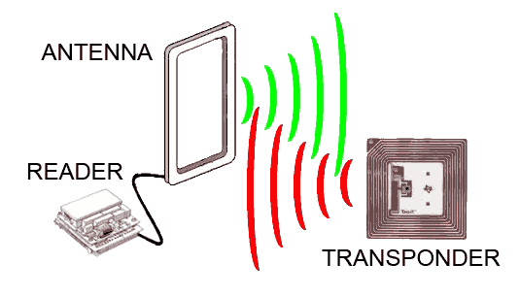
RFID

Slide 4
RFID characteristics
ADC (Automated Data Collection) technology that:
  uses radio-frequency waves to transfer data between a reader and an item to identify, categorize, track etc.
  It is fast and does not require physical sight or contact between reader/scanner and the tagged item.
  Performs the operation using low cost components.
  Attempts to provide unique identification and backend integration that allows for wide range of applications.
Other ADC technologies: Bar codes, OCR, smartcards.

Slide 5


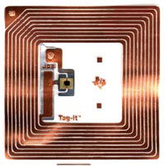
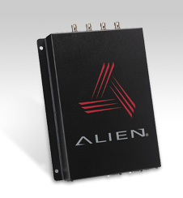
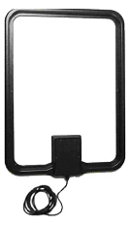
RFID System Components
Tags (Transponders)
  Attached to the object to be identified, stores information (unique code) about object and sends this information back to reader when receives appropriate frequency signals
Reader/Interrogator
Reader sends signals of appropriate frequency and facilitates data transfer
Antenna
Antenna radiates the RF signal to, and receives signal from the transponder
Interface
This unit interfaces the reader to an intelligent device / controller
Host/Controller (PC/Laptop)
Computer with suitable software controls RFID readers

Slide 6

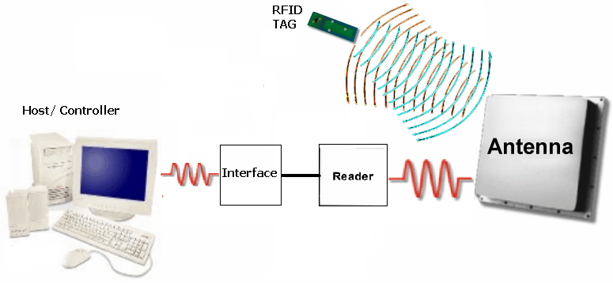
How RFID system works?
Controller activates RFID reader to send RF signals
Reader sends the signal of appropriate frequency (LF,HF,UHF,MW)
Tag receives and modifies the signal
Tag sends modified signals back through tag antenna
Reader antenna receives the modified signal and reader decodes it
Controller analyzes the results

Slide 7
RFID System Diagram
11
Product Information (PML Format)
ONS Server
12
Internet
Internet
Write data to RF tags
Items with RF Tags
Antenna
Read
Manager
Transaction
Data Store
Reader
Application Systems
RF
Antenna
Trading Partner Systems
1
2
3
4
5
6
7
8
EDI /
XML
Tag/Item Relationship Database
10
9
Tag Interfaces
RFID Middleware
Other Systems

Slide 8

RFID tags: Smart labels
A paper label
with RFID inside
an antenna,
printed, etched
or stamped ...
… and a chip
attached to it
… on a substrate
e.g. a plastic
foil ...

Slide 9
RFID tags
Tags can be attached to almost anything:
  Items, cases or pallets of products, high value goods
  vehicles, assets, livestock or personnel
Passive Tags
  Do not require power – Draws from Interrogator Field
  Lower storage capacities (few bits to 1 KB)
  Shorter read ranges (4 inches to 15 feet)
  Usually Write-Once-Read-Many/Read-Only tags
  Cost around 25 cents to few dollars
Active Tags
  Battery powered
  Higher storage capacities (512 KB)
  Longer read range (300 feet)
  Typically can be re-written by RF Interrogators
  Cost around 50 to 250 dollars

Slide 10
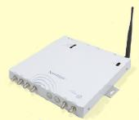
RFID readers
Reader functions:
  Remotely power tags
  Establish a bidirectional data link
  Inventory tags, filter results
  Communicate with networked server(s)
  Can read 100-300 tags per second
Readers (interrogators) can be at a fixed point such as
  Entrance/exit
  Point of sale
Readers can also be mobile/hand-held

Slide 11
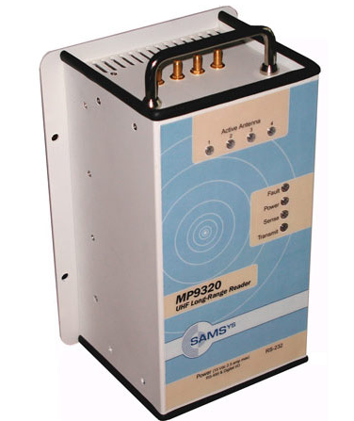
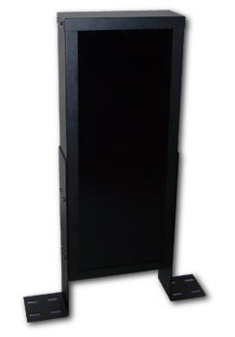
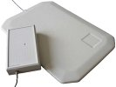
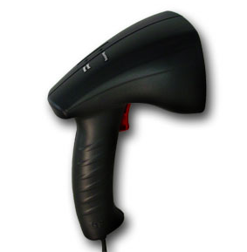
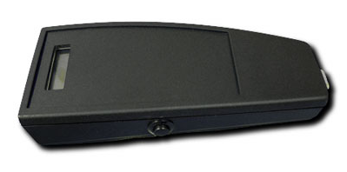
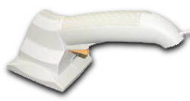
Some RFID readers

Slide 12
RFID application configuration
Assembly Line
Wireless
Scanning Applications
Bill of Landing
Material Tracking
Shipping Portals

Slide 13
RFID applications
Manufacturing and Processing
  Inventory and production process monitoring
  Warehouse order fulfillment
Supply Chain Management
  Inventory tracking systems
  Logistics management
Retail
  Inventory control and customer insight
  Auto checkout with reverse logistics
Security
  Access control
  Counterfeiting and Theft control/prevention
Location Tracking
  Traffic movement control and parking management
  Wildlife/Livestock monitoring and tracking

Slide 14
RFID provides real-time visibility of point-of-sale data across the supply chain to trigger production and/or movement of freight for automatic replenishment.
RFID primary applications up to point of sale:
  Asset tracking and management
  Increased security of freight
  Improved stock management and availability
  Reduced errors in product data handling

Slide 15
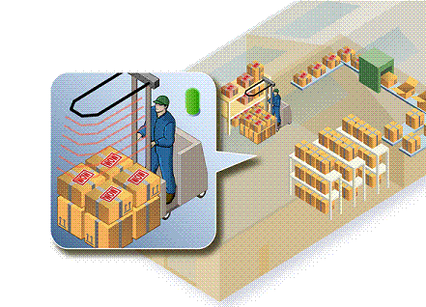
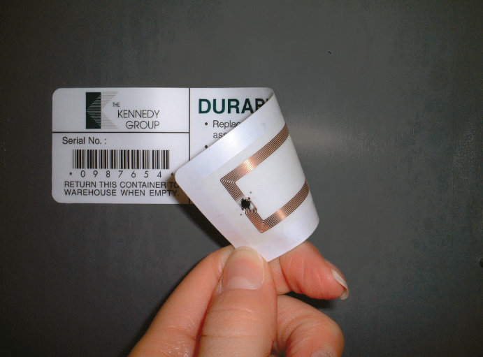
Data / Information provided with RFID Tags
What the product is
Where it has been
When it expires
When and where merchandise is manufactured, picked, packed and shipped
Expiration dates
Numbers that will have to be stored, transmitted in real-time and shared with warehouse management, inventory management, financial and other enterprise systems
RFID tags can be read automatically by electronic readers
Notes:
RFID technology generates mountains of new data about the products, their location, who is the manufacturer, supplier, and retailer. Ocean of information. Imagine a truck carrying a container equipped with an RFID tag to a shipping terminal in China. The terminal has an RFID sensor network. Automatically information will send to the head company. They will know all necessary information about the container in real time. RFID has the potential to add a substantial amount of visibility into the extended supply chain. RFID will transform the supply chain as we know it today.

Slide 16
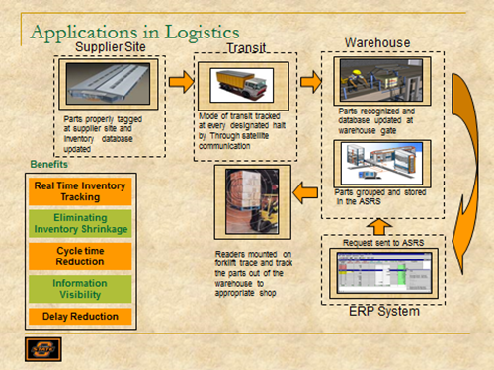

Slide 17
Source: Lim et al. (2013) RFID in Warehouse

Slide 18
RFID general advantages
No line of sight required for reading
Multiple items can be read with a single scan
Each tag can carry large amounts of data (read/write)
Individual items can be identified and not just the category
Passive tags have a virtually unlimited lifetime
Active tags can be read from distances
Can be combined with barcode technology

Slide 19
Source: Tajima, M.(2006) Strategic value of RFID in supply chain management

Slide 20
Creating competitive advantages
Source: Tajima, M.(2006) Strategic value of RFID in supply chain management

Slide 21
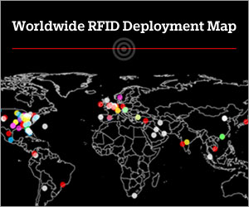
RFID Users
The U.S.A. Air Force use RFID to improve business process ranging from tracking hazardous material to receiving goods from suppliers.
Wal-Mart uses RFID for automatic inventory counting and locating goods in warehouse facilities.
Ford will equip Ford F-150, F-Series Super Duty pickups and E-Series vans with an embedded RFID asset tracking system .
Motorola embeds RFID tags in its handheld computers.
Notes:
The biggest users of RFID are US Department of Defense (DOD); Wal-Mart for example, required that their 100 top suppliers place RFID tags on all shipments to improve supply chain management, Sam’s Club, Procter & Gamble, Ford, and Motorola. UPS and FedEx are working in.

Slide 22
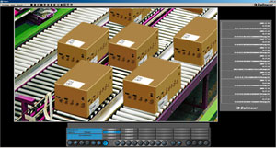
RFID Provides Visibility
Integrating RFID data into video images to provide higher visibility of supply chan.
Users not only read the tag but view video images of the products in real time.
Video images provides information for recovering transport costs due to damages.
RFID and associated technologies provide the location of the product and current condition at the moment of delivery.
Facilitates the claims for transport damages or losses.
The flow of goods is completely documented throughout the logistics centre.
Notes:
Dallmeier Company integrated RFID data into video images that provides higher visibility of supply chain. Data transmitted via RFID tags, such as date, time or serial number, can be integrated into any video image, using management software, allowing users to not only read the tag but view the product equipped with it in real time. The combination of RFID technology coupled with video images not only gives the location of the product, but the current condition as well, right up to the moment of delivery. Using video images also provides definitive information for recovering transport costs due to damages.

Slide 23
RFID for Inventory Inspection and Certification Solution
UPM & Marnlen, Inc supplies two new durable RFID options for both metal and non-metal applications.
The metal application utilizes special materials to preserve the RFID tags readability.
Provides an efficient & accurate way to conduct inspection and certification processes.
Eliminates the physical paperwork and human error associated with manual processes.
Designed to resists harsh as a high-volume of physical abuse, shock, UV radiation, temperature variability and moisture.
Serving numerous industries including construction and fire and rescue services.
Notes:
UPM & Marnlen created an innovative durable RFID of metal and non-metal applications for inventory inspection and certification solution. Tags can be mounted to a wide variety of surfaces including polyester, nylon, rope, wire and steel. The metal application utilizes special materials to preserve the RFID tags readability. High-frequency RFID tags provide an efficient and accurate way to conduct inspection and certification processes. The durable tags are designed for construction and fire and rescue services to withstand harsh environments where there is a high-volume of physical abuse, shock, UV radiation, temperature variability and moisture.

Slide 24
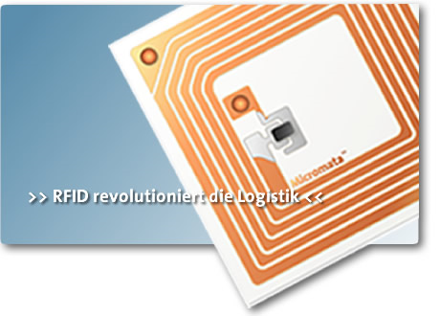
Impact of using RFID
Radio frequency identification (RFID) tags have changed the way industry tracks, traces, and manages assets.
RFID have major impact on manufacturing, retail, distribution, transportation, healthcare and pharmaceutical industries.
RFID improves operations management, inventory control and production security.
Notes:
Radio frequency identification (RFID) tags will change the way industry tracks, traces, and manages assets. RFID will have major impact on manufacturing, retail, distribution, transportation, healthcare and pharmaceutical industries. RFID will improve operations management, inventory control and production security.

Slide 25
Limitations of RFID Technology
Item must be within range of sensor and with no interference (metal, liquid, walkie-talkies or nylon conveyors)
Sensors must be provided and located throughout supply chain
Only communicates data programmed in the chip and only those items that have passed through a location
Imperfect (Estimated that 20% of tags don’t function properly)
Notes:
“Read range of the tags in the working environment is often well below the actual specifications of the tags and readers, which are usually generated from tests conducted in ideal conditions. This reduction in read range is due to many environmental factors in the workplace that affect the signal.
“Interference in the reading of tags comes from metal objects either obstructing or contact the tag itself. It is possible to use specialised tags for attaching to metal objects however it is always best to evaluate the work environment prior to finalising tag type.”
The smart tag technology is yet to be perfected , today on an average 20% of the tags do not function properly
Physical limitations like reading through liquid or metals still exist
Accurate read rates on some items can be very low
Nylon conveyor belts and other RFs can disrupt the tag transmissions in warehouses
Increase in expenses - the suppliers will have to equip their warehouses and transport vehicles with readers. These readers have to be connected to the computer networks for exchange of information

Slide 26
Barriers of RFID adoption
Security and privacy issues;
Popularity of barcodes
Technical risks (i.e. defective tags, false reads, and collision of the signal from multiple tags or readers)
IT security breaches (i.e. computer viruses)
Integration aspects with companies software systems (i.e. legacy systems)

Slide 27
Challenges and Opportunities
From RFID to Internet of things
Internet of things in Logistics
IoT in Logistics

Slide 28
Discussion & Questions?

